Slide 1
Counting to 100

Slide 2
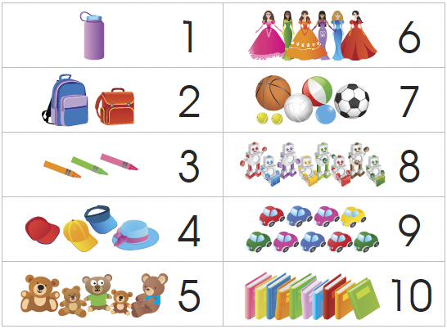
Count the things in the cupboard.

Slide 3
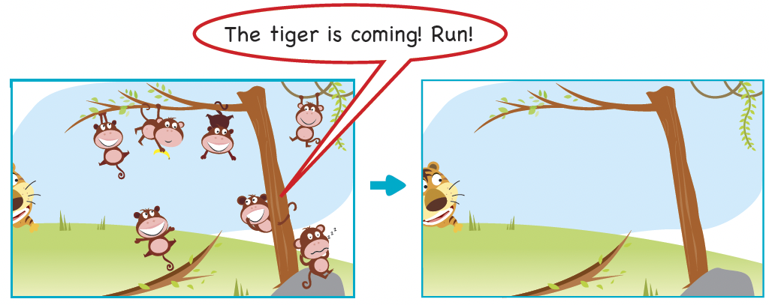
How many monkeys are there now? There are no monkeys.
The number of monkeys is zero or 0.
How many monkeys are there?
The monkeys run away.

Slide 4
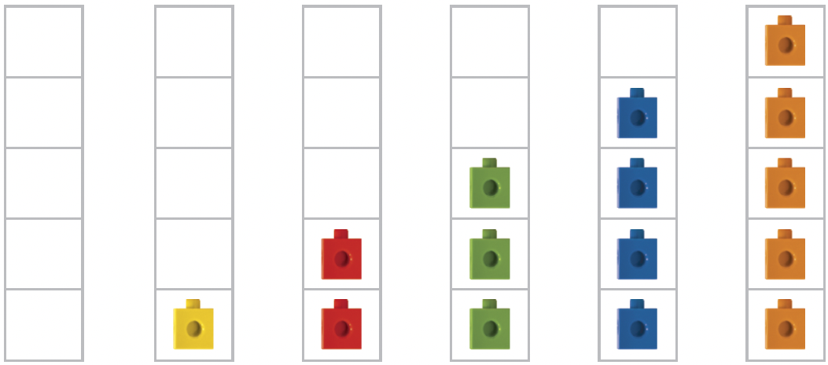
Counting to 10
0
zero
1
one
2
two
3
three
4
four
5
five

Slide 5
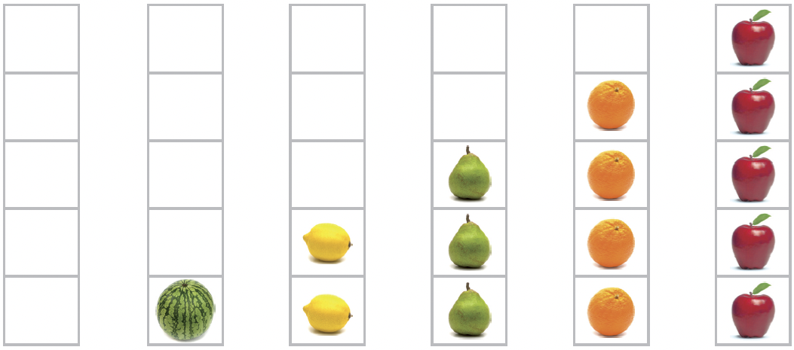


Slide 6
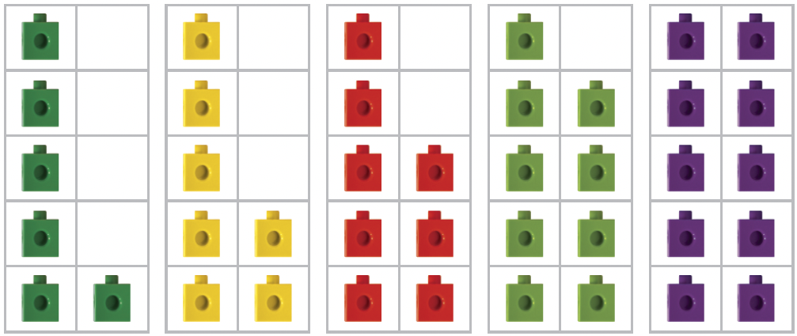
Counting to 10
6
six
7
seven
8
eight
9
nine
10
ten

Slide 7
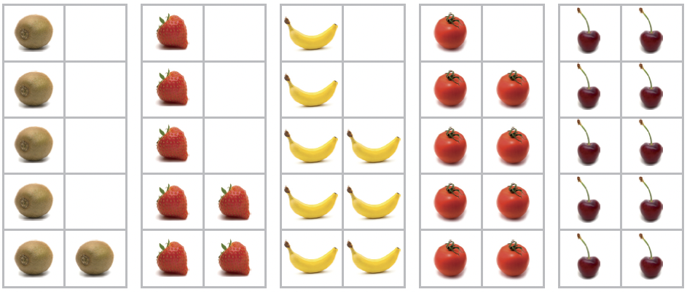


Slide 8
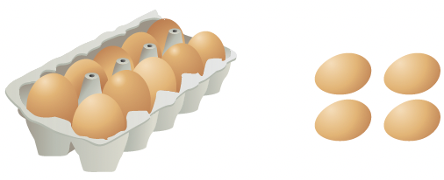
Counting to 20
How many eggs are there?
10 and 4 loose ones
10 and 4 make 14.
10 + 4 = 14

Slide 9
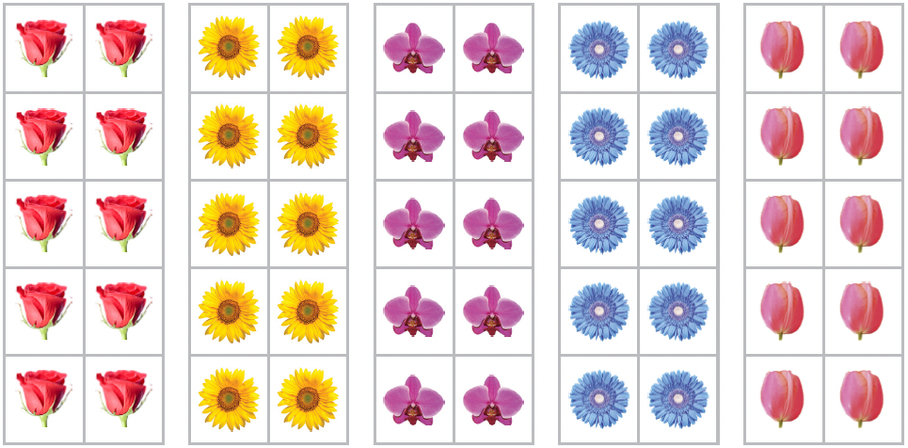
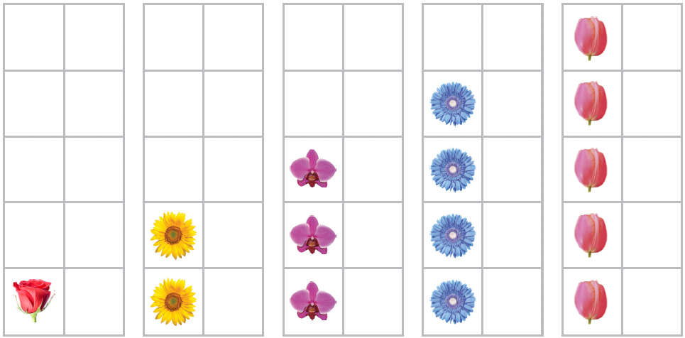
11
eleven
12
twelve
13
thirteen

Slide 10
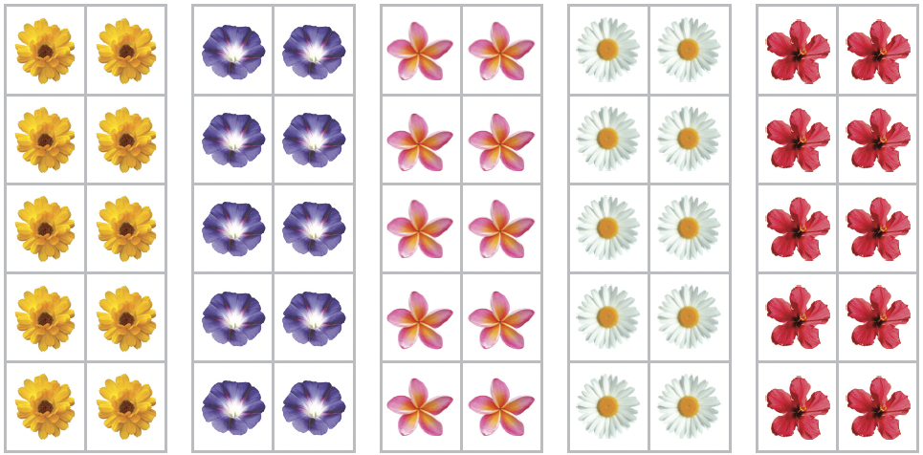
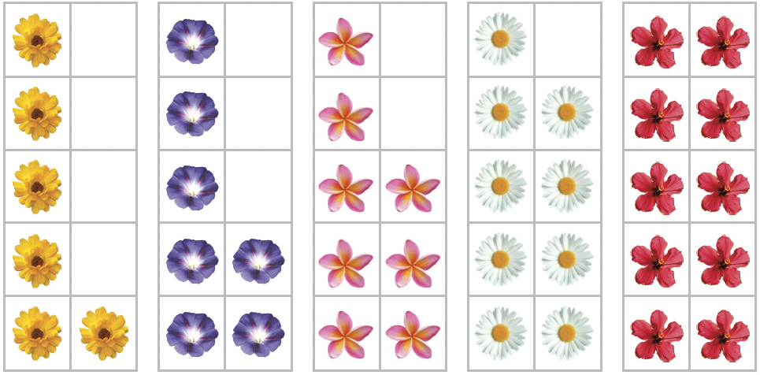
14
fourteen
15
fifteen
16
sixteen

Slide 11
17
seventeen
18
eighteen
19
nineteen

Slide 12
19
nineteen
20
twenty

Slide 13
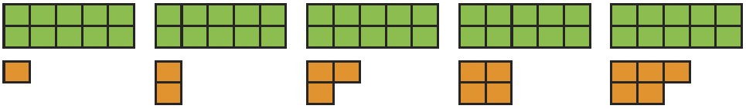
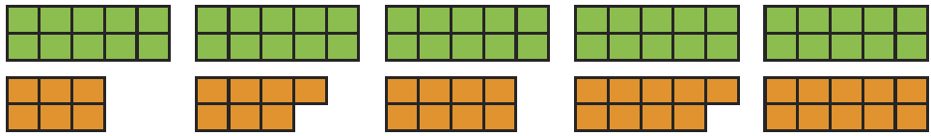
11
eleven
12
twelve
13
thirteen
14
fourteen
15
fifteen
16
sixteen
17
seventeen
18
eighteen
19
nineteen
20
twenty

Slide 14
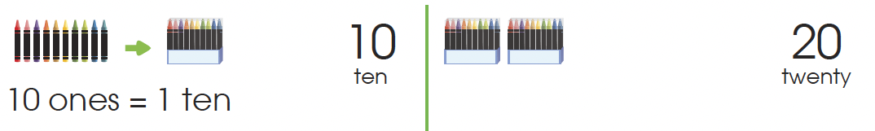
Count in tens.
Counting to 100
10
ten
20
twenty

Slide 15
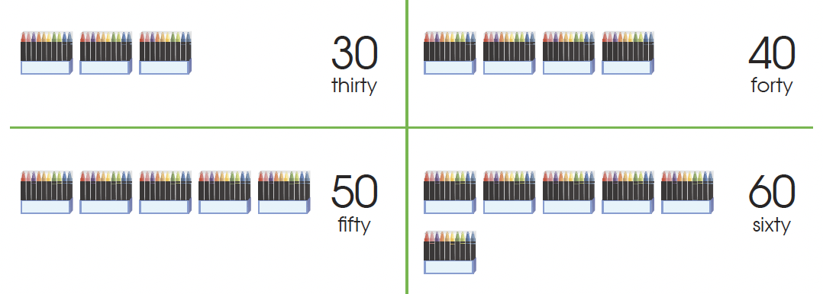
30
thirty
40
forty
50
fifty
60
sixty

Slide 16
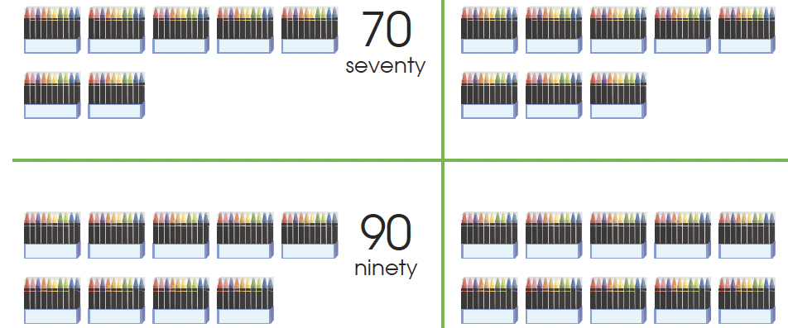
70
seventy
80
eighty
90
ninety
100
one hundred

Slide 17
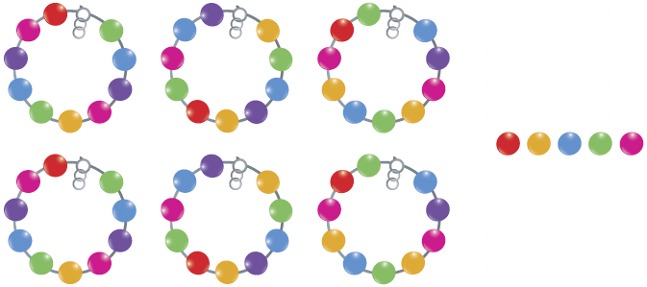
We can count in tens and ones.
65 is read as sixty-five.
60 and 5 loose ones
60 and 5 makes 65.
60 + 5 = 65

Slide 18
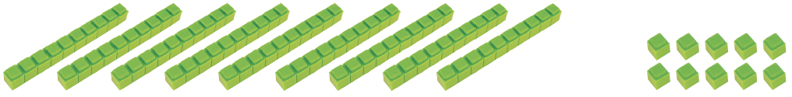
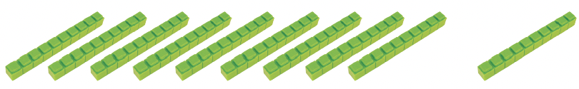
Add 1 loose one to 90 and 9 loose ones to get 90 and 10 loose ones.
100 is just after 99.
90 and 10 loose ones
90 and 1 ten make 10 tens.
10 tens make 100.
regroup 10 loose ones
into 1 ten

Slide 19

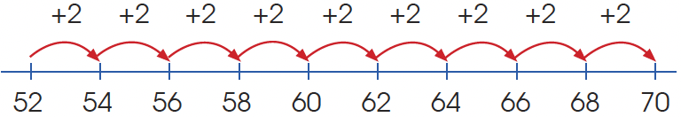
Skip counting
Tens | Ones
4 | 1
Tens | Ones
4 | 2
1 more
+ 1
54 is 2 more than 52.
We can skip count by 2s.
52, 54, 56, 58, 60, 62, 64, 66, 68, 70

Slide 20
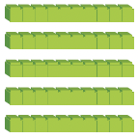
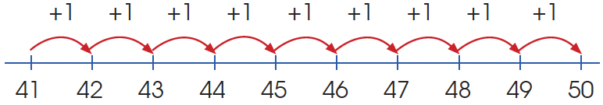
Tens | Ones
5 | 2
Tens | Ones
5 | 4
2 more
+ 2
42 is 1 more than 41.
41, 42, 43, 44, 45, 46, 47, 48, 49, 50

Slide 21
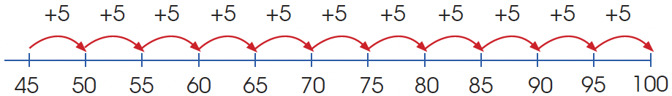
Tens | Ones
4 | 5
Tens | Ones
5 | 0
5 more
+ 5
50 is 5 more than 45.
We can skip count by 5s.
45, 50, 55, 60, 65, 70, 75, 80, 85, 90, 95, 100

Slide 22
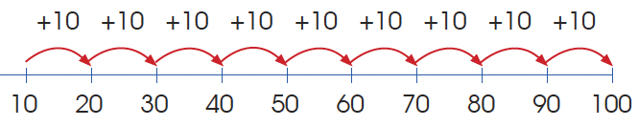
We can skip count by 10s from 10 to 100.
10, 20, 30, 40, 50, 60, 70, 80, 90, 100

