Slide 1
Number Bonds

Slide 2
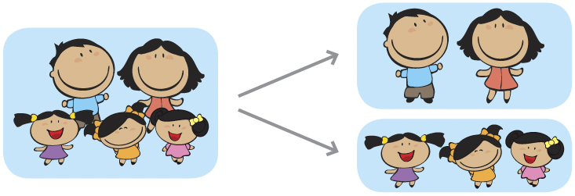
Put 5 members of the family into two groups.
5 members is the same as 2 members and 3 members.

Slide 3
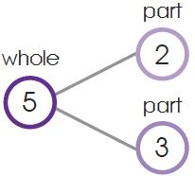
This is a number bond.
2 and 3
Make 5.

Slide 4


2 and 3 make 5 is the same as 3 and 2 make 5.
Is
the same as
?

Slide 5
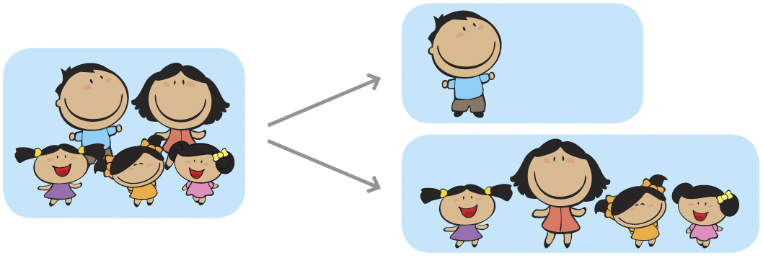
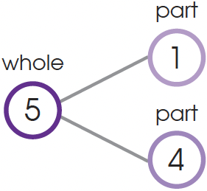
There are other ways to make 5.
5 members is the same as 1 member and 4 members.
1 and 4
Make 5.

Slide 6
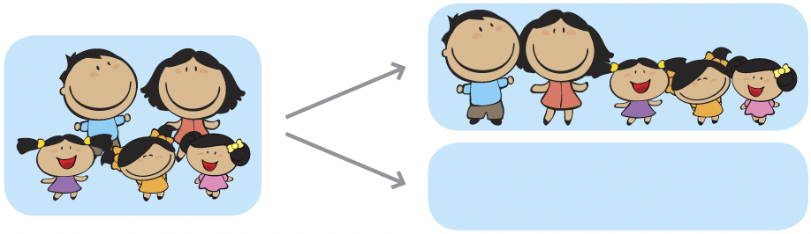
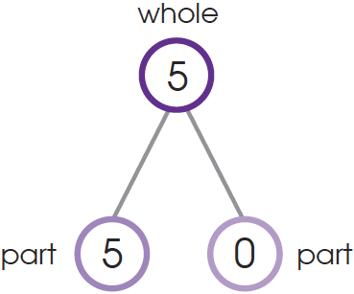
5 members is the same as 5 members and 0 members.
5 and 0
Make 5.

Slide 7
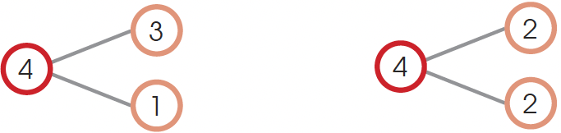
Mrs. Cruz has 4 slices of cake.
We can make number stories.
3 slices have cherries. 2 slices have pineapple jelly.
1 slice has no cherry. 2 slices have strawberry jelly.

