Slide 1

Math for Life 1
Chapter 1 : Counting Numbers from 0 to 100
IMPORTANT REMINDER: Users are NOT ALLOWED to distribute the contents of this material nor use them for other purposes without permission from Rex Book Store Inc. (RBSI)

Slide 2
Learning Competencies
Visualize and represent numbers from 0 to 100 using a variety of materials
Count the number of objects in a given set by ones and tens

Slide 3
Key Questions
What is a counting number?
How do you count the number of objects in a given set by ones and tens?

Slide 4
What is a counting number?
From the term itself, a counting number is a number we use in counting.
These are the counting numbers in numeral form:
1 2 3 4 5 6 7 8 9 10…

Slide 5
Numbers can also be written in words.
one, two, three, four, five, six, seven, eight, nine, ten, and so on

Slide 6
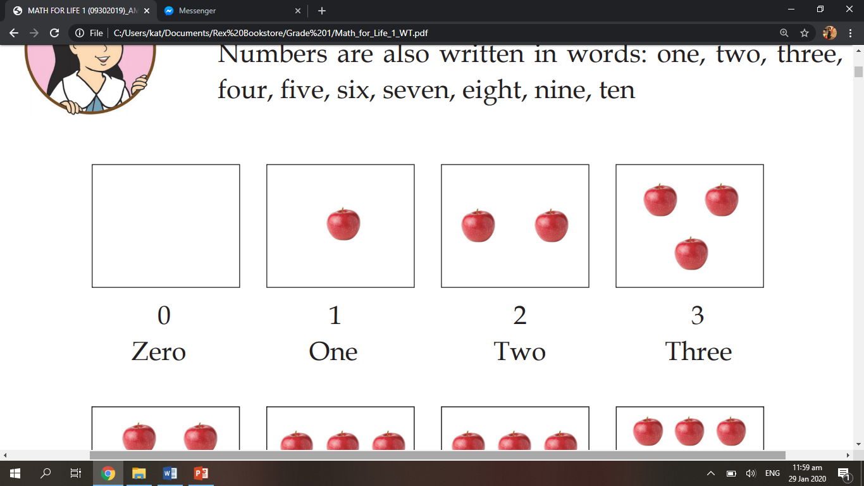
0 is a whole number.
It is not a counting number because it represents nothing.

Slide 7
Here are the numbers 1 to 3 and how they are written in words. Count the objects inside the set.

Slide 8
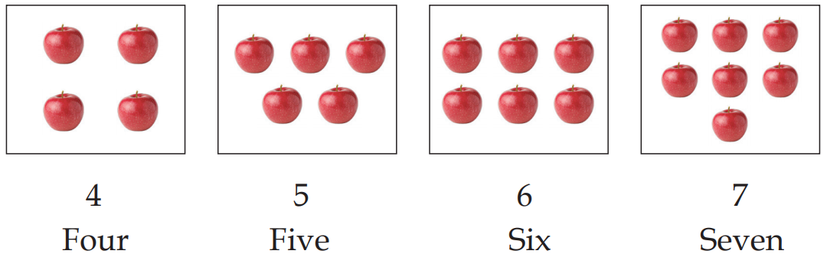
Here are the numbers 4 to 7. Count the objects inside the set.

Slide 9
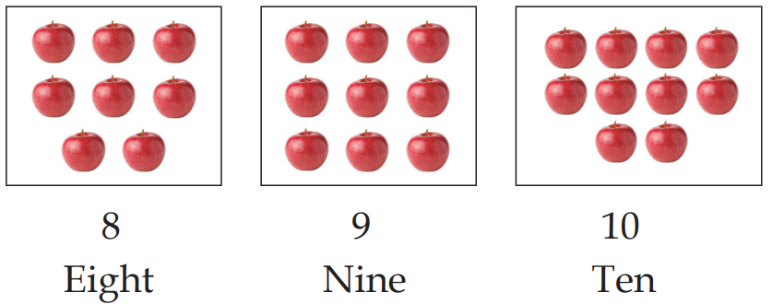
Here are the numbers 8 to 10. Count the objects inside the set.

Slide 10
We can also combine digits to make larger numbers.
Digits are the single numbers from 0 to 9.
0 1 2 3 4 5 6 7 8 9

Slide 11
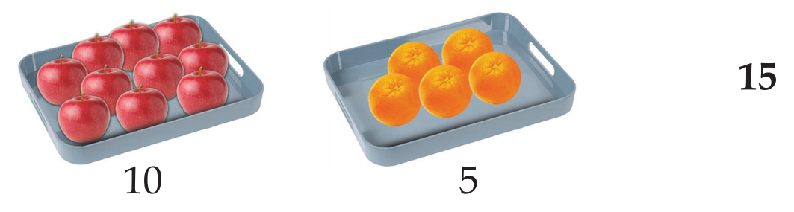
10 and 5 make 15
1 ten and 5 ones is 15.

Slide 12
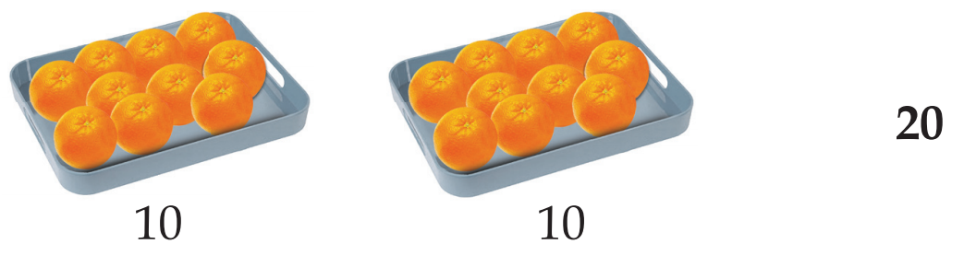
10 and 10 make 20
2 tens is 20.

Slide 13
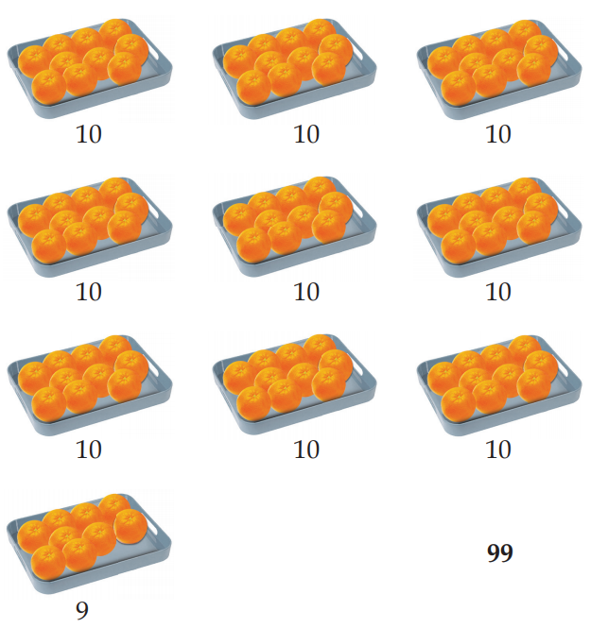
How many is 99? Count the objects.
9 tens and 9 ones is 99.

Slide 14
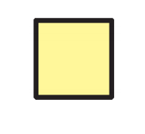
Let us count using blocks.
This is 1.
1 block

Slide 15
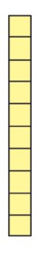
This is 10.
10 blocks

Slide 16
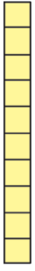
This is 100.
100 blocks

Slide 17
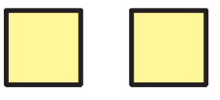
How many is 2?
2 blocks

Slide 18
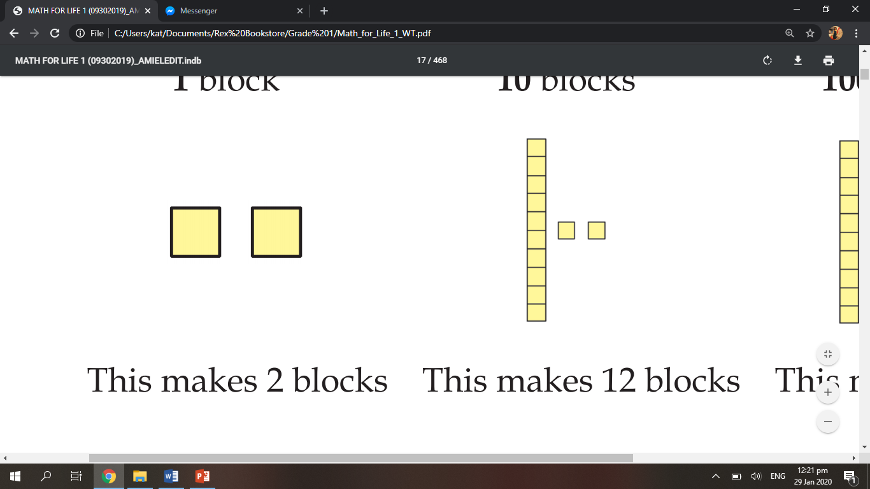
How many is 12?
12 blocks

Slide 19
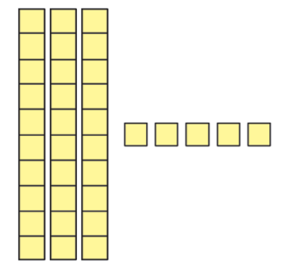
How many is 35?
35 blocks

Slide 20
How many is 90?
90 blocks

Slide 21
How many blocks are there?
50 blocks

Slide 22
What number do the blocks represent?
34

Slide 23
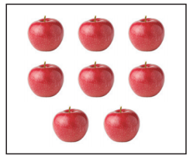
How many apples are there?
Answer:
There are 8 apples.

Slide 24
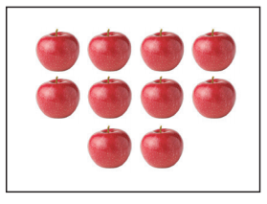
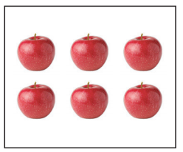
What is this number?
Answer:
26

Slide 25
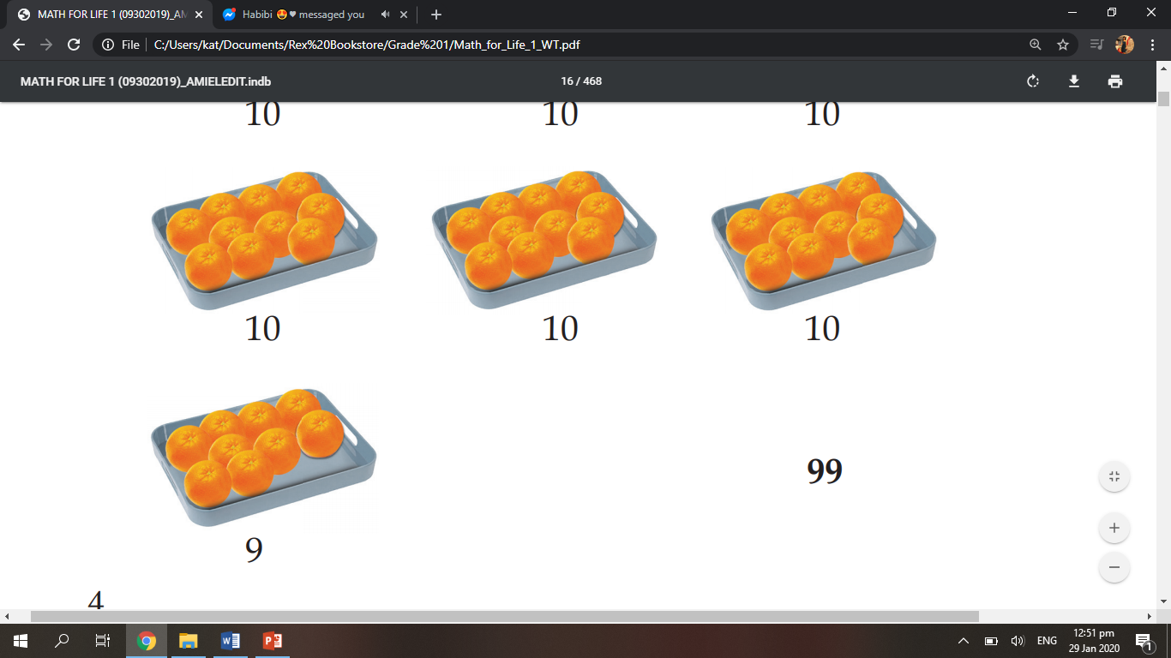
What is this number?
Answer:
49

Slide 26
What is this number?
Answer:
0

Slide 27
Question:
What is this in numeral form?
eight
Answer:
8

Slide 28
Question:
How do you write 7 in words?
Answer:
seven

Slide 29
Remember these!
The counting numbers are 1,2, 3, 4, 5, 6, 7, 8, 9, 10 and so on.
Numbers can be written in numerals and words.

Slide 30
IMPORTANT REMINDER: Users are NOT ALLOWED to distribute the contents of this material nor use them for other purposes without permission from Rex Book Store Inc. (RBSI)

