Slide 1
Conversion of Time

Slide 2

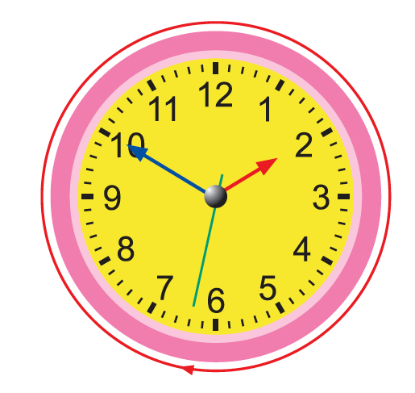
1.
1 minute = 60 s
This is the second hand.
Each small marking on the clock face stands for 1 second.
The second hand makes a complete round in 60 seconds, or 1 minute.

Slide 3

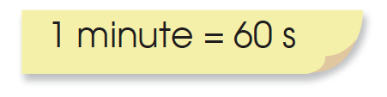
2. Daniel read a book for 600 seconds.
Write the time in minutes.
600 ÷ 60 = 10
600 s = 10 minutes

Slide 4
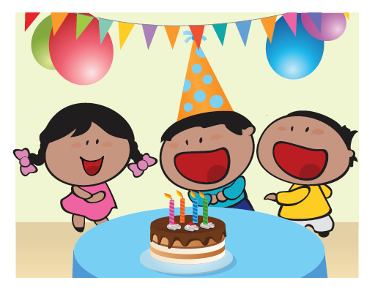
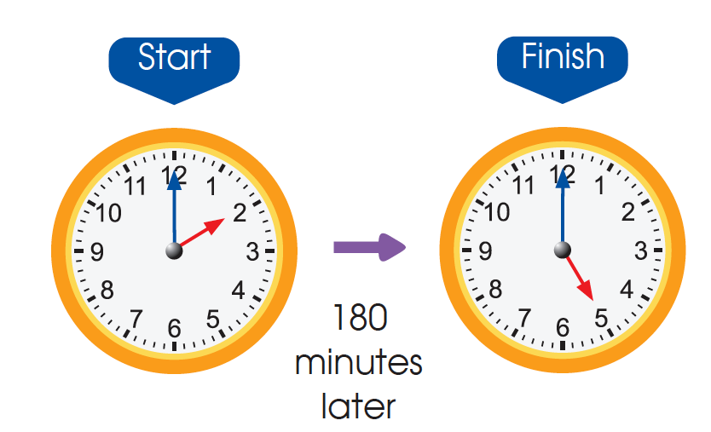
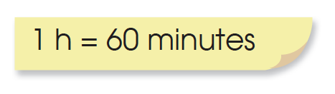
3. The birthday party lasted for 180 minutes.
Write the time in hours.
2 h = 120 minutes
3 h = 180 minutes
The birthday party lasted for 3 h.

Slide 5
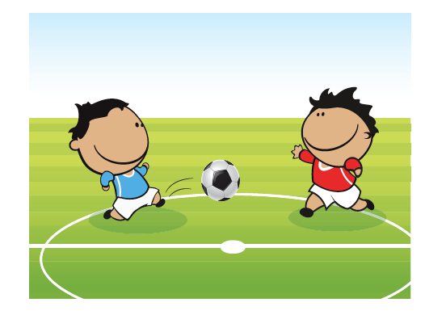
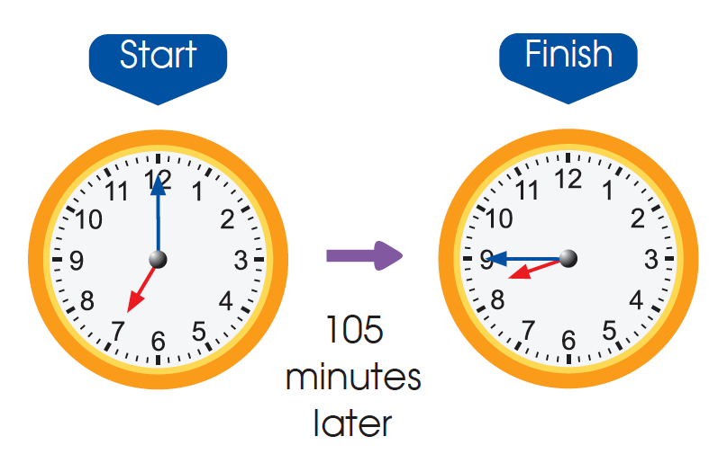
4. The football match lasted for 105 minutes.
Write the time in hours and minutes.
105 minutes = 60 minutes + 45 minutes
= 1 hour 45 minutes

Slide 6
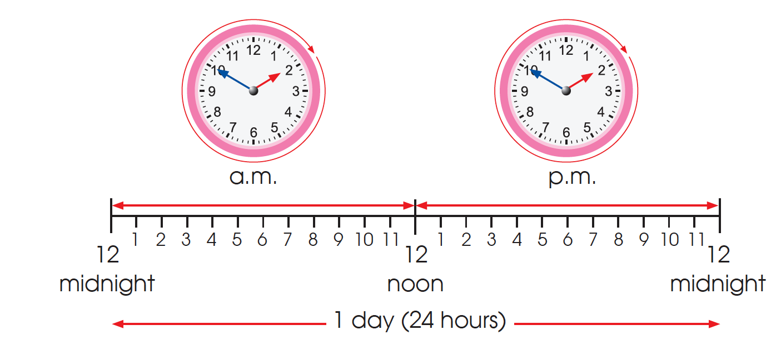
5. The hour hand makes 2 complete turns around the clock in 1 day.
There are 24 hours in 1 day.

Slide 7
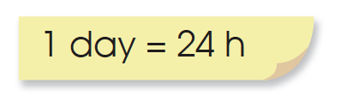
6. A garden festival lasted for 72 hours. How many days did it last?
72 – 24 = 48 Day 1
48 – 24 = 24 Day 2
24 – 24 = 0 Day 3
The garden festival lasted for 3 days.

Slide 8
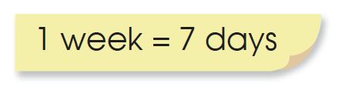
We have learned that there are 7 days in 1 week, 4 complete weeks in 1 month and 12 months in 1 year.
1. Aunt Sal has been away for 42 days.
How many weeks has she been away?
42 ÷ 7 = 6
Aunt Sal has been away for 6 weeks.

Slide 9
2. How many weeks are there in 35 days?
35 ÷ 7 = 5
There are 5 weeks in 35 days.

Slide 10
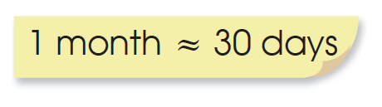
3. A ship took 90 days to sail from London to Singapore.
How many months did the journey take?
1 month is about 30 days. Count in 30s.
2 months ≈ 60 days
3 months ≈ 90 days
The journey took about 3 months.

Slide 11
4. Ann went to Spain for 2 weeks. How many days was her trip?
2 x 7 = 14
Her trip to Spain was 14 days long.

Slide 12
5. Summer holidays last for 2 months. How many days will it last?
2 x 30 = 60
Summer holidays last for about 60 days.

Slide 13
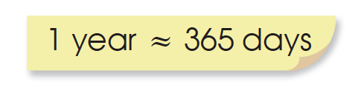
6. How many days are there in 2 years?
2 × 365 ≈ 730
There are about 730 days in 2 years.

