Slide 1
Meters and Centimeters

Slide 2

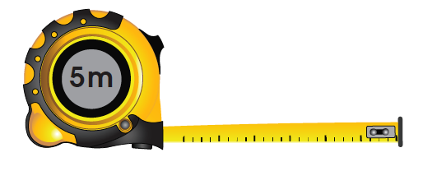
LET’S LEARN
1. Both the centimeter (cm) and meter (m) are standard units of length.
1 meter is equal to 100 centimeters.
1 m = 100 cm
We often use a measuring tape to measure lengths of more than 1 m.

Slide 3
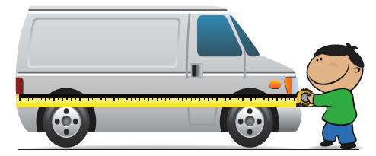
2.
about 3 m
3 m = 300 cm
The van is about 300 cm long.

Slide 4
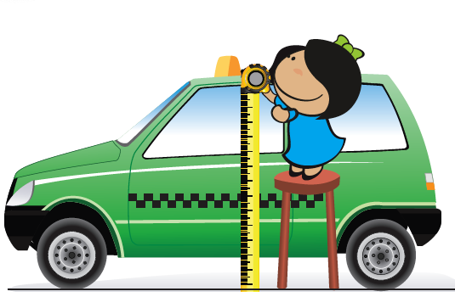
3.
1 m 40 cm
1 m 40 cm = 100 cm + 40 cm
= 140 cm
The height of my uncle’s taxi is about 140 cm.

Slide 5
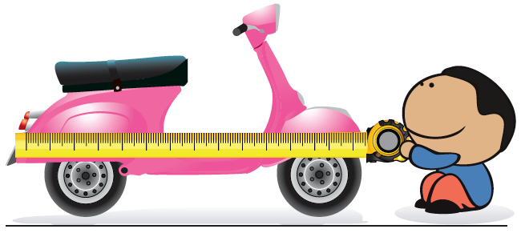
4.
135 cm
135 cm = 100 cm + 35 cm
= 1 m 35 cm
The length of my sister’s scooter is about 1 m 35 cm.

Slide 6

Using a measuring tape, measure the length of your desk and the blackboard in your classroom.
Can you give the lengths in meters and centimeters?

