Slide 1
Kilometers and Meters

Slide 2
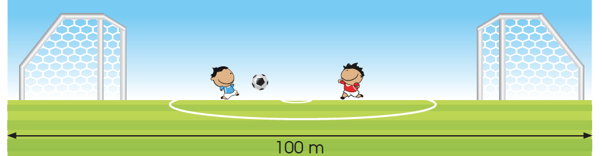
LET’S LEARN
The kilometer is another unit of length for measuring long distances.
km = kilometer.
The length of this football field is about 100 m.
The length of 10 such football fields is about 1 kilometer.
1 km = 1000 m

Slide 3

We measure long distances in kilometers.

Slide 4
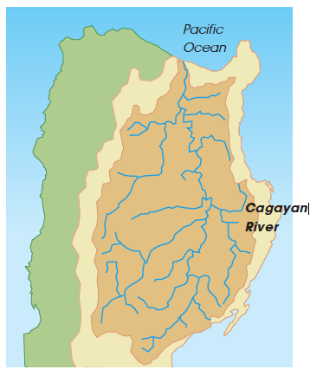
The longest river in the Philippines is the Cagayan River.
The total length of the river is about 505 kilometers.
The river is located in Luzon, the largest island in the Philippines.

Slide 5
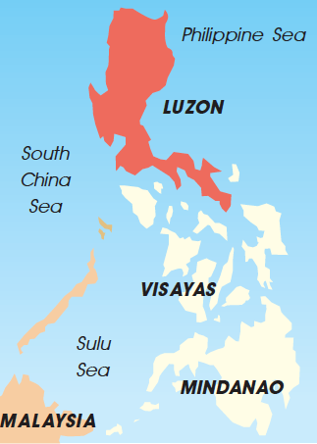

What is the
width of Luzon
Island?
The length of Luzon Island is about 402 km.

Slide 6

2. A train traveled 1 km 400 m from one station to another station.
Write the distance in meters.
1 km 400 m = 1000 m + 400 m
= 1400 m

Slide 7
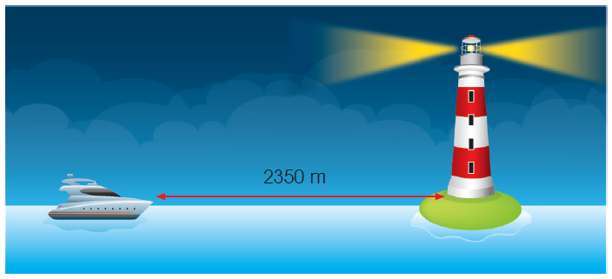
3. The distance between the boat and the lighthouse is 2350 m.
Write the distance in kilometers and meters.
2350 m = 2000 m + 350 m
= 2 km 350 m

