Slide 1
Word Problems: Length

Slide 2
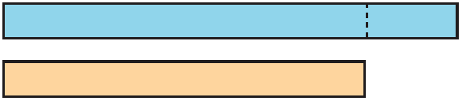
LET’S LEARN
1. Kate walks 1 km from home to school. She returns home by another route that is 200 m shorter.
Let us find the total distance that Kate travels in meters.
1 km
1 km = 1000 m
1000 m – 200 m = 800 m
1000 m + 800 m = 1800 m
Kate travels a total distance of 1800 m.
?
? 200 m

Slide 3
2.
800 m 250 m 1 km 100 m
Miguel’s Market Library Amelia’s
home home
Who lives nearer the library, Miguel or Amelia?
From Miguel’s home to the library:
800 m + 250 m = 1050 m
= 1 km 50 m
1 km 50 m is less than 1 km 100 m.
Miguel lives nearer the library.

Slide 4
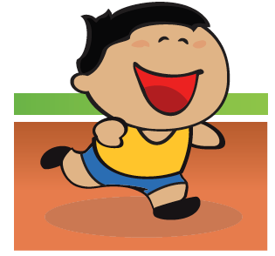
3. Eric jogged 5 times round a circular track.
One complete round of the track is 500 m long.
How far did Eric jog?
500 m × 5 = 2500 m
= 2 km 500 m
Eric jogged 2 km 500 m.

