Slide 1
Kilograms and Grams

Slide 2

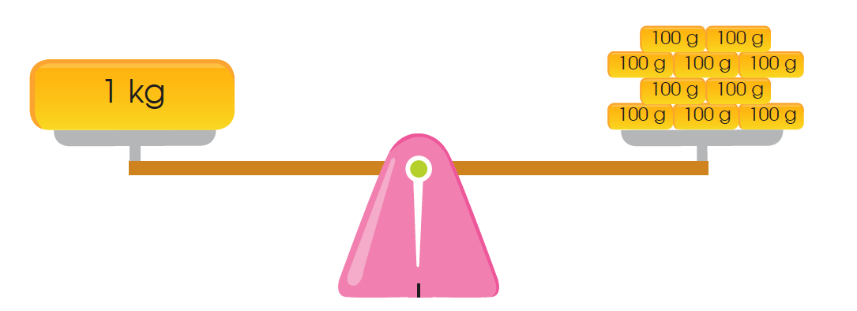
1. 1 kilogram is as heavy as 1000 grams.

Slide 3
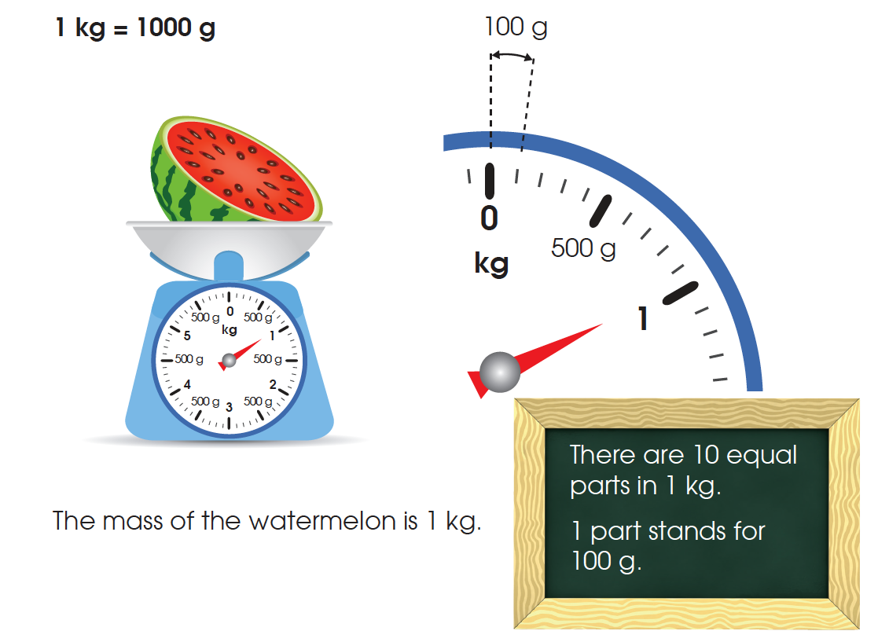
The mass of the watermelon is 1 kg.

Slide 4
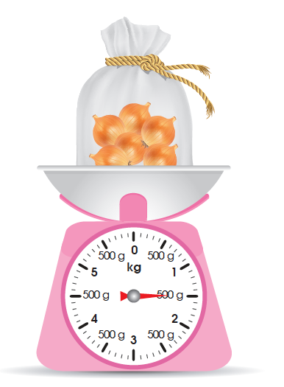
2. The mass of the bag of onions
is 1 kg 500 g.

Slide 5
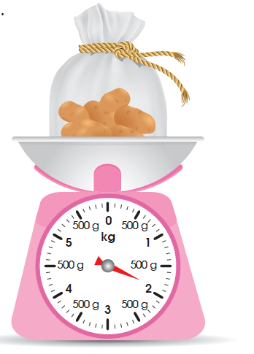
3. The mass of the bag of potatoes
is 1 kg 900 g.

Slide 6
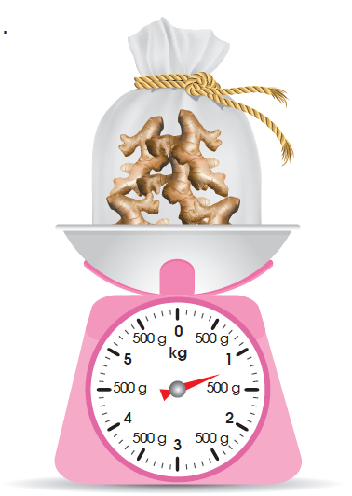
4. The mass of the bag of ginger is 1 kg 200 g.
1 kg = 1000 g
1 kg 200 g = 1 kg + 200 g
= 1000 g + 200 g
= 1200 g

Slide 7
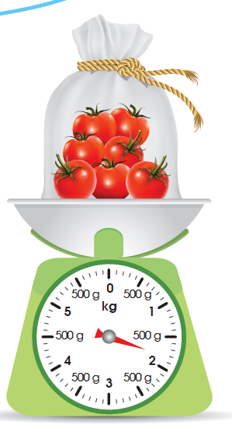
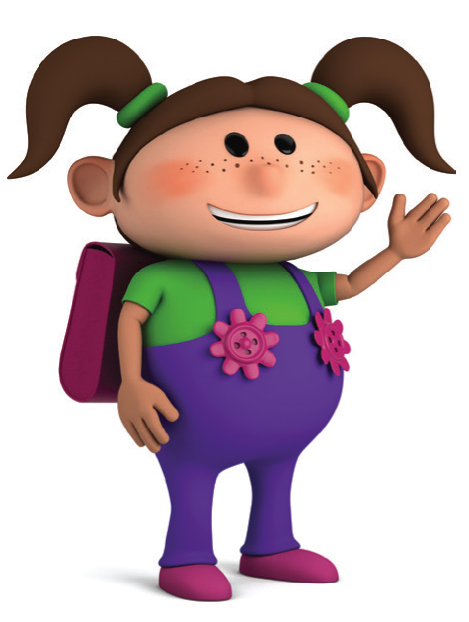
5. The mass of the bag of tomatoes is 1800 g.
1 kg = 1000 g
1800 g = 1000 g + 800 g
= 1 kg + 800 g
= 1 kg 800 g
The mass of the bag of tomatoes is 1 kg 800 g.
What is the mass of the bag of tomatoes
in kilograms and grams?

Slide 8
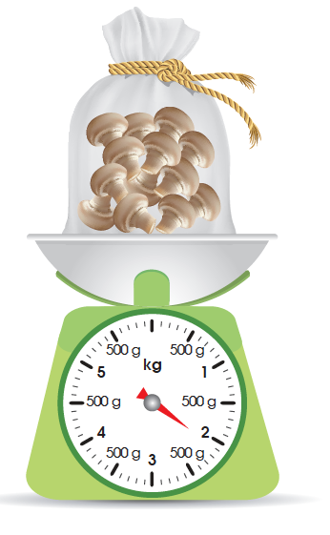
6. What is the mass of the bag of mushrooms in grams?
The mass of the bag of mushrooms is 2 kg 100 g.
1 kg = 1000 g
2 kg 100 g = 2 kg + 100 g
= 2000 g + 100 g
= 2100 g
The mass of the bag of mushrooms is 2100 g.

