Slide 1
Word Problems: Mass

Slide 2

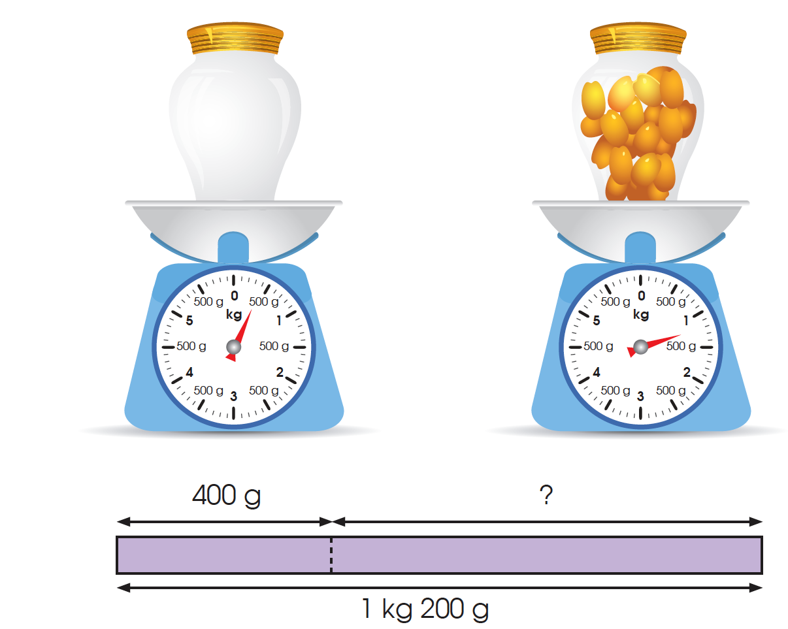
1. The mass of the empty jar is 400 g. When filled with crackers, its mass is 1 kg 200 g. What is the mass of the crackers?

Slide 3
1 kg 200 g = 1000 g + 200 g
= 1200 g
1200 g – 400 g = 800 g
The mass of the crackers is 800 g.

Slide 4
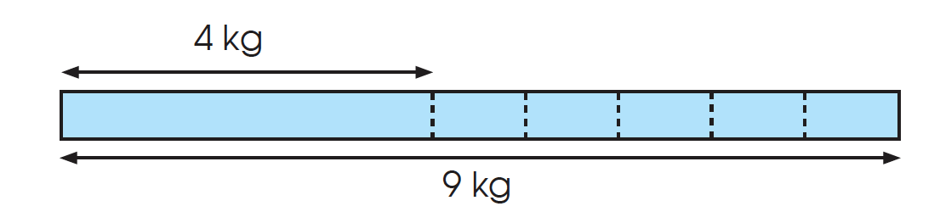
2. The mass of 1 bag of flour and 5 bags of sugar is 9 kg.
The mass of the bag of flour is 4 kg.
What is the mass of each bag of sugar? Give your answer in grams.

Slide 5
3. 9 kg – 4 kg = 5 kg
5 kg ÷ 5 = 1 kg
1 kg = 1000 g
The mass of 1 bag of sugar is 1000 g.

Slide 6
Solving Word Problems on Mass
1. Read and understand the question.
2. Plan. Draw a model.
3. Carry out the plan.
4. Check. Have you answered the question?
Remember to write the correct units.

