Slide 1
Liters and Milliliters

Slide 2

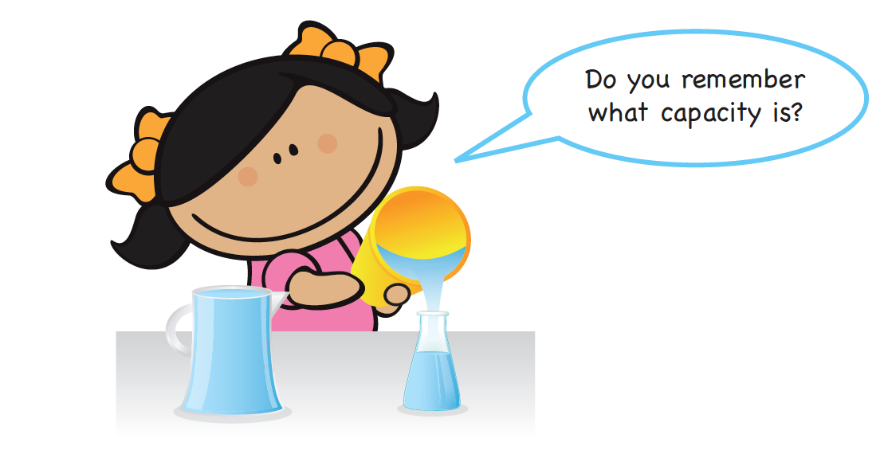
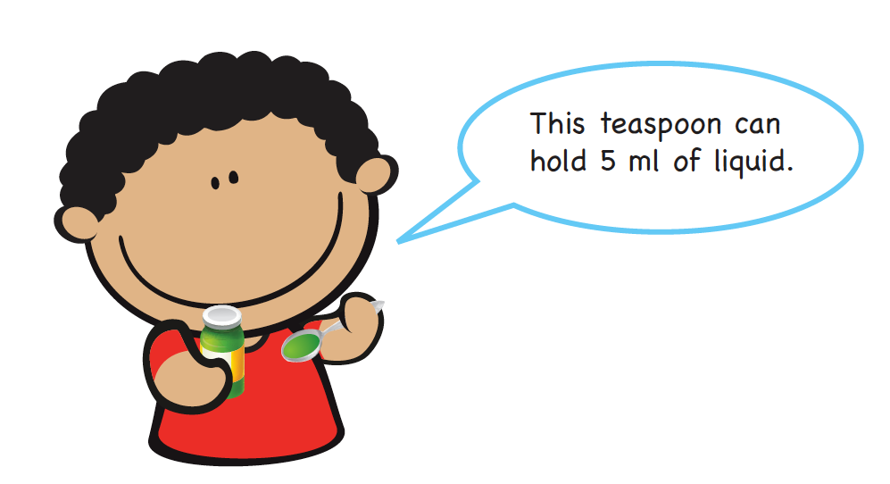
1.
Liter is a unit used to measure capacity.
We write l for liters.
Milliliter is another unit used to measure capacity.
We write milliliters as ml.
We measure small amounts of liquid in milliliters.

Slide 3
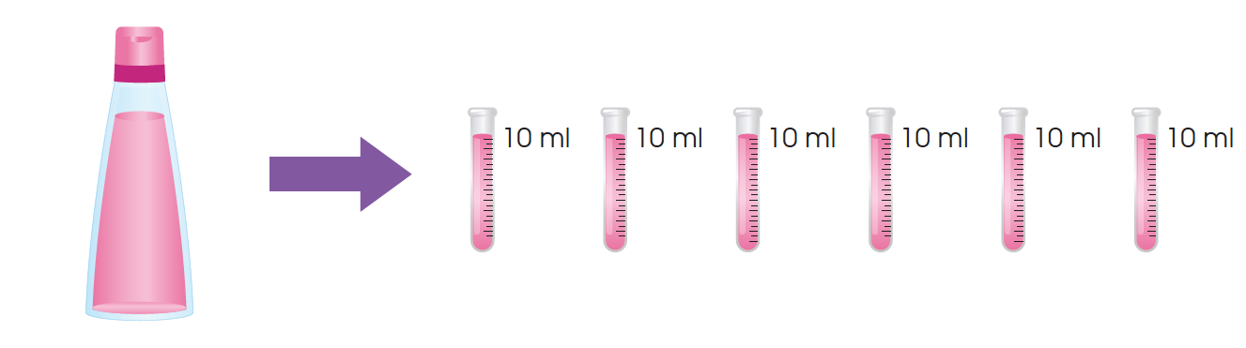
2. This glass tube can hold up to 10 ml of liquid.
We can measure up to 10 ml of liquid using this glass tube.
The capacity of the shampoo bottle is 60 ml.

Slide 4
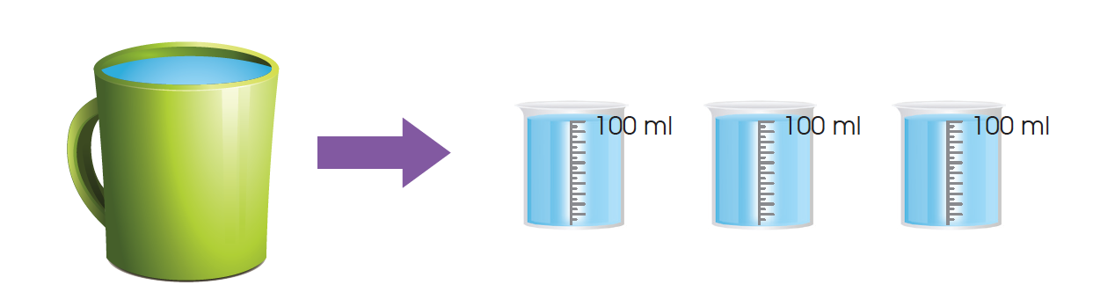
3. This beaker can hold up to 100 ml of liquid.
We can measure up to 100 ml of liquid using this beaker.
The capacity of the mug is 300 ml.

Slide 5
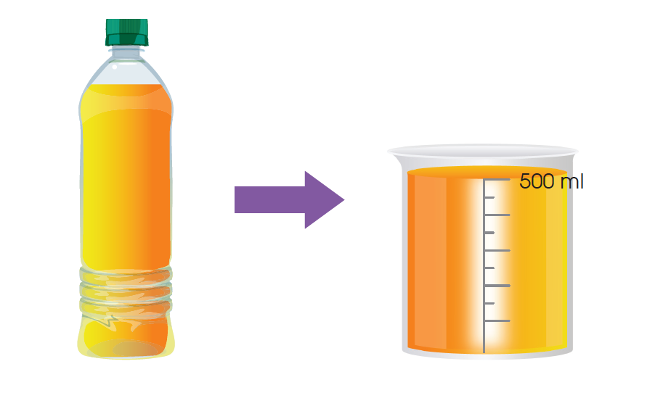
4. This beaker can hold up to 500 ml of liquid.
We can measure up to 500 ml of liquid using this beaker.
The capacity of the bottle is 500 ml.

Slide 6
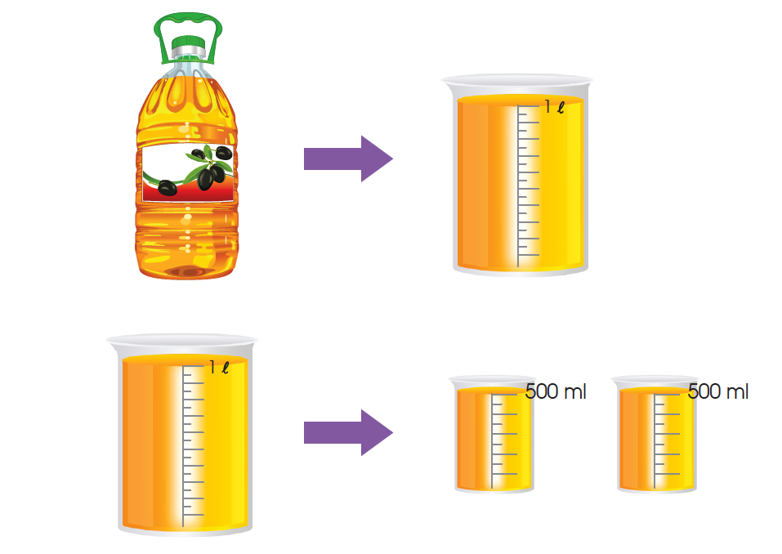
5. This bottle can hold up to 1 liter of liquid when it is full.
The capacity of the bottle is 1 l.
1 l = 1000 ml

Slide 7
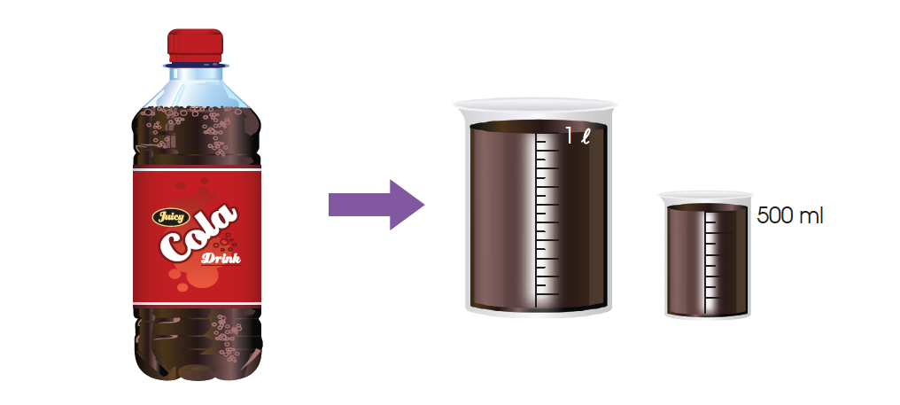
6. These 2 beakers can hold up to 1 l 500 ml altogether.
1 l = 1000 ml
1 l 500 ml = 1000 ml + 500 ml
= 1500 ml
The capacity of the bottle of soft drink is 1500 ml.

Slide 8
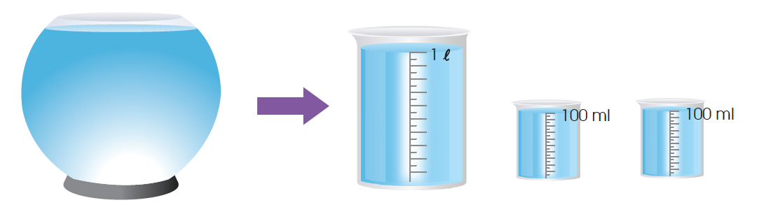
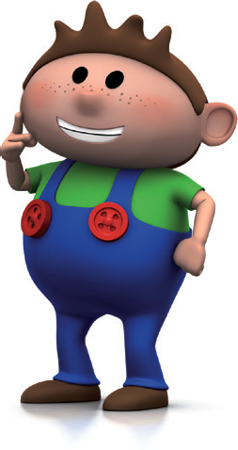
8. The total amount of liquid in the beakers is 1200 ml.
1200 ml = 1000 ml + 200 ml
= 1 l 200 ml
The capacity of the fish bowl is 1 l 200 ml.
1 l = 1000 ml

