Slide 1
Word Problems: Capacity

Slide 2

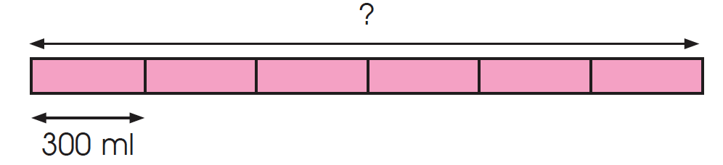
1. Mrs. Torres bought 6 cans of soft drink for a party.
The capacity of each can is 300 ml.
She drank a can and filled a bowl with the rest.
(a) How many milliliters of soft drink did Mrs. Torres buy altogether?
300 ml x 6 = 1800 ml
Mrs. Torres bought 1800 ml of soft drink.

Slide 3
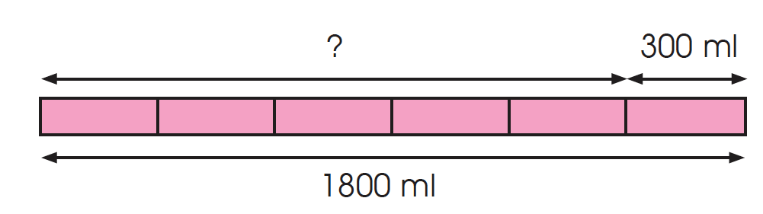
(b)
1800 ml – 300 ml = 1500 ml
1500 ml = 1000 ml + 500 ml = 1 l 500 ml
The capacity of the bowl is 1 l 500 ml.

Slide 4
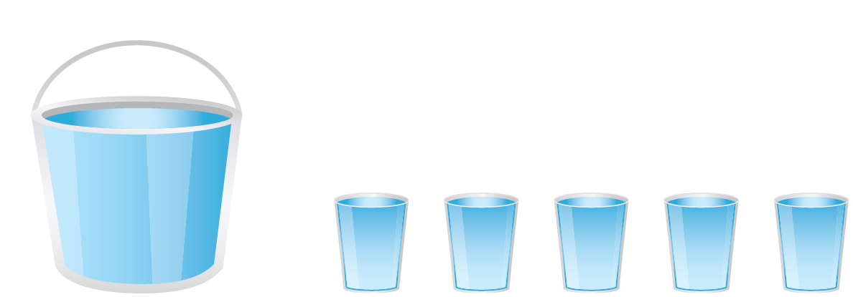
2. A container is filled to the brim with water.
Gemma poured the water into 5 cups until each cup is full.
The capacity of each cup is 650 ml.
There is 800 ml of water left in the container.
What is the capacity of the container in liters and milliliters ?

Slide 5
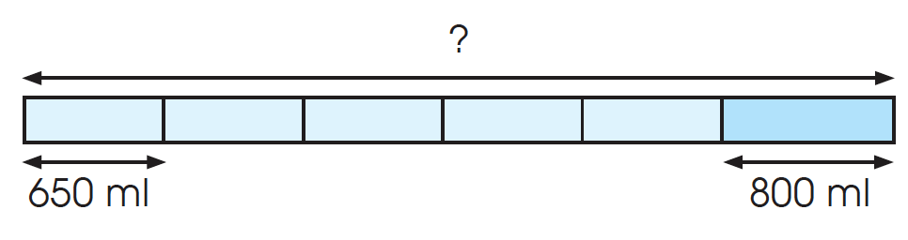
650 ml × 5 = 3250 ml
3250 ml + 800 ml = 4050 ml
4050 ml = 4000 ml + 50 ml
= 4 l 50 ml
The capacity of the container is 4 l 50 ml.

