Slide 1
Kinds of Fractions

Slide 2
Kind of Fractions
A fraction names or describes a part of a whole or set of objects.
A proper fraction is a fraction in which the numerator is less than its denominator.
An improper fraction is a fraction in which the numerator is greater than or equal to its denominator.

Slide 3
Kind of Fractions
A mixed number is a combination of a whole number and a proper fraction.
Similar fractions are fractions with the same denominator. They are also called like fractions.
Dissimilar fractions are fractions with different denominators. They are also called unlike fractions.

Slide 4
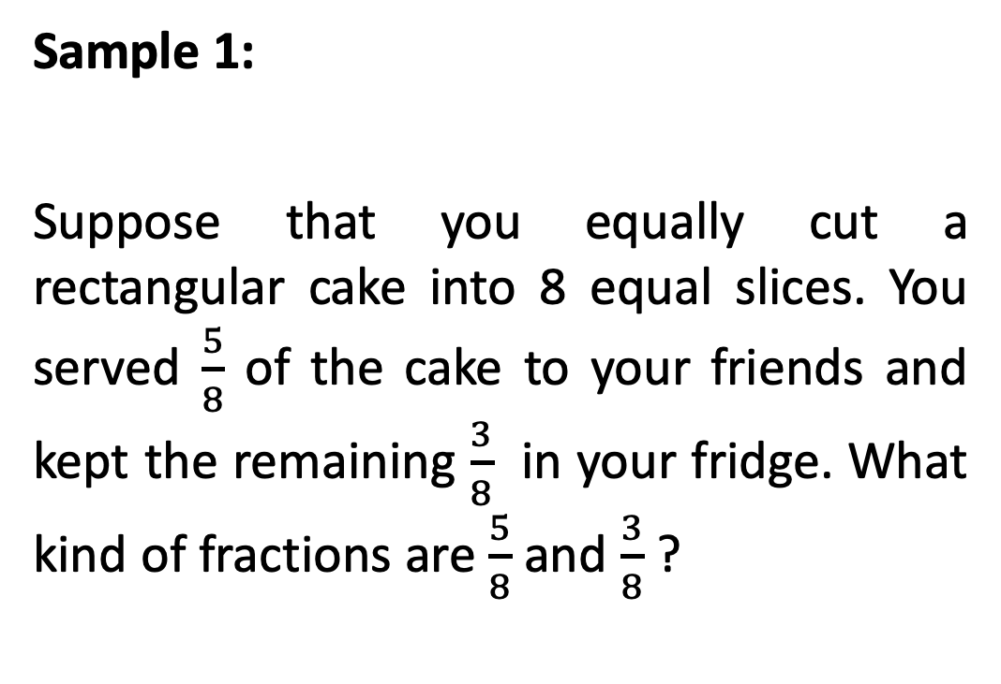
Kind of Fractions
Sample 1:
Suppose that you equally cut a rectangular cake into 8 equal slices. You served $\frac{5}{8}$ of the cake to your friends and kept the remaining $\frac{3}{8}$ in your fridge. What kind of fractions are $\frac{5}{8}$ and $\frac{3}{8}$ ?

Slide 5

Kind of Fractions
When you say that $\frac{5}{8}$ of the cake has been eaten, it means 5 slices out of 8 total slices have been eaten. The picture also shows that $\frac{3}{8}$ of the cake was left.

Slide 6
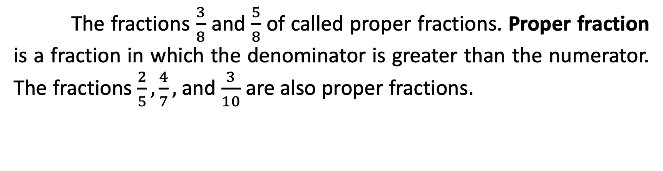
Kind of Fractions
The fractions $\frac{3}{8}$ and $\frac{5}{8}$ of called proper fractions. Proper fraction is a fraction in which the denominator is greater than the numerator. The fractions $\frac{2}{5},\frac{4}{7},$ and $\frac{3}{10}$ are also proper fractions.

Slide 7
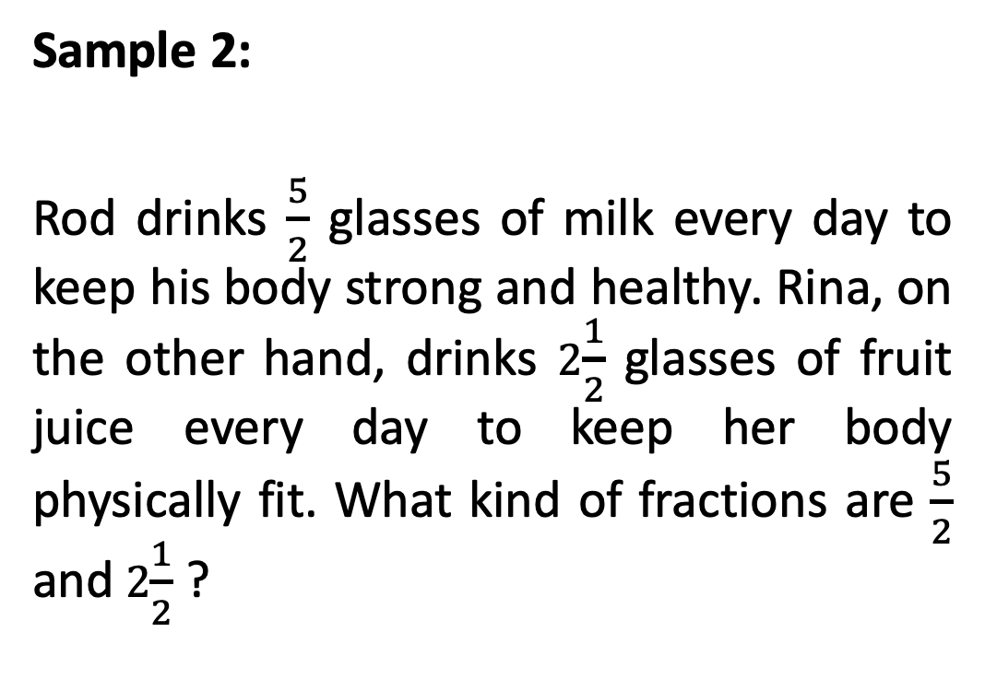
Kind of Fractions
Sample 2:
Rod drinks $\frac{5}{2}$ glasses of milk every day to keep his body strong and healthy. Rina, on the other hand, drinks 2$\frac{1}{2}$ glasses of fruit juice every day to keep her body physically fit. What kind of fractions are $\frac{5}{2}$ and 2$\frac{1}{2}$ ?

Slide 8
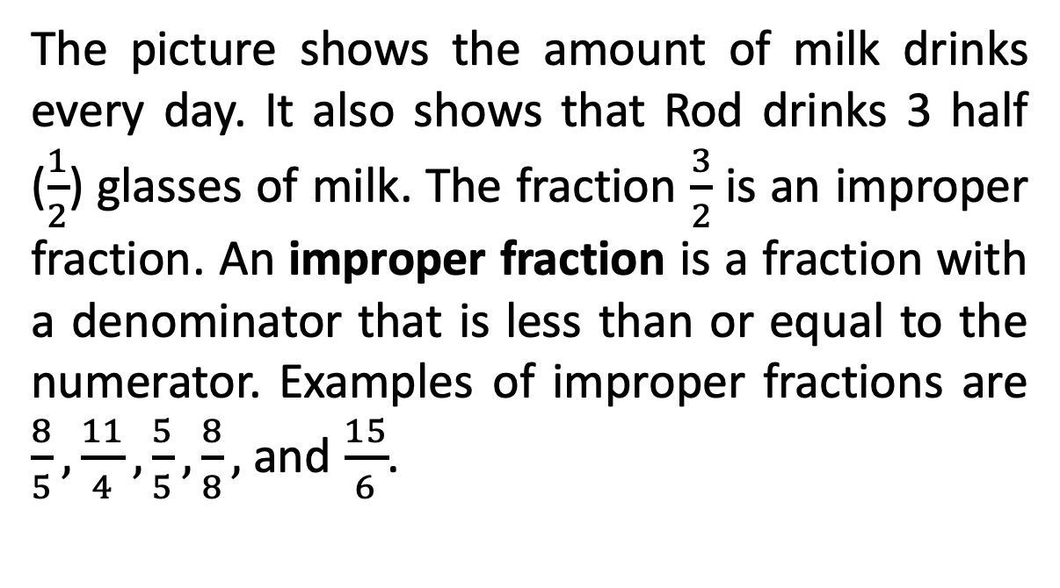
Kind of Fractions
The picture shows the amount of milk drinks every day. It also shows that Rod drinks 3 half ($\frac{1}{2}$) glasses of milk. The fraction $\frac{3}{2}$ is an improper fraction. An improper fraction is a fraction with a denominator that is less than or equal to the numerator. Examples of improper fractions are $\frac{8}{5},\frac{11}{4},\frac{5}{5},\frac{8}{8},$ and $\frac{15}{6}$.

Slide 9
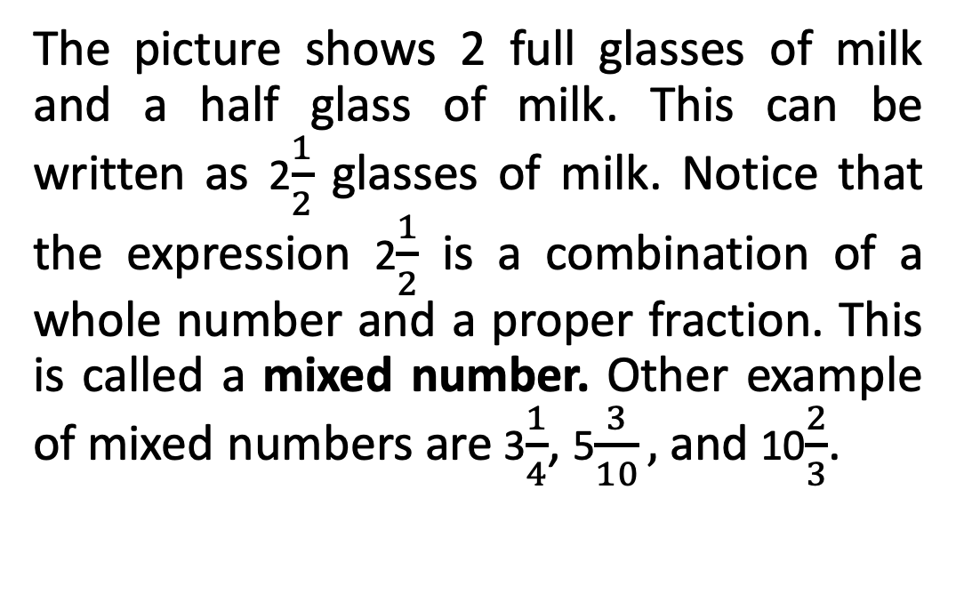
Kind of Fractions
The picture shows 2 full glasses of milk and a half glass of milk. This can be written as 2$\frac{1}{2}$ glasses of milk. Notice that the expression 2$\frac{1}{2}$ is a combination of a whole number and a proper fraction. This is called a mixed number. Other example of mixed numbers are 3$\frac{1}{4}$, 5$\frac{3}{10},$and 10$\frac{2}{3}$.

Slide 10
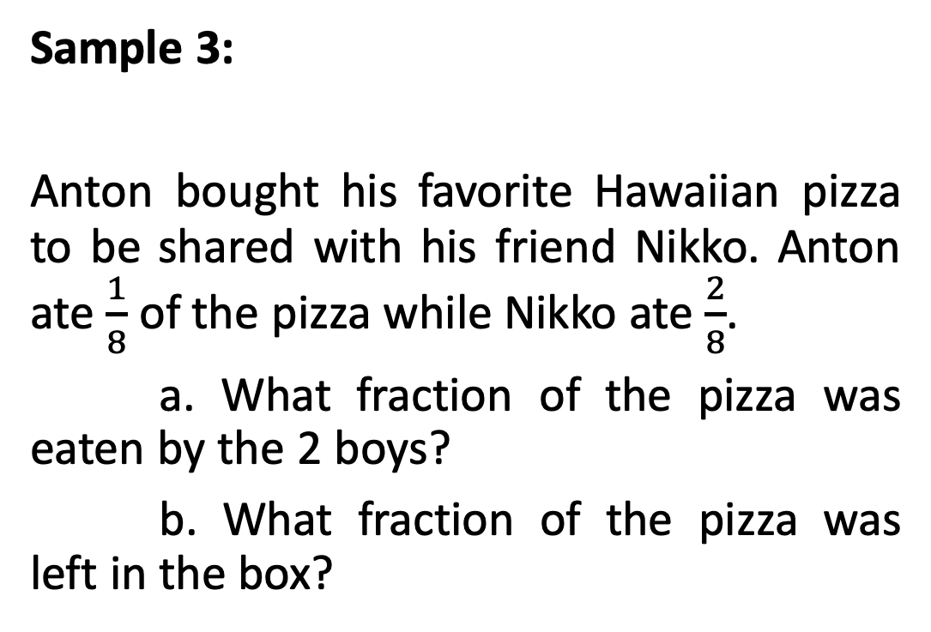
Kind of Fractions
Sample 3:
Anton bought his favorite Hawaiian pizza to be shared with his friend Nikko. Anton ate $\frac{1}{8}$ of the pizza while Nikko ate $\frac{2}{8}$.
a. What fraction of the pizza was eaten by the 2 boys?
b. What fraction of the pizza was left in the box?

Slide 11
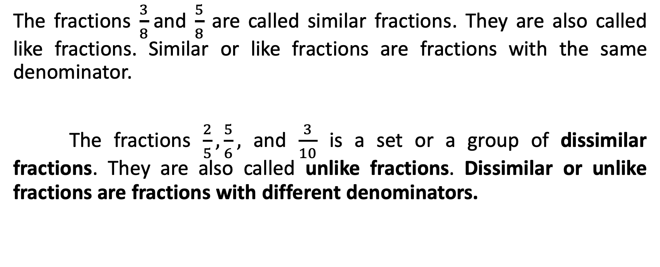
Kind of Fractions
The fractions $\frac{3}{8}$and $\frac{5}{8}$ are called similar fractions. They are also called like fractions. Similar or like fractions are fractions with the same denominator.
The fractions $\frac{2}{5},\frac{5}{6},$ and $\frac{3}{10}$ is a set or a group of dissimilar fractions. They are also called unlike fractions. Dissimilar or unlike fractions are fractions with different denominators.

