Slide 1
Changing Improper Fractions to Mixed Numbers

Slide 2
Changing Improper Fractions to Mixed Numbers
To change an improper fraction to a mixed number:
1. Divide the numerator by the denominator.
2. The quotient will be the whole number, the remainder will be the new numerator over the same denominator.
Remainder
Quotient
Denominator

Slide 3
Changing Improper Fractions to Mixed Numbers
To change a mixed number to an improper fraction:
1. Multiply the whole number by the denominator of the fraction.
2. Add the numerator of the fraction to the product, then write the sum over the same denominator.
(Whole Number × Denominator) + Numerator
Denominator

Slide 4
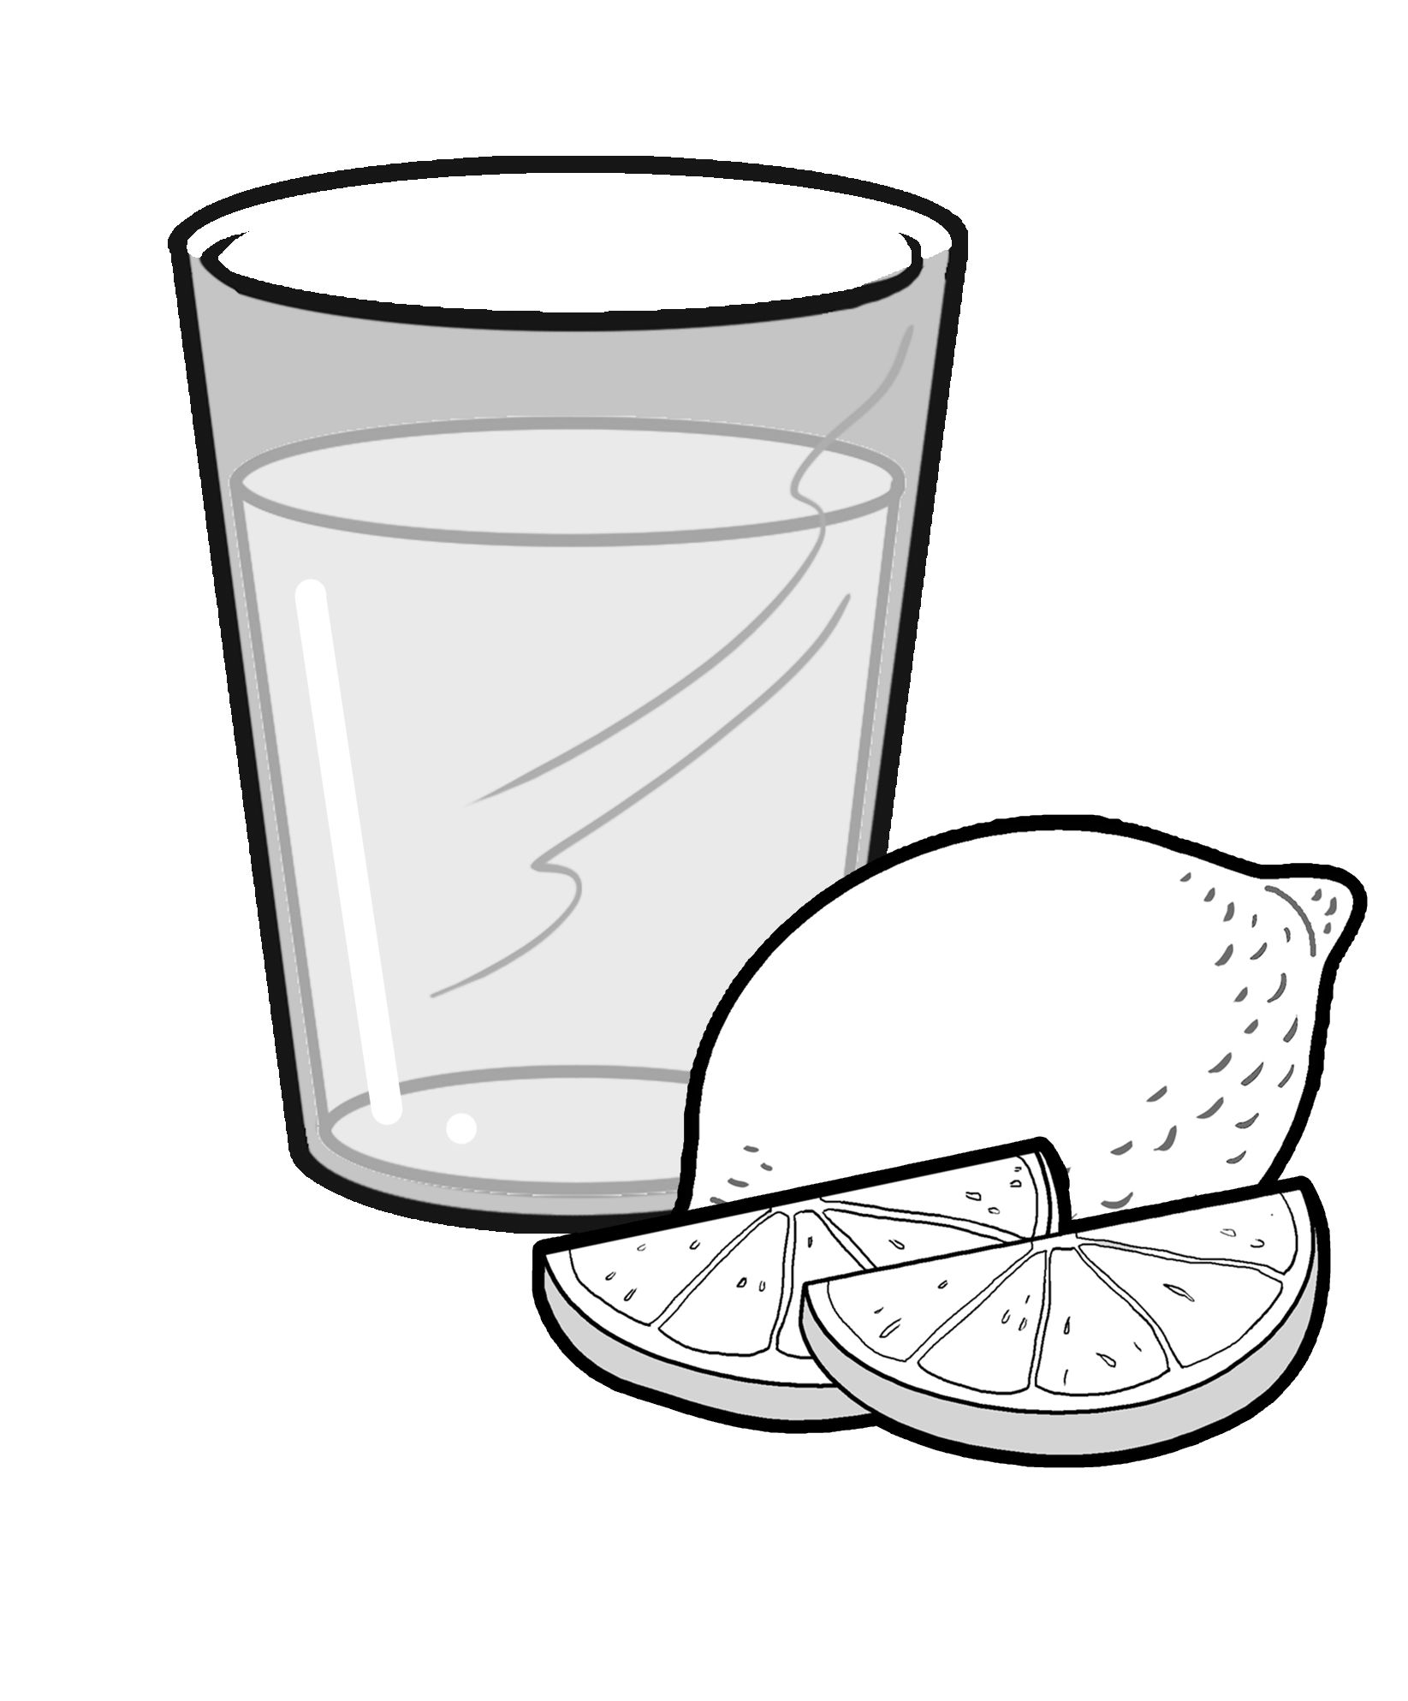
Changing Improper Fractions to Mixed Numbers
Lemon juice is rich in vitamin C. It helps to keep you healthy. To maintain his healthy lifestyle, Josh uses 7 lemon halves to make a pitcher of juice. How many lemons does he use in making juice? How do you write 7 halves as a fraction and as a mixed number?

Slide 5
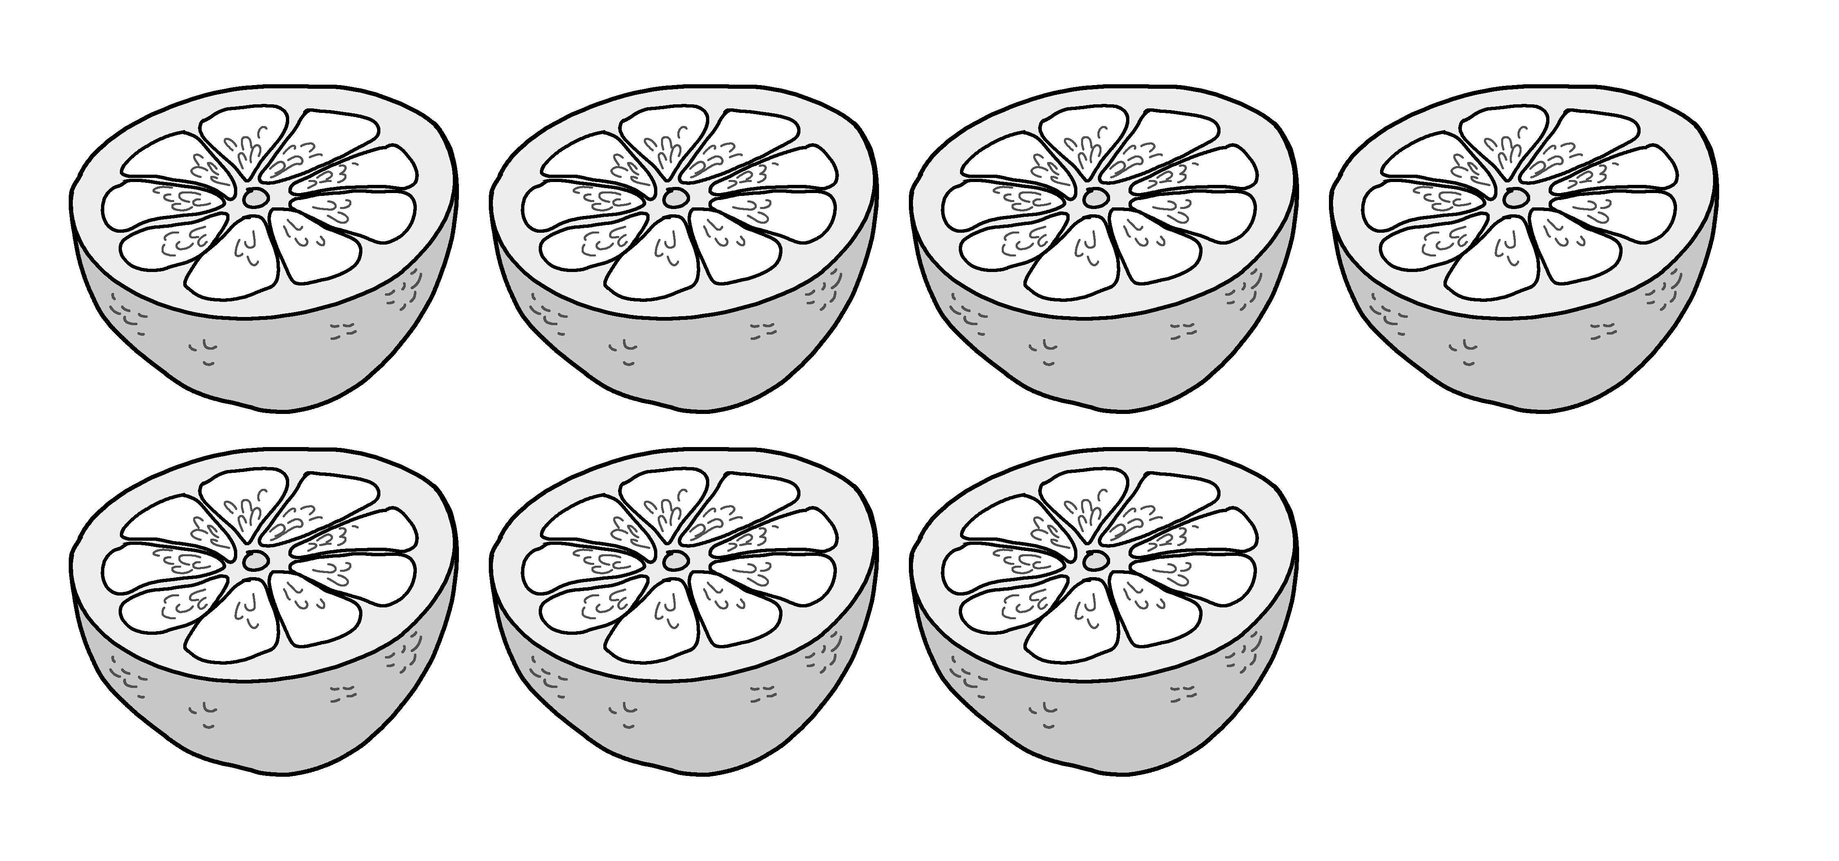
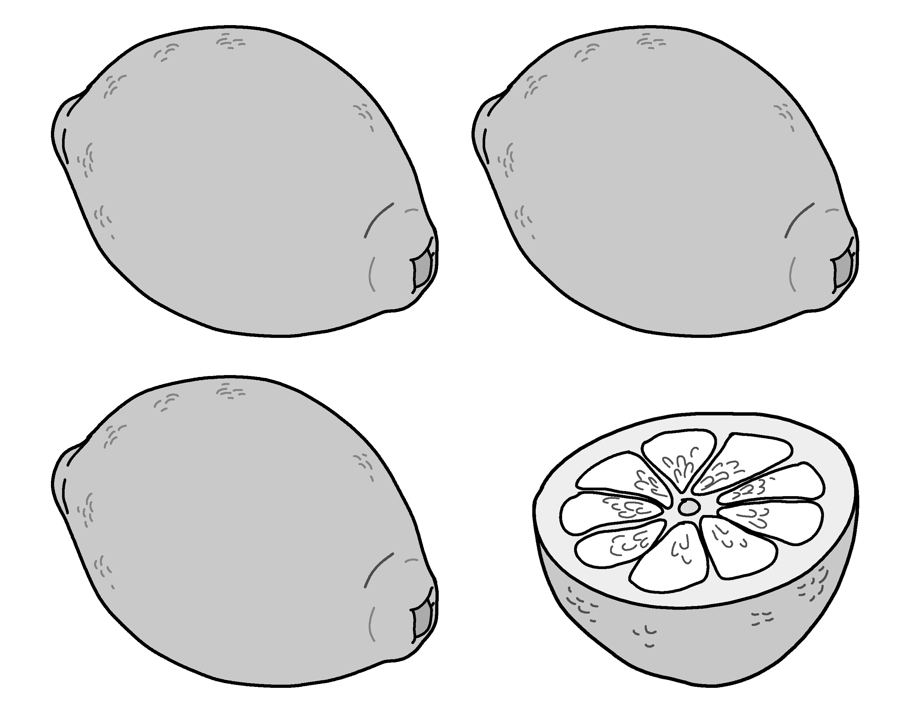
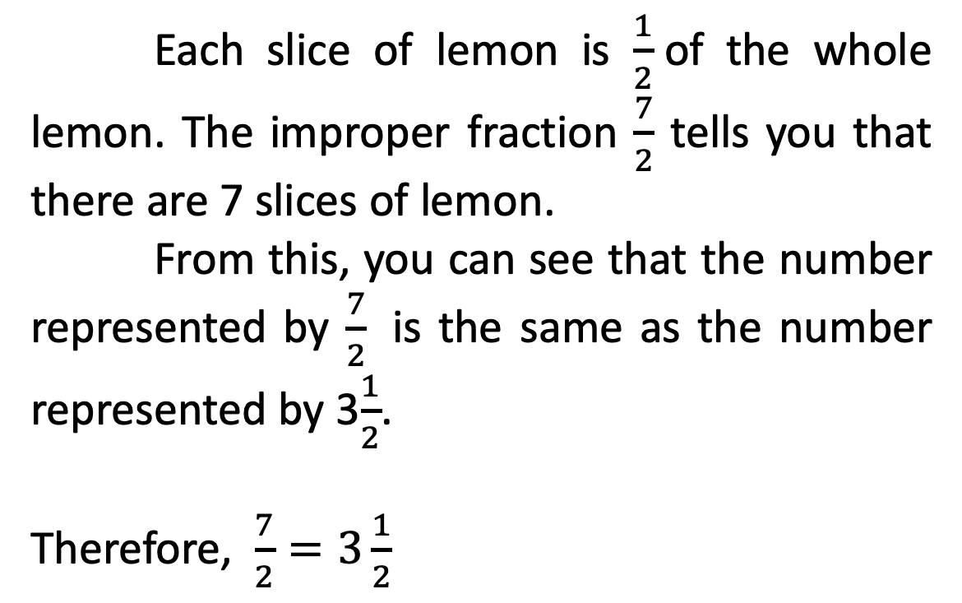


Changing Improper Fractions to Mixed Numbers
Each slice of lemon is $\frac{1}{2}$of the whole lemon. The improper fraction $\frac{7}{2}$ tells you that there are 7 slices of lemon.
From this, you can see that the number represented by $\frac{7}{2}$ is the same as the number represented by 3$\frac{1}{2}$.
Therefore, $\frac{7}{2}=3\frac{1}{2}$
$$\frac{7}{2}$$
$$3\frac{1}{2}$$

Slide 6
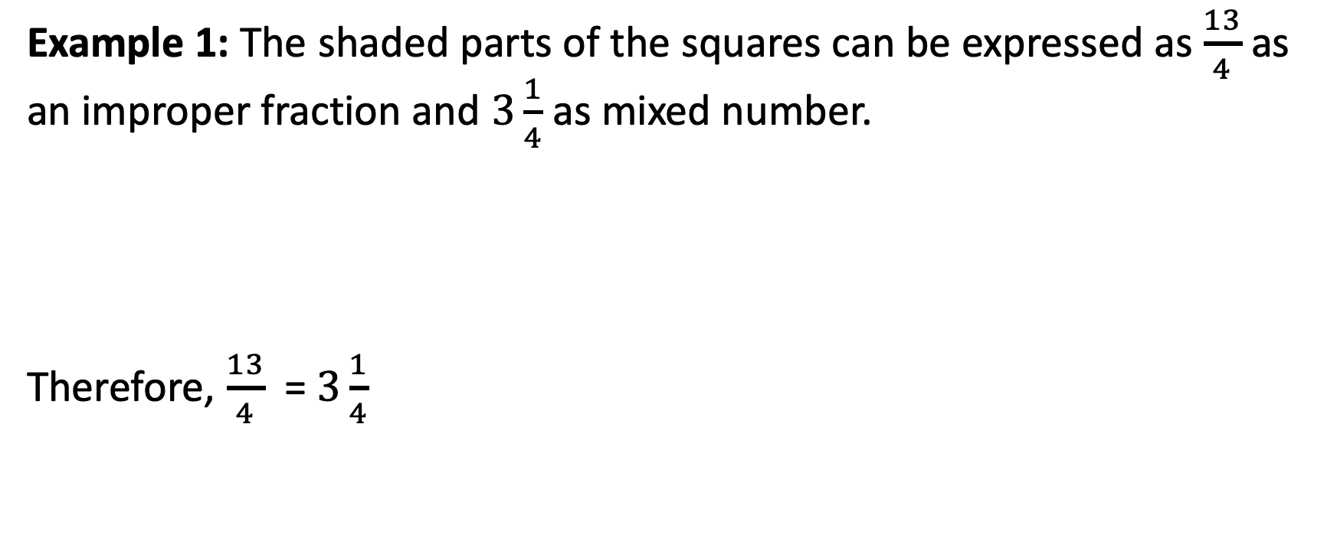
Changing Improper Fractions to Mixed Numbers
Example 1: The shaded parts of the squares can be expressed as $\frac{13}{4}$ as an improper fraction and $3\frac{1}{4}$ as mixed number.
Therefore, $\frac{13}{4}$ = $3\frac{1}{4}$

Slide 7
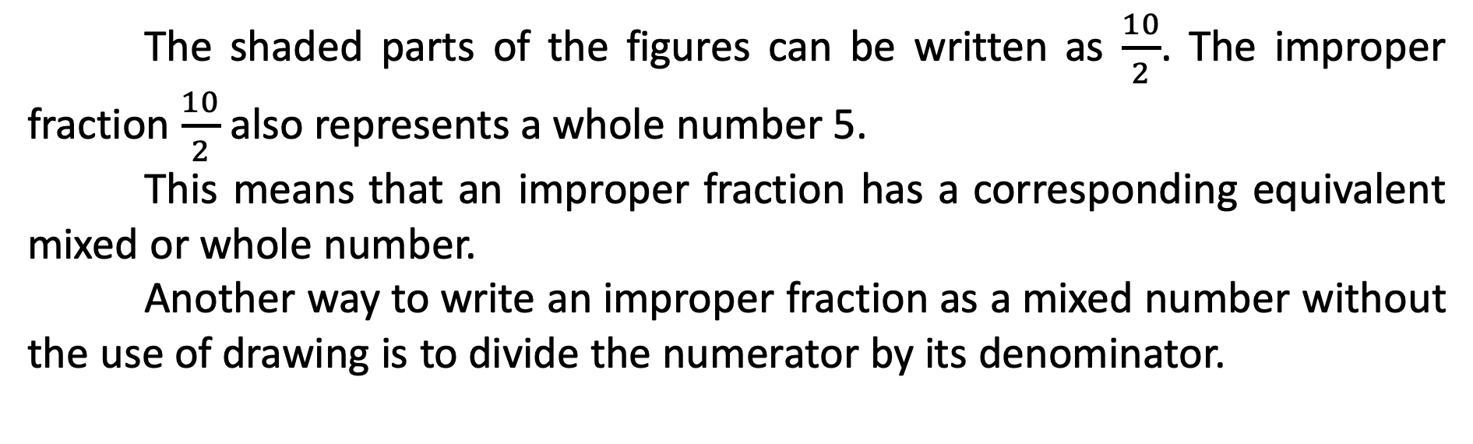
Changing Improper Fractions to Mixed Numbers
Example 2:
The shaded parts of the figures can be written as $\frac{10}{2}$. The improper fraction $\frac{10}{2}$also represents a whole number 5.
This means that an improper fraction has a corresponding equivalent mixed or whole number.
Another way to write an improper fraction as a mixed number without the use of drawing is to divide the numerator by its denominator.

Slide 8
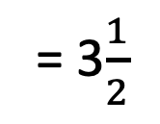
Changing Improper Fractions to Mixed Numbers
whole number part
3
7
– 6
1
Steps:
Divide the numerator by the denominator.
The quotient will be the whole number part.
The remainder will be the new numerator of the fraction over the same denominator.
7 ÷ 2
= 3$\frac{1}{2}$
new numerator
same denominator

Slide 9
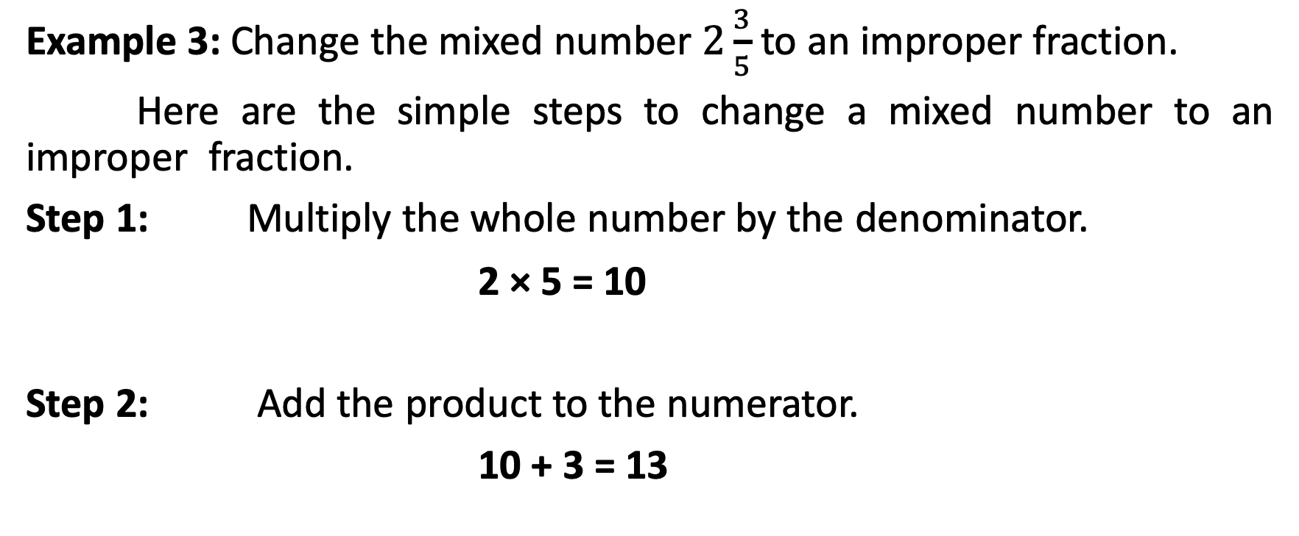
Changing Improper Fractions to Mixed Numbers
Example 3: Change the mixed number $2\frac{3}{5}$ to an improper fraction.
Here are the simple steps to change a mixed number to an improper fraction.
Step 1: Multiply the whole number by the denominator.
2 × 5 = 10
Step 2: Add the product to the numerator.
10 + 3 = 13

Slide 10
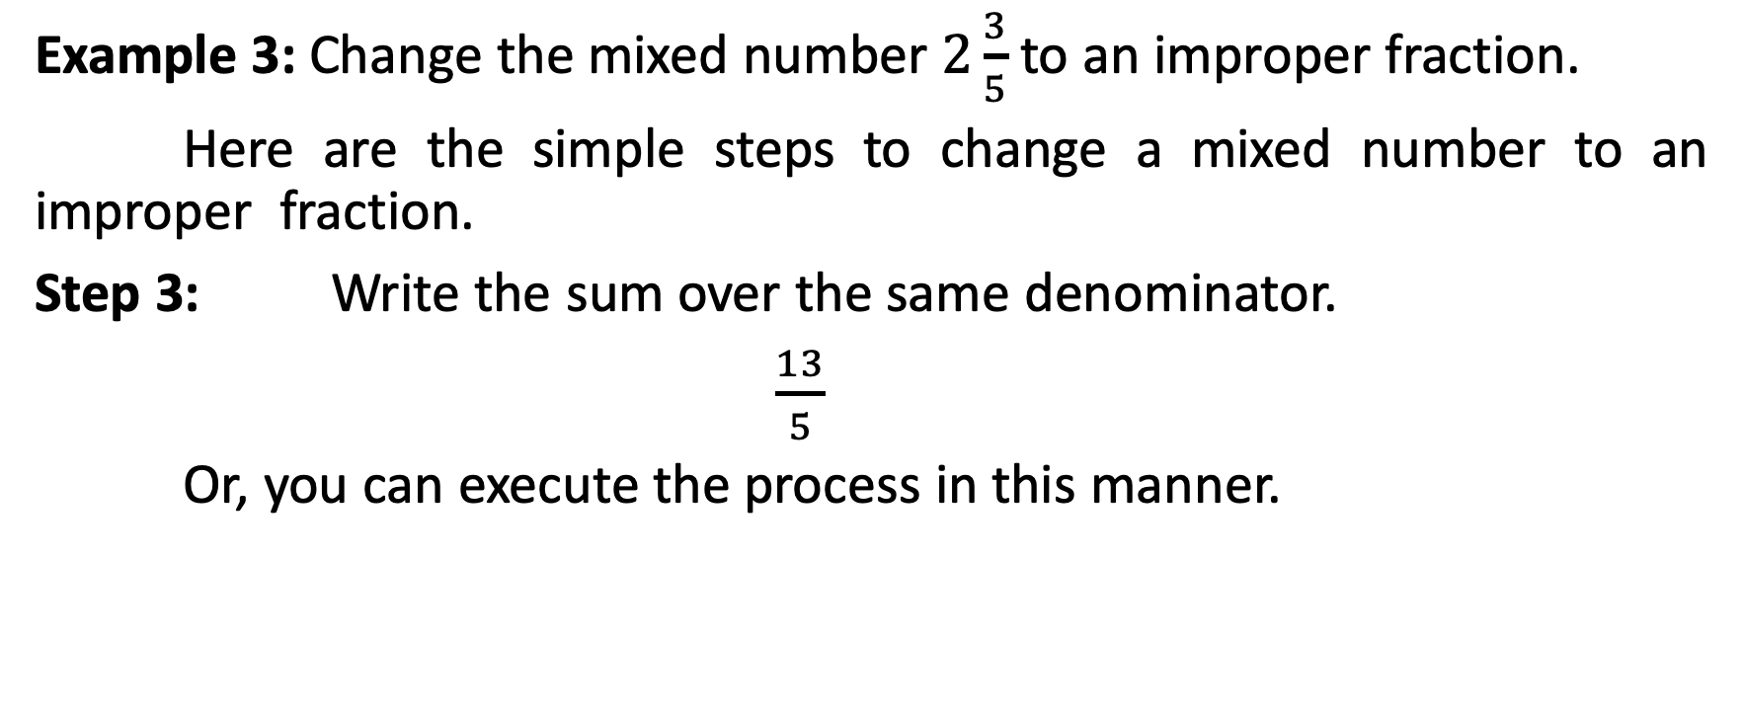
Changing Improper Fractions to Mixed Numbers
Example 3: Change the mixed number $2\frac{3}{5}$ to an improper fraction.
Here are the simple steps to change a mixed number to an improper fraction.
Step 3: Write the sum over the same denominator.
$\frac{13}{5}$
Or, you can execute the process in this manner.
3
(2 × 5) + 3
10 + 3
13
2
=
=
=
5
5
5
5

Slide 11
Changing Improper Fractions to Mixed Numbers
You can easily remember this process by applying the M-A-D (Multiply-Add-Denominator) method.

