Slide 1
Reducing Fractions to Lowest Terms

Slide 2
Reducing Fractions to Lowest Terms
A fraction is in its lowest terms when the numerator and the denominator of a fraction has no common factor other than 1.
To write a fraction in its simplest form or lowest terms, divide both the numerator and the denominator of the fraction by their greatest common factor or GCF.
A fraction can also be reduced by expressing the numerator and denominator as prime factors and cancelling out pairs of common factors.

Slide 3
Reducing Fractions to Lowest Terms
Kerwin, Alex, and Ronn each bought a pan of bibingka. Each bibingka was cut into equal slices.

Slide 4



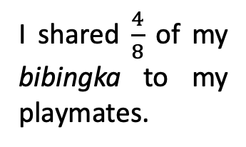
Reducing Fractions to Lowest Terms
I shared $\frac{4}{8}$ of my bibingka to my playmates.
I shared $\frac{2}{4}$ of my bibingka to my friends.
I shared $\frac{1}{2}$ of my bibingka to my brother and sister.
Kerwin
Alex
Ronn

Slide 5
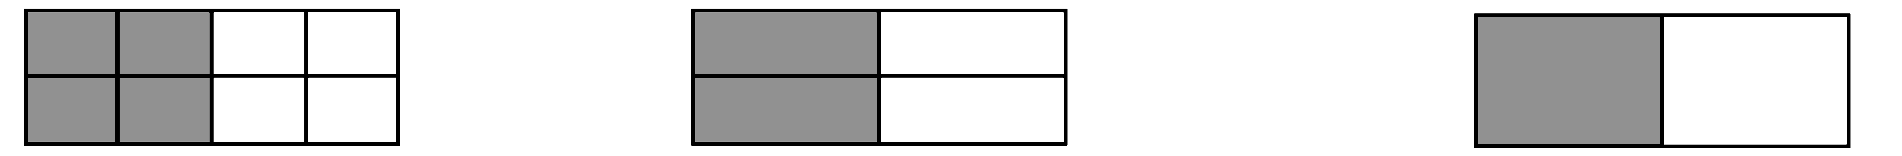
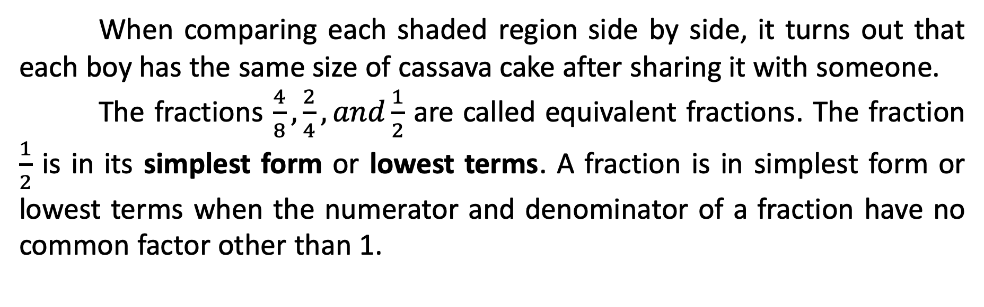



Reducing Fractions to Lowest Terms
$$\frac{4}{8}$$
$$\frac{2}{4}$$
$$\frac{1}{2}$$
When comparing each shaded region side by side, it turns out that each boy has the same size of cassava cake after sharing it with someone.
The fractions $\frac{4}{8},\frac{2}{4},and\frac{1}{2}$ are called equivalent fractions. The fraction $\frac{1}{2}$ is in its simplest form or lowest terms. A fraction is in simplest form or lowest terms when the numerator and denominator of a fraction have no common factor other than 1.

Slide 6
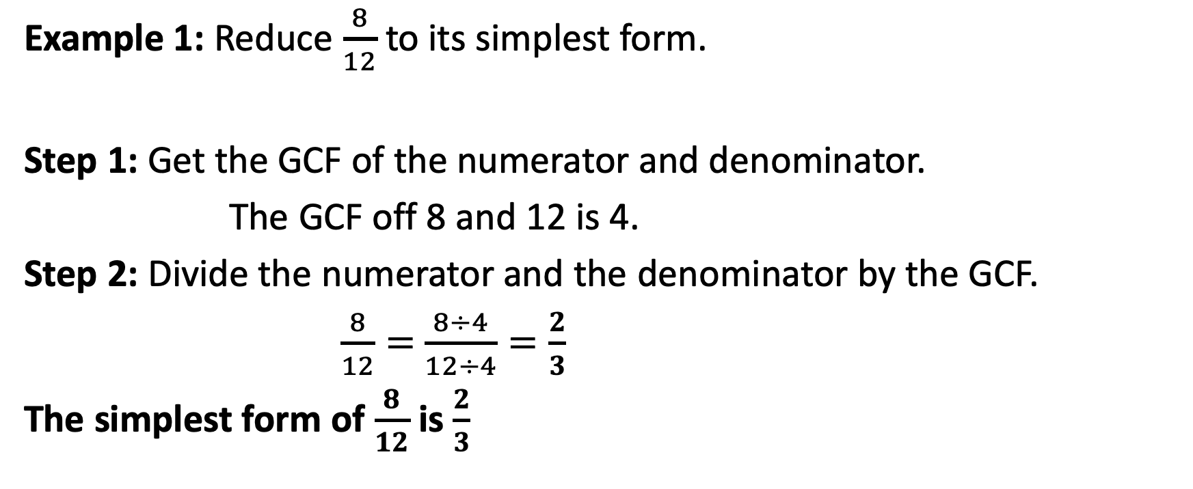
Reducing Fractions to Lowest Terms
Example 1: Reduce $\frac{8}{12}$ to its simplest form.
Step 1: Get the GCF of the numerator and denominator.
The GCF off 8 and 12 is 4.
Step 2: Divide the numerator and the denominator by the GCF.
$\frac{8}{12}=$ $\frac{8÷4}{12÷4}=\frac{2}{3}$
The simplest form of $\frac{8}{12}$ is $\frac{2}{3}$

Slide 7
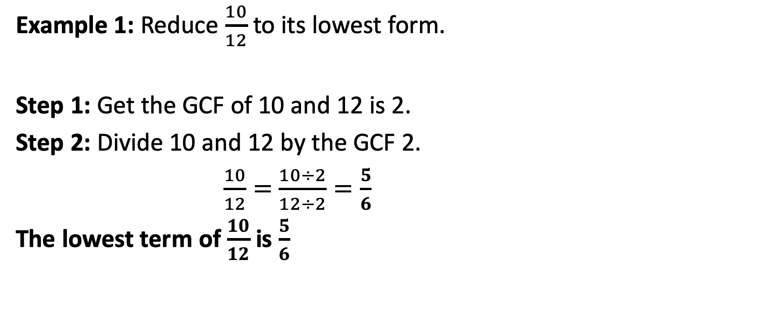
Reducing Fractions to Lowest Terms
Example 1: Reduce $\frac{10}{12}$ to its lowest form.
Step 1: Get the GCF of 10 and 12 is 2.
Step 2: Divide 10 and 12 by the GCF 2.
$\frac{10}{12}=$ $\frac{10÷2}{12÷2}=\frac{5}{6}$
The lowest term of $\frac{10}{12}$ is $\frac{5}{6}$

Slide 8
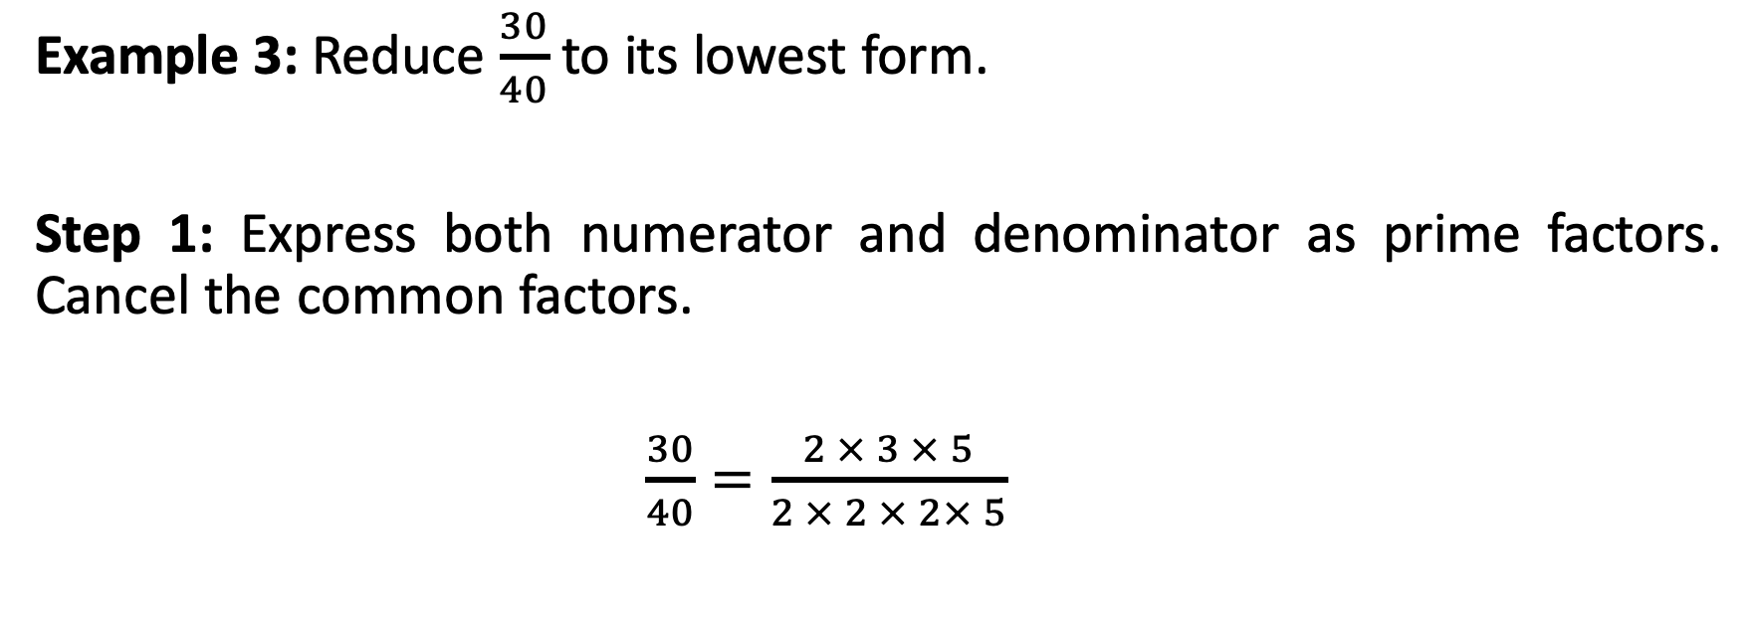
Reducing Fractions to Lowest Terms
Example 3: Reduce $\frac{30}{40}$ to its lowest form.
Step 1: Express both numerator and denominator as prime factors. Cancel the common factors.
$\frac{30}{40}=\frac{2 × 3 × 5}{2 × 2 × 2× 5}$

Slide 9
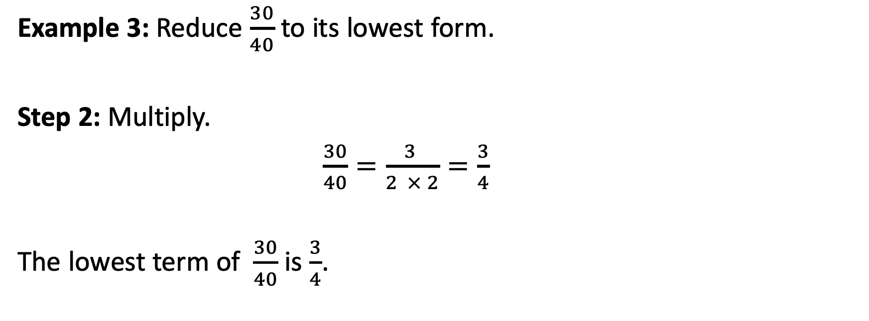
Reducing Fractions to Lowest Terms
Example 3: Reduce $\frac{30}{40}$ to its lowest form.
Step 2: Multiply.
$\frac{30}{40}=\frac{3 }{2 × 2}=\frac{3}{4}$
The lowest term of $\frac{30}{40}$ is $\frac{3}{4}$.

