Slide 1
Addition of Similar Fractions

Slide 2
Addition of Similar Fractions
Steps in adding similar fractions:
Add the numerators.
Write the sum over the common denominator.
Convert the answer to the lowest terms or mixed number when necessary.

Slide 3
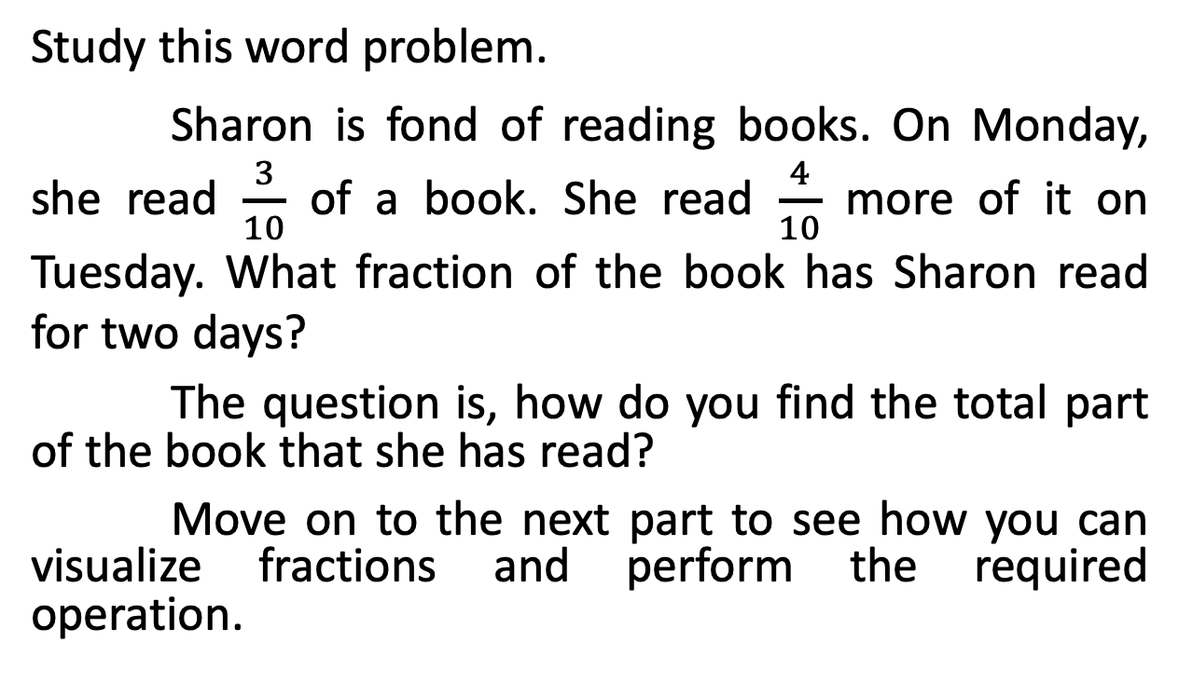
Addition of Similar Fractions
Study this word problem.
Sharon is fond of reading books. On Monday, she read $\frac{3}{10}$ of a book. She read $\frac{4}{10}$ more of it on Tuesday. What fraction of the book has Sharon read for two days?
The question is, how do you find the total part of the book that she has read?
Move on to the next part to see how you can visualize fractions and perform the required operation.

Slide 4
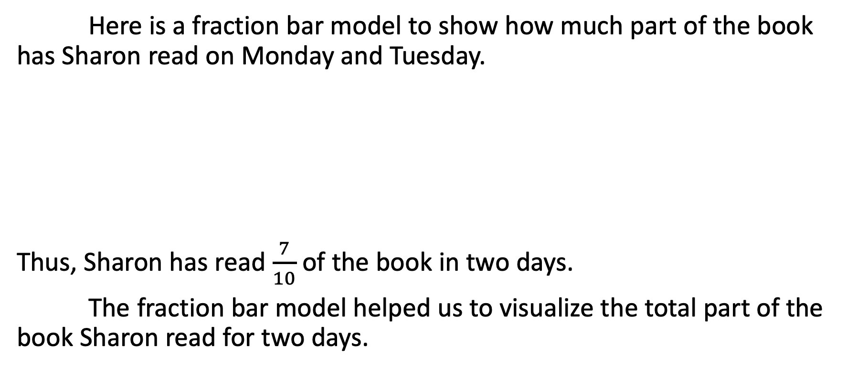
Addition of Similar Fractions
Here is a fraction bar model to show how much part of the book has Sharon read on Monday and Tuesday.
Thus, Sharon has read $\frac{7}{10}$ of the book in two days.
The fraction bar model helped us to visualize the total part of the book Sharon read for two days.

Slide 5
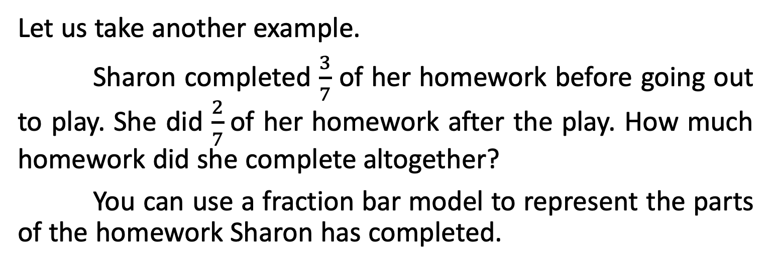
Addition of Similar Fractions
Let us take another example.
Sharon completed $\frac{3}{7}$ of her homework before going out to play. She did $\frac{2}{7}$of her homework after the play. How much homework did she complete altogether?
You can use a fraction bar model to represent the parts of the homework Sharon has completed.
A fraction bar model uses rectangles to describe fractions. This will help us visualize and solve problems involving fractions.

Slide 6
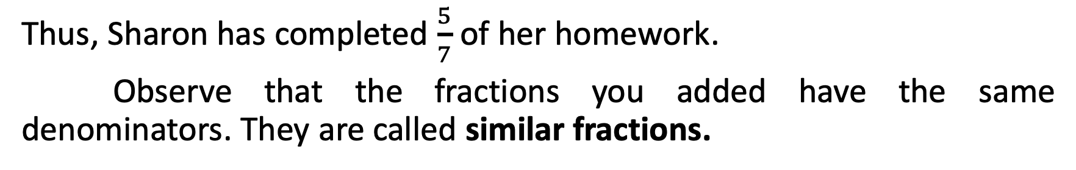
Addition of Similar Fractions
Thus, Sharon has completed $\frac{5}{7}$ of her homework.
Observe that the fractions you added have the same denominators. They are called similar fractions.

Slide 7
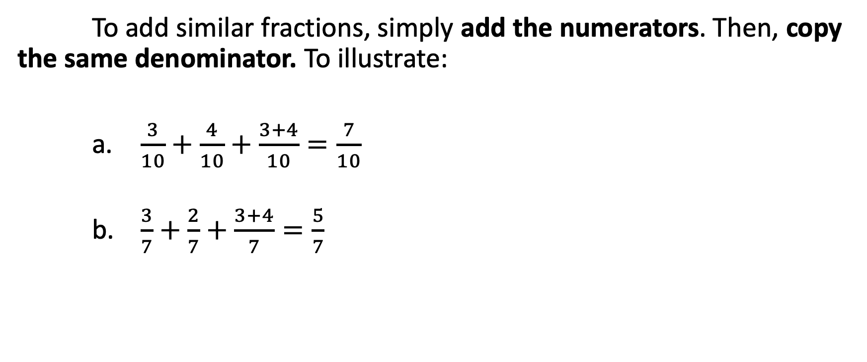
Addition of Similar Fractions
To add similar fractions, simply add the numerators. Then, copy the same denominator. To illustrate:
    $\frac{3}{10}+\frac{4}{10}+\frac{3+4}{10}=\frac{7}{10}$
    $\frac{3}{7}+\frac{2}{7}+\frac{3+4}{7}=\frac{5}{7}$

Slide 8
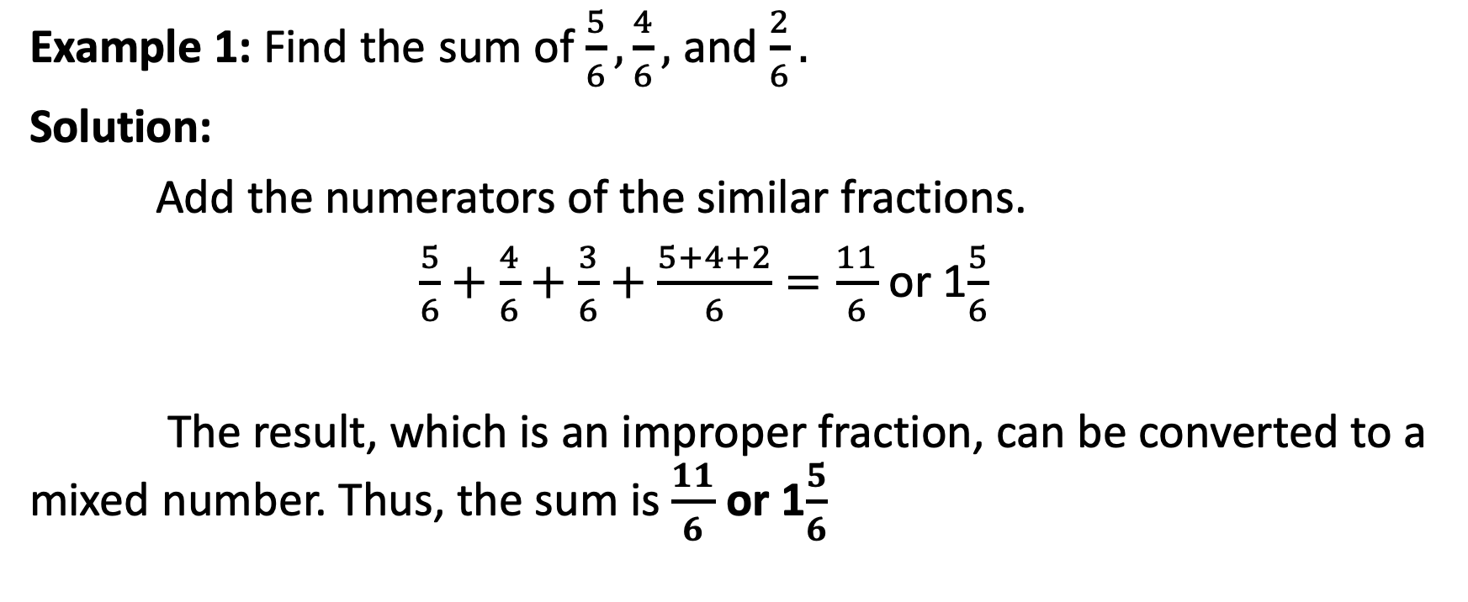
Addition of Similar Fractions
Example 1: Find the sum of $\frac{5}{6},\frac{4}{6},$ and $\frac{2}{6}.$
Solution:
Add the numerators of the similar fractions.
$\frac{5}{6}+\frac{4}{6}+\frac{3}{6}+\frac{5+4+2}{6}=\frac{11}{6}$ or 1$\frac{5}{6}$
The result, which is an improper fraction, can be converted to a mixed number. Thus, the sum is $\frac{11}{6}$ or 1$\frac{5}{6}$

Slide 9
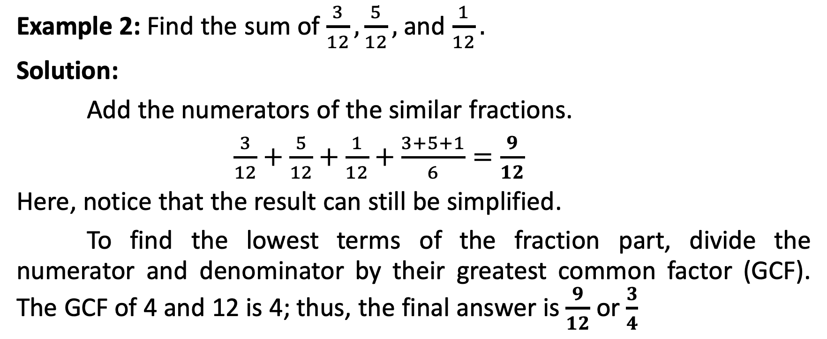
Addition of Similar Fractions
Example 2: Find the sum of $\frac{3}{12},\frac{5}{12},$ and $\frac{1}{12}.$
Solution:
Add the numerators of the similar fractions.
$\frac{3}{12}+\frac{5}{12}+\frac{1}{12}+\frac{3+5+1}{6}=\frac{9}{12}$
Here, notice that the result can still be simplified.
To find the lowest terms of the fraction part, divide the numerator and denominator by their greatest common factor (GCF). The GCF of 4 and 12 is 4; thus, the final answer is $\frac{9}{12}$ or $\frac{3}{4}$

