Slide 1
Subtraction of Similar Fractions

Slide 2
Subtraction of Similar Fractions
Steps in subtracting similar fractions:
1. Subtract the numerators.
2. Write the difference over the common denominator.
3. Convert the answer to the lowest terms or mixed number when necessary.

Slide 3
Subtraction of Similar Fractions
Steps in subtracting a fraction from a whole number:
1. Convert the whole number into an equivalent improper fraction with the same denominator as the fraction you are subtracting from it.
2. Start subtracting, following the rules on subtracting similar fractions.

Slide 4
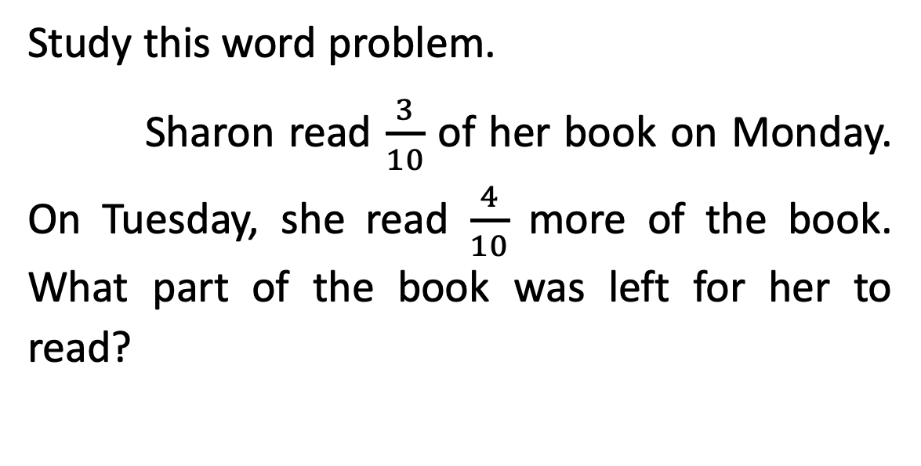
Subtraction of Similar Fractions
Study this word problem.
Sharon read $\frac{3}{10}$ of her book on Monday. On Tuesday, she read $\frac{4}{10}$ more of the book. What part of the book was left for her to read?

Slide 5
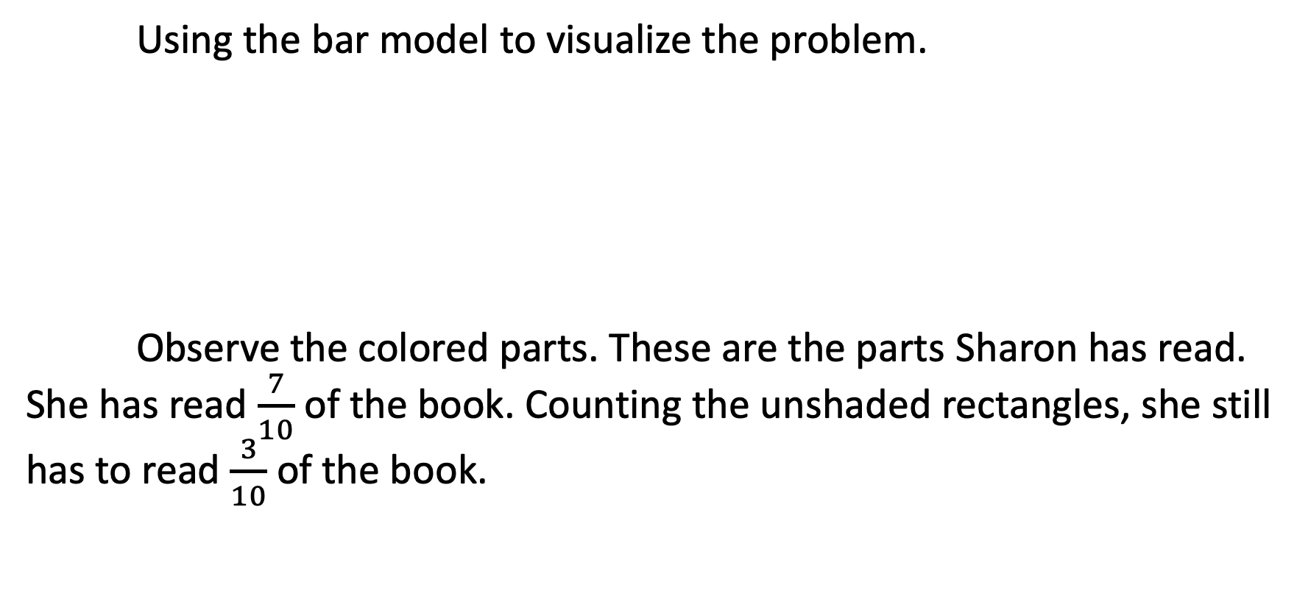
Subtraction of Similar Fractions
Using the bar model to visualize the problem.
Observe the colored parts. These are the parts Sharon has read. She has read $\frac{7}{10}$ of the book. Counting the unshaded rectangles, she still has to read $\frac{3}{10}$ of the book.

Slide 6
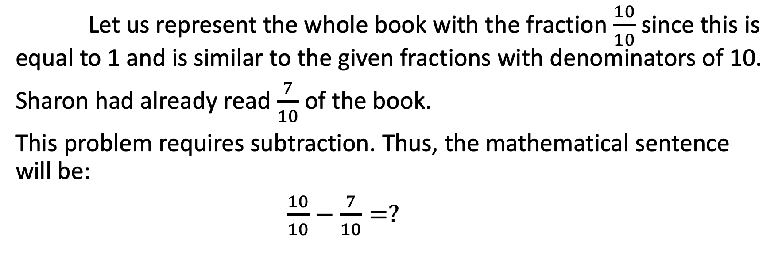
Subtraction of Similar Fractions
Let us represent the whole book with the fraction $\frac{10}{10}$ since this is equal to 1 and is similar to the given fractions with denominators of 10.
Sharon had already read $\frac{7}{10}$ of the book.
This problem requires subtraction. Thus, the mathematical sentence will be:
$\frac{10}{10}−\frac{7}{10}=?$

Slide 7
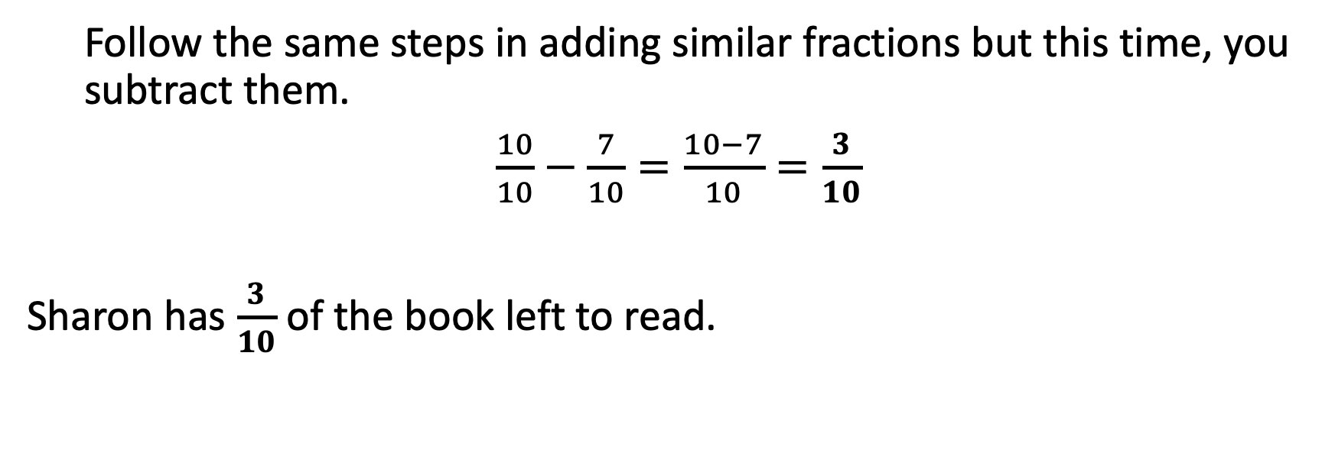
Subtraction of Similar Fractions
  Follow the same steps in adding similar fractions but this time, you subtract them.
$\frac{10}{10}−\frac{7}{10}=\frac{10−7}{10}=\frac{3}{10}$
Sharon has $\frac{3}{10}$ of the book left to read.

Slide 8
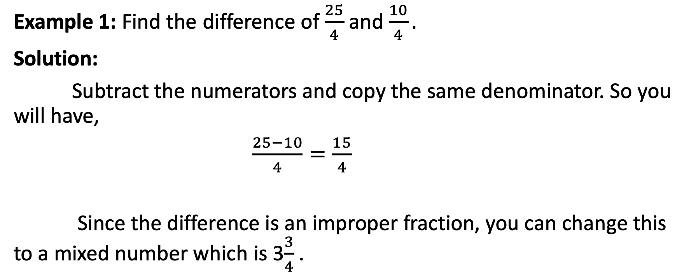
Subtraction of Similar Fractions
Example 1: Find the difference of $\frac{25}{4}$and $\frac{10}{4}.$
Solution:
Subtract the numerators and copy the same denominator. So you will have,
$\frac{25−10}{4}=\frac{15}{4}$
Since the difference is an improper fraction, you can change this to a mixed number which is 3$\frac{3}{4}$.

Slide 9
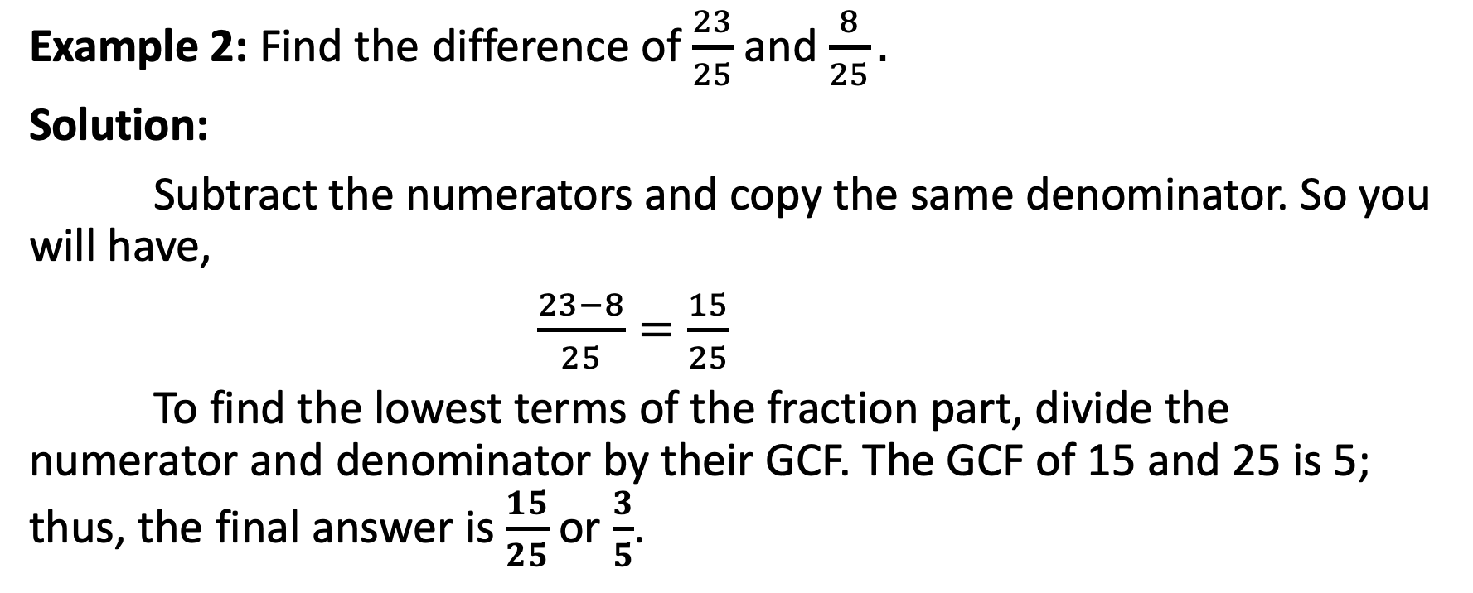
Subtraction of Similar Fractions
Example 2: Find the difference of $\frac{23}{25}$and $\frac{8}{25}.$
Solution:
Subtract the numerators and copy the same denominator. So you will have,
$\frac{23−8}{25}=\frac{15}{25}$
To find the lowest terms of the fraction part, divide the numerator and denominator by their GCF. The GCF of 15 and 25 is 5; thus, the final answer is $\frac{15}{25}$ or $\frac{3}{5}$.

Slide 10
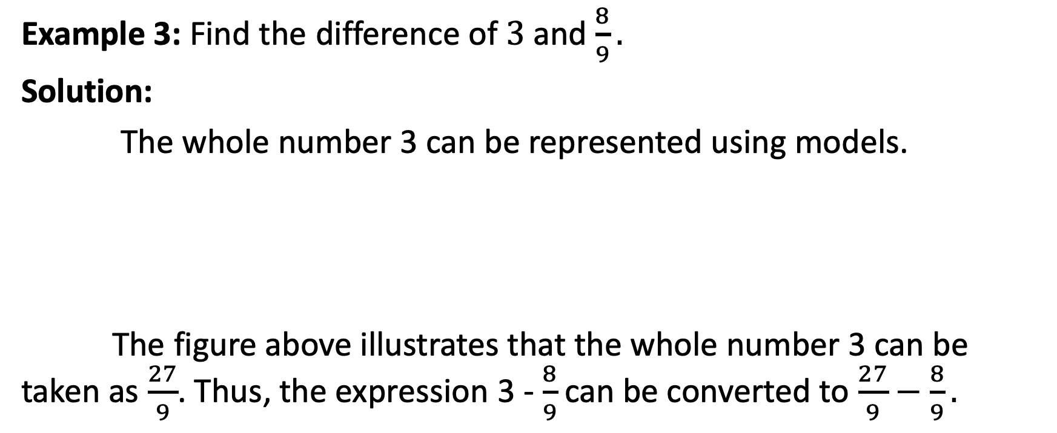
Subtraction of Similar Fractions
Example 3: Find the difference of $3$and $\frac{8}{9}.$
Solution:
The whole number 3 can be represented using models.
The figure above illustrates that the whole number 3 can be taken as $\frac{27}{9}$. Thus, the expression 3 - $\frac{8}{9}$can be converted to $\frac{27}{9}−\frac{8}{9}.$

Slide 11
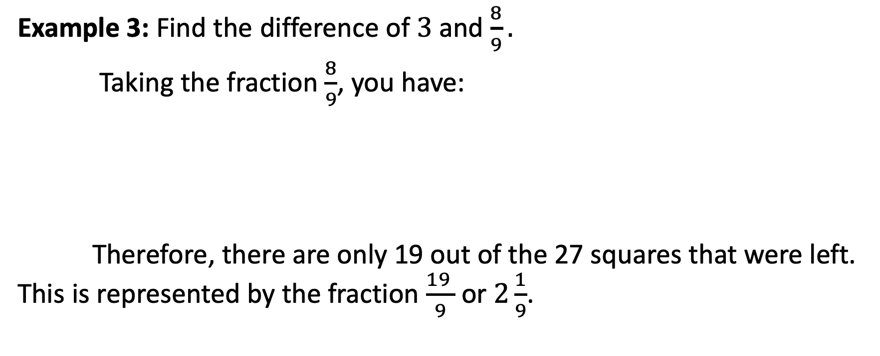
Subtraction of Similar Fractions
Example 3: Find the difference of $3$and $\frac{8}{9}.$
Taking the fraction $\frac{8}{9}$, you have:
Therefore, there are only 19 out of the 27 squares that were left. This is represented by the fraction $\frac{19 }{9}$ or $2\frac{1}{9}$.

Slide 12
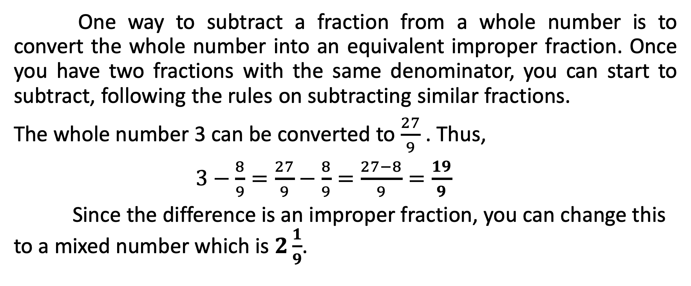
Subtraction of Similar Fractions
One way to subtract a fraction from a whole number is to convert the whole number into an equivalent improper fraction. Once you have two fractions with the same denominator, you can start to subtract, following the rules on subtracting similar fractions.
The whole number 3 can be converted to $\frac{27}{9}$ . Thus,
$3−\frac{8}{9}=\frac{27}{9}−\frac{8}{9}=\frac{27−8}{9}=\frac{19}{9}$
Since the difference is an improper fraction, you can change this to a mixed number which is $2\frac{1}{9}$.

