Slide 1
Solving Word Problems Involving Addition and Subtraction of Similar Fractions

Slide 2
Solving Word Problems Involving Addition and Subtraction of Similar Fractions
Use models to visualize the problem and help you in getting the final answer.
Use these steps in solving word problems:
1. Understand the problem.
2. Make a plan.
3. Carry out the plan.
4. Look back.
Simplify the final answer.

Slide 3
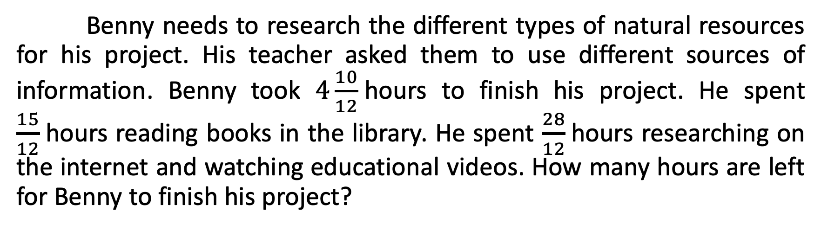
Solving Word Problems Involving Addition and Subtraction of Similar Fractions
Benny needs to research the different types of natural resources for his project. His teacher asked them to use different sources of information. Benny took $4\frac{10}{12}$hours to finish his project. He spent $\frac{15}{12}$hours reading books in the library. He spent $\frac{28}{12}$hours researching on the internet and watching educational videos. How many hours are left for Benny to finish his project?

Slide 4
Solving Word Problems Involving Addition and Subtraction of Similar Fractions
To solve the given problem, answer the questions below. Write the answers in your notebook.
What do you think is the first operation you have to use to solve this word problem?
What is the next operation you will use to get the final answer?

Slide 5
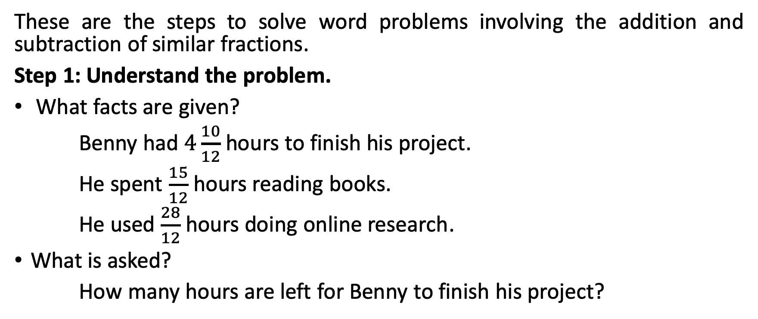
Solving Word Problems Involving Addition and Subtraction of Similar Fractions
These are the steps to solve word problems involving the addition and subtraction of similar fractions.
Step 1: Understand the problem.
What facts are given?
Benny had $4\frac{10}{12}$ hours to finish his project.
He spent $\frac{15}{12}$hours reading books.
He used $\frac{28}{12}$ hours doing online research.
What is asked?
How many hours are left for Benny to finish his project?

Slide 6
Solving Word Problems Involving Addition and Subtraction of Similar Fractions
Step 2: Make a plan.
What operation should be used?
    a. The first step is to figure the amount of time Benny used in researching. This requires adding the hours spent in researching.
b. The next step is to solve for how much time is left for Benny to finish the project. This involves subtracting the hours he used for research from the total number of hours he had to work for the project.
c. The final step is to express the answer in the lowest terms.

Slide 7
Solving Word Problems Involving Addition and Subtraction of Similar Fractions
Step 3: Carry out the plan/Solve.
Begin by adding the fractions.
You may use pie models to visualize the problem.
To find out Benny’s total hours in doing research, the first step is to add the fractions.

Slide 8

Solving Word Problems Involving Addition and Subtraction of Similar Fractions
Let us use these models to get the answer.
Combine the whole parts and add the fraction parts. Therefore, it took Benny $\frac{43}{12}$hours to do research.

Slide 9
Solving Word Problems Involving Addition and Subtraction of Similar Fractions
The next step is to find out how much time is left for Benny to do the project. This requires us to subtract the fractions.
Let us use the models below to find the answer.

Slide 10
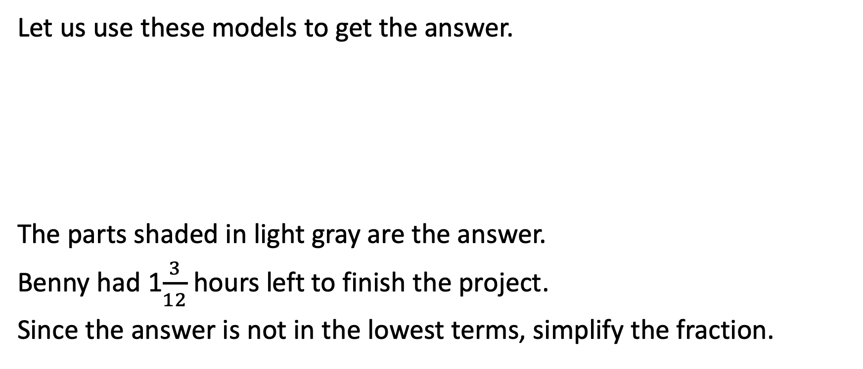
Solving Word Problems Involving Addition and Subtraction of Similar Fractions
Let us use these models to get the answer.
The parts shaded in light gray are the answer.
Benny had 1$\frac{3}{12}$hours left to finish the project.
Since the answer is not in the lowest terms, simplify the fraction.

Slide 11
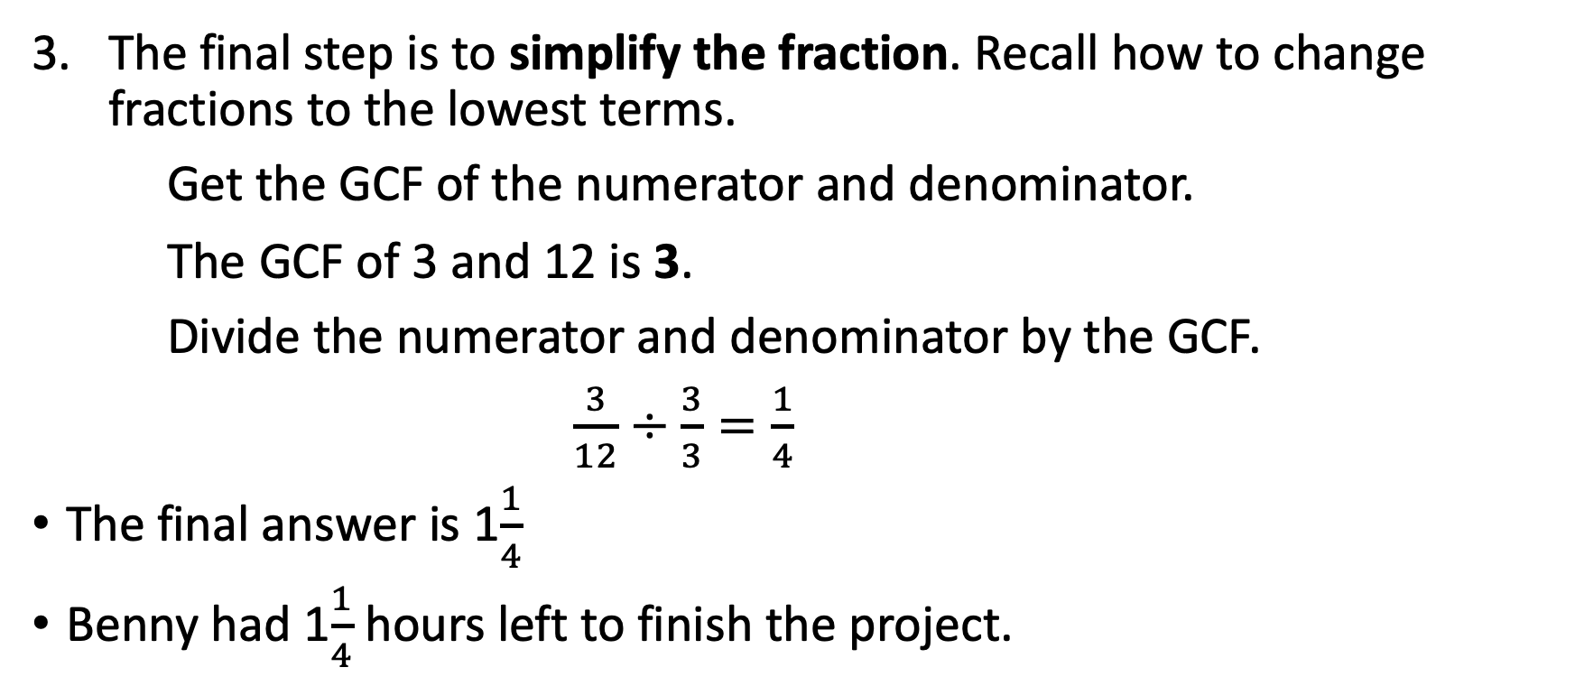
Solving Word Problems Involving Addition and Subtraction of Similar Fractions
The final step is to simplify the fraction. Recall how to change fractions to the lowest terms.
Get the GCF of the numerator and denominator.
The GCF of 3 and 12 is 3.
Divide the numerator and denominator by the GCF.
$\frac{3}{12}÷\frac{3}{3}=\frac{1}{4}$
The final answer is 1$\frac{1}{4}$
Benny had 1$\frac{1}{4}$ hours left to finish the project.

Slide 12
Solving Word Problems Involving Addition and Subtraction of Similar Fractions
Step 4: Look back.
Review your answer and ask yourself the following questions:
  Did the equation help you get the correct answer?
  Does the answer make sense?

