Slide 1
Adding and Subtracting Fractions and Mixed Numbers Without Regrouping

Slide 2
Adding and Subtracting Fractions and Mixed Numbers Without Regrouping
To add or subtract similar fractions, simply add or subtract the numerators then write the result over the same denominator.
When the fraction of the mixed number minuend is smaller than the fraction of the subtrahend, borrow from the whole number and make the fraction improper before you continue with the subtraction.

Slide 3
Adding and Subtracting Fractions and Mixed Numbers Without Regrouping
To add or subtract dissimilar fractions, make the dissimilar fractions similar by finding their least common divisor (LCD) and proceed with addition or subtraction.
Always simplify the final answers into their lowest terms.

Slide 4
Adding and Subtracting Fractions and Mixed Numbers Without Regrouping
Sharing is caring. Take any two packs of biscuits or cookies. Then, take 2 plates. The first plate is yours, and the second plate will be for someone in your house you want to share your food with. Now, cut your biscuits or cookies into 4 equal parts each and place as much as you like on each plate. You can also put whole biscuits if you like. Your two plates might look like this.

Slide 5
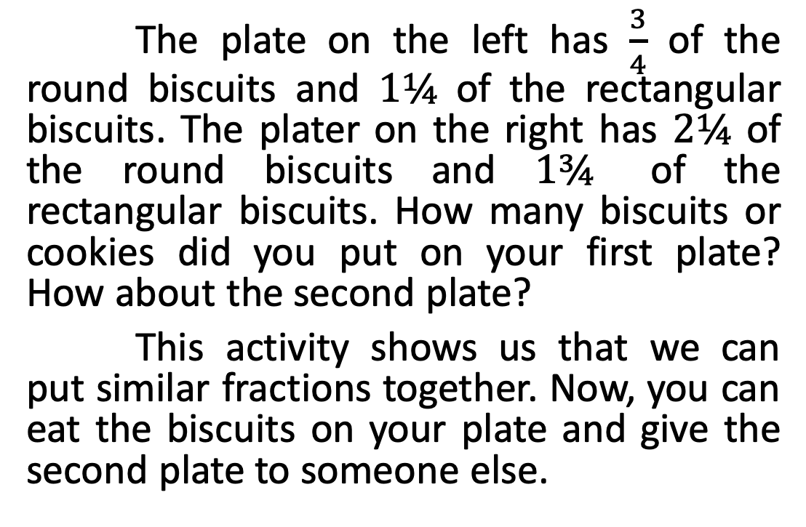
Adding and Subtracting Fractions and Mixed Numbers Without Regrouping
The plate on the left has $\frac{3}{4}$ of the round biscuits and $1¼$ of the rectangular biscuits. The plater on the right has $2¼$ of the round biscuits and $1¾$ of the rectangular biscuits. How many biscuits or cookies did you put on your first plate? How about the second plate?
This activity shows us that we can put similar fractions together. Now, you can eat the biscuits on your plate and give the second plate to someone else.

Slide 6
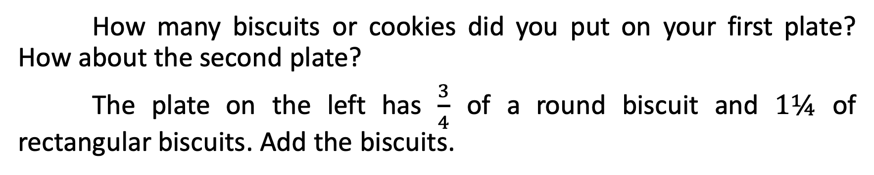
Adding and Subtracting Fractions and Mixed Numbers Without Regrouping
How many biscuits or cookies did you put on your first plate? How about the second plate?
The plate on the left has $\frac{3}{4}$ of a round biscuit and $1¼$ of rectangular biscuits. Add the biscuits.

Slide 7




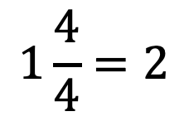

Adding and Subtracting Fractions and Mixed Numbers Without Regrouping
In the given example, the two fractions are similar because both have a denominator of 4. Since they are similar fractions, simply add their numerators and write the sum over the denominator. Thus, the
answer is or 2.
The plate on the right has of round biscuits
and of rectangular biscuits.
$$\frac{3}{4}$$
$$1\frac{1}{4}$$
+
$$1\frac{1}{4}$$
______
$$1\frac{4}{4}=2$$
$$2\frac{1}{4}$$
$$1\frac{3}{4}$$

Slide 8
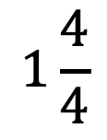
Adding and Subtracting Fractions and Mixed Numbers Without Regrouping
In the given example, the two fractions are similar because both have a denominator of 4. Since they are similar fractions, simply add their numerators and write the sum over the denominator. Thus, the answer is
or 2.
$$1\frac{4}{4}$$

Slide 9






Adding and Subtracting Fractions and Mixed Numbers Without Regrouping
$$2\frac{1}{4}$$
$$\frac{9}{4}$$
$$2\frac{1}{4}$$
=
The plate on the right has of round
biscuits and of rectangular biscuits.
$$1\frac{3}{4}$$
$$\frac{7}{4}$$
$$1\frac{3}{4}$$
–
=
_____
$\frac{2}{4}=$ $\frac{1}{2}$

Slide 10
Adding and Subtracting Fractions and Mixed Numbers Without Regrouping
$$2\frac{1}{4}$$
$$\frac{9}{4}$$
$$2\frac{1}{4}$$
=
The plate on the right has of round
biscuits and of rectangular biscuits.
$$1\frac{3}{4}$$
$$\frac{7}{4}$$
$$1\frac{3}{4}$$
–
=
_____
$\frac{2}{4}=$ $\frac{1}{2}$

Slide 11






Adding and Subtracting Fractions and Mixed Numbers Without Regrouping
In the situation above, the two fractions are also similar. Both have a denominator of 4. Since they are similar fractions, simply subtract their numerators. However, since the fraction part of the minuend is smaller than the fraction part of the subtrahend, we 7 can proceed by converting the mixed number to an improper fraction.
Thus, and were converted to and , respectively. The
result is then , which is the lowest term of .
$$2\frac{1}{4}$$
$$1\frac{3}{4}$$
$$\frac{9}{4}$$
$$\frac{7}{4}$$
$$\frac{1}{2}$$
$$\frac{2}{4}$$

Slide 12
Adding and Subtracting Fractions and Mixed Numbers Without Regrouping
In the situation above, the two fractions are also similar. Both have a denominator of 4. Since they are similar fractions, simply subtract their numerators. However, since the fraction part of the minuend is smaller than the fraction part of the subtrahend, we 7 can proceed by converting the mixed number to an improper fraction.
Thus, and were converted to and , respectively. The
result is then , which is the lowest term of .
$$2\frac{1}{4}$$
$$1\frac{3}{4}$$
$$\frac{9}{4}$$
$$\frac{7}{4}$$
$$\frac{1}{2}$$
$$\frac{2}{4}$$

Slide 13
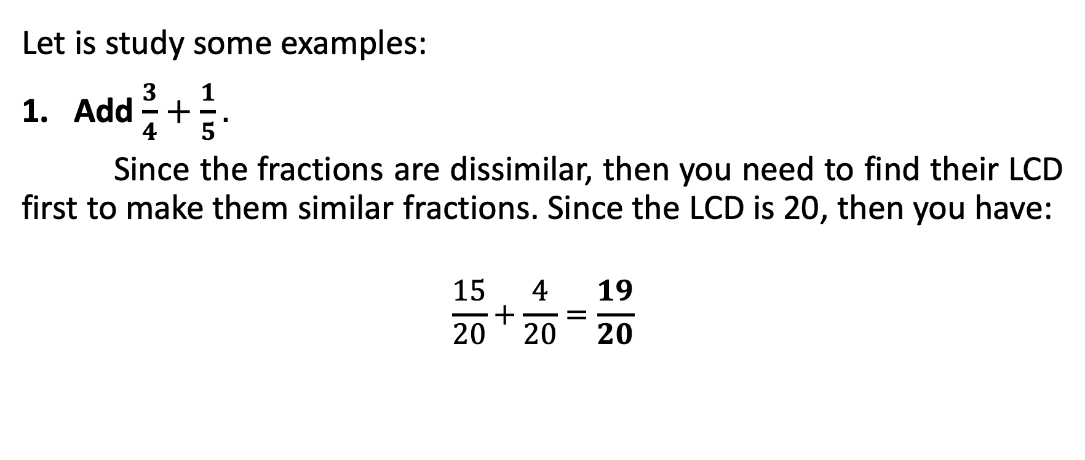
Adding and Subtracting Fractions and Mixed Numbers Without Regrouping
Let is study some examples:
Add $\frac{3}{4}+\frac{1}{5}.$
Since the fractions are dissimilar, then you need to find their LCD first to make them similar fractions. Since the LCD is 20, then you have:
$$\frac{15}{20}+\frac{4}{20}=\frac{19}{20}$$

Slide 14
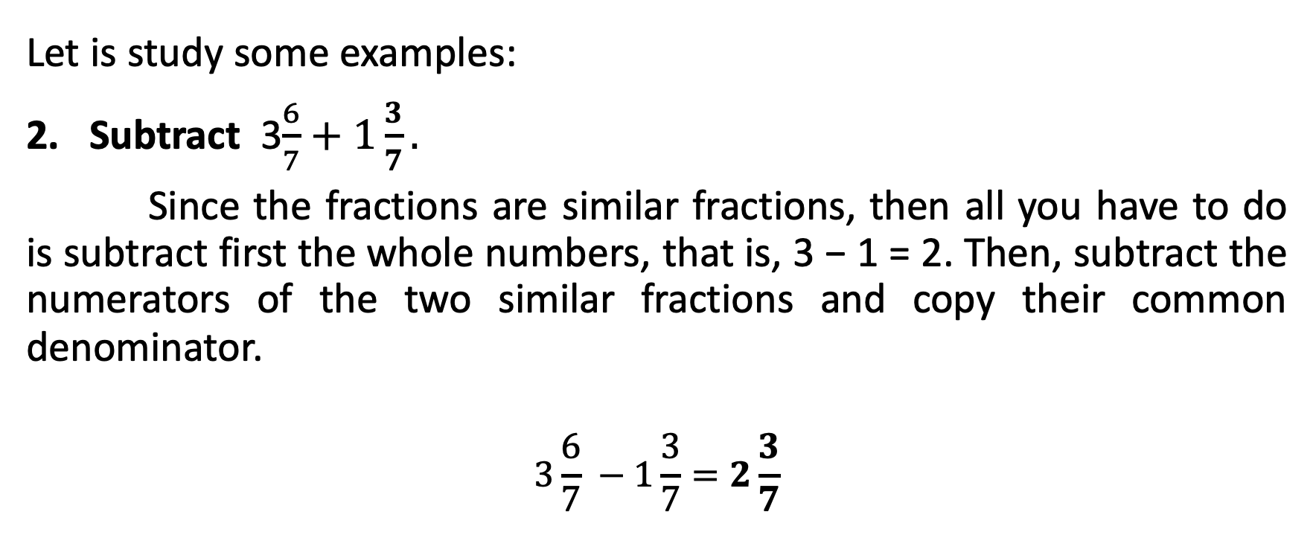
Adding and Subtracting Fractions and Mixed Numbers Without Regrouping
Let is study some examples:
Subtract 3$\frac{6}{7}+1\frac{3}{7}.$
Since the fractions are similar fractions, then all you have to do is subtract first the whole numbers, that is, 3 − 1 = 2. Then, subtract the numerators of the two similar fractions and copy their common denominator.
$$3\frac{6}{7} −1\frac{3}{7}=2\frac{3}{7}$$

Slide 15
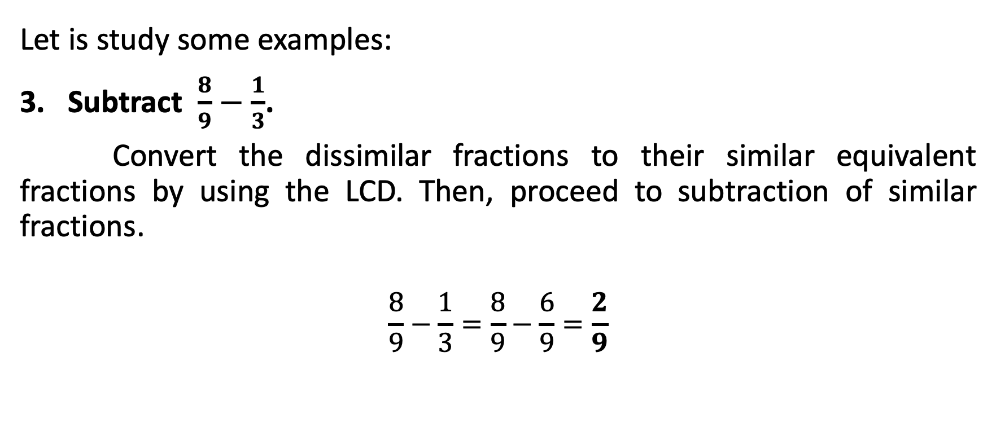
Adding and Subtracting Fractions and Mixed Numbers Without Regrouping
Let is study some examples:
Subtract $\frac{8}{9}−\frac{1}{3}$.
Convert the dissimilar fractions to their similar equivalent fractions by using the LCD. Then, proceed to subtraction of similar fractions.
$$\frac{8}{9}−\frac{1}{3}=\frac{8}{9}−\frac{6}{9}=\frac{2}{9}$$

