Slide 1
Solving Word Problems Involving Addition and Subtraction of Fractions and Mixed Numbers

Slide 2
Solving Word Problems Involving Addition and Subtraction of Fractions and Mixed Numbers
The steps in solving word problems are Understand, Plan, Solve, and Check.
To add or subtract fractions, make sure that they are similar first before continuing with the addition or subtraction. Get the LCD of dissimilar fractions to change them to similar fractions.

Slide 3
Solving Word Problems Involving Addition and Subtraction of Fractions and Mixed Numbers
When the fraction of the mixed number minuend is smaller than the fraction of the subtrahend, change the mixed number to improper fraction and continue with the subtraction.
Always simplify the final answers into their lowest terms.

Slide 4
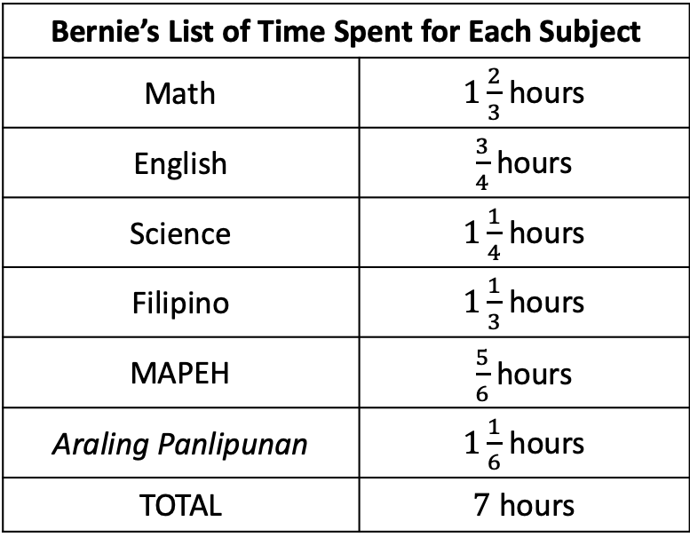
Solving Word Problems Involving Addition and Subtraction of Fractions and Mixed Numbers
How many hours do you regularly spend each day answering a math module? How about the other subjects? Do you spend the same length of time in all your modules? Let’s take a look at Bernie’s list of time spent for each subject today.
Bernie’s List of Time Spent for Each Subject
Math | $1\frac{2}{3}$hours
English | $\frac{3}{4}$hours
Science | $1\frac{1}{4}$hours
Filipino | $1\frac{1}{3}$hours
MAPEH | $\frac{5}{6}$hours
Araling Panlipunan | $1\frac{1}{6}$ hours
TOTAL | $7$hours
Bernie was able to finish all his modules for the day in 7 hours. He spent a different length of time on each subject. You can also do a similar table starting tomorrow so you can monitor your progress while studying.

Slide 5
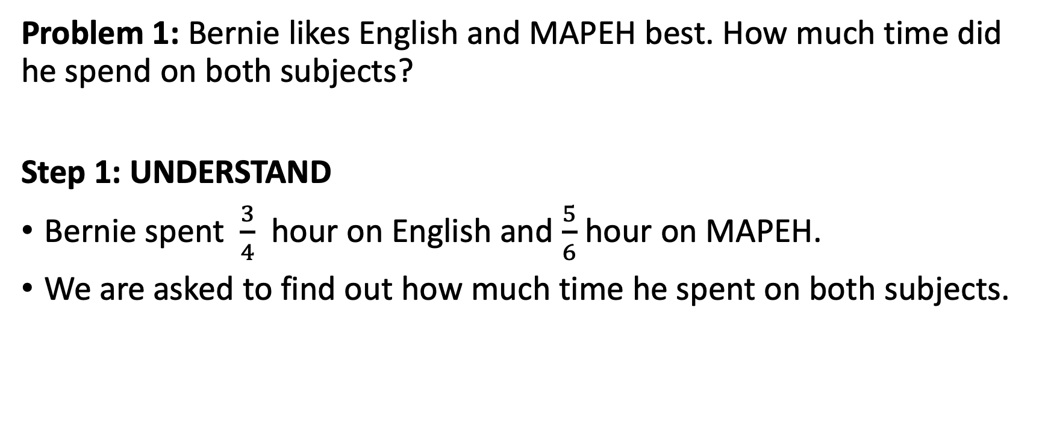
Solving Word Problems Involving Addition and Subtraction of Fractions and Mixed Numbers
Problem 1: Bernie likes English and MAPEH best. How much time did he spend on both subjects?
Step 1: UNDERSTAND
Bernie spent $\frac{3}{4}$ hour on English and $\frac{5}{6}$ hour on MAPEH.
We are asked to find out how much time he spent on both subjects.

Slide 6
Solving Word Problems Involving Addition and Subtraction of Fractions and Mixed Numbers
Problem 1: Bernie likes English and MAPEH best. How much time did he spend on both subjects?
Step 2: PLAN
Because we are asked how much time for both subjects, we will add.
Because the fractions are dissimilar, we need to regroup first. We need to find the LCD before we can continue with the addition.

Slide 7
Solving Word Problems Involving Addition and Subtraction of Fractions and Mixed Numbers
Problem 1: Bernie likes English and MAPEH best. How much time did he spend on both subjects?
Step 3: SOLVE
To get the LCD of 4 and 6, let’s find the LCM of 4 and 6.
2 4 6
2 3
LCM = 2 × 2 × 3 = 12. The LCD is 12. To change the first denominator, we need to multiply 4 by 3 to get 12. To change the second denominator, we need to multiply 6 by 2 to get 12.

Slide 8
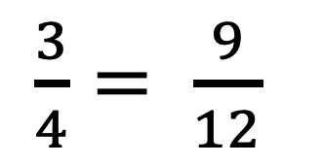
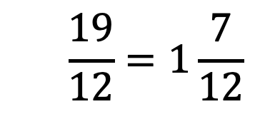
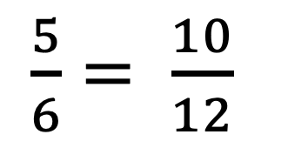
Solving Word Problems Involving Addition and Subtraction of Fractions and Mixed Numbers
Problem 1: Bernie likes English and MAPEH best. How much time did he spend on both subjects?
Step 3: SOLVE
$\frac{3}{4}= \frac{9}{12}$
Now that we have a new denominator (LCD), let’s change the fractions to similar ones. Once done changing the fractions, continue with the addition to get the sum. Always simplify the fractions. If it is an improper fraction, change it to a mixed number with the fraction part in the lowest terms.
+
$\frac{5}{6}= \frac{10}{12}$
________
$$\frac{19}{12}=1\frac{7}{12}$$

Slide 9
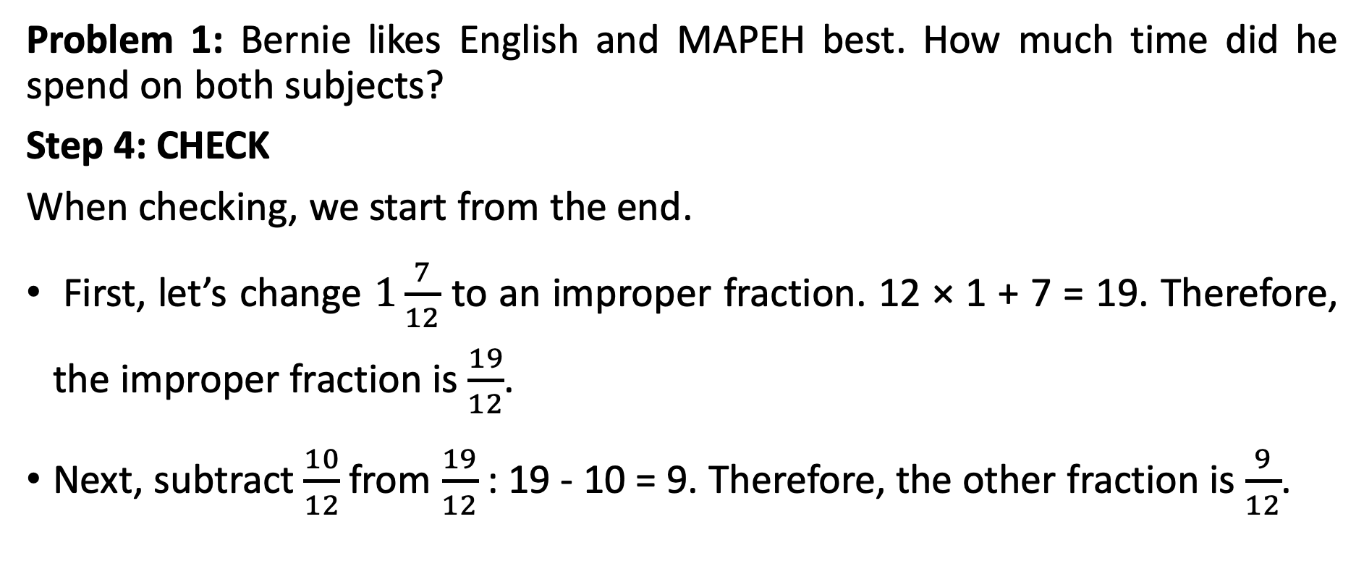
Solving Word Problems Involving Addition and Subtraction of Fractions and Mixed Numbers
Problem 1: Bernie likes English and MAPEH best. How much time did he spend on both subjects?
Step 4: CHECK
When checking, we start from the end.
First, let’s change $1\frac{7}{12}$ to an improper fraction. 12 × 1 + 7 = 19. Therefore, the improper fraction is $\frac{19}{12}$.
Next, subtract $\frac{10}{12}$from $\frac{19}{12}$ : 19 - 10 = 9. Therefore, the other fraction is $\frac{9}{12}$.

Slide 10
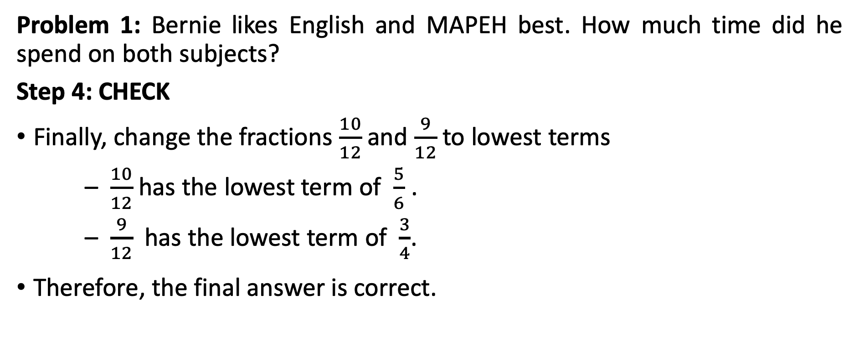
Solving Word Problems Involving Addition and Subtraction of Fractions and Mixed Numbers
Problem 1: Bernie likes English and MAPEH best. How much time did he spend on both subjects?
Step 4: CHECK
Finally, change the fractions $\frac{10}{12}$and $\frac{9}{12}$to lowest terms
– $\frac{10}{12}$ has the lowest term of $\frac{5}{6}$ .
– $\frac{9}{12}$ has the lowest term of $\frac{3}{4}$.
Therefore, the final answer is correct.

Slide 11
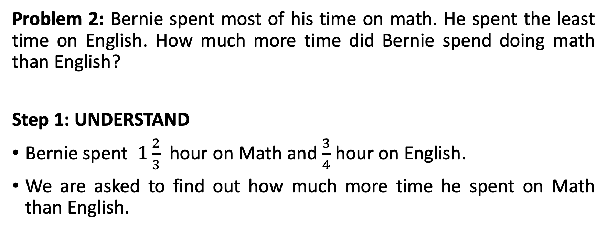
Solving Word Problems Involving Addition and Subtraction of Fractions and Mixed Numbers
Problem 2: Bernie spent most of his time on math. He spent the least time on English. How much more time did Bernie spend doing math than English?
Step 1: UNDERSTAND
Bernie spent $1\frac{2}{3}$ hour on Math and $\frac{3}{4}$hour on English.
We are asked to find out how much more time he spent on Math than English.

Slide 12
Solving Word Problems Involving Addition and Subtraction of Fractions and Mixed Numbers
Problem 2: Bernie spent most of his time on math. He spent the least time on English. How much more time did Bernie spend doing math than English?
Step 2: PLAN
Because we are comparing the time spent between two subjects, we will subtract.
Because the fractions are dissimilar, we need to regroup first. We need to find the LCD before we can continue with addition.

Slide 13
Solving Word Problems Involving Addition and Subtraction of Fractions and Mixed Numbers
Problem 2: Bernie spent most of his time on math. He spent the least time on English. How much more time did Bernie spend doing math than English?
Step 3: SOLVE
To get the LCD of 3 and 4, let’s find the LCM of 3 and 4.
The numbers 3 and 4 are relatively prime numbers. Therefore, the LCM is their product. 3 × 4 = 12. The LCD is 12.

Slide 14
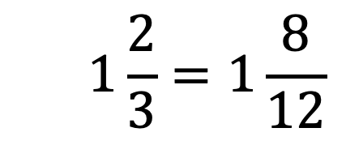
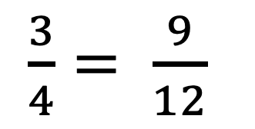
Solving Word Problems Involving Addition and Subtraction of Fractions and Mixed Numbers
Problem 2: Bernie spent most of his time on math. He spent the least time on English. How much more time did Bernie spend doing math than English?
Step 3: SOLVE
$$1\frac{2}{3}=1\frac{8}{12}$$
Now that we have a new denominator (LCD), let’s change the fractions to similar fractions. Once done changing the fractions, continue with the subtraction to get the difference. Always simplify the fractions. If it is an improper fraction, change it to a mixed number with the fraction part in lowest terms.
$\frac{3}{4}= \frac{9}{12}$
________

Slide 15
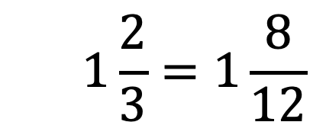
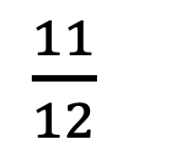
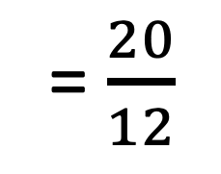
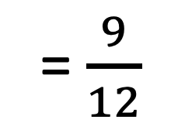
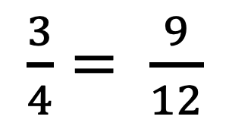
Solving Word Problems Involving Addition and Subtraction of Fractions and Mixed Numbers
Problem 2: Bernie spent most of his time on math. He spent the least time on English. How much more time did Bernie spend doing math than English?
Step 3: SOLVE
$$1\frac{2}{3}=1\frac{8}{12}$$
= $\frac{20}{12}$
Since the fraction of the minuend is smaller than the subtrahend, we need to change the minuend into an improper fraction. Then, continue with the subtraction.
$\frac{3}{4}= \frac{9}{12}$
= $\frac{9}{12}$
________
$\frac{11}{12}$

Slide 16
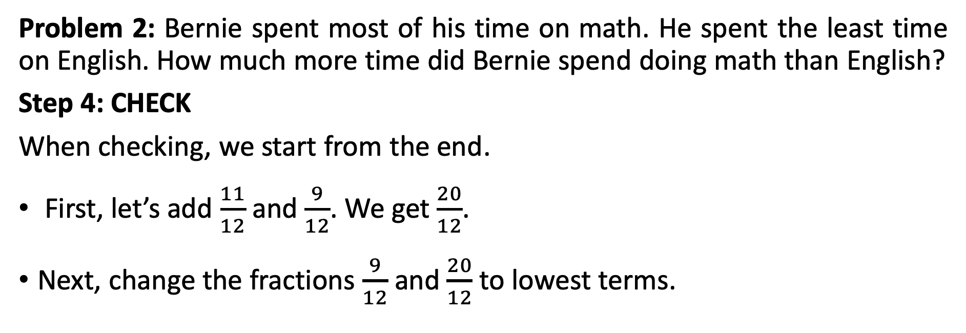
Solving Word Problems Involving Addition and Subtraction of Fractions and Mixed Numbers
Problem 2: Bernie spent most of his time on math. He spent the least time on English. How much more time did Bernie spend doing math than English?
Step 4: CHECK
When checking, we start from the end.
First, let’s add $\frac{11}{12}$ and $\frac{9}{12}$. We get $\frac{20}{12}$.
Next, change the fractions $\frac{9}{12}$and $\frac{20}{12}$ to lowest terms.

Slide 17
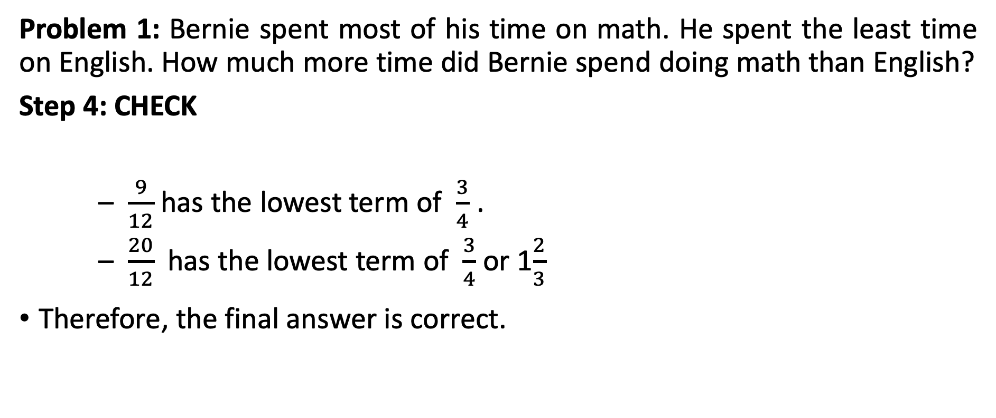
Solving Word Problems Involving Addition and Subtraction of Fractions and Mixed Numbers
Problem 1: Bernie spent most of his time on math. He spent the least time on English. How much more time did Bernie spend doing math than English?
Step 4: CHECK
– $\frac{9}{12}$ has the lowest term of $\frac{3}{4}$ .
– $\frac{20}{12}$ has the lowest term of $\frac{3}{4}$or 1$\frac{2}{3}$
Therefore, the final answer is correct.

