Slide 1
Adding and Subtracting Simple Fractions and Mixed
Numbers Without Regrouping

Slide 2
Adding and Subtracting Simple Fractions and Mixed Numbers Without Regrouping
• To add or subtract similar fractions, add or subtract their numerators and write the result over the common denominator.
• To add or subtract dissimilar fractions,
1. Get the LCD of the fractions. This is exactly the same process as finding the LCM of whole numbers.
2. Convert the fractions to their equivalent fractions using the LCD.
3. Find the sum or difference of the similar equivalent fractions.
• To add or subtract mixed numbers, add or subtract the whole numbers, then add or subtract the fractional parts. If the fractional parts are dissimilar fractions, follow the steps in adding or subtracting dissimilar fractions.
• Remember to reduce the answer to lowest terms.

Slide 3
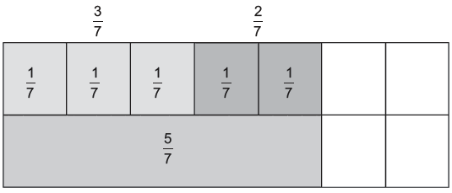
Adding and Subtracting Simple Fractions and Mixed Numbers Without Regrouping
Example #1:
Add 3/7 and 2/7
Solution:
You can use a fraction bar model to visualize the problem.

Slide 4


Adding and Subtracting Simple Fractions and Mixed Numbers Without Regrouping
Cont.
By this visual representation, you get three-sevenths and two-sevenths, which
is equal to five-sevenths. Therefore,
You can see that the two fractions are similar. So, you can use the rule for
adding like or similar fractions. Hence,
Subtracting similar fractions follows the same rules as addition of similar fractions. Study the succeeding illustrative examples.

Slide 5
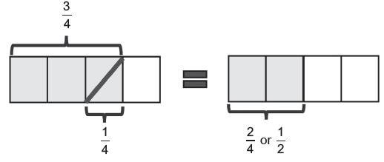

Adding and Subtracting Simple Fractions and Mixed Numbers Without Regrouping
Example 2: Subtract 3/4 and 1/4.
Solution:
You can use the fraction bar model to visualize the problem.
From the visual representation, you have or

Slide 6

Adding and Subtracting Simple Fractions and Mixed Numbers Without Regrouping
Cont.
You can also use the rules in subtracting similar fractions.
1. Get the difference of the numerators.
Subtract 1 from 3.
2. Write the result in #1 over the common denominator.
Write 2 over of 4.
3. Then, simplify the answer by getting the lowest terms.

Slide 7
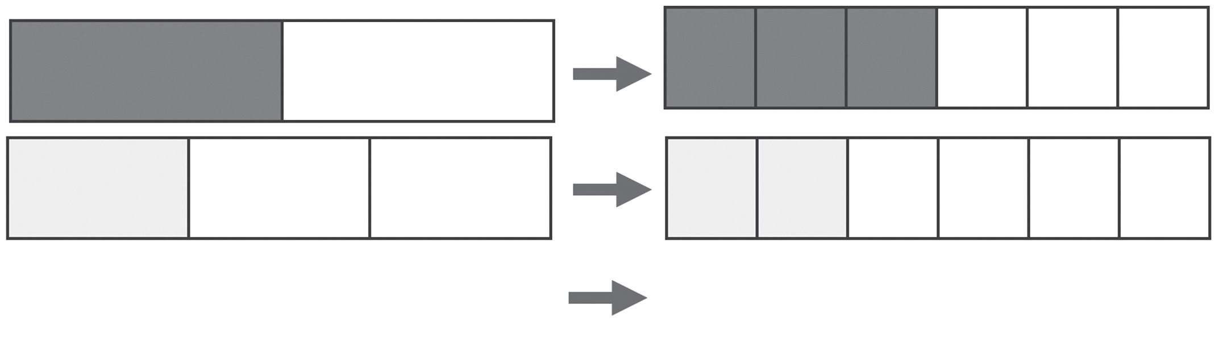




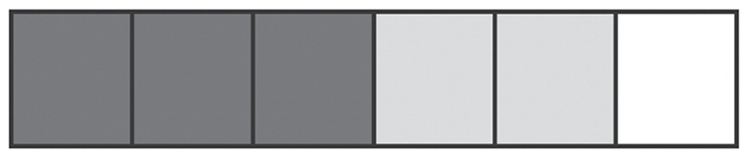
Adding and Subtracting Simple Fractions and Mixed Numbers Without Regrouping
Now, let us explore adding and subtracting dissimilar fractions.
Example 3: 1/2 + 1/3 = N
Solution:
You can use the fraction bar model to visualize the problem. Since the sizes of the bars are not the same, you first need to convert them to similar sizes.
therefore, is equal to the sum, is 5/6.

Slide 8

Adding and Subtracting Simple Fractions and Mixed Numbers Without Regrouping
.Cont.
Another method of adding dissimilar fractions is by using the concepts of equivalent fractions and the least common multiple (LCM). These are the simple steps:
1. Get the LCD of the fractions. This is exactly the same process as finding the LCM of whole numbers.
The LCD of 1/2 and 1/3 is 6.
2. Convert the fractions to their equivalent fractions using the LCD.
The equivalent fractions of 1/2 and 1/3 are 3/6 and 2/6 , respectively.
3. Find the sum of the similar equivalent fractions. Express the answer in the simplest form.
The sum of these two fractions is

Slide 9
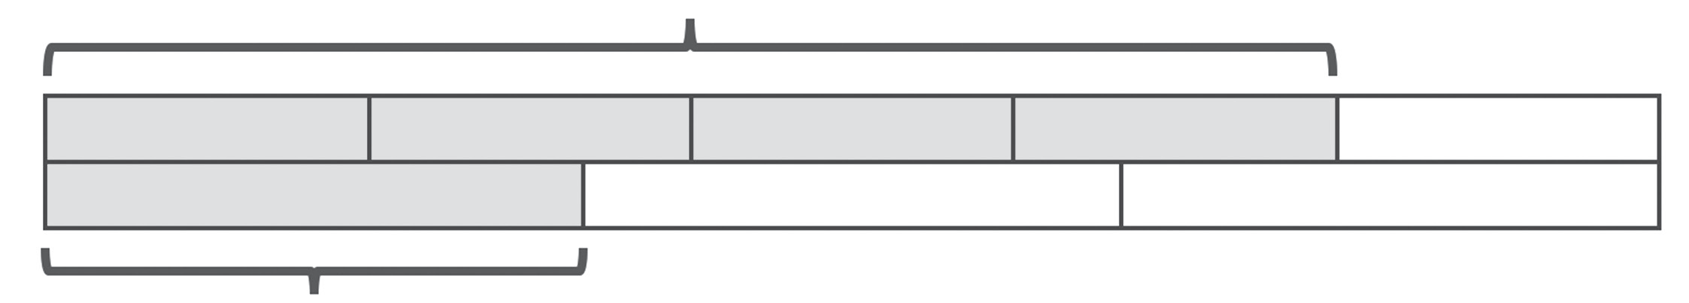

Adding and Subtracting Simple Fractions and Mixed Numbers Without Regrouping
Example 4: Subtract 4/5 and 1/3.
Solution:
You can use the fraction bar model to visualize the problem.
Since the sizes of the bars are not the same, you first need to convert them to similar sizes.
.

Slide 10

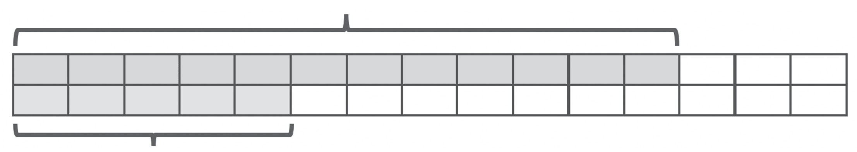


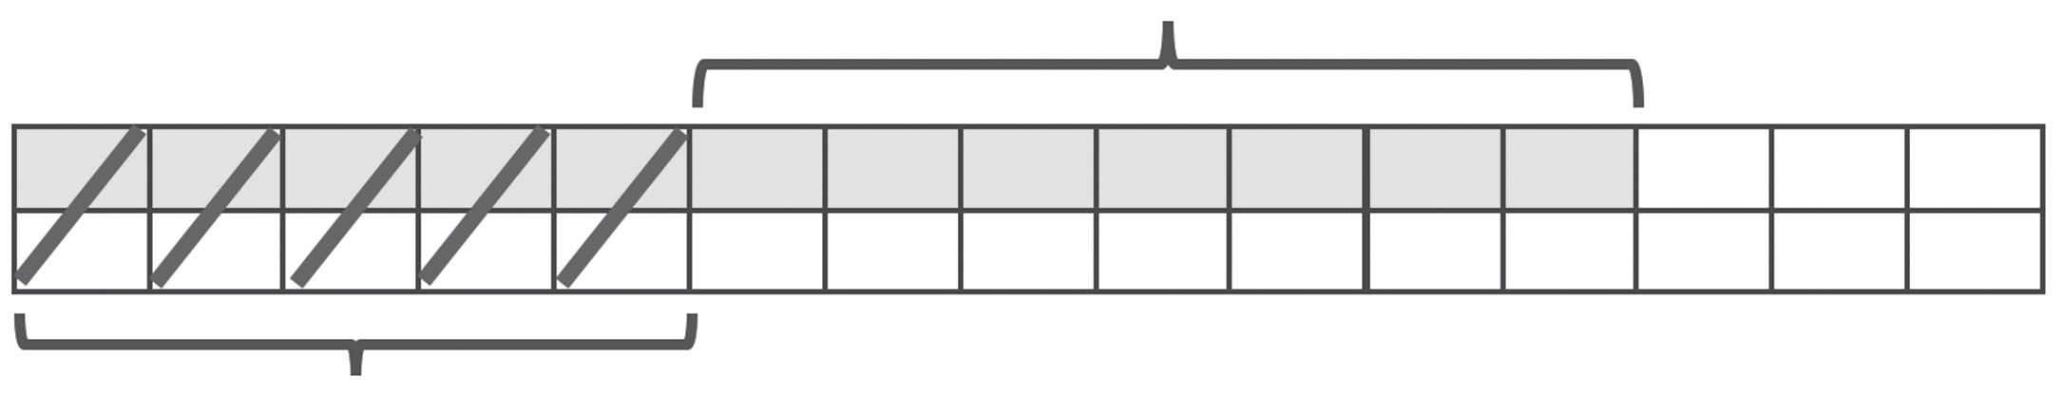

Adding and Subtracting Simple Fractions and Mixed Numbers Without Regrouping
Cont.
Subtracting 5 parts from 12 parts
will result to 7 remaining parts
out of 15 parts.
.

Slide 11
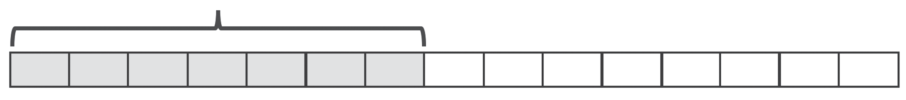

Adding and Subtracting Simple Fractions and Mixed Numbers Without Regrouping
.Cont.
Therefore;

Slide 12

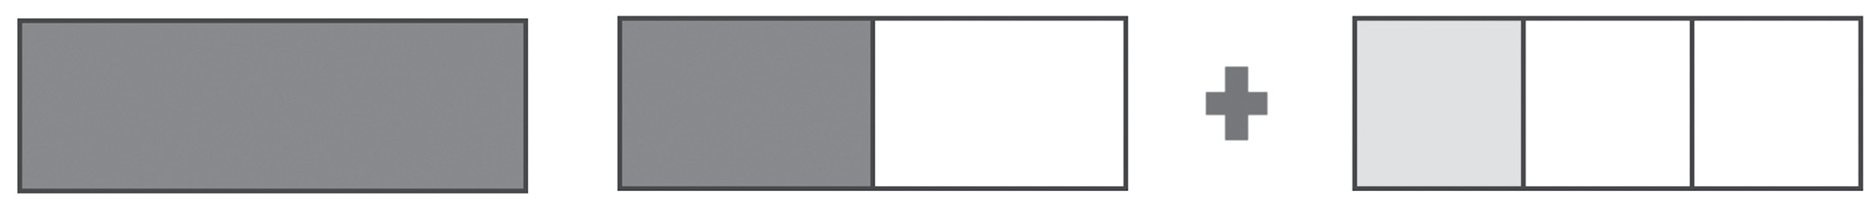


Adding and Subtracting Simple Fractions and Mixed Numbers Without Regrouping
You can also add a mixed number to a fraction or another mixed number. Study the following examples.
Example 5:
Solution:
You can use the fraction bar model to visualize the problem.

Slide 13
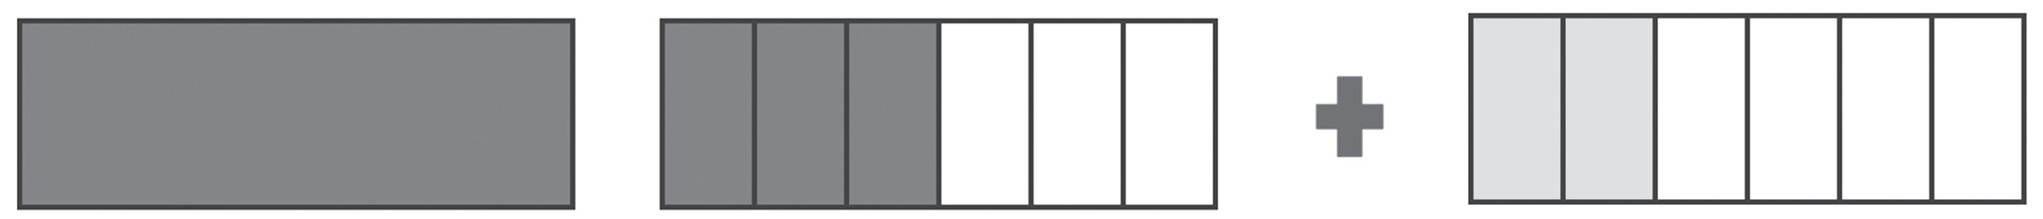


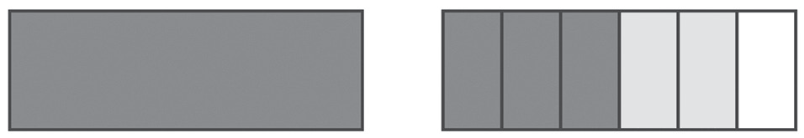

Adding and Subtracting Simple Fractions and Mixed Numbers Without Regrouping
Cont.
The LCD of and is 6. Divide each region into 6 parts.
Therefore is equal to
The sum is

Slide 14



Adding and Subtracting Simple Fractions and Mixed Numbers Without Regrouping
Cont.
You can obtain the sum of mixed numbers by using the concepts of equivalent fractions and LCD. Change the dissimilar fractions to their equivalent similar fractions with the same denominators. In the
example, the equivalent similar fractions
of and are and respectively. Add the whole numbers, then proceed to add the
fractions. Express the answer in the simplest form.
Thus, the sum of these two fractions is

Slide 15

Adding and Subtracting Simple Fractions and Mixed Numbers Without Regrouping
You can also subtract mixed numbers by following the same process, except that the operation is subtraction.
Example 6: Subtract and
Solution:
Using a fraction bar model to visualize the problem, you have:
The LCD of and is 6. Divide each region into 6 parts.

Slide 16

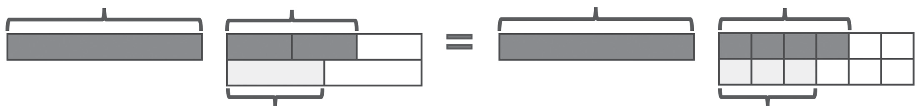


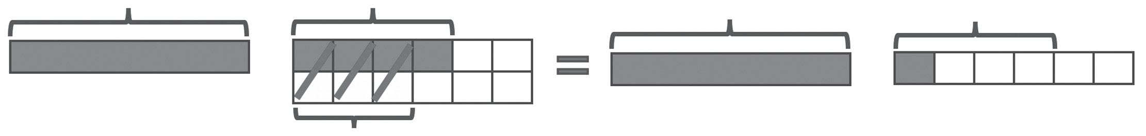

Adding and Subtracting Simple Fractions and Mixed Numbers Without Regrouping
Cont.
Subtract and
Therefore

Slide 17




Adding and Subtracting Simple Fractions and Mixed Numbers Without Regrouping
Example 7: Subtract and
Solution:
Since the fractional parts of the mixed numbers are dissimilar fractions, convert them first to their equivalent similar fractions.
The equivalent fractions of 4/5 and 1/2 are 8/10 and 5/10, respectively.
Subtract the whole numbers, then the fractional parts.
Thus,

