Slide 1
Adding and Subtracting Simple Fractions and Mixed
Numbers With Regrouping

Slide 2
Adding and Subtracting Simple Fractions and Mixed Numbers With Regrouping
• To add or subtract similar fractions with regrouping, add or subtract their numerators and write the result over the denominator.
• To add or subtract dissimilar fractions with regrouping, convert the fractions to their equivalent similar fractions. Then, follow the rules in adding or subtracting similar fractions.
• To add mixed numbers, the whole numbers and the fraction parts are added separately. The answer is the mixed number corresponding to the sum of the whole numbers and the fraction parts.

Slide 3
Adding and Subtracting Simple Fractions and Mixed Numbers With Regrouping
Cont.
• To subtract mixed numbers,
- convert the dissimilar fractions to similar fractions. To do this, get the LCD and use this as the denominator of the equivalent fractions.
- regroup by borrowing from the whole number so that you can subtract the fractions.
• You may change the sum or difference, which is in improper fraction form into a mixed number form.
Remember to express answers in their simplest form.

Slide 4
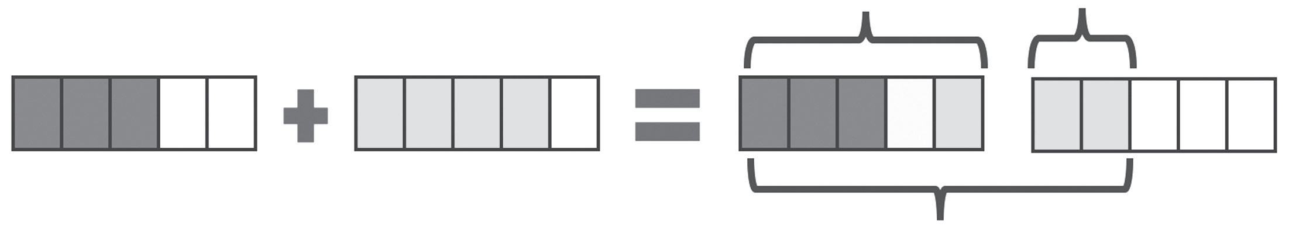

Adding and Subtracting Simple Fractions and Mixed Numbers With Regrouping
Example #1: Solve the given problem.
Mr. Reyes decided to paint his living and dining rooms. He used 3/5 gallon of paint in the living room and 4/5 gallon of paint in the dining room. How many gallons of paint did he use?
To solve the problem, you can use the model method.

Slide 5


Adding and Subtracting Simple Fractions and Mixed Numbers With Regrouping
Cont.
Remember that when adding similar fractions, just add the numerators and write the sum over the denominator. If the sum is an improper fraction, then you may change it to a mixed number. Express the fraction part of the mixed number in its simplest form. You can see that the two fractions are similar. So, you can use the rules for adding similar fractions.
Hence,
Since the answer is an improper fraction, you may express it as a mixed number. To do this, divide the numerator by the denominator. Then, take the quotient as the whole number part and the remainder as the numerator of the fraction part.
Therefore, the final answer is

Slide 6
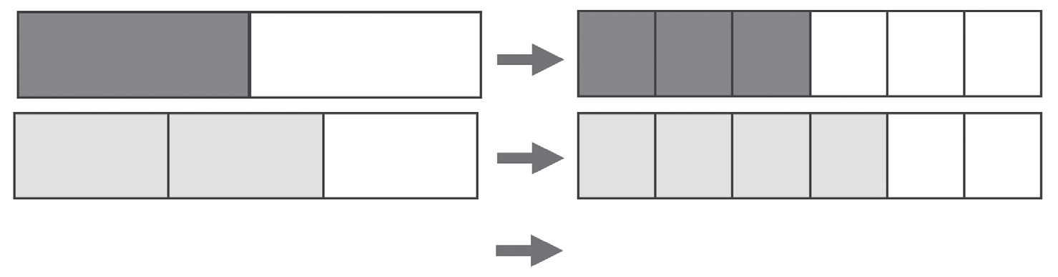


Adding and Subtracting Simple Fractions and Mixed Numbers With Regrouping
You can also add dissimilar fractions. Convert the dissimilar fractions to similar fractions. Then, follow the rules in adding similar fractions.
Example 2: Solve for the sum of 1/2 and 2/3.
Solution:
The LCD of 1/2 and 2/3 is 6. Divide each region into 6 parts.
.

Slide 7
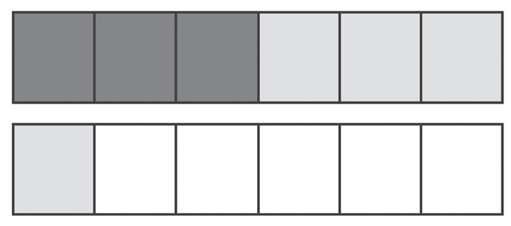



Adding and Subtracting Simple Fractions and Mixed Numbers With Regrouping
Cont.
Hence, is equal to the sum is 7/6.
You may express 7/6 in its mixed number form, which is
Remember that the two given fractions are dissimilar. So, you need to change them to their equivalent similar fractions.
Hence . Therefore, the sum of two fractions is 7/6 or
.

Slide 8

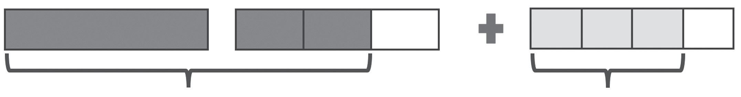


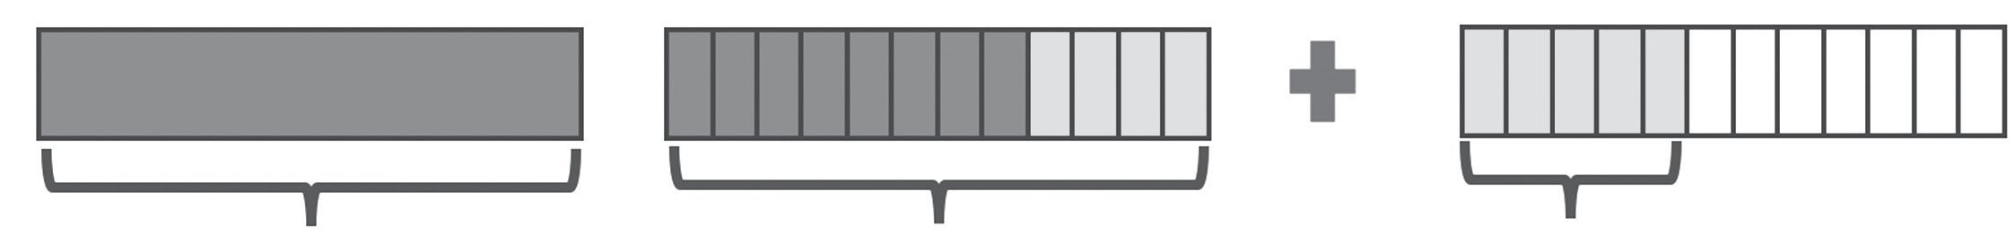


Adding and Subtracting Simple Fractions and Mixed Numbers With Regrouping
You can also add a mixed number to a fraction or another mixed number.
Example 3:
The LCD of and . Is 12. Divide each region into 12 parts.

Slide 9









Adding and Subtracting Simple Fractions and Mixed Numbers With Regrouping
Cont.
Hence is equal to the sum is or or
You can observe that or
Therefore, the sum of and is
Now that you learned how to add fractions with regrouping, it is time to learn about subtracting fractions with regrouping. You can subtract fractions using the same process as addition of fractions, except that the operation is subtraction.

Slide 10


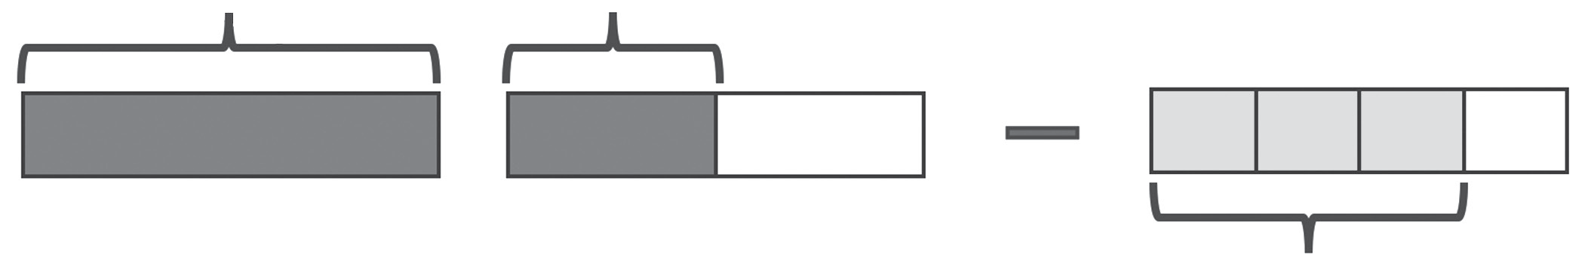

Adding and Subtracting Simple Fractions and Mixed Numbers With Regrouping
Example #4: Find the difference when 3/4 is subtracted from
Solution:
Convert the dissimilar fractions to similar fractions. To do this, get the LCD and use this as the denominator of the equivalent fractions of 1/2 and 3/4
. The LCD of 4 and 2 is 4, and the equivalent fractions are 2/4 and 3/4 , respectively.

Slide 11


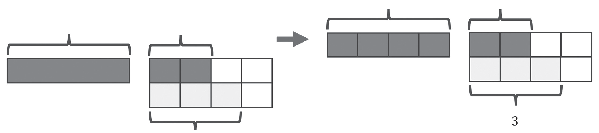
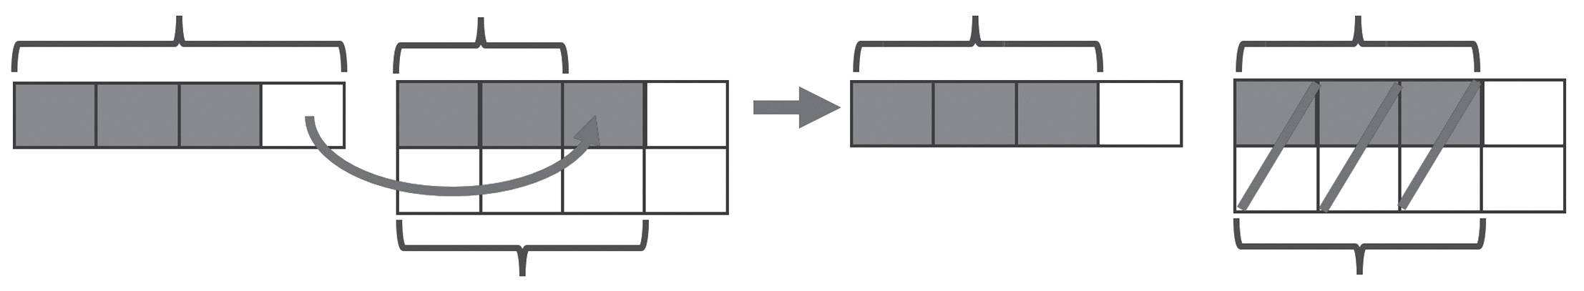
Adding and Subtracting Simple Fractions and Mixed Numbers With Regrouping
Cont.

Slide 12

Adding and Subtracting Simple Fractions and Mixed Numbers With Regrouping
Cont.
The bar model illustrates how regrouping can help facilitate subtraction when the fractional part of the subtrahend is greater than the fractional part of the minuend. You need to borrow 1 part from 4/4 to be able to subtract the fractions.
So, we will have
The final answer is 3/4.

Slide 13

Adding and Subtracting Simple Fractions and Mixed Numbers With Regrouping
Example 5:
Solution:
Convert the dissimilar fractions to similar fractions. To do this, get the LCD and use this as the denominator of the equivalent fractions of 2/3 and 3/4. The LCD of 3 and 4 is 12, and the equivalent fractions are 8/12 and 9/12 , respectively.
Observe that the fraction part of the subtrahend is greater than the fraction part of the minuend. With this, you need to regroup by borrowing from the whole number so that you can subtract the fractions.
.

Slide 14
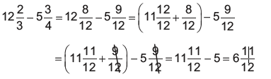

Adding and Subtracting Simple Fractions and Mixed Numbers With Regrouping
Cont. .
.
Thus,

