Slide 1
Pagkakatatag ng
Kongreso ng Malolos

Slide 2
Pagkakatatag ng Kongreso ng Malolos
Noong ika-15 ng Setyembre 1898, pinasinayaan ang Kongreso ng Malolos. Ang mga kinatawan ay binubuo ng 85 na mga mamamayang nabibilang sa may mataas na pinag-aralan, matalino, at mayroong kaya sa buhay. Sila ay nagpulong sa Simbahan ng Barasoain sa Malolos, Bulacan.
Sa pamumuno ni Felipe G. Calderon, ang mga kinatawan ng kongreso ay naghanda ng Saligang Batas. Ang Saligang Batas ng Malolos ay nagtadhana ng isang pamahalaang demokratiko.
Itinatag ng konstitusyon ang isang malayang Republika ng Pilipinas. Ang itinatag na Republika ng Pilipinas ay binubuo ng tatlong sangay kung saan magkakahiwalay ang kapangyarihan ng mga ito: ang tagapagpaganap o ehekutibo, tagapagbatas o lehislatibo, at hudikatura.

Slide 3
Pagkakatatag ng Kongreso ng Malolos
Pinaghiwalay nito ang tungkulin ng simbahan sa tungkulin ng estado. Ang mga karapatan ng tao at ang kapangyarihan at tungkulin ng mga opisyal ng pamahalaan ay nakasulat din dito. May kalayaan ang mga mamamayan sa pagpili ng kanilang relihiyon. Ang kapangyarihan sa paggawa ng batas ay nakaatang sa asamblea at ang mga kasapi nito ay inihalal ng mga tao. Ang pangulo ang tumatayong tagapagpaganap kasama ang pitong kalihim. Ang mga kalihim ay hinirang ng pangulo at ang mga ito ay mananagot sa Kongreso.

Slide 4
Mga Nagawa ng Kongreso ng Malolos
1. Pagpapatibay ng kalayaan ng Pilipinas
2. Paggawa ng Saligang Batas
3. Pagpapahintulot ng pag-utang ng ₱20,000,000.00 para sa pamahalaan
4. Pagtatatag ng Unibersidad Literaria de Filipinas (Library University of the Philippines)

Slide 5
Saligang Batas ng Malolos 1899
Sipi ng ilang bahagi ng Saligang Batas na binuo ng Kongreso ng Malolos:
The 1899 Malolos Constitution
We, the Representatives of the Filipino People, legally convened to establish justice, provide for the common defense, promote the general welfare, and ensure the blessings of liberty, imploring the aid of the the Sovereign Lawgiver of the Universe in order to obtain these of objectives, have voted, decreed, and approved the following:
Political Constitution
Title I – On the Republic
Article 1 – The political association of all Filipinos constitutes a Nation, whose State shall be named the Philippine Republic.
Article 2 – The Philippine Republic is free and independent.
Article 3 – Sovereignty resides exclusively in the people.

Slide 6
Saligang Batas ng Malolos 1899
Title II - On the Government
Article 4 – The Government of the Republic is popular, representative, alternative and responsible, and shall be divided among three distinct powers, which shall be named legislative, executive, and judicial. Never can two or more of these powers be given to a person or corporation, nor shall the power of the legislative be vested in any single individual.
Title III – On Religion
Article 5 – The State recognizes the freedom and equality of all beliefs, as well as the separation of Church and State.
Title IV – On the Filipinos and Their National and Individual Rights
Article 6 – The following are Filipinos:
1. All persons born in Philippine territory. Any sea vessel where the Philippine flag is flown is considered, for this purpose, a part of Philippine territory.

Slide 7
Saligang Batas ng Malolos 1899
2. Children of a Filipino father or mother, even though they were born outside the Philippines.
3. Foreigners who have obtained the certificate of naturalization.
4. Those who, without such certificate, have acquired domicile in any town within Philippine territory.
It is understood that domicile is acquired through an uninterrupted residence of two years in a locality within Philippine territory, keeping an open house and having a known occupation, and paying all the taxes imposed by the Nation. Philippine citizenship is lost in accordance to the laws.
Article 7 – No Filipino or foreigner can be detained or imprisoned except by virtue of a crime and in accordance to the laws.
Article 8 – Any detainee shall either be set free, or be given to judicial authority within the next twenty-four hours following the act of detention.
Any detention shall either be rendered without effect, or be raised to imprisonment within seventy-two hours of the detainee being handed over to a competent court.

Slide 8
Saligang Batas ng Malolos 1899
The interested party shall be duly notified within the same period of whatever decision
Article 9 – No Filipino can be imprisoned except by virtue of a warrant issued by a competent court.
The order through which the warrant has been pronounced shall be ratified or revised, after having heard the accused, within seventy-two hours following the act of imprisonment.
Article 10 – Nobody can enter the place of residence of any Filipino or foreign resident in the Philippines without his consent, except in urgent cases of fire, flood, earthquake or any similar danger, or of unlawful aggression coming from within, or in order to help any person who therein asks for help.
Other than these cases, entry into the place of residence of any Filipino or foreign resident in the Philippines, and searching his papers or effects can be ordered only by a competent court and be executed only in daytime.

Slide 9
Saligang Batas ng Malolos 1899
The search of papers and effects shall always be made in the presence of the person concerned or any member of his family and, in their absence, of two witnesses from the same neighborhood. However, should a delinquent caught in fraganti and pursued by the authorities through their agents take refuge in his place of residence, these agents can enter therein for the sole purpose of carrying out the arrest. Should the delinquent seek refuge in another person’s house, permission must be first obtained from its owner.
(Approved by the Malolos Congress on November 29, 1898… approved by President Aguinaldo on December 23, 1898; formally adopted by the Malolos Congress on January 20, 1899.)
Pinagkunan: http://www.officialgazette.gov.ph/constitutions/the-1899-malolos-constitution/
Puntahan ang website na ito upang masuri nang mabuti ang Saligang Batas ng Malolos.

Slide 10
Ang Republika ng Malolos
Pinasinayaan ang Unang Republika ng Pilipinas, na mas kilala bilang Republika ng Malolos, noong Enero 23, 1899.
Si Heneral Emilio Aguinaldo ang nahalal na unang pangulo nito. Naging mga kalihim ng gabinete ni Heneral Aguinaldo sina Apolinario Mabini (Panlabas), Teodoro Sandiko (Panloob), Gracio Gonzaga (Kawanggawa), Mariano Trias (Pananalapi), at Baldomero Aguinaldo (Pandigma).
Nakaayon ang Republika ng Malolos sa republikanong sistema ng pamahalaan na may tatlong sangay—ang ehekutibo, lehislatura, at hudikatura—na may pantay-pantay na kapangyarihan.
Sa kasamaang palad, ang Unang Republika na itinatag ng mga Pilipino ay hindi kinilala ng mga Amerikano.

Slide 11
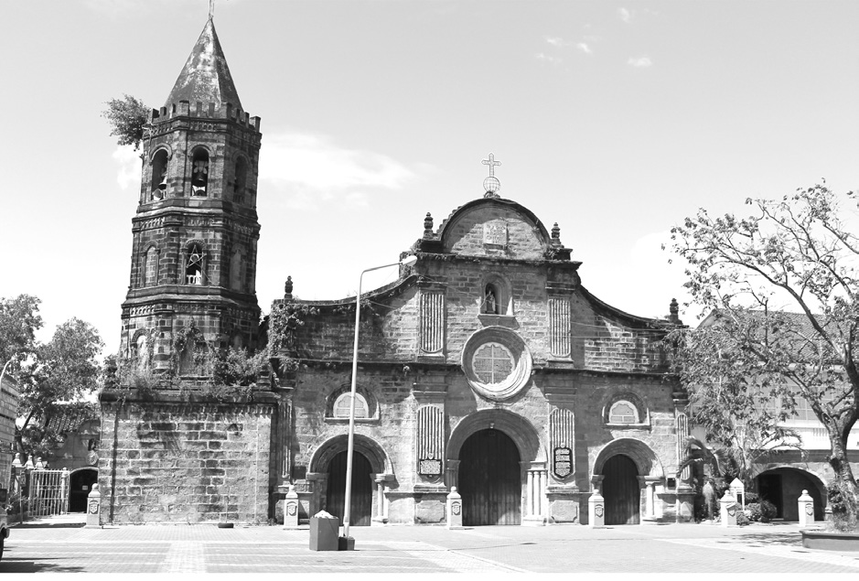
Ang Republika ng Malolos
Bahagi ng inaugural address ni Pangulong Aguinaldo noong Enero 23, 1899:
Honorable Representatives:
I congratulate you upon having concluded your constitutional work. From this date, the Philippines will have a National Code to the just and wise precepts of which we, each and every one of us, owe blind obedience, and whose liberal and democratic guarantees also extend to all.
Hereafter, the Philippines will have a fundamental law, which will unite our people with the other nations by the strongest of solidarities; that is the solidarity of justice, of law, and of right, eternal truths, which are the basis of human dignity.
Aerous, CC BY-SA 3.0 via Wikimedia Commons
Barasoain Church sa Malolos, Bulacan
Pinagkunan: http://www.gov.ph/1899/01/23/inaugural-address-of-president-aguinaldojanuary-23-1899

Slide 12
Ang Republika ng Malolos
I congratulate myself also on seeing my constant efforts crowned; efforts which I continued from the time I entered the battlefield with my brave countrymen of Cavite, as did our brothers in other provinces with no arms, but bolos, to secure our liberty and independence.
And finally, I congratulate our beloved people, who from this date will cease to be anonymous and will be able with legitimate pride to proclaim to the universe the long coveted name of the PhilippineRepublic...
Pinagkunan: http://www.gov.ph/1899/01/23/inaugural-address-of-president-aguinaldojanuary-23-1899

Slide 13
Pagsasanay
I. Panuto: Sagutin ang mga tanong batay sa iyong natutuhan.
1. Sa iyong palagay, ano ang nais ipahiwatig ni Pangulong Aguinaldo sa kaniyang inaugural address?
2. Bakit mahalaga ang Saligang Batas ng Malolos?

Slide 14
Mga Gabay na Kasagutan
Pagkakaroon ng sariling konstitusyon at republika ng Pilipinas at ang tuluyang paglaya ng mga Pilipino sa mga mananakop
Pinaghiwalay nito ang tungkulin ng simbahan sa tungkulin ng estado. Ang mga karapatan ng tao at ang kapangyarihan at tungkulin ng mga opisyal ng pamahalaan ay nakasulat din dito. May kalayaan ang mga mamamayan sa pagpili ng kanilang relihiyon.

