Slide 1
Comparing Things: Length

Slide 2
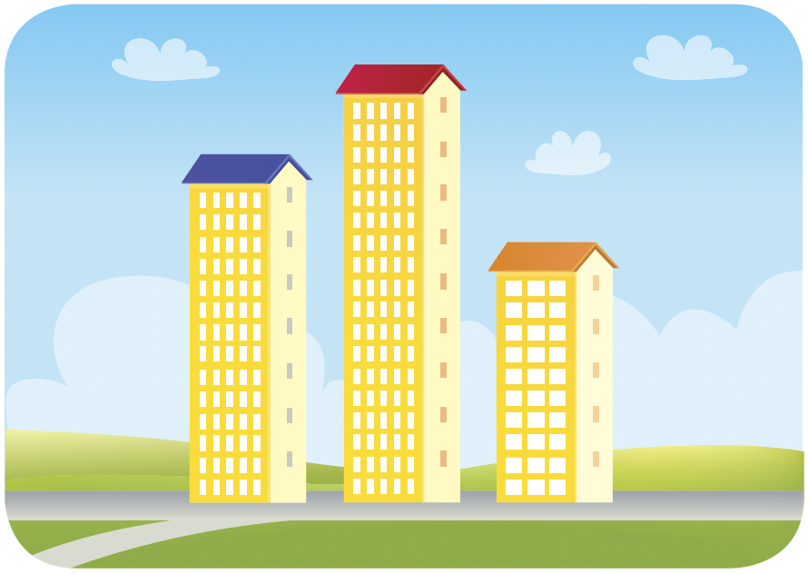
We can only use tallest or shortest when comparing 3 or more things.
The block with the red roof is tall.
It is taller than the block with the blue roof and the block with the orange roof.
The block with the red roof is the tallest.
The block with the orange roof is short.
It is shorter than the block with the blue roof and the block with the red roof.
The block with the orange roof is the shortest.

Slide 3
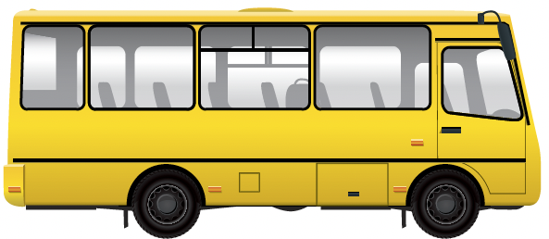
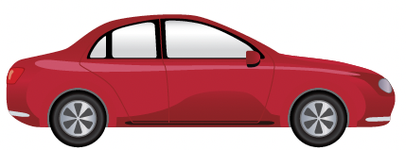

bus
car
Habal-habal
The bus is long.
The bus is longer than the car and the habal-habal.
The bus is the longest.
The habal-habal is short.
The habal-habal is shorter than the bus and the car.
The habal-habal is the shortest.

Slide 4
