Slide 1
Finding the Length of Things

Slide 2
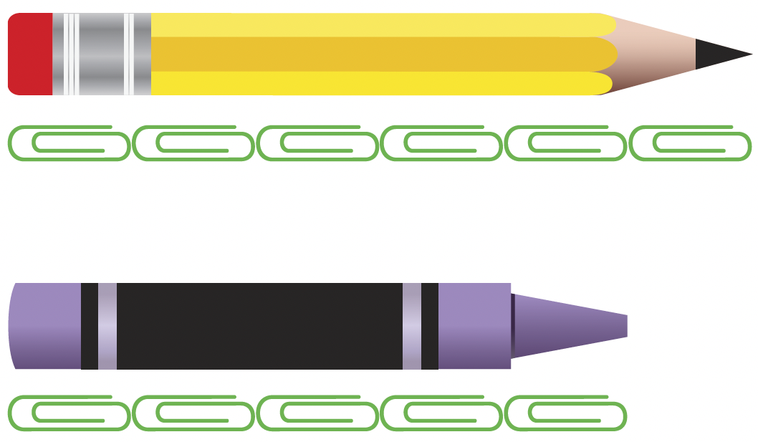

We can use things around us to measure lengths.
Each thing we use stands for 1 unit.
The pencil is about 6 long.
The crayon is about 5 long.
1 stands for 1 unit.
We can say the length of the pencil is about 6 units.
We can also say the length of the crayon is about 5 units.
So, the pencil is longer than the crayon.

Slide 3
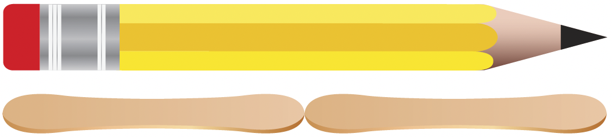

We can also
use other things to measure lengths.
The pencil is about 2 long.
1 stands for 1 unit.
The length of the pencil is about 2 units.

Slide 4
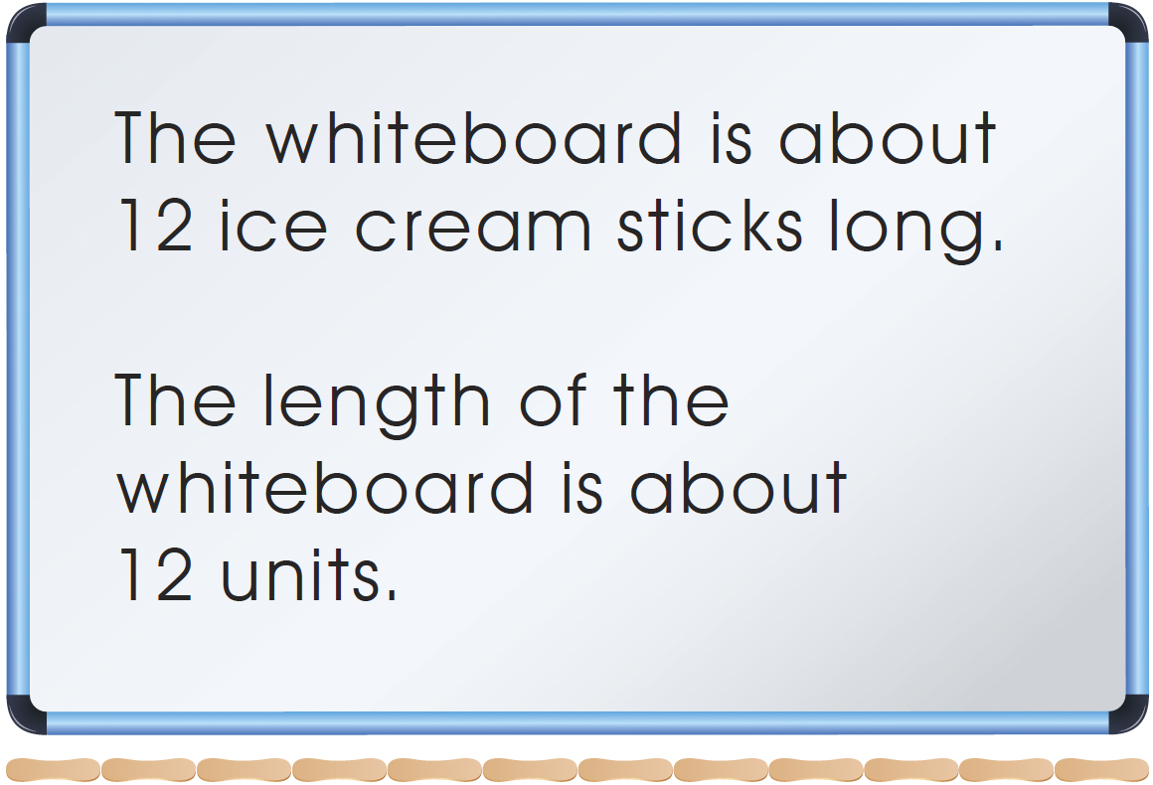
What other things can we use to measure lengths?

