Slide 1
Subtraction Within 1000

Slide 2
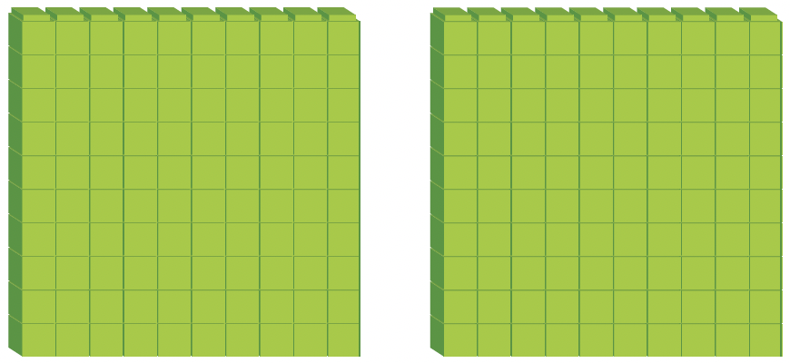
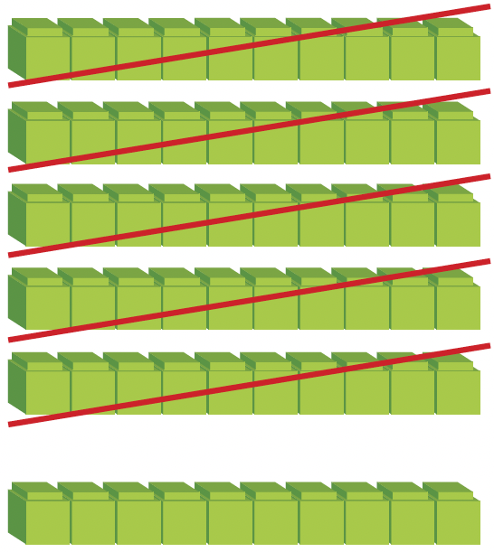
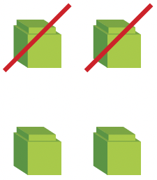
264 –52 = ?
Show 264 with base-ten blocks.
Hundreds (H) | Tens (T) | Ones (O)

Slide 3
H T O
Step 1
Subtract the ones.
4 ones – 2 ones
= 2 ones
2 6 4
–
5 2
2 1 2
Step 2
Subtract the tens.
6 tens – 5 tens
= 1 ten
Step 3
Subtract the hundreds.
2 hundreds – 0 hundreds
= 2 hundreds

Slide 4
264 = 2 hundreds 6 tens 4 ones
52 = 5 tens 2 ones
264 – 52 = 2 hundreds 6 tens 4 ones – 5 tens 2 ones
= 2 hundreds 1 ten 2 ones
= 212

Slide 5
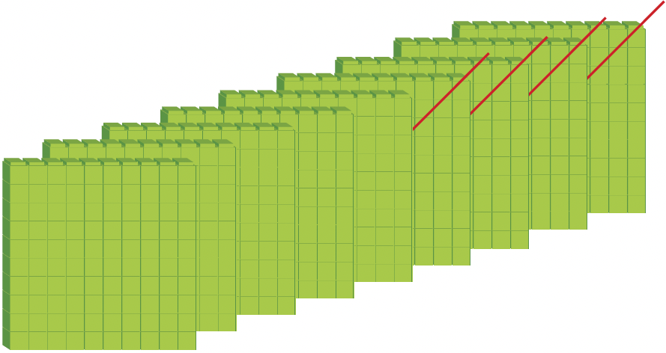
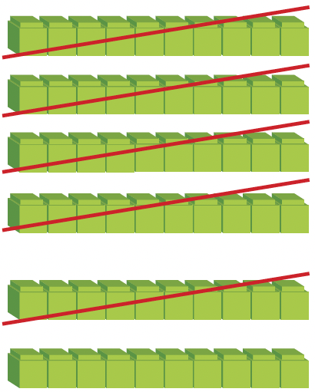
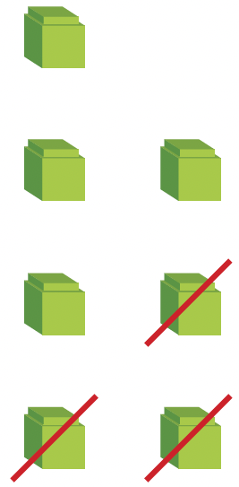
976 –453 = ?
Show 967 using base-ten blocks.
Hundreds (H) | Tens (T) | Ones (O)

Slide 6
H T O
Step 1
Subtract the ones.
7 ones – 3 ones
= 4 ones
9 6 7
–
4 5 3
5 1 4
Step 2
Subtract the tens.
6 tens – 5 tens
= 1 ten
Step 3
Subtract the hundreds.
9 hundreds – 4 hundreds
= 5 hundreds

Slide 7
967 = 9 hundreds 6 tens 7 ones
453 = 4 hundreds 5 tens 3 ones
967 – 453 = 9 hundreds 6 tens 7 ones – 4 hundreds 5 tens 3 ones
= 5 hundreds 1 ten 4 ones
= 514

