Slide 1
More Subtraction Within 1000

Slide 2
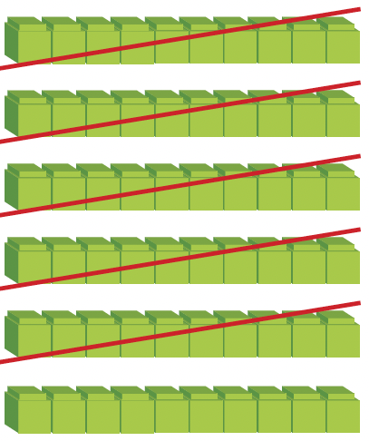
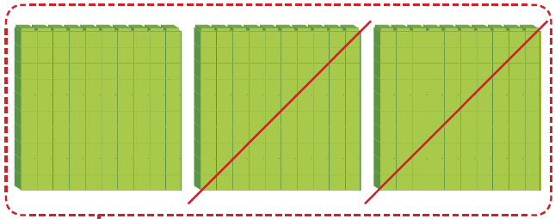
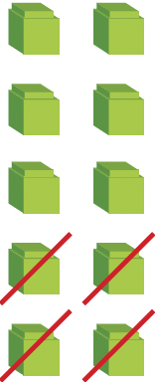


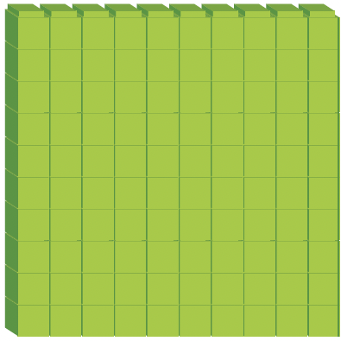
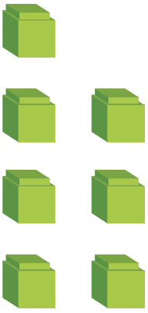

Show 371 using base-ten blocks.
371 – 254 = ?
Hundreds (H) | Tens (T) | Ones (O)

Slide 3
H T O
Step 1
Regroup 1 ten as 10 ones.
Subtract the ones.
11 ones – 4 ones
= 10 ones – 4 ones + 1 one
= 7 ones
6
11
3 7 1
–
2 5 4
1 1 7
Step 2
Subtract the tens.
6 tens – 5 tens
= 1 ten
Step 3
Subtract the hundreds.
2 hundreds – 0 hundreds
= 2 hundreds

Slide 4
371 = 3 hundreds 7 tens 1 one
254 = 2 hundreds 5 tens 4 ones
371 – 254 = 3 hundreds 7 tens 1 one – 2 hundreds 5 tens 4 ones
= 3 hundreds 6 tens 11 ones
– 2 hundreds 5 tens 4 ones
= 1 hundred 1 ten 7 ones

Slide 5
459 – 178 = ?
Show 459 using base-ten blocks.

Slide 6
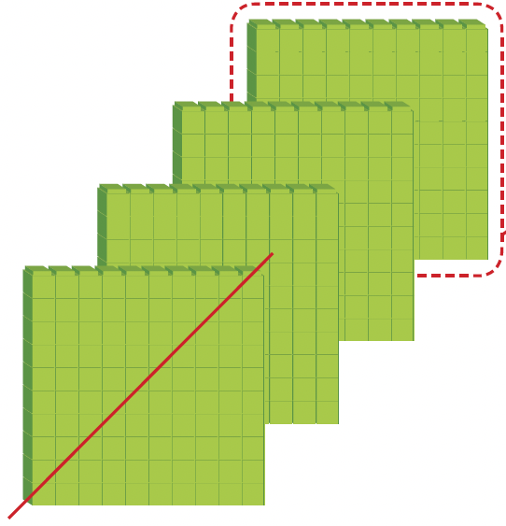
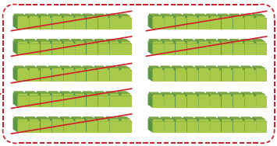
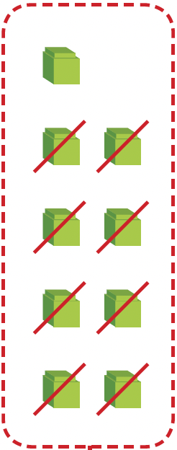
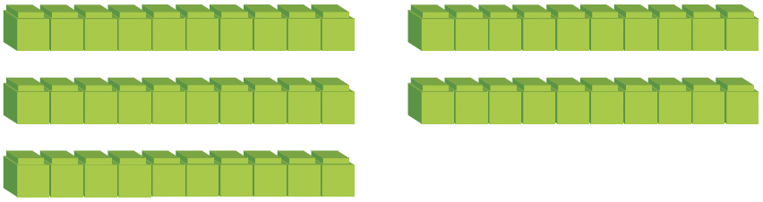
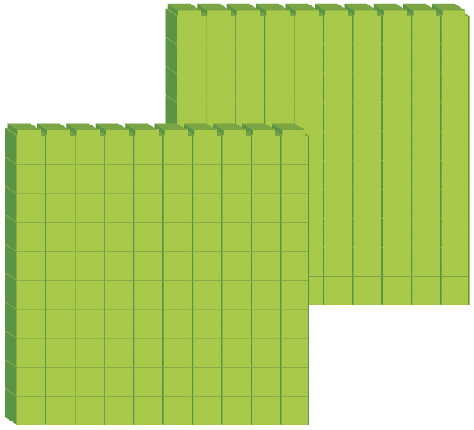
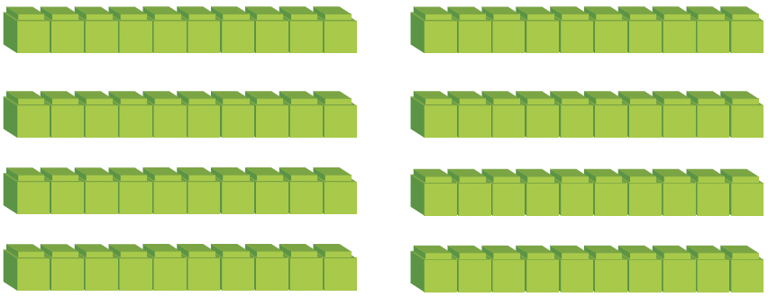

Hundreds (H) | Tens (T) | Ones (O)
Regroup 1 hundred as 10 tens.

Slide 7
H T O
Step 1
Subtract the ones.
9 ones – 8 ones
= 1 one
3
15
4 5 9
–
1 7 8
2 8 1
Step 2
Regroup 1 hundred as 10 tens.
Subtract the tens.
5 tens + 10 tens – 7 tens
= 8 tens
Step 3
Subtract the hundreds.
4 hundreds – 1 hundred
– 1 hundred
= 2 hundreds

Slide 8
459 = 4 hundreds 5 tens 9 ones
178 = 1 hundred 7 tens 8 ones
459 – 178 = 4 hundreds 5 tens 9 ones – 1 hundred 7 tens 8 ones
= 3 hundreds 15 tens 9 ones – 1 hundred 7 tens 8 ones
= 1 hundred 8 tens 1 one
= 281

Slide 9
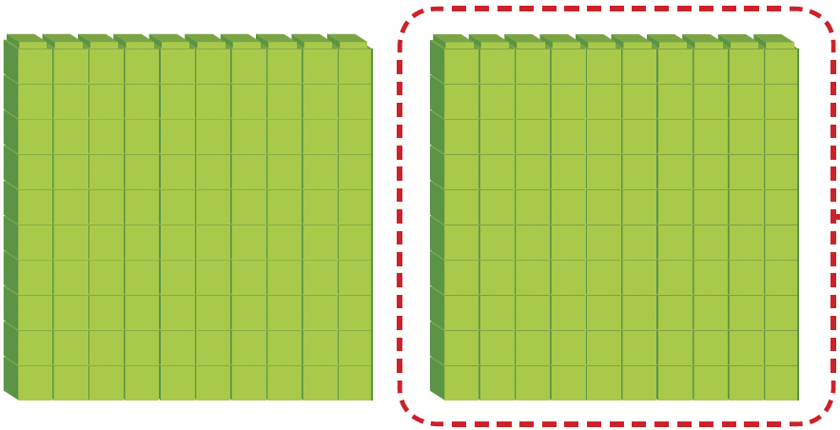
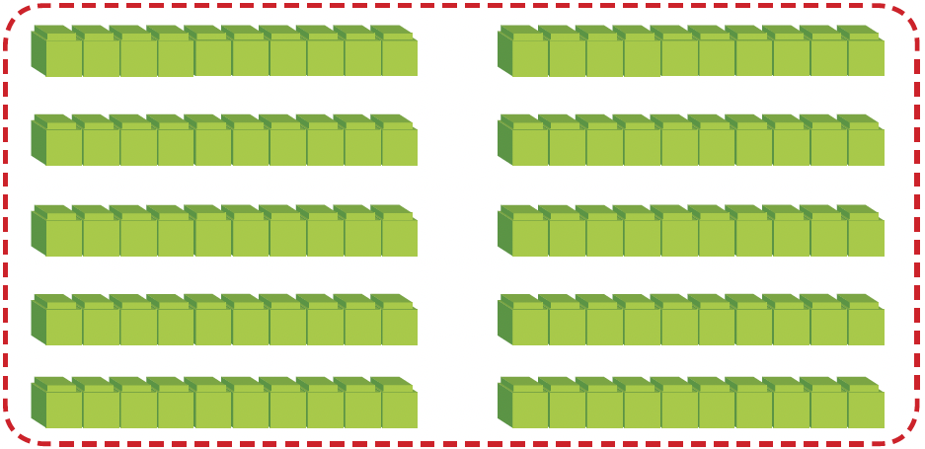
200 – 156 = ?
Show 459 using base-ten blocks.
Regroup 1 hundred as 10 tens.
Hundreds (H) | Tens (T) | Ones (O)

Slide 10
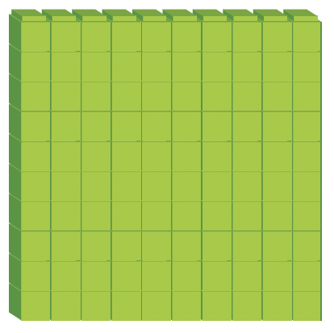
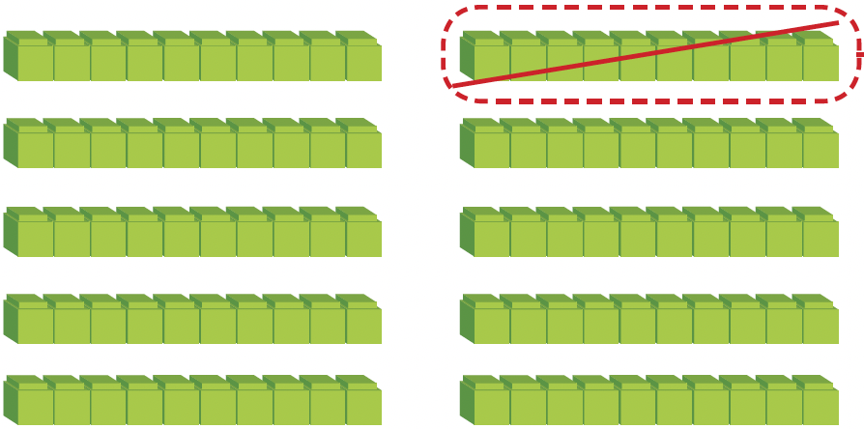
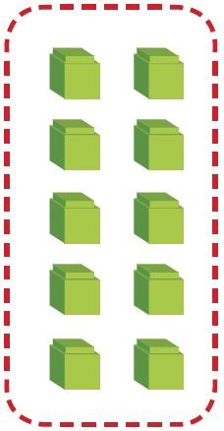
Regroup 1 ten
as 10 ones.
Hundreds (H) | Tens (T) | Ones (O)
2 hundreds is regrouped as 1 hundred 9 tens 10 ones.

Slide 11
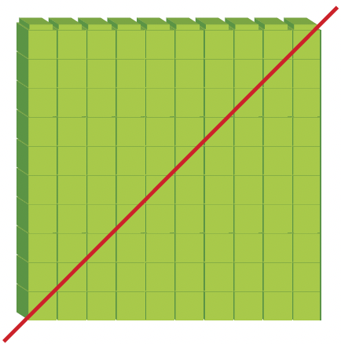
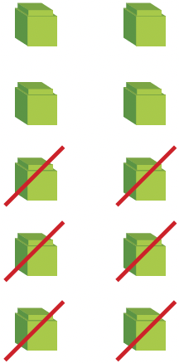
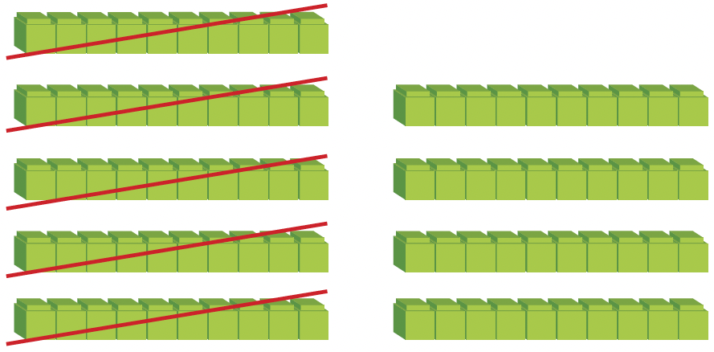
Hundreds (H) | Tens (T) | Ones (O)

Slide 12
Step 1
Regroup 2 hundreds as
1 hundred 9 tens 10 ones.
Subtract the ones.
10 ones – 6 ones
= 4 ones
H T O
1
9
10
2 0 0
–
1 5 6
0 4 4
Step 2
Subtract the tens.
9 tens – 5 tens
= 4 tens
Step 3
Subtract the hundreds.
1 hundred – 1 hundred
= 0 hundreds

Slide 13
200 = 2 hundreds
156 = 1 hundred 5 tens 6 ones
200 – 156 = 2 hundreds – 1 hundred 5 tens 6 ones
= 1 hundred 9 tens 10 ones – 1 hundred 5 tens 6 ones
= 0 hundred 4 tens 4 ones
= 44
We write the answer as 44 but not 044. Do you know why?

