Slide 1
Mental Subtraction

Slide 2
49 – 6 = ?
We can subtract mentally by expanding the number.
49 = 4 tens 9 ones
49 – 6 = 4 tens 9 ones – 6 ones
= 4 tens 3 ones
= 43

Slide 3
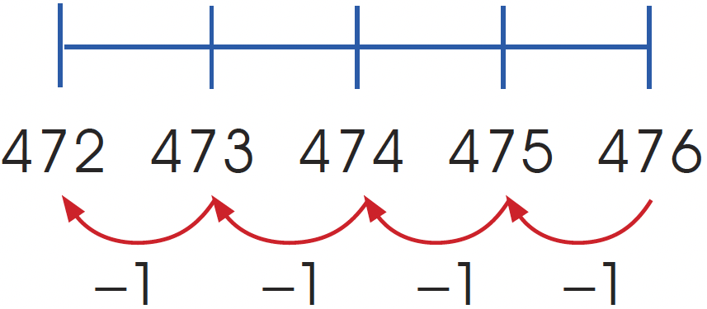
476 – 4 = ?
We can subtract mentally by counting back 4 ones.
So, 476 – 4 = 472.

Slide 4
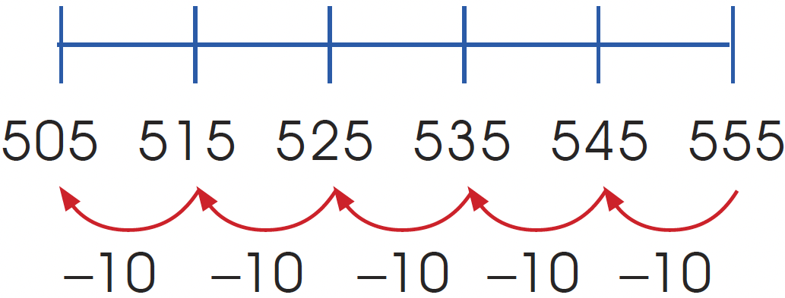
555 – 50 = ?
We subtract mentally by counting back 5 tens.

Slide 5
555 – 50 = 505
We can also subtract mentally by expanding the number.
555 = 5 hundreds 5 tens 5 ones
= 500 + 50 + 5
555 – 50 = 5 hundreds 5 tens 5 ones – 5 tens
= 5 hundreds 0 tens 5 ones
= 505

Slide 6
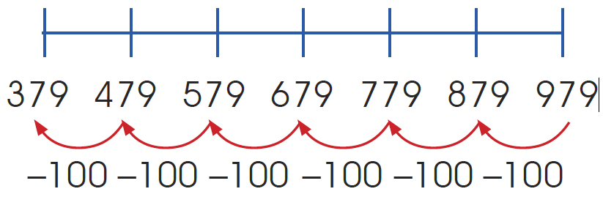
979 – 600 = ?
We count back 6 hundreds.
979 – 600 = 379

