Slide 1
Word Problems: Subtraction

Slide 2
Mrs. Santos had 15 eggs.
  She broke 4 eggs.
  How many eggs did she have left?
Read and understand the question. Look for key words.
Plan. Draw a model to help you.

Slide 3
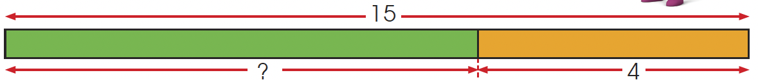
Carry out your plan.
1 5
– 4
1 1
15 – 4 = 11
Mrs. Santos had 11 eggs left.

Slide 4
Amelia has 18 books and Miguel has 12 books.
  How many more books does Amelia have than Miguel?
Read and understand the question. Find the difference.

Slide 5
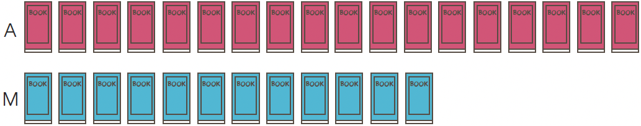
Plan. Draw a model to show the number of books that each of them has.

Slide 6
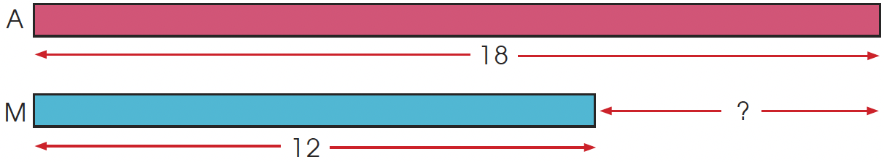
1 8
–1 2
6
18 – 12 = 6
Amelia has 6 more books than Miguel.

Slide 7
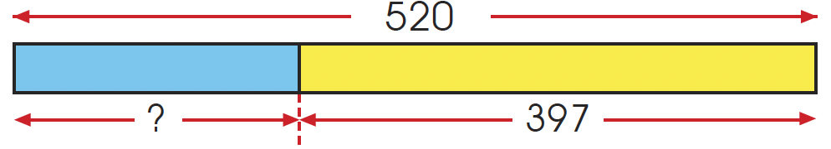
A baker baked 520 cupcakes.
  He sold 397 cupcakes.
  How many cupcakes did he have left?
520 – 397 = 123
He had 123 cupcakes left.
We have to subtract the number
of cupcakes that he sold
4
11
1
5 2 0
–3 9 7
1 2 3

Slide 8
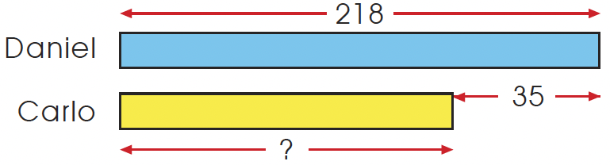
Daniel had 218 stamps.
  He had 35 more stamps than Carlo.
  How many stamps did Carlo have?
218 – 35 = 183
Carlo had 183 stamps.
1
1
2 1 8
– 3 5
1 8 3

Slide 9
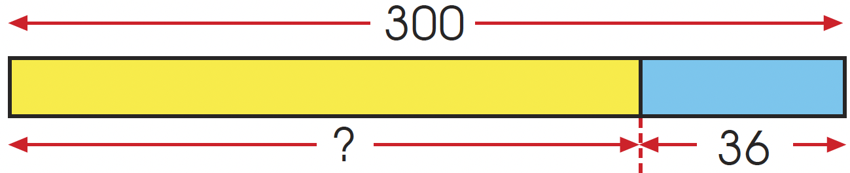
Miguel had 300 postcards.
  He threw away 36 torn postcards and gave away
  125 postcards to his friends.
  How many postcards did he have left in the end?
300 – 36 = 264
He had 264 postcards after throwing 36 postcards
away.
First, we subtract to find the number of postcards he had after throwing some away.
2
9
1
3 0 0
– 3 6
2 6 4

Slide 10
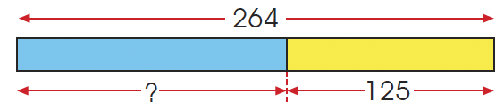
Next, subtract to find the number of postcards he had left after giving some away.
264 – 125 = 139
He had 139 postcards left in the end.
5
1
2 6 4
– 1 2 5
1 3 9

Slide 11
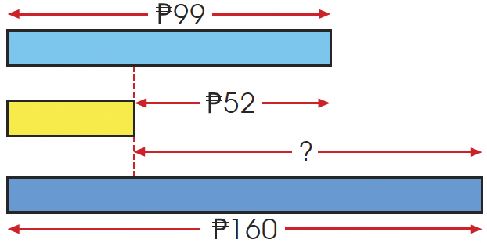
At a bookshop, a notebook costs 99 and a pen costs
  52 less than the notebook.
  If a book costs 160, how much more than the pen does the book cost?
Notebook
Pen
Book

Slide 12
99 – 52 = 47
160 – 47 = 113
The book costs 113 more than the pen.
Check. Have you written the money symbol?

