Slide 1
Patterns and Algebra

Slide 2

We have learnt that shapes can be used to form patterns.
There is a change in size. The next shape is .

Slide 3


We have learnt that shapes can be used to form patterns.
The shape is turned. The next shape is .
There is a change in orientation and color.
Look carefully. There is also a change in color.

Slide 4

What comes next in the pattern below?
    ________________
There is a change in shape and color.
The next shape is .

Slide 5
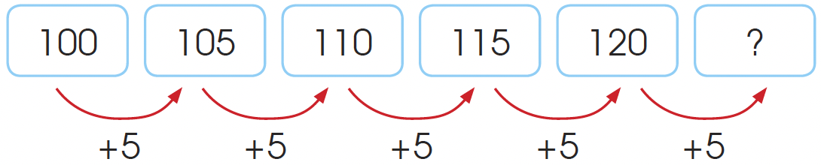
We have also learnt about patterns in numbers.
  120 + 5 = 125
  The next number in the pattern is 125.

Slide 6
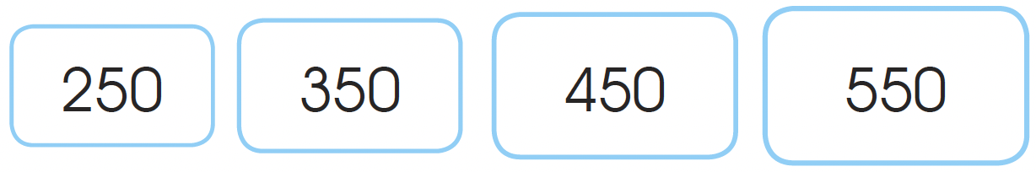
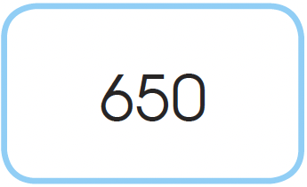
What comes next in the pattern below?
450 is 100 more than 350.
550 is 100 more than 450.
The size of the rectangle increases as well.
comes next in the pattern.

Slide 7
Using Multiplication and Division
What is the missing number?
30 ÷ ? = 6
We can use the related multiplication
sentence to find the missing number in the
division sentence.
6 × 5 = 30
So, 30 ÷ 5 = 6.
The missing number is 5.
What number must 30 be divided by to get 6?

Slide 8
What is the missing number?
? × 4 = 28
Similarly, we can use the related division
sentence to find the missing number.
28 ÷ 4 = 7
So, 7 × 4 = 28.
The missing number is 7.
What number gives 28 when multiplied by 4?

