Slide 1
Plate Movements

Slide 2
Plate Movements
Continental Drift Theory
Alfred Wegener, a German climatologist, proposed the continental drift theory. In his book, The Origins of Continents and Oceans, in 1915, Wegener expanded his theory and presented pieces of evidence that Pangaea (meaning “all Earth”) had existed during the Permian period.
Wegener explained that during the late Triassic period, Pangaea began to break up into two smaller supercontinents called Laurasia and Gondwanaland. These two smaller super- continents moved to the northern and southern extremes of the planet, respectively.

Slide 3
Plate Movements
During Pangaea’s formation, now-known North America smashed into northwestern Africa, forming a vast mountain range. Traces of these mountain ranges can still be located on a belt stretching from the southern United States to northern Europe, including the Appalachians. As Pangaea continued northward and crashed into the ocean floor, it created a chain of mountain ranges extending from Alaska to Southern South America. At around 200 Ma, Pangaea began to break apart, forming a valley called the Atlantic Ocean.

Slide 4
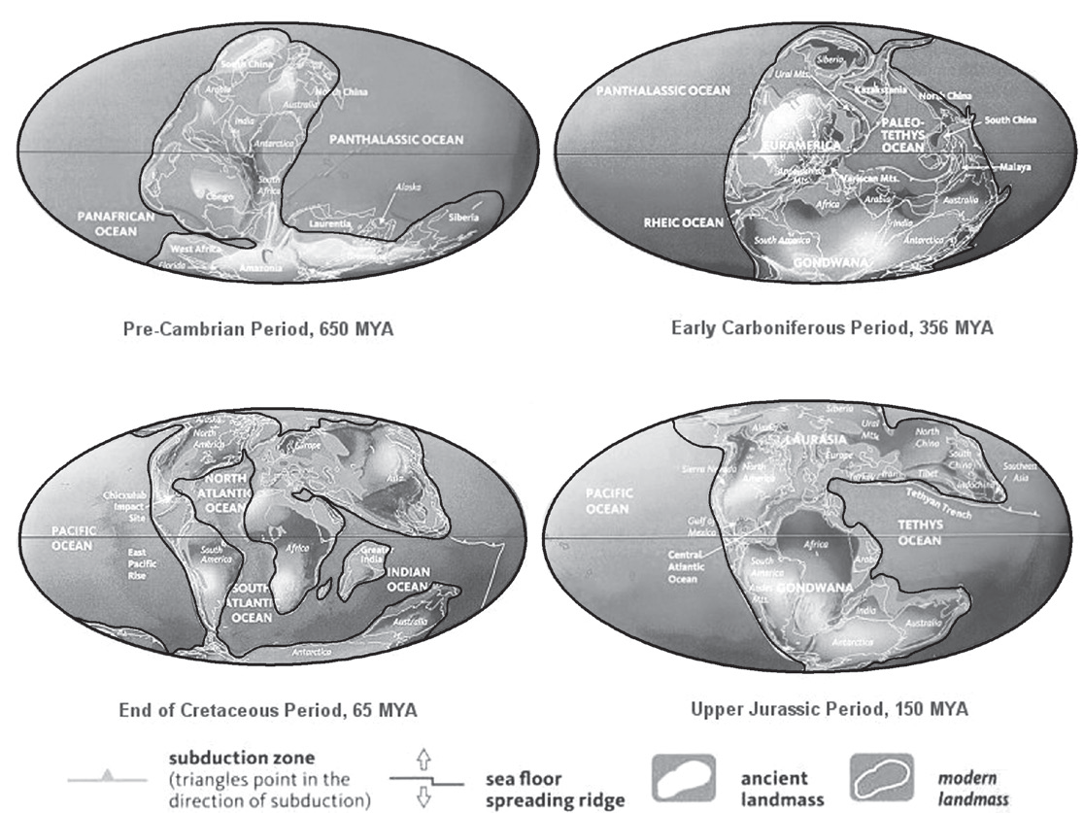
Plate Movements
Continental drifting continued during the Jurassic period. By the end of the Cretaceous period and the beginning of the Cenozoic, the continents were already taking their forms as we know them today. However, the big landmass now known as Central America was still covered with water while Antarctica and Australia had still not separated, and India was still colliding with Eurasia.
According to Wegener, the landmasses on Earth once existed as a single supercontinent.

Slide 5
Plate Movements
By about 65 Ma, all the present continents and oceans had been formed. India was moving northward, eventually smashing into southern Asia. Such movement and plate interactions shaped the world’s tallest mountain, the Himalayas, the Karakoram Range, and the Hindu Kush. Scientists believe that the crustal plates are still drifting. It is also predicted that some 250–300 million years from now, the seven continents will move toward each other again, reforming the historical Pangaea.
There are 15 major tectonic plates. Out of these major plates, seven or eight are primary plates. The primary plates are the African Plate, Eurasian Plate, Indo-Australian Plate, North American Plate, Pacific Plate, and the South American Plate with the Nazca Plate, sometimes considered a primary plate instead of a secondary plate. It can be noted that the primary plates comprise the majority of the landmass world’s major continents, along with most of the surface area of Earth’s oceans.

Slide 6
Plate Movements
Seafloor Spreading Theory
The seafloor spreading theory also played a crucial role in providing a conceptual base for the development of plate tectonics. The term seafloor spreading was first coined by Robert S. Dietz, a scientist with the US Coast and Geodetic Survey, in 1961.
The seafloor spreading theory was proposed by the American geologist Harry Hess in the 1960s. According to this theory, the seafloor was created at mid ocean ridges, spreading in both directions from the ridge system. Hess suggested that the new oceanic crust continuously spread away from the ridges in a conveyor belt motion.

Slide 7
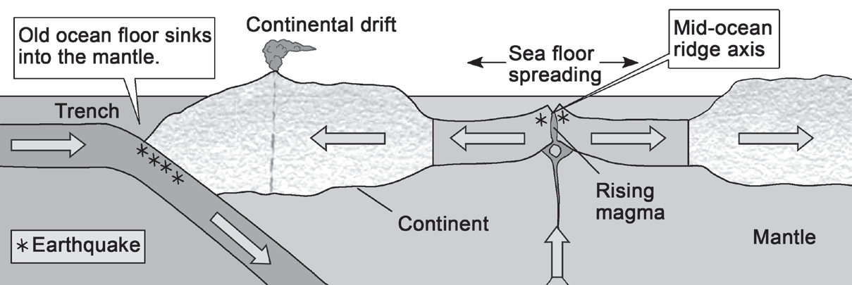
Plate Movements
After millions of years, the oceanic crust eventually slid down into the oceanic trenches along the Pacific Ocean basin. He believed that the Atlantic Ocean was expanding while the Pacific Ocean was shrinking. As old oceanic crust was consumed in the trenches, new magma was released from volcanic activities and accumulated along the spreading ridges to form new crust. As a result, the ocean basins were perpetually being recycled the creation of new crust and the destruction of old oceanic lithosphere happened simultaneously.

Slide 8
Plate Movements
As presented in a conveyor belt model, tectonic plates are moved passively by convection currents in Earth’s mantle. Mantle rocks near Earth’s core become extremely hot, making them less dense than the cooler mantle rocks in the upper layers. In effect, the hot rocks rise and the relatively cooler rocks sink, creating slow vertical currents within the mantle. These convection currents, in turn, generate convection cells, circling within the mantle-like conveyor belts.
The convection currents push the magma up, forming new crusts, exerting a lateral force on the plate, and pushing it apart to create seafloor spreading. This continuous circulation of convection currents in the mantle is one of the driving mechanisms behind plate movements.

Slide 9
Plate Movements
Plate Tectonics Theory
Tectonic is a term derived from the Greek word tekton, which means “carpenter” or “builder.” Scientists have used tectonic plates to describe the movement of the lithosphere. However, this term is now widely used for expressing the physical plates rather than their motion. The theory of tectonic plates was developed from earlier hypotheses and data collected about the ocean floor rocks. Implications of continental drift and seafloor spreading set off the formulation of the plate tectonics theory.

Slide 10
Plate Movements
The plate tectonics theory states that Earth’s outermost layer is fragmented into a dozen or more large and small lithospheric plates or tectonic plates. These tectonic plates are constantly in motion relative to one another as they ride atop hotter, more mobile material known as asthenosphere. These plates fit together like the pieces of a jigsaw puzzle, and the movement ranges from less than one to more than 15 cm per year. The motion of the plates over millions of years resulted in the opening and closure of bodies of water, likewise the formation and disintegration of continents in the world.

Slide 11
Plate Movements
Activity
Directions: Read and answer each item carefully. Give the letter of the correct answer.
1. Who proposed the continental drift theory?
A. Harry Hess
B. Robert Dietz
C. Alfred Wegener
D. Antonio Pellegrini
2. Which statement is NOT true about the theory of seafloor spreading?
A. Oceanic crust subducts.
B. There is a creation of a new crust.
C. The continents today were once one supercontinent.
D. Two oceanic plates move apart at the divergent boundary.

Slide 12
Plate Movements
3. What is the name of the supercontinent 200 million years ago that fragmented into our present-day continents?
A. Pandora
B. Pangaea
C. Laurasia
D. Gondwanaland
4. How do matters move during convection?
A. sideward
B. circular
C. downward
D. upward

Slide 13
Plate Movements
5. Who among the following coined the term “seafloor spreading” in 1961?
A. Alfred Wegener
B. Harry Reid
C. Robert Dietz
D. Clarence Dutton

Slide 14
Plate Movements
Answer Key
1. Who proposed the continental drift theory?
A. Harry Hess
B. Robert Dietz
C. Alfred Wegener
D. Antonio Pellegrini
2. Which statement is NOT true about the theory of seafloor spreading?
A. Oceanic crust subducts.
B. There is a creation of a new crust.
C. The continents today were once one supercontinent.
D. Two oceanic plates move apart at the divergent boundary.

Slide 15
Plate Movements
3. What is the name of the supercontinent 200 million years ago that fragmented into our present-day continents?
A. Pandora
B. Pangaea
C. Laurasia
D. Gondwanaland
4. How do matters move during convection?
A. sideward
B. circular
C. downward
D. upward

Slide 16
Plate Movements
5. Who among the following coined the term “seafloor spreading” in 1961?
A. Alfred Wegener
B. Harry Reid
C. Robert Dietz
D. Clarence Dutton

