Slide 1
Weather and Climate Patterns

Slide 2
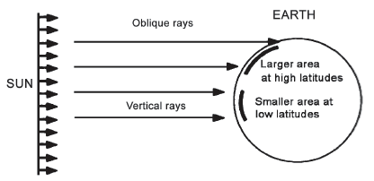
Weather and Climate Patterns
Wind Movement
Different parts of the Earth receive varying amounts of solar radiation
Areas that are directly hit by the Sun are generally warmer than areas hit by slanted rays. This explains why it is hot in the Philippines. This also explains why it is hotter at 12 noon as compared to sunrise or sunset hours.

Slide 3
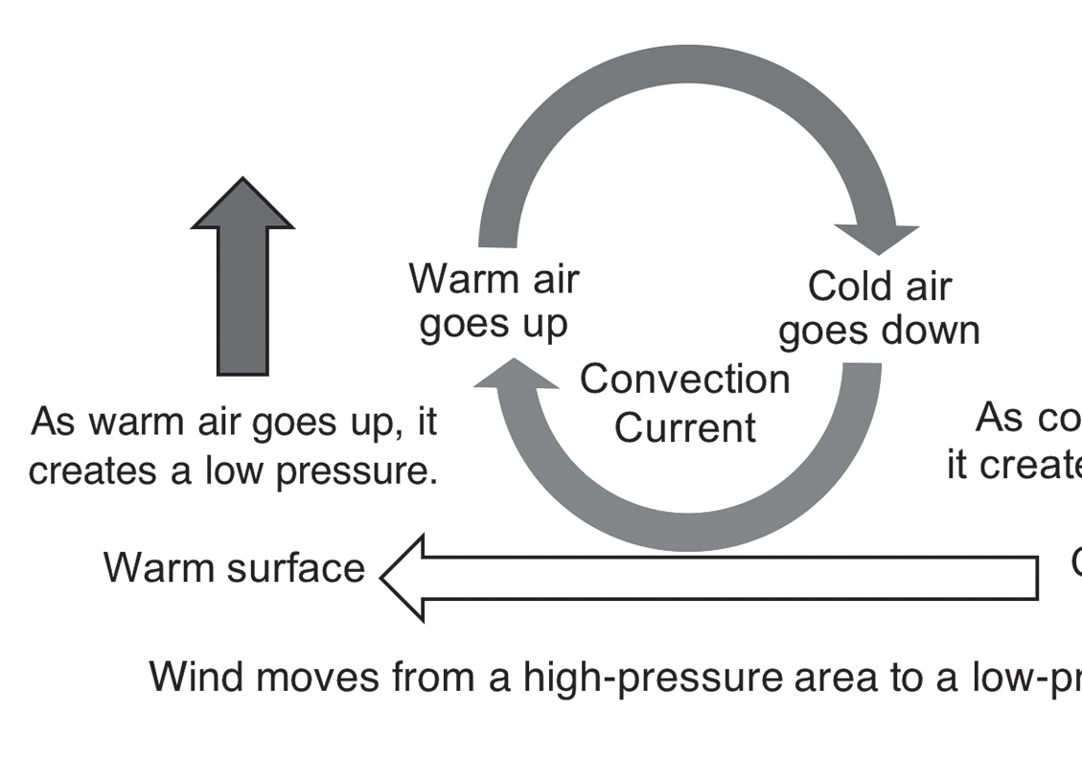
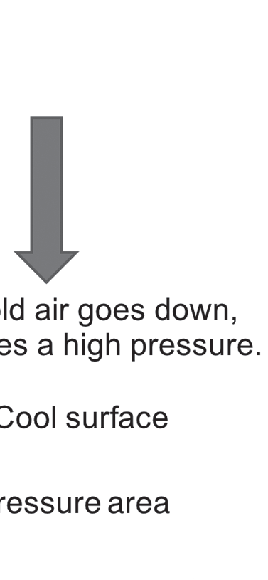
Weather and Climate Patterns
Movement of warm air and cold air to generate wind
Warm air goes up because it is less dense and cold air goes down because it is denser. As the warm air goes up, the area it leaves becomes low in pressure because there are fewer air molecules that exert force on the ground. Recall that pressure refers to the force exerted per unit area. The cold air, which has molecules that are close to each other, goes down and exerts a high pressure on the ground. The cycle is repeated as the cold air absorbs heat from the ground, becomes warm, and rises again. The rising and sinking of air produce wind or the movement of air. This pattern of wind movement is called convection or the transfer of heat through moving air particles. The movement of air sets up a convection current in the atmosphere.

Slide 4
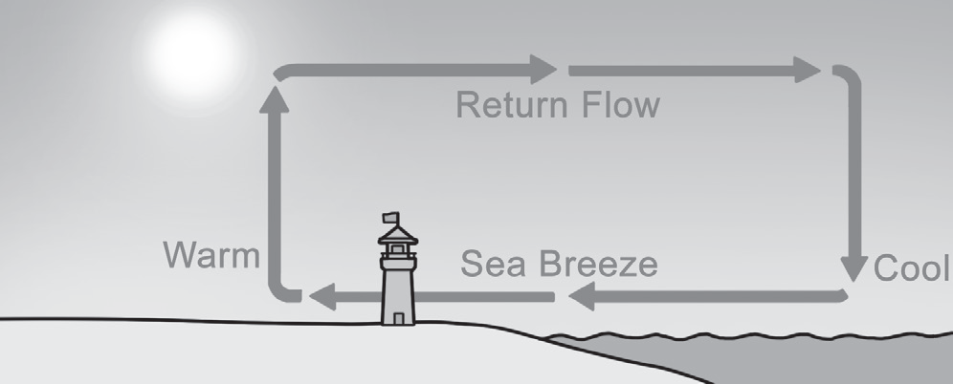
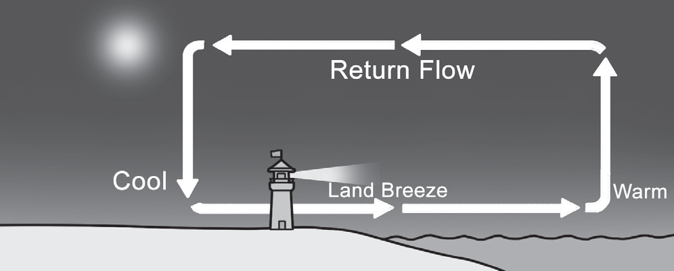
Weather and Climate Patterns
Local winds are also created when warm air mass rises and cold air mass sinks due to differential heating of certain areas on the Earth. Local winds blow over limited areas, usually on areas near a body of water or areas near a mountain. The most common examples of local winds are the breezes.
Movement of sea breeze and land breeze
A sea breeze happens when cool air from the sea moves horizontally to the adjacent land.Water can retain heat and warm up longer than soil. So when the Sun is out, the sea is at a much cooler temperature than the land. This temperature difference leads to changes in air pressure, and consequently, the wind blows from an area of higher pressure to an area of lower pressure. A land breeze happens at night as the land is cooler than the sea. Thus, the warm air over the sea rises, and the cold air over the land moves toward the sea.

Slide 5
Weather and Climate Patterns
Different Weather Systems in the Philippines
Both Amihan and Habagat are monsoon winds. These winds that are much larger than breezes are also caused by the difference in heating patterns of land and water.
Amihan or the northeast monsoon happens when the cool and dry air from Siberia (a region in Russia) brings cold weather to the eastern part of the Philippines.
Habagat or the southwest monsoon happens when the warm and moist air from Australia brings heavy rain to the western part of the country.
Since the Earth rotates on its axis, it can also cause the wind to get deflected and follow a curved line. This is known as the Coriolis effect. It makes the wind blow northeast to the southwest or the reverse in the northern hemisphere (where the Philippines is located). The opposite is true if you are in the southern hemisphere.

Slide 6
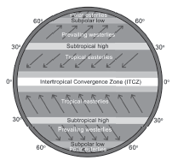
Weather and Climate Patterns
The ITCZ is an area near the equator that receives direct rays from the Sun, which makes it warmer than other areas on the Earth. When warm air from this area rises, it contains moisture that leads to the formation of clouds, resulting in torrential downpours. ITCZ is usually the reason for thunderstorms during certain months of the year, such as months when the Sun’s rays are most direct—the warm months.
Now, when the winds from the east and northeast converge, this brings in the rain. The leading edge of a cooler mass of air, known as the cold front, replaces the warmer mass of air at ground level. When a cold front appears, it is an indication that an extratropical cyclone is bound to happen.
In the Philippines, where the seasons are only wet and dry, the best time to visit is from January to May, because the typhoon season can bring bad and unpredictable weather. The weather system of the Philippines can be greatly associated with its geographical location as it is surrounded by bodies of water, contributing to the formation of its climatic condition.

Slide 7
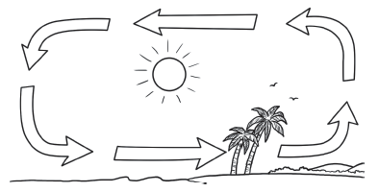
Weather and Climate Patterns
Activity
Directions: Label the illustration. Compare the temperature and pressure on land and in water. Identify the type of breeze that the illustration represents.

Slide 8
Weather and Climate Patterns
Answer Key
The illustration refers to a sea breeze. The following should be present: a low pressure on the side where warm air goes up and high pressure on the side where cold air goes down. The body of water/land can also be identified.

