Slide 1
Changes in Climate

Slide 2
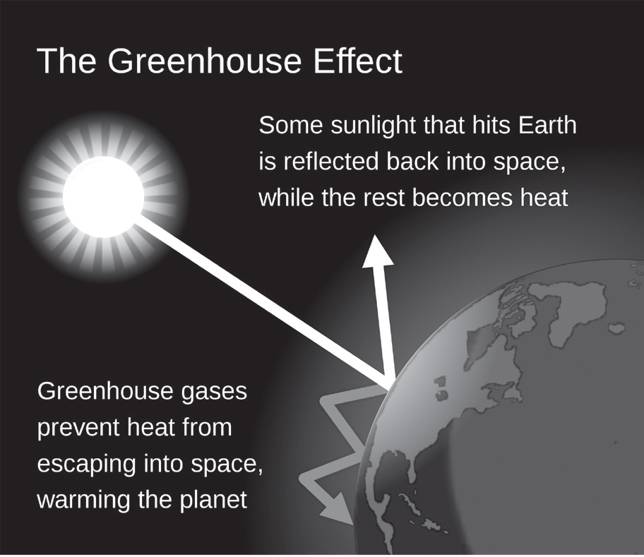
Changes in Climate
Climate change is defined as a long-term shift in the average conditions of a region, such as temperature and rainfall. It is a natural phenomenon for the Earth’s climate to change over time. This can be attributed to natural causes like variations in the Sun’s energy reaching the Earth, volcanic eruptions, variations in the Earth’s orbit, and impacts by large meteors.
Climate change greatly impacts humans, other organisms, and the environment. It is, therefore, essential to understand the following climatic phenomena in order to obtain a better knowledge of their consequences and what people can do to protect the planet.
Greenhouse Effect
Greenhouse effect (natural greenhouse effect) occurs when gases such as carbon dioxide (CO2), methane (CH4), and nitrous oxide (N2O) in the Earth’s atmosphere capture heat from the Sun. Visible, ultraviolet, and infrared lights are absorbed by greenhouse gases, causing heat to be trapped in the atmosphere. They are crucial in maintaining the planet’s temperature. This process warms our Earth, making it a more hospitable environment for all living things.
Figure 10: Greenhouse effect

Slide 3
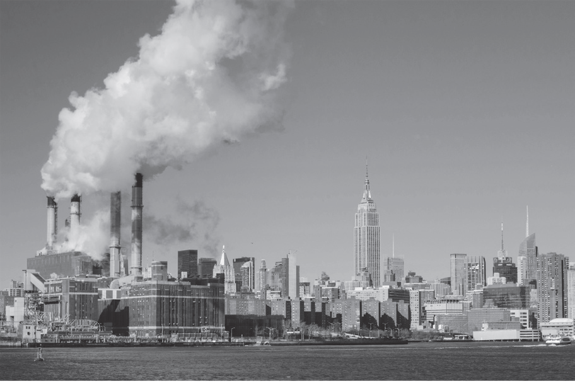
Changes in Climate
Global warming is a phenomenon characterized by the Earth’s average temperature that is over its typical level. This could be due to the greenhouse effect (human enhanced greenhouse effect), which is caused by the increased levels of CO2, chlorofluorocarbons (CFCs), and other pollutants in the atmosphere.
One of the major sources of greenhouse gases is the burning of fossil fuels.
The burning of fossil fuels began at the dawn of the Industrial Revolution (1760–1840) when humans began to burn huge amounts of fossil fuels, producing a huge amount of CO2 in the atmosphere. This has resulted in unnatural warming, with the Earth’s temperature rising substantially in a short period of time. It has risen by 0.6 degrees Celsius since 1880, reaching 14.4 degrees Celsius (as of 2015). Currently, adding to the rate of warming 50 times quicker than the previous 21,000-year rate of warming is the burning of forest and large-scale agriculture.
Figure 11: Industrial revolution

Slide 4
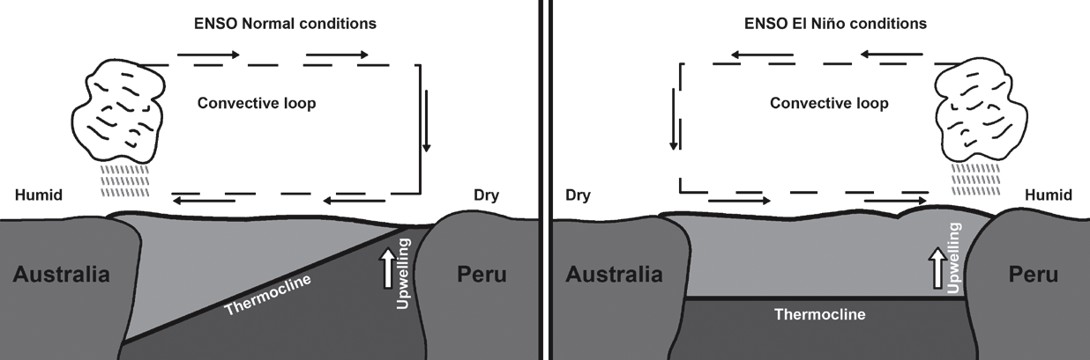
Changes in Climate
El Niño and La Niña
El Niño (which means Little Boy/Christ Child) is a change in the weather pattern in the Philippines induced by an increase in the temperature of the Pacific Ocean. This can impact air and sea currents, resulting in less rainfall. On the other hand, La Niña occurs when the Pacific Ocean’s typical temperature drops, cooling the water toward the equator and creating excessive heavy rains in the Philippines.
Normal Conditions
El Niño occurs near the equator in the Pacific Ocean. As shown in Figure 12, trade winds normally blow from east to west in typical conditions. Warm water is being pushed to Asia and Australia’s coasts like a conveyor belt by these winds. Thus, in the west part of the Pacific Ocean, warm waters are present. The thermocline (the difference in temperature between the top and bottom of the ocean) deepens as a result.
Figure 12: Trade winds in normal conditions (left) vs el niño (right)

Slide 5
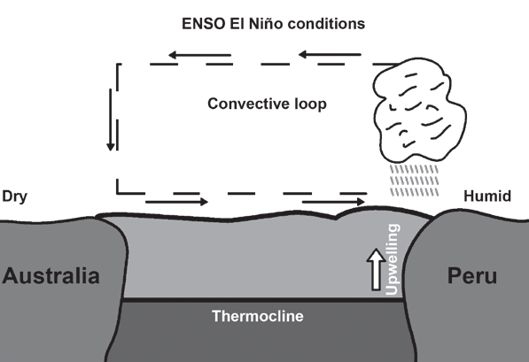
Changes in Climate
El Niño
El Niño occurs every three to five years when the west-blowing trade winds diminish occurs every three to five years when the west-blowing trade winds diminish. As the winds diminish, less warm water reaches the west. Because of this, there is less cold upwelling water off the Americas’ coasts. As a result, there is less warm surface water pushing west. On top of that, the eastern side has less upwelling. As a result, warm water pools in the Pacific Ocean’s central region, breaking the natural temperature balance between the eastern and western Pacific.
Increased water temperature drives rainfall during El Niño. When there is a high concentration of heat, pressure systems arise, which leads to storm formation. This is why, during this time, rainfall and winds increase in the tropical Pacific. Consequently, global weather conditions in other parts of the world are also affected.

Slide 6
Changes in Climate
Impacts of Changes in the Climate
1. Rising Sea Levels
2. Melting Ice
3. Heavy Rains and Strong Storms
4. Heat Waves and Drought
5. Changing Ecosystem
6. Reduced Food Security
7. Pests and Diseases

Slide 7
Changes in Climate
What have we done to manage climate change?
The United Nations Framework Convention on Climate Change (UNFCCC) has organized a global effort to regulate climate change. The UNFCCC was established at the 1992 Rio Earth Summit to attain Greenhouse Gas (GHG) concentration targets. It also established voluntary GHGs emission reduction targets that countries failed to reach. The parties to the convention have met annually from 1995 to assess progress in dealing with the issue of climate change.
Greta Thunberg
She is a Swedish environmental activist who is well known around the world for calling on world leaders to take quick action to combat climate change. In 2019, there were a number of coordinated multi city protests involving over a million students. Thunberg sailed to America to join the 2019 United Nations Climate Action Summit.

Slide 8
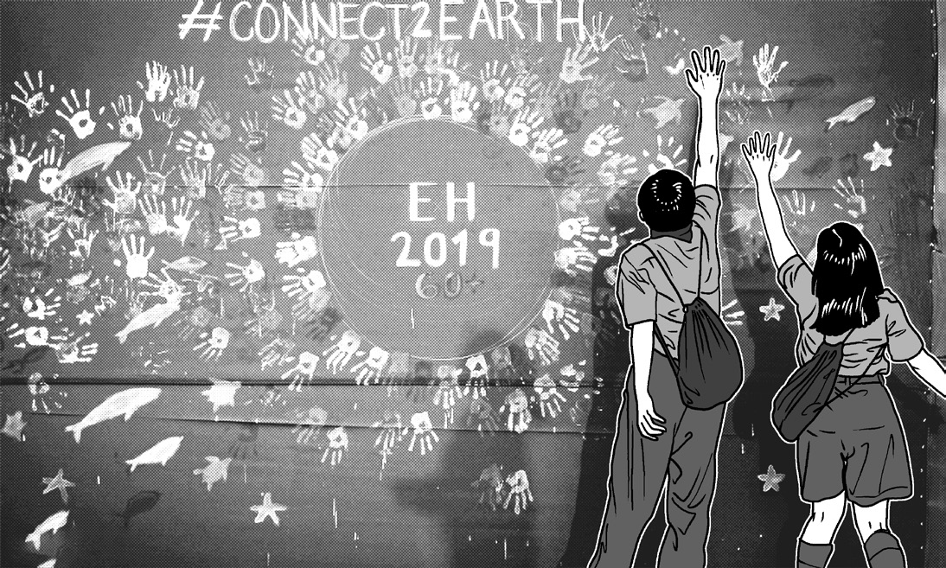
Changes in Climate
Earth Hour
Earth Hour is a global campaign spearheaded by the World Wide Fund for Nature (WWF). The yearly event encourages individuals, towns, and businesses to switch off nonessential electric lights for one hour, from 8:30 to 9:30 p.m. on a certain day at the end of March, as a symbol of commitment to the environment. It began in 2007 as a lights-out event in Sydney, Australia. For the past 10 years, the Philippines is active to support such efforts to combat climate change. Filipinos developed a powerful movement that resulted in significant worldwide pledges to combating this threat.
Figure 17: Earth hour

Slide 9
Changes in Climate
When it comes to dealing with climate change and preventing the effects it has on the planet’s ecosystems, humans adopt two types of measures: mitigation and adaptation. Mitigation strategies are steps done to reduce greenhouse gas emissions, whereas adaptation measures aim to lessen the risk of the effects of climate change. As a result, mitigation targets the causes of climate change, whereas adaptation addresses its consequences.
Mitigation Measures | Adaptation Measures
-Efficient use of energy - Wider use of renewable energy - Greater use of electric public transport, bicycle, and shared cars - Expansion of forests because trees absorb carbon | -More typhoon resilient facility locations and infrastructures - Diverse and adaptable agriculture to prepare for natural disasters—research and development on potential disasters and temperature behavior - Preventive and precautionary actions (evacuation plans and health issues)

Slide 10
Changes in Climate
Activity
Directions: Arrange the following steps on how human enhanced greenhouse effect happens. Use numbers 1–6, with 1 for the first event and 6 for the last event.
_____1. Some solar energy waves are reflected in space by clouds and greenhouse gases.
_____2. When solar energy waves hit the Earth’s surface, they slow down and combine to generate longer heat (thermal) energy waves.
_____3. Heat contained in the atmosphere warms the planet.
_____4. These longer thermal energy waves have a difficult time returning to space due to greenhouse gas emissions.
_____5. Other kinds of heat energy waves reach the Earth’s surface.
_____6. Shortwave solar (radiant) energy waves from the Sun reach the atmosphere.

Slide 11
Changes in Climate
Answer Key
___2__1. Some solar energy waves are reflected in space by clouds and greenhouse gases.
___4__2. When solar energy waves hit the Earth’s surface, they slow down and combine to generate
longer heat (thermal) energy waves.
___6__3. Heat contained in the atmosphere warms the planet.
___5__4. These longer thermal energy waves have a difficult time returning to space due to greenhouse
gas emissions.
___3__5. Other kinds of heat energy waves reach the Earth’s surface.
___1__6. Shortwave solar (radiant) energy waves from the Sun reach the atmosphere.

