Slide 1
Projectile Motion

Slide 2
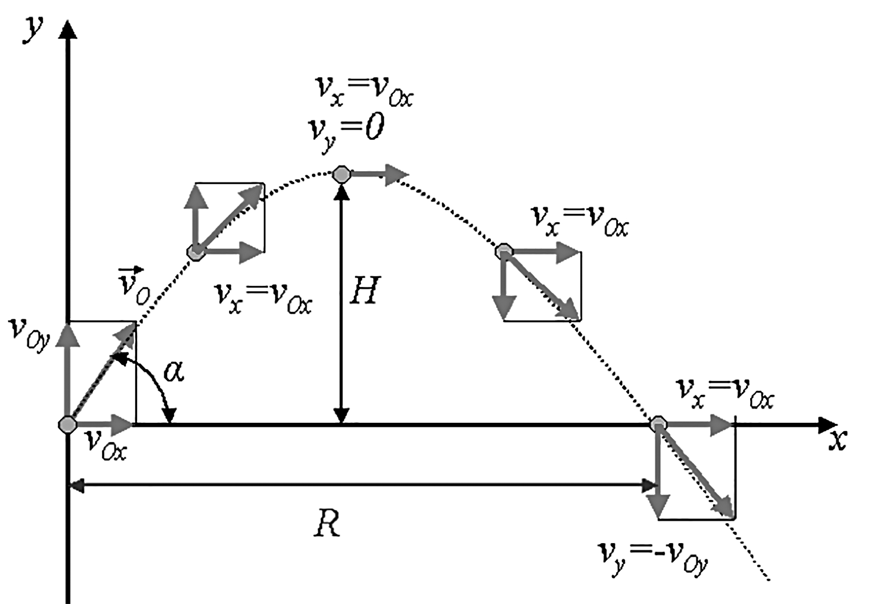
Projectile Motion
A projectile is any object acted upon by gravity and thrown into the air to move on its trajectory. A projectile traces a curved (parabolic) line or trajectory because it simultaneously moves in the horizontal and vertical directions. In this condition, the object is undergoing projectile motion.
When launching the projectile, it is given an initial velocity (vo) with an initial angle (θ੦). As it travels through the air, it moves along the horizontal and vertical directions. Eventually, because of gravity, the object launched will go down back to the Earth. It hits the Earth or a target with a final velocity (vf)

Slide 3
Projectile Motion
Figure also shows the horizontal and vertical components of the projectile motion. Assuming nothing opposes the motion, its horizontal velocity ( vx ) is constant throughout its flight. The projectile covers the same displacement at an equal time interval. Since no horizontal forces are acting, it has no horizontal acceleration.
The vertical component of the projectile motion can be compared to the motion of an object experiencing free fall. On the ideal condition, the object is accelerating due to the influence of gravity. For easier reference, whenever an object is going upward or downward, the value of g that we will use is -9.8 m/s². As the projectile moves to a higher position, its vertical velocity is opposite of g, thus slowing it down. Once it reaches the highest possible position, the vertical velocity of the projectile becomes zero. After passing this, g is now in the same direction as the vertical velocity, thus speeding it up.

Slide 4
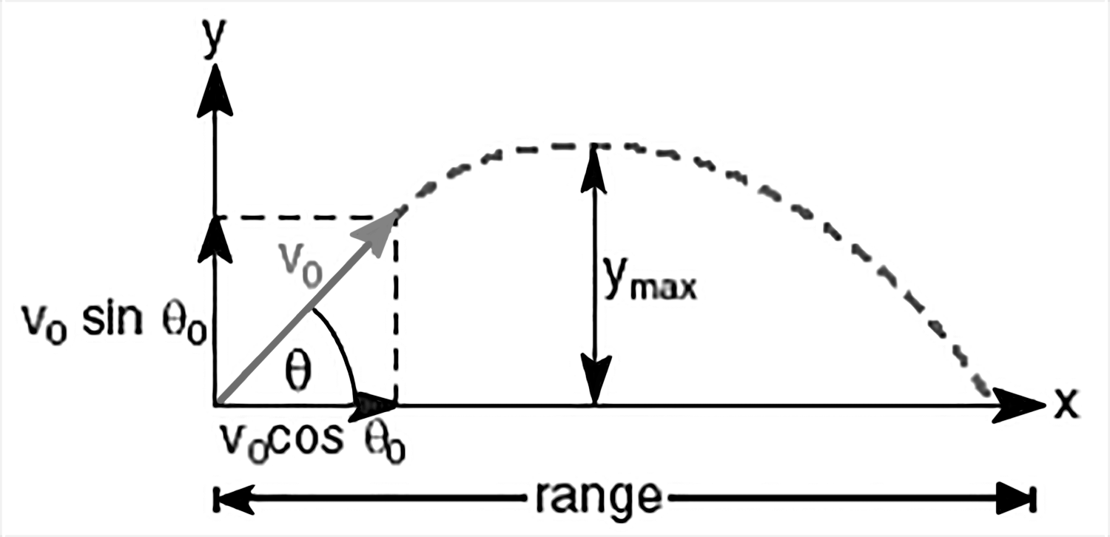
Projectile Motion
There are other physical quantities that are associated with projectile motion, as shown in Figure The range (R) is the maximum horizontal distance traveled by the projectile. The maximum height (Y max) is the maximum vertical displacement traveled by the projectile in its trajectory.
The time of flight ( tT ) is the entire duration, while the projectile is in its trajectory. The velocity of a projectile in motion has two components that are independent of each other.

Slide 5







Projectile Motion
The Horizontal and Vertical Components of Projectile Motion
Quantity | Horizontal Motion | Vertical Motion
Acceleration | ax = o | ay = g
Displacement (d) | With the initial position being zero,
Velocity (v) | With Vfx = Vox, the horizontal component of velocity: The final horizontal velocity: | The vertical component of initial velocity: The final vertical velocity:
__

Slide 6




Projectile Motion
The magnitude of the velocity of the projectile just before it hits the ground:
Example: A volleyball is thrown horizontally from a height of 6.00 m with an initial speed of 27.0 m/s. (a) How long will it take the ball to reach the ground? (b) At what horizontal distance from the point of release will it strike the ground? (c) At what magnitude and direction will it strike the ground?
Given: dy = - 6.00 m v0 = 27.0 m/s g = - 9.8m/s2 | Unknown: time of flight, t range, R final velocity, Vf | Equations:

Slide 7




Projectile Motion
Solution: Since the projectile is thrown horizontally, the angle of projection is zero. Resolving the initial velocity into its horizontal and vertical components will result in: Horizontal: Vertical: a) The time of flight can be computed if we consider the point of release as the origin and only the vertical component of motion. Substituting the given values in the equation,

Slide 8




Projectile Motion
Simplifying the equation, working with units, and solving for time, t gives us: With time being a scalar quantity, we will only consider the positive value, hence, t = 1.11 s b) With the positive value of time in the horizontal component of motion, Horizontal: Vertical:

Slide 9


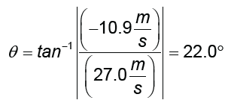

Projectile Motion
Substituting the computed values, we have vf : Magnitude: Direction: Since the volleyball is going down, we choose the negative value of the magnitude. Thus, the final velocity is -29.1 m/s at 22° below the ground level.

Slide 10
Projectile Motion
Activity
Directions: Read and answer each item carefully. Give the letter of the correct answer.
1. Which of the following is TRUE about object A that is dropped from a roof at the same time as object B thrown horizontally from the same roof?
A. Object A reaches the ground first.
B. Object B reaches the ground first.
C. Object A has a greater speed when it reaches the ground.
D. Object B has a greater speed when it reaches the ground.
2. Which of these components of projectile motion is constant?
A. vertical velocity
B. horizontal velocity
C. both vertical and horizontal velocity
D. neither vertical nor horizontal velocity

Slide 11
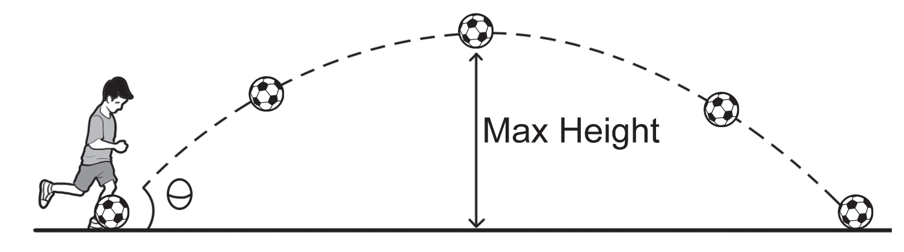
Projectile Motion
For numbers 3–5, refer to the illustration of the path traveled by a projectile, which is kicked with an initial velocity of 10 m/s at 30° from the horizontal.
C
D
B
A
E
3. What is the vertical velocity of the ball at point C in the path?
A. 0 m/s
B. 2.5 m/s
C. 5 m/s
D. 10 m/s

Slide 12
Projectile Motion
4. Which of the following is TRUE about the horizontal velocity of the ball?
A. VB < VD
B. VB > VD
C. VB = VD
D. VA < VB
5. Which of the following is TRUE about the time of flight of the ball?
A. tAC = tCE
B. tAB = tBC
C. tAC > tCE
D. tAC < tCE

Slide 13
Projectile Motion
Answer Key
1. D
2. B
3. A
4. C
5. A

