Slide 1
Acceleration
Acceleration

Slide 2
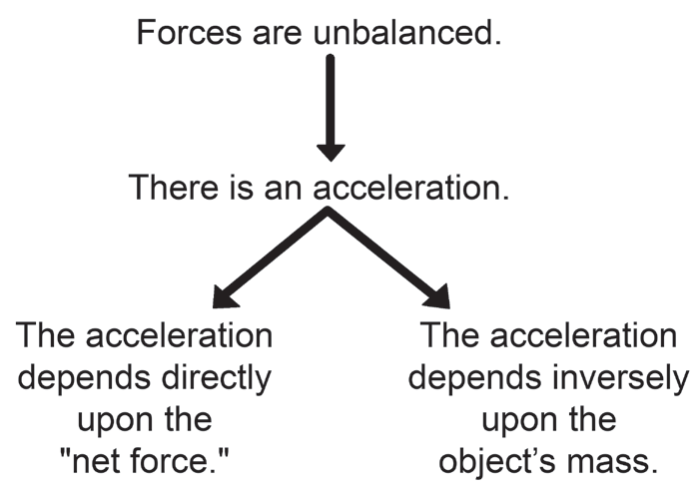
Acceleration
Law of acceleration - Newton’s second law of motion
The acceleration of an object as produced by a net force is directly proportional to the magnitude of the net force, in the same direction as the net force, and inversely proportional to the mass of the object.

Slide 3
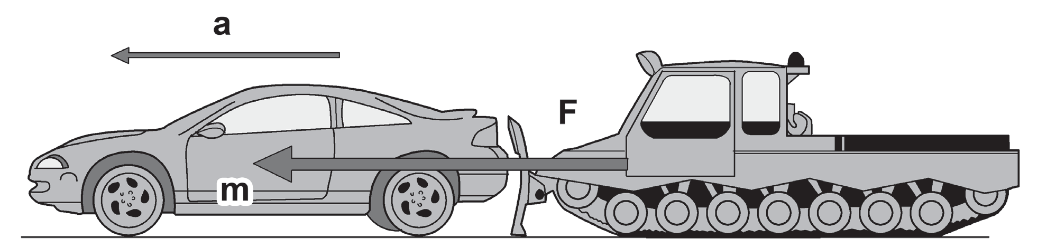

Acceleration
Force F acts on the car of mass m. If the car is initially at rest, the force applied by the tractor will cause the car to increase its velocity. Thus, the car will accelerate.
This law also explains that as the net force increases, the object’s acceleration also increases. However, as the mass of the object increases, the acceleration decreases. The net force (N) is equal to the product of the object’s mass (kg) and its acceleration (m/s2). This is the equation form for both acceleration and the net force:

Slide 4
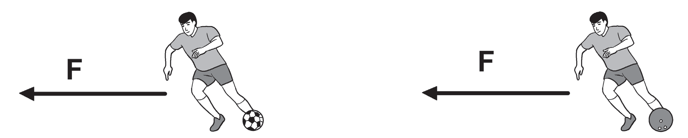
Acceleration
Example:
If you kick a ball, it will speed up in the direction of the kick. If you kick it harder, more force is applied so the ball will speed up more in the same direction. Therefore, the change in speed is directly related to the amount of force. More force gives more acceleration, and less force gives less acceleration.
If the player kicks a soccer ball and a bowling ball with the same amount of force, which ball will accelerate faster? Since the soccer ball is less massive, it will accelerate much faster; the bowling ball, which is more massive, will experience less acceleration. Thus, more mass gives less acceleration and less mass gives more acceleration.
A Player Kicking a Soccer Ball and a Player Kicking a Bowling Ball

Slide 5
Acceleration
Example:
A force of 20 newtons acts on an object whose weight is 8 newtons. What is the object’s mass and how fast does it accelerate?
Given: F = 20 N W = 8 N (1 N = 1 kg · m/s2) Constant: Acceleration due to gravity (g = 9.8 m/s2) | Unknown: a) mass, m b) acceleration, a | Equations: W= m.g

Slide 6


Acceleration
Solution:
The equation W = m . g shows the relationship between mass and weight. You can solve for the
object’s mass as follows:
Substitute the computed value of the object’s mass and the value of the force in the equation to solve for acceleration:

Slide 7

Acceleration
Activity
Directions: Solve the following problems involving Newton’s second law of motion.
A. A certain force accelerates a 3.2-kilogram mass by 2.4 m/s2. What would be the acceleration of a
1.6-kilogram mass when the same force acts on it?
Given: m1 = 3.2 kg m2 = 1.6 kg a1 = 2.4 m/s F1 = F2 | Unknown: acceleration, a2
Solution: To solve for the acceleration of a 1.6-kilogram object, you need to find the value of force,
which is in equal amount with the force applied to accelerate a 3.2-kilogram body.

Slide 8
Acceleration
Answer Key:
Given: m1 = 3.2 kg m2 = 1.6 kg a1 = 2.4 m/s F1 = F2 | Unknown: acceleration, a2
Solution: To solve for the acceleration of a 1.6-kilogram object, you need to find the value of force,
which is in equal amount with the force applied to accelerate a 3.2-kilogram body.
W=m.g W=m.g
W= 3.2 kg x 2.4 m/s W= 1.6 kg x 2.4 m/s
W= 7.68 N W= 3.84 N
W= 7.68 N = 2.4 m/s² W= 3.84 N = 2.4 m/s²
3.2 kg 1.6 Kg
a= 4.8 m/s²

