Slide 1
Action - Reaction
Action - Reaction

Slide 2
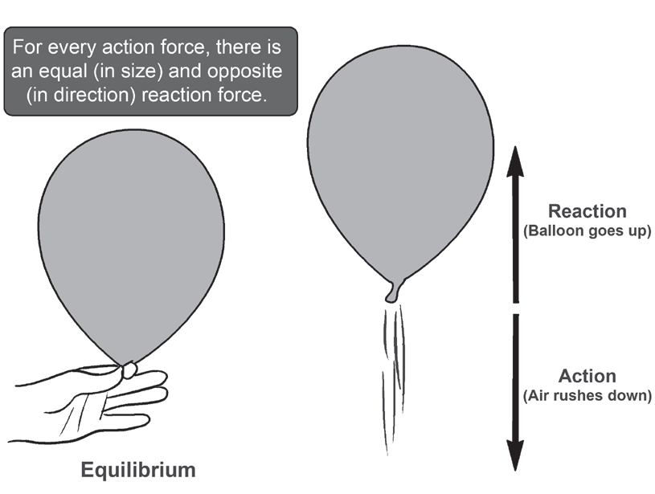
Action - Reaction
Law of Action-Reaction
Newton’s third law of motion
Whenever one object exerts a force on a second object, the second object exerts an equal and opposite force on the first object
for every action, there is an equal and opposite reaction.
Forces always come in pairs: one is the action, and the other is the reaction. Action reaction pair of forces are equal in magnitude but opposite in direction. One cannot exist without the other. This pair of forces make up the interaction. Hence, the third law of motion is
also called the law of interaction.
Action-Reaction Forces in a Balloon

Slide 3
Action - Reaction
Properties of action and reaction pair of forces
1. action and reaction forces always come in pairs.
2. action and reaction forces are equal in magnitude but opposite in direction
3. action and reaction forces act on two different bodies
4. action and reaction forces have the same line of action

Slide 4
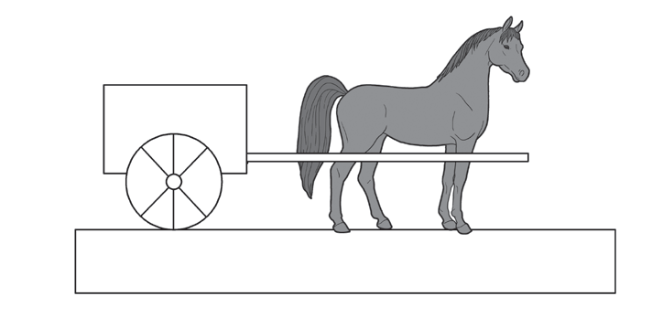
Action - Reaction
Example:
The forces acting on the horse and the cart are classified as action and reaction forces. First, an action occurs—the horse pulls the cart. Then, the reaction happens—the cart pushes back on the horse. Also, as the horse moves forward, the horse pushes against the ground and exerts a larger force to overcome friction. The ground exerts an equal amount of force in return. This horse-cart system depicts Newton’s third law of motion.

