Slide 1
Electromagnetic Waves

Slide 2
Electromagnetic Waves
One of the most amazing aspects of science is the presence of electromagnetic (EM) waves. We all know that energy is the capacity to do work, and to do work, energy has to be transferred from one body to another. It was thought before that energy can only be transferred when there is a medium or a material that it can travel through, like a bridge! That was until Hans Christian Oersted (1820) discovered that a rotating electric current creates a magnetic field, and Michael Faraday (1830) observed that a magnetic field can generate electricity. With these observations, James Clerk Maxwell made some mathematical manipulations and found out that energy can be transferred through electric and magnetic fields in the vacuum of space in the form of waves. These forms of waves that do not need a medium to propagate (or transfer energy) are called electromagnetic waves. These waves span a broad spectrum from very long radio waves to very short gamma rays.

Slide 3
Electromagnetic Waves
The Electromagnetic Spectrum
The EM spectrum is an array of EM waves that gives off energy, also commonly known as radiation. It is a distribution of EM waves that can be described by their wavelength and frequency.
Here are some basic facts you need to know about the EM spectrum:
• EM waves are produced when a moving electrical field comes in contact at a right angle (perpendicular) with a magnetic field.
• EM waves are transverse waves, which means that their vibration is perpendicular to the direction of wave propagation.
• EM waves can travel in a “vacuum” and do not need a medium to propagate.
• All EM waves, regardless of their wavelength and frequency, travel at the speed of light (3.0 × 10⁸ m/s). This means that all EM waves are carrying energy in the form of photons or particles of light.

Slide 4
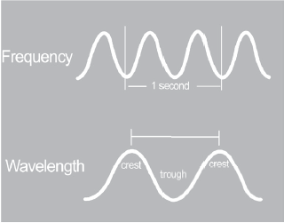
Electromagnetic Waves
There are two types of waves: transverse waves and longitudinal waves. EM waves are transverse waves. As you start to understand the spectrum, you must first learn the parts of a transverse wave and the quantities that define it: wavelength and frequency. On the right is an image of the parts of a transverse wave.
One complete transverse wave cycle is composed of the crest, the highest point of the wave, and the trough, the lowest point of the wave. One EM wave is differentiated from others by its wavelength, the distance between two consecutive crests or two consecutive troughs, and frequency, the number of complete wave cycles per second that uses the unit cycles/second of hertz.
The parts of a transverse wave

Slide 5
Electromagnetic Waves
Wavelengths of EM waves vary depending on the amount of energy carried by the moving high-energy electron in the form of photons, or particles of light, which are measured in electron volts (eV). The lesser the energy, the longer the wavelength. The longer the wavelength, the lesser the wave frequency. This shows that the relationship between frequency and wavelength is inverse proportion, while the speed of light is in direct proportion to the two quantities.
We can express it mathematically as: c = λν,
where c is the speed of light that has a constant value of 3.00 × 10⁸ m/s; λ (the Greek lambda) is the wavelength; and ν (the Greek nu) is the frequency.

Slide 6
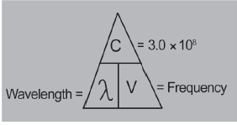
Electromagnetic Waves
When solving for the wavelength, you need to divide the speed of light that is constant by the frequency given. On the other hand, the speed of light (3.0 × 10⁸ m/s) is equal to the wavelength in meters (m) or nanometers (nm) multiplied by the frequency in hertz (Hz). Lastly, if the frequency is missing, divide the speed of light by the wavelength. Refer to the figure on the right to easily remember the derivation of the formula.
Example:
The color orange within the visible light spectrum has a wavelength of about 620 nm. What is the frequency of the orange light?
Step 1: List the known quantities and plan on how to solve the problem.
Given:
wavelength (λ) = 620 nm
speed of light (c) = 3.00 × 10⁸ m/s
conversion factor 1 m = 10⁹ nm
Required:
Frequency in Hz
Consider this figure to remember the formula.

Slide 7



Electromagnetic Waves
Solution:
  Convert the wavelength to m. Then, apply the equation c = λν and solve for the frequency.
Dividing both sides of the equation by λ yields:
Step 2: Calculate
Step 3:
Think about your result.
Interpretation: The value for the frequency falls within the range for visible light.
( derived formula )

Slide 8
Electromagnetic Waves
Relationship of Wavelength, Frequency, and Energy
EM waves form an uninterrupted spectrum of waves. The following can be observed:
The wavelength is inversely proportional to the frequency and energy of the wave. This
means that:
• waves with short wavelengths have high frequency and high energy; and
• waves with long wavelengths have low frequency and low energy.
Maxwell’s electromagnetic light theory states that the amount of radiation, or energy carried by EM waves in a form of high-energy electron emitted as a photon, depends on the amount of energy carried by the intensity of the light beam responsible for it. Meaning, the more intense the light source is, the higher is the energy carried by the EM wave. However, toward the end of the nineteenth century when the photoelectric effect was first observed, it was found that even a faint light illuminating a metal surface can cause an electron emission. Meaning, even a faint light can produce photons.

Slide 9


Electromagnetic Waves
This discovery contradicts the EM light theory. In 1905, Albert Einstein solved this by working on the theory of Max Planck, which suggests that radiation is produced by little bursts of energy called quanta rather than continuously. The relationship between the energy and the frequency of the light source is shown by this equation:
E = hν,
where E is the energy of one photon; h is the Planck’s constant = 6.63 × 10^{–34} J-s (or 4.1357 × 10^{–15} eV s);
and ν is the frequency in Hz.
Equations and constants:
E = energy of one photon with a frequency of ν
c = speed of light = 3.0 × 10⁸ m/s (meters per second)
h = Planck’s constant = 6.63 × 10^{–34} J-s
λ = wavelength in meters
ν = frequency in Hz (waves/s or 1/s or s^{–1})

Slide 10
Electromagnetic Waves
Example:
A photon has a frequency (ν) of 2.68 × 10⁶ Hz. Calculate its energy.
Given: Required: Solution:
ν = 2.68 × 10⁶ Hz E = ? E = hv
h = 6.63 × 10^{–34} J-s E = (6.63 × 10^{–34} J-s)(2.68 × 10⁶/s)
E = 1.78 × 10⁻²⁷ J

Slide 11
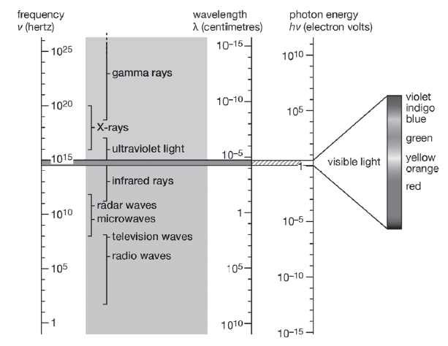
Electromagnetic Waves
Regions of the Electromagnetic Spectrum In the EM spectrum, you will be able to find specific regions that carry energy based on the frequency and wavelength of the EM waves emitted. There are no specific boundaries between any of these areas of EM radiation, so the ranges tend to overlap.
Overlapping of the frequencies of EM waves

Slide 12
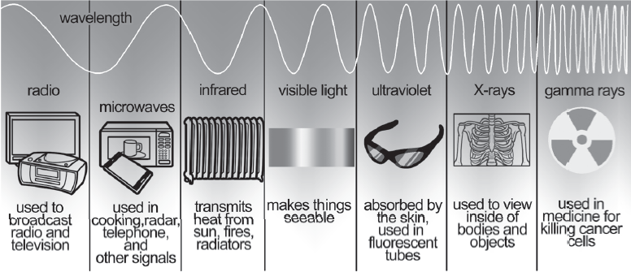
Electromagnetic Waves
The entire EM spectrum is composed of EM waves that range from the lowest to the highest frequency or longest to shortest wavelengths. It begins with the longest wavelength radiation, which are the radio waves followed by the microwaves, infrared radiation, visible light, ultraviolet radiation, X-rays, and gamma rays. Below is an image showing the regions of the EM radiation present in the spectrum.
Types of electromagnetic radiation

Slide 13
Electromagnetic Waves
Practical Applications of Electromagnetic Waves
The effect of EM waves on matter depends on its frequency and wavelength. Each EM wave has a distinct characteristic that allows it to have a specific use and application.
1. Radio Waves
Radio waves have the longest wavelength in the spectrum, which means that they carry the lowest energy. Radio waves are produced by the oscillation in the electrical circuits. They produce the alternating current for the aerial radio FM or frequency modulation and AM or amplitude modulation. Since they have longer wavelengths, they can cover longer distances, and they can easily be transmitted. They are commonly used for communication processes, such as television broadcasting, AM and FM broadcast radio, heart- rate monitors, and cell phone communication. Radio waves are also used for MRI or magnetic resonance i Imaging, which uses shorter radio waves with a magnet to create an image.

Slide 14
Electromagnetic Waves
2. Microwaves
Microwaves are similar to radio waves but have shorter wavelengths. Their wavelength ranges from 1 millimeter to 1 meter. Because of their short wavelength and high frequency, microwaves can pass through the atmosphere, which make them an excellent means of satellite communication. They can pass through food and penetrate water particles, causing them to vibrate and increase their thermal energy. Microwaves are mainly used for cooking, heating food, and satellite communication. Specific examples of its uses include microwave ovens, wireless headsets and speakers, broadband wireless internet, radar, and GPS.
3. Infrared Light
Infrared light is the region of wavelengths between microwaves and visible light. It is not visible to the human eye, but infrared cameras can detect it. Through thermal imaging, people can see entities in the dark. Infrared light has frequencies that are absorbed by chemical bonds, which makes it easier to be conducted through electrical heaters, cooking, and infrared cameras. Its uses include night-vision goggles, remote controls, and heat-seeking missiles.

Slide 15
Electromagnetic Waves
4. Visible Light
Visible light is the only type of EM wave that can be detected by the human eye. Violet is the highest frequency light, while red light is the lowest. The rainbow is an example of this phenomenon with ROYGBIV as its main colors. As the rainbow is caused by the reflection, refraction, and diffraction of light in water droplets, it strikes the visible light spectrum, causing its multicolored form. It is also used in fiber-optic communication, where coded pulses of light travel through glass fibers from a source to a receiver.
5. Ultraviolet Radiation
Ultraviolet waves have shorter wavelengths than visible light. This is the main radiation that we get from direct sunlight. Vitamin D is produced in our skin when exposed to UV radiation. However, too much exposure may also cause severe problems, such as sunburn or skin cancer. Their major uses today include black lights, security images on money, and sterilization of medical equipment as they can kill bacteria.

Slide 16
Electromagnetic Waves
6. X-ray
X-ray radiation has tiny wavelengths that indicate high energy content embedded in its waves. It has high ionizing energy, which means that it can penetrate the electrons from the shell of the atomic structure and turn them into ions (charged particles). Its major uses today include medical imaging and airport security. A moderate dose can be damaging to cells due to deterioration of cell structure and mutation; hence, radiology technologists must be careful when exposing themselves to X-ray radiation.
7. Gamma Rays
Gamma rays pertain to the region of the EM spectrum with the smallest wavelengths, which means that they have the highest energy compared to all other EM waves. They have a high ionizing capacity that can damage or allow cells to mutate. They are used to sterilize medical equipment and to kill cancer cells through chemotherapy or radiotherapy. Too much exposure to gamma rays will kill nearly all living cells.

Slide 17
Electromagnetic Waves
Effects of Electromagnetic Waves on Living Things and the Environment
Too Much Cell Exposure Can Cause Cell Damage
All EM waves in the spectrum emit radiation. Radiation is the energy in form of waves or particles emitted, which is transmitted in a vacuum of space. Exposure to very high levels of radiation can cause acute health effects, such as skin burns and acute radiation syndrome or sickness. It can also result in long-term health effects, such as cancer and cardiovascular disease. The ionizing radiation has sufficient energy to affect the atoms in living cells and thereby damages their genetic material (DNA). Fortunately, the cells in our bodies are extremely efficient at repairing this damage. Public health is of utmost importance since high exposure to EM radiation can cause alteration in genetic composition, resulting in a mutation. Because of this, children and adult mortality and cancer-causing phenomena have spread rapidly, especially those near the high powered magnetic fields of radiography and X-ray crystallography machines, cables, and telecommunication towers.

Slide 18
Electromagnetic Waves
The majority of studies focusing on the effects of EM radiation in the environment are centered on plant growth. Due to EM radiation, pollen fertility was reduced, according to the study of Zaidi and Khatoon (2003). The World Health Organization issued an information sheet on EMFs and their effects on public health in 2005. It was highly emphasized in the paper that awareness of any environmental impacts of EMF is important to ensure the preservation of terrestrial and marine ecosystems, which form the basis for sustainable development.
Protection of the environment and conservation of nature have become matters of great interest to the public, as well as to governments. Such interest is often expressed as concern over possible environmental impacts of large technology projects, such as dams, nuclear power plants, and radio-frequency transmitters. In general, too much exposure to something is harmful, and too little exposure will also put people at risk. This simply teaches us to utilize gadgets, devices, and materials with EMFs in moderation and become fully aware of their potential hazards to the human body cells, organisms with cellular structure, and the environment.

Slide 19
Electromagnetic Waves
Activity
Directions: Enumerate and discuss the parts of a wave and how scientists use this information to determine electromagnetic radiation.
1. Characteristics
2. Major uses of Electromagnetic Waves
3. Parts of Electromagnetic Waves
4. Effects on living things and the Environment

Slide 20
Electromagnetic Waves
Answer Key
1. Characteristics
- described by wavelength, frequency, energy; propagated by oscillating electric and magnetic fields; transverse waves
2. Major uses of Electromagnetic Waves
- TV broadcasting, Global Positioning System (GPS), night-vision goggles, sterilizing medical equipment, radiotherapy
3. Parts of Electromagnetic Waves
- radio waves, microwaves, infrared rays, visible light, ultraviolet rays, X-rays, gamma rays
4. Effects on living things and the Environment
- can cause acute health effects, such as skin burns, and acute radiation syndrome or sickness; can cause long-term health effects, such as cancer and cardiovascular disease; can cause mutation; can lead to a reduction of pollen fertility in plants

