Slide 1
Circuit and Circuit Elements

Slide 2
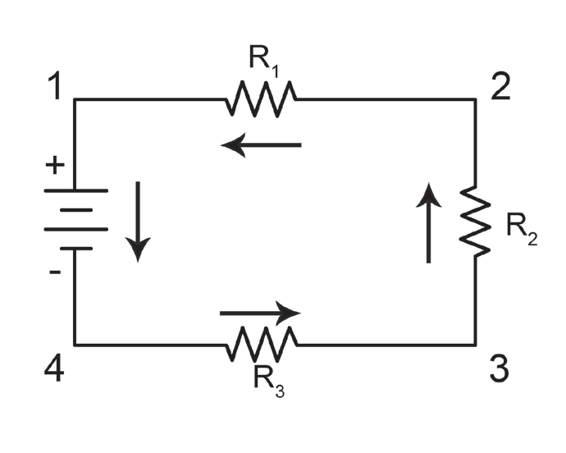
Circuit and Circuit Elements
Series and Parallel Circuits
In a series circuit, the various components comprising the circuit are connected one after another. The current, starting from the voltage source, must flow through each circuit component in turn before returning to the other side of the source.

Slide 3
Circuit and Circuit Elements
There are three important facts concerning a series circuit that must be kept in mind in order to understand thoroughly the action of such circuits and to determine their solution. In a series circuit,
1. the total voltage is equal to the sum of the voltages across the different parts of the circuit.
2. the current in any part of the circuit is the same.
3. the total resistance of the circuit is equal to the sum of the resistance of the different parts.
Vt = V1 – V2 = V3 + ...
I = I1 = I2 = I3 ...
Rt = R1 = R2 + R3 + ...

Slide 4
Circuit and Circuit Elements
The example below will show you how to determine electrical quantities, such as voltage, resistance, and power, in a series circuit.
Example:
Three resistors, R1 = 20 Ω, R2 = 50 Ω, and R3 = 30 Ω, are connected in a series across a generator. The current through the circuit is 2.5 A. Find out the answers to the following questions: (a) What is the generator voltage? (b) What is the voltage across each resistor? (c) How much power is expended in each resistor? (d) What is the total power expended?
Solution:
a. Calculate the total resistance by adding the individual resistances:
Rt = R1 + R2 + R3 = 20 + 50 + 30 = 100 Ω
b. Using Ohm’s law, determine the total voltage:
Vt = I Rt = 2.5 × 100 = 250 V

Slide 5
Circuit and Circuit Elements
c. Using Ohm’s law, determine the individual voltages:
V1 = I R1 = 2.5 × 200 = 50 V
V2 = I R2 = 2.5 × 50 = 125 V
V3 = I R3 = 2.5 × 30 = 75 V
d. To determine the individual electrical power in each resistor, use the formula P = VI.
P1 = V1 I = 50 × 2.5 = 125 W
P2 = V2 I = 125 × 2.5 = 312.5 W
P3 = V3 I = 75 × 2.5 = 187.5 W
Calculate the electrical power by adding the individual electrical power in each resistor.
Pt = P1 + P2 + P3 = 125 + 312.5 + 187.5 = 625 W

Slide 6
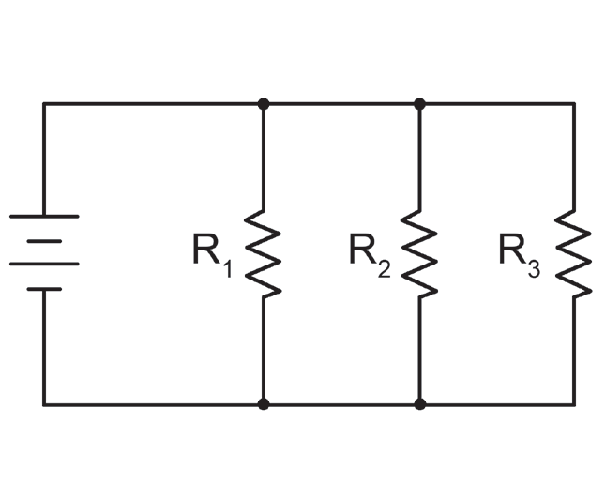
Circuit and Circuit Elements
Parallel circuit is the most commonly used circuit. The average distribution circuits have many types of loads, all connected parallel with each other: lighting circuits, motors, transformers for various uses, and others. The same is true for electronic circuits, which range from the most simple parallel circuits to complex networks. Components in a circuit are parallel if one side of each component is connected to a common junction and the other side is connected to another common junction.

Slide 7
Circuit and Circuit Elements
A parallel circuit has the following characteristics:
1. The voltage in any part of the circuit is the same.
2. The total current is equal to the sum of the currents across the different parts of the circuit.
3. The total resistance of the circuit is given by:
The example on the next page will show you how to determine electrical quantities, such as voltage, resistance, and power, in a parallel circuit.
V = V1 = V2 = V3 = ...
I = I1 = I2 = I3 ...
____ = ____ + ____ + ____
1
1
1
1
Rt
R1
R2
R3

Slide 8
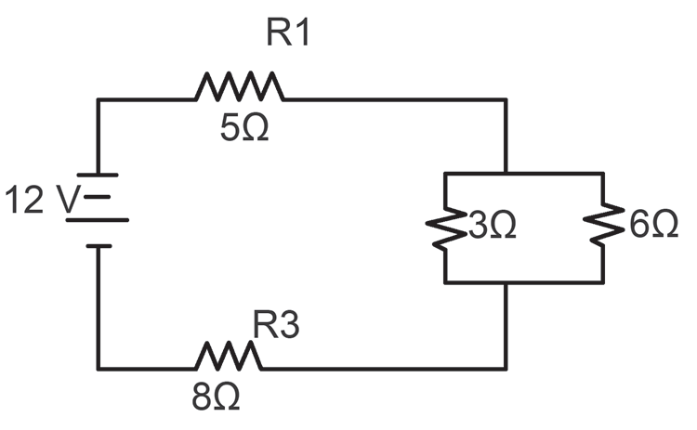
Circuit and Circuit Elements
Example:
Calculate the equivalent resistance of the arrangement of resistors shown in the figure below and the total current IT flowing through the battery.
The total resistance of the parallel resistors is:
The equivalent resistance of the series resistors is:
To calculate the total current:
____ = ____ + ____ = 2Ω
1
1
1
Rp
3Ω
6Ω
Req = R1 + Rp + R3 = 5 Ω + 2 Ω + 8 Ω = 15 Ω
IT = ____ = ____ = 0.80 A
V
12 V
Req
15 Ω

Slide 9
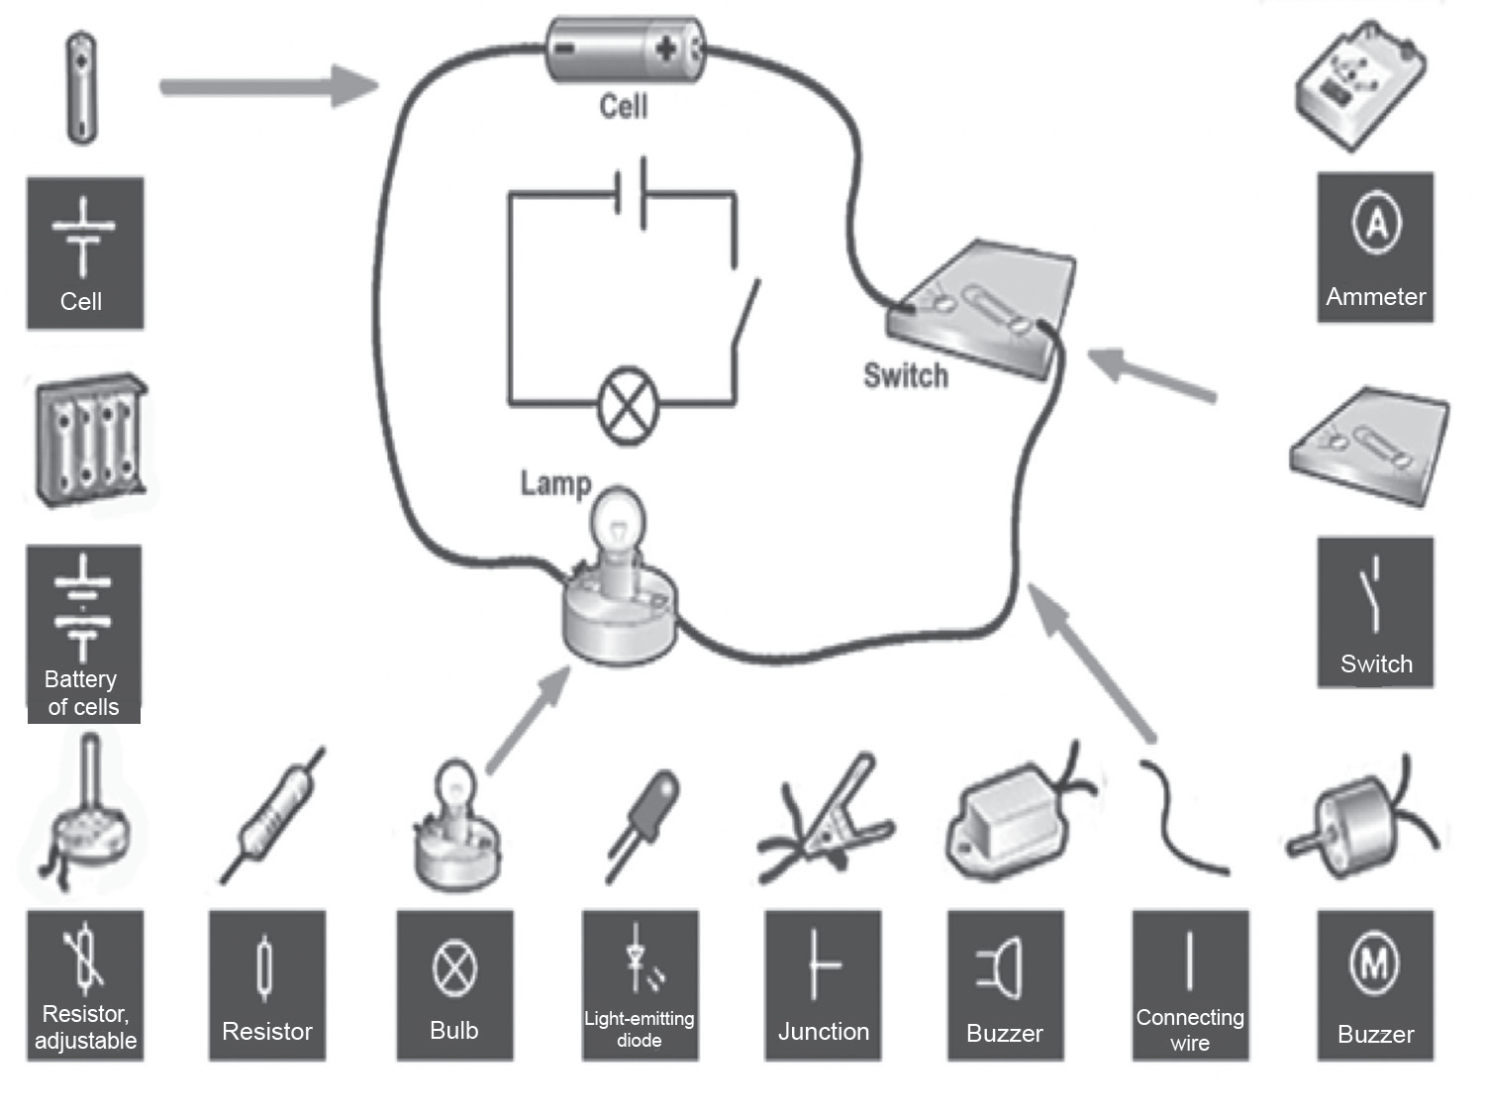
Circuit and Circuit Elements
Electric Circuits
Electric Circuits
Electric circuits are formed when a conductive path is created to allow free electrons to continuously move in a closed path (with no breaks or gaps). On the right is a diagram of an electric circuit with the components and their symbols. Some common elements found in electrical circuits include light bulbs, batteries, connecting leads, switches, resistors, voltmeters, and ammeters. These symbols of electrical components are used when you draw diagrams to create physical circuits. Hence, it is important to remember these symbols and how to represent them in circuit diagrams.

Slide 10
Circuit and Circuit Elements
The electrical circuits in a house have a parallel connection. As you turn on more appliances, there is a corresponding increase in the total electrical current in the house circuits. Looking at the illustration below, a fuse or a circuit breaker put in series limits the total current through any particular circuit. The main fuse limits the total current from the transmission line into the house. The house is thereby protected from overloading circuits.

Slide 11
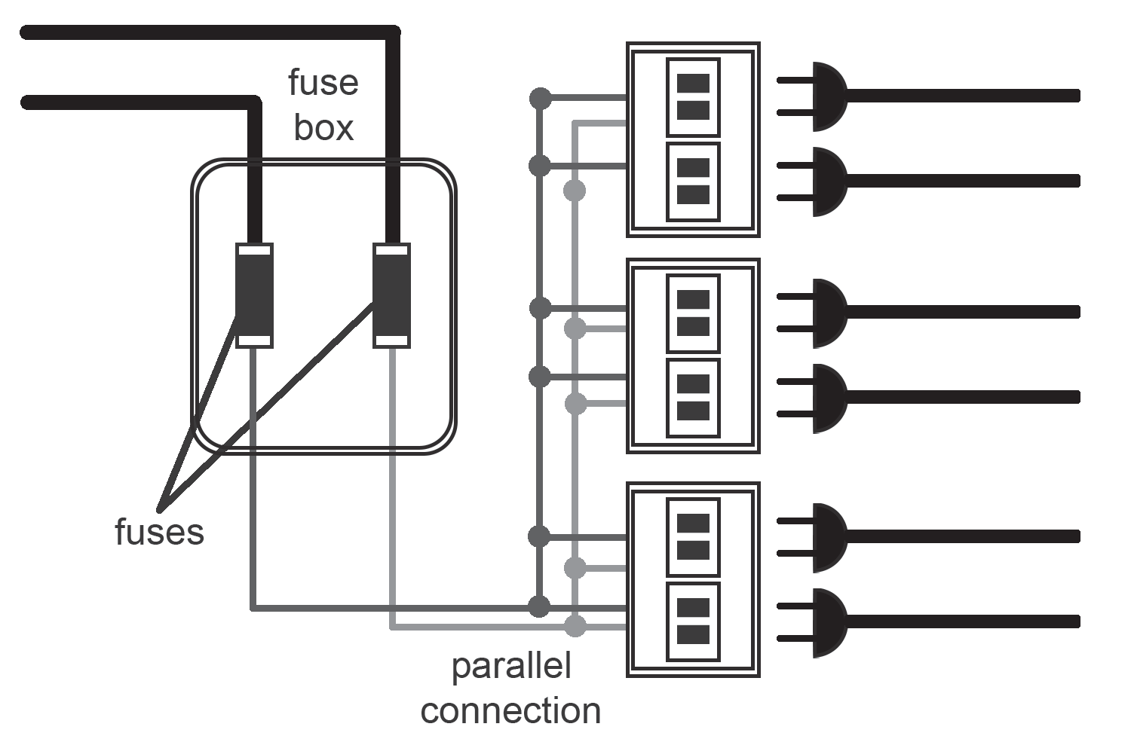
Circuit and Circuit Elements
Switches are devices that create a short circuit or an open circuit, depending on the position of the switch. A typical light switch is ON when a short circuit is present, that is, the current flows through the switch and bulbs light up. The switch is OFF when there is an open circuit, meaning the current does not flow and the lights go out. The switch functions as a wire when it is ON; as such, when the switch is OFF, there is no connection.

Slide 12
Circuit and Circuit Elements
Electrical Safety
Perhaps you or someone you know have experienced some form of electric shock. A mild electric shock could just be a tingling feeling or a small jolt of pain, but a severe shock could be fatal. To avoid any injuries and accidents caused by electricity, here are some important rules to remember:
Never handle electrical appliances when you or your hands are wet or if you are standing in water.
Never stick your fingers or any object other than a plug into an electrical outlet.
Always unplug an electrical appliance before attempting to open or repair it.
Never overload a circuit by plugging in too many appliances to it.
Never touch wires on power poles or wires that have fallen.
Never use broken or frayed wires.

Slide 13
Circuit and Circuit Elements
Activity
Directions: Match column A to column B. Write only the letter of the correct answer.
Column A
Column B
_____1. Is the most commonly used in circuit.
_____2. This put in series limits the total current through any particular circuit.
_____3. Are devices that create a short circuit or an open circuit, depending on the position of the switch.
_____4. A circuit where resistances (or loads) are placed one after another.
_____5. Are formed when a conductive path is created to allow free electrons to continuously move in a closed path (with no breaks or gaps).
A. Switches
B. Electric Circuits
C. Circuit Breaker
D. Series Parallel
E. Parallel Circuit

Slide 14
Circuit and Circuit Elements
Answer Key
_____1. Is the most commonly used in circuit.
_____2. This put in series limits the total current through any particular circuit.
_____3. Are devices that create a short circuit or an open circuit, depending on the position of the switch.
_____4. A circuit where resistances (or loads) are placed one after another.
_____5. Are formed when a conductive path is created to allow free electrons to continuously move in a closed path (with no breaks or gaps).
E
C
A
D
B

