Slide 1
Electricity—The Charging Process

Slide 2
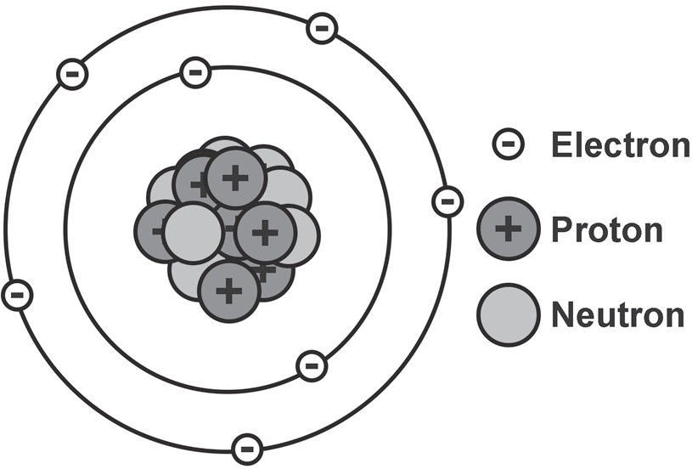
Electricity—The Charging Process
Matter is made up of tiny particles called atoms. An atom has three subatomic particles: (1) electron, (2) proton, and (3) neutron. Figure below shows the charges of the subatomic particles. The electron carries the negative charge while the proton carries the positive charge.
The neutron is the part of the atom that has no charge or neutral. An atom with an equal number of protons and neutrons is described as electrically neutral. If an atom has more electrons than protons, it is negatively charged. Conversely, an atom that has fewer electrons than protons is said to be positively charged. This principle can also be applied to objects. Objects with fewer electrons than protons are positively charged and vice versa. When charges of atoms come close to each other, they behave depending on their charge. Charges of the same type repel each other while opposite charges attract.

Slide 3
Electricity—The Charging Process
Charging by Friction
What will happen to the electrons of two objects that were rubbed against each other? When two objects are rubbed together, one object may pull electrons away from the other object creating one positively charged object and one negatively charged object.
Friction is the resisting force between two sliding or rubbing objects. Friction allows electrons to travel. The rubbing of one object against another object will lead to the movement of electrons from one surface to the other. Because of this, one object loses an electron and becomes positively charged. Conversely, the other object gains an electron and becomes negatively charged. This process is called charging by friction. Note that the charge of an object is determined by its loss or gain of an electron. Whenever there is friction between materials that differ in their ability to lose or gain electrons, the electrons can be transferred easily.

Slide 4
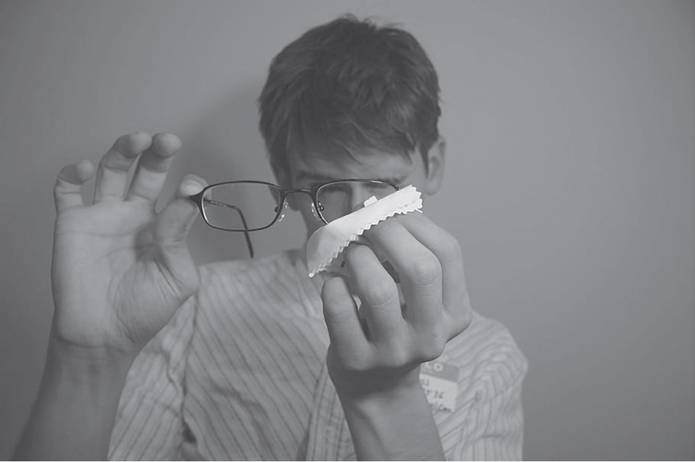
Electricity—The Charging Process
Example is when you use a cloth to clean your eyeglasses. Electrons move from the glass onto the cloth. Since the glass lost electrons, it became positively charged. The cloth that gained electrons became negatively charged. Remember that charges remain on the surfaces of the objects until they can flow.

Slide 5
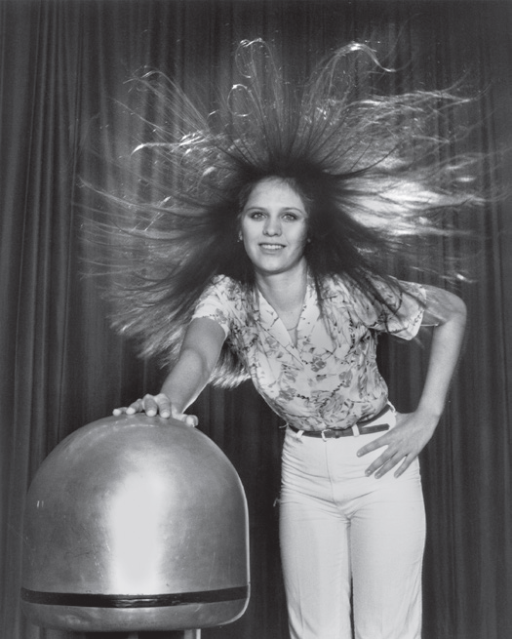
Electricity—The Charging Process
Charging by Conduction
Charging by conduction involves touching a charged object to a conductive material. This way, the charges are transferred from the charged object to the conductor. Remember that whenever a neutral body is charged by conduction, the charge produced is same as the charge of the charging body. This simply means that if the charging body is negatively charged, then the charge produced is also negative.
The student stands on an insulating platform and touches the negatively charged Van de Graaf generator. In this system, the Van de Graaf generator is the charged body and the student is the neutral body. Since the charged body is negatively charged, when the student comes in direct contact with it, the student becomes negatively charged as well. The excess negative charges repel the negative charges on the student’s body, which makes her hair stand on end.

Slide 6
Electricity—The Charging Process
Behavior of Electric Charges on Conductors and Insulators
Conductors and insulators behave the same way with electricity. Conductors allow electrons to flow easily from atom to atom inside them, thus allowing the transmission of electricity. In contrast, insulators block or slow down the flow of electricity. Metals, such as copper and aluminum are great conductors of heat and electricity. That is why they are widely used in electrical wires. Rubber, plastic, and glass are good examples of insulators. They are commonly used to cover materials that carry electricity. You see this in the electrical wires at home that are wrapped in plastic.

Slide 7
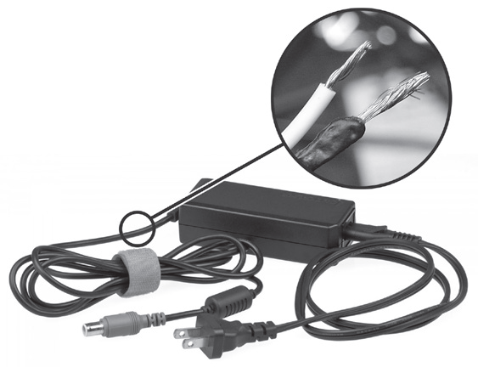
Electricity—The Charging Process
Figure below shows a laptop power adapter or charger which uses metal wires and connectors to conduct electricity from the wall socket to the laptop computer. The conducting wire allows electrons to flow through the cables, which are covered by rubber and plastic. These materials act as insulators that block electric charges from escaping outward, protecting users from being electrocuted.

Slide 8
Electricity—The Charging Process
Charging by Induction
Charging by induction is a process that does not involve contact between the neutral body and the charging body. The neutral body is just brought very close to the charging body. Unlike charging by conduction, the acquired charge in charging by induction is opposite to that of the charging body. Simply put, if the charging body is positively charged, the acquired charge is the opposite of that which is negative. When charging through induction, the charged particle is held near a neutral conductive material that is grounded on a neutrally charged material.

Slide 9
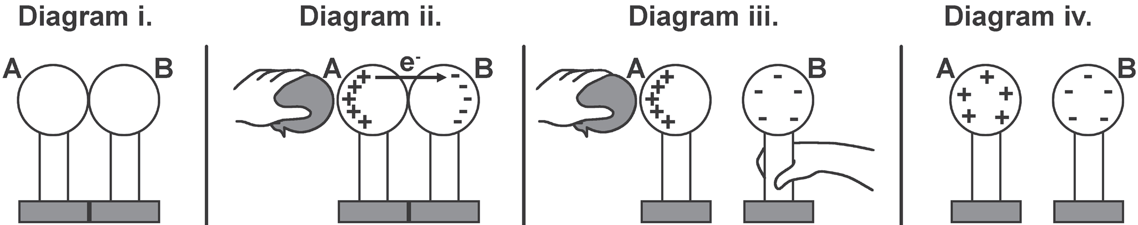
Electricity—The Charging Process
Figure below shows two metal spheres put on insulating stands. The positively charged balloon acts as the charging body and is brought near the conductive sphere A that is grounded on the neutrally charged sphere B. As discussed earlier, opposite charges attract and like charges repel. When the positively charged balloon is brought near the sphere, it attracts the electrons of sphere B to move to sphere A. Sphere A now becomes negatively charged, which is opposite to the balloon’s charge. Note that the charge of the balloon did not transfer to any of the spheres. It was only used to induce the movement of the electrons from sphere B to sphere A.

Slide 10
Electricity—The Charging Process
Grounding
Objects with an excess of charge either positive or negative can have this charge removed by a process known as grounding or earthing. Grounding is the process of removing the excess charge on an object by means of transferring electrons between it and another object. When a charged object is grounded, the excess charge is balanced by the transfer of electrons between the charged object and the ground. A ground is simply an object that serves as an infinite reservoir of electrons. The ground can transfer electrons to or receive electrons from a charged object in order to neutralize that object. Earth is generally taken as the ground because of its ability to disperse positive as well as negative charges over a huge volume and not just accept electrons.

Slide 11
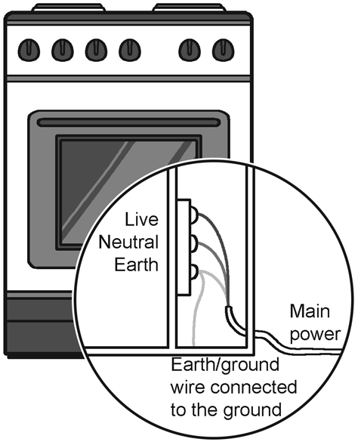
Electricity—The Charging Process
Have you ever noticed the thin wire connected at the back of a refrigerator or microwave oven? You may notice that this wire is connected to a nail on the wall. This is an example of grounding. Figure below shows the grounding or earthing wire of an oven. This removes the excess charges from the appliance, ensuring your safety when you use it.
When there is adequate grounding, the excess current flow is removed, eliminating threats. In the absence of grounding, the excess current may cause an electrical appliance to short circuit, which can break the appliance or cause a fire in the house. In some cases, you can also get electrocuted if you touch an appliance that is not properly grounded. Any object can be grounded provided that the charged atoms of that object have a conducting pathway between the atoms and the ground.

Slide 12
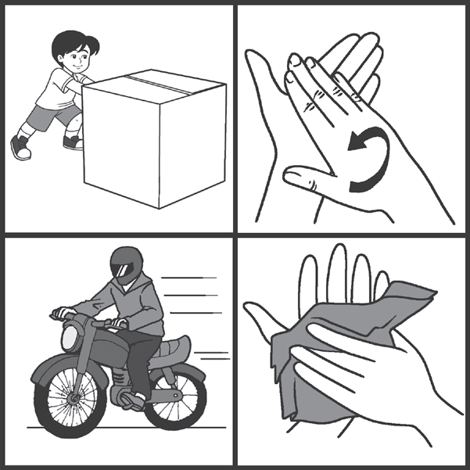
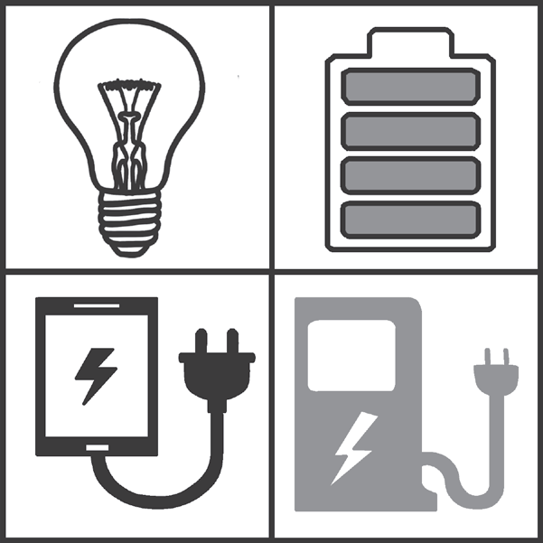
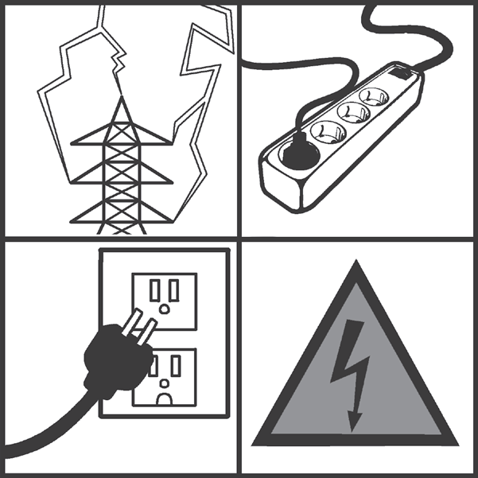
Electricity—The Charging Process
Activity
Direction: Look at the given sets of pictures and identify what they are portraying. Complete the word at the bottom of each set of pictures.
F __ __ C __ __ __ N
__ H A __ __ E
E __ E __ T R __ __ __ __ Y

Slide 13
Electricity—The Charging Process
Answer Key
F R I C T I O N
C H A R G E
E L E C T R I C I T Y

