Slide 1
Electric Power and Energy

Slide 2
Electric Power and Energy
Electric Power
Electric power is characterized by the current or the flow of electric charge and voltage or the potential of charge to deliver energy. This relationship is expressed as:
P = VI
where P is the power in watts (W), V is the voltage measured in volts (V), and I is the current expressed in ampere (A). For example, an electric fan draws a 5 A current from a 110 V outlet. Its power input is 550 W.

Slide 3
Electric Power and Energy
Electric power also represents the amount of energy transformed from one form to another divided by the elapsed time. Mathematically, this can be expressed as:
Power = ________
Energy
time
Rearranging the equation,
Energy = Power × time
E = Pt
where E is in kilowatt-hour, P can be expressed in watt or kilowatt, and t is in hours.The usual unit for electric energy consumption is the kWh. One kilowatt-hour of energy is consumed when 1,000 W of power continues in action for an hour. The consumer of electric energy pays for the amount of energy used by the electrical equipment. Using the equation above, you can determine the cost of energy consumption at your home.

Slide 4
Electric Power and Energy
Examples:
1. Air conditioners in a certain building are in use for 8 h every day and together use 35 kW. How much energy is used in a day? If the cost per kWh of energy is ₱ 7.90, how much will the operation of air conditioners cost in a day?
Given:
P = 35 kW
t = 8 h
E = ?
Solutions:
E = Pt
E = (35 kWh) (8 h)
E = 280 kWh
To compute the cost of operating air-conditioning units for a day, multiply the energy consumption by the cost per kWh: 280 kWh (₱ 7.90/kWh) = ₱ 2,212.00.

Slide 5
Electric Power and Energy
2. A toaster on a 200 V line draws a current of 5 A. How much energy in kWh does it generate in 30 min?
Given:
V = 200 V
I = 5 A
t = 30 min or 0.5 h
E = ?
Solutions:
P = VI
P = (200 V) (5 A)
P = 1,000 W or 1 kW
E = Pt = (1 kW) (0.5 h) = 0.5 kWh

Slide 6
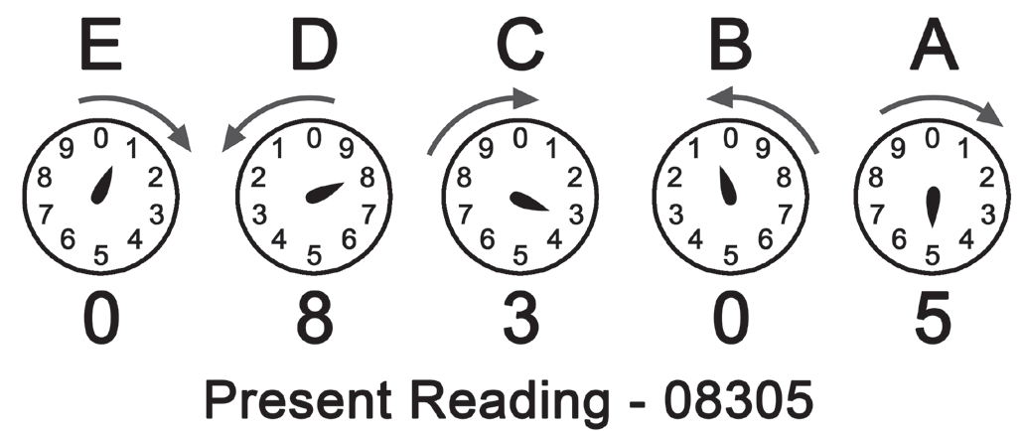
Electric Power and Energy
Electric Meter and Power Cost
Electric energy consumption can be measured by an instrument known as an electric meter. This meter records the amount of energy taken by the consumer. Many of these meters are digital, but the common meters found in our homes are analog. Study the sample meter reading shown in illustration below.
To read the energy consumed and recorded in the meter, there are guidelines to be followed. Start with the dial on the left and record each number in order. When the dial is in between numbers, record the lower number. Note that some dials move clockwise, and some move counterclockwise. The units are always recorded in kWh.

Slide 7

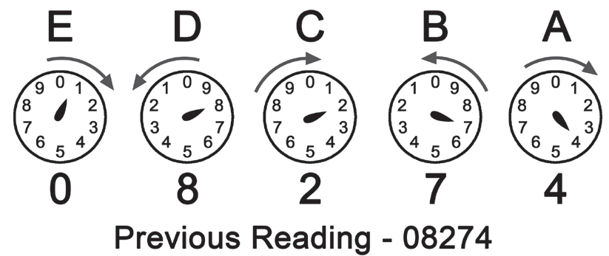
Electric Power and Energy
To compute your electric consumption, simply subtract the previous reading from the present reading.
= 31 kWh
If your household consumes around 200 kWh, your energy provider will charge you a generation fee amounting to ₱ 924.00 (using the rate of ₱ 4.62 per kWh as of June 2021).

Slide 8
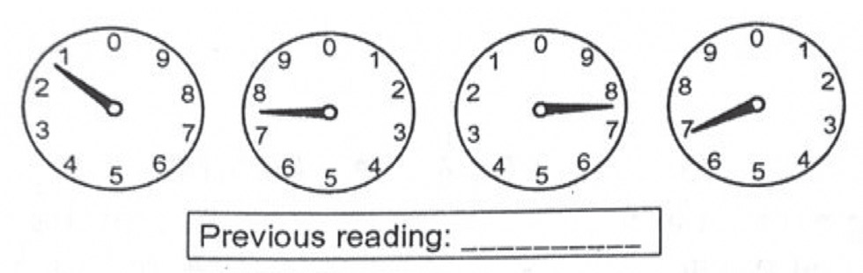
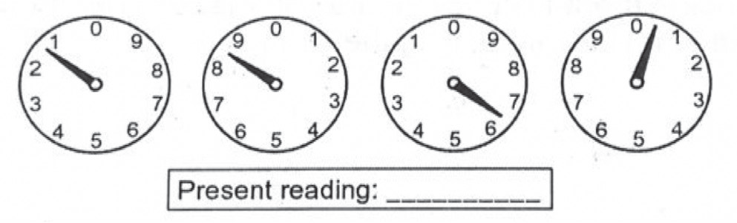
Electric Power and Energy
Sample Problem:
Determine the energy consumption cost of a household for one month if their electric meter reads as follows in illustrations below. The cost per kWh is ₱ 4.62.

Slide 9
Electric Power and Energy
Given:
cost per kWh = ₱ 4.62
previous meter reading = 1,777 kWh
present meter reading = 1,860 kWh
Solution:
Kwhconsumed = present reading – previous reading
= 1, 860 kWh – 1, 777 kWh
= 83 kWh
Energy consumption cost = (kWhconsumed) (cost per kWh)
= (83 kWh) (₱ 4.62)
= ₱ 383.46.

Slide 10
Electric Power and Energy
Activity
Directions: Solve the following problems.
1. A kettle has a power rating of 2,200 W and is used for 80 s. Calculate the total energy transferred.
2. What is the energy consumption cost of the household appliance in question 1 if it is used 20 times with an energy cost of ₱ 5.00 per kWh?

Slide 11
Electric Power and Energy
Answer Key
1. Given:
P = 2.2 kW
t = 0.022 h
E = ?
Solution:
E = Pt
E = (2.2 kW) (0.022 h)
E = 0.048 kWh
2. ECost = (0.048 kWh)(5.0)
= ₱ 0.24 (20)
= ₱ 4.80

