Slide 1
Comparing Things: Mass

Slide 2
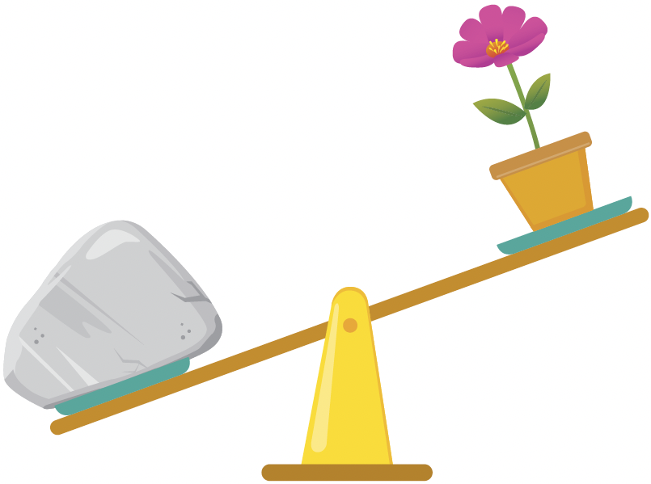
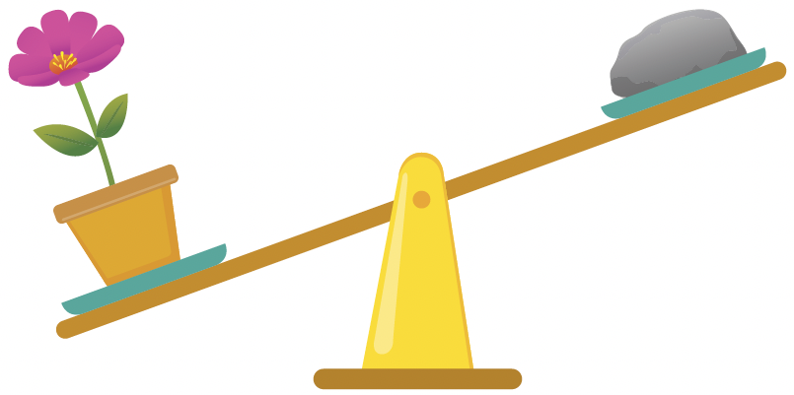
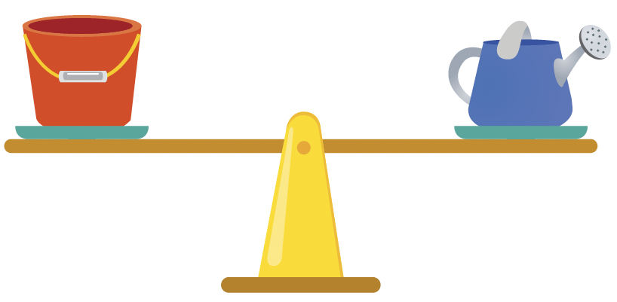
The mass of a thing means how heavy or light the thing is.
The rock is heavy. The pebble is light.
It is heavier than the flower pot. It is lighter than the flower pot.
The pail is as heavy as the watering can.
We can use a balance to compare the mass of things.

Slide 3
The rock is heavier than the flower pot.
The flower pot is heavier than the pebble.
The rock is the heaviest.
The pebble is the lightest.

