Slide 1
Finding the Masses of Things

Slide 2
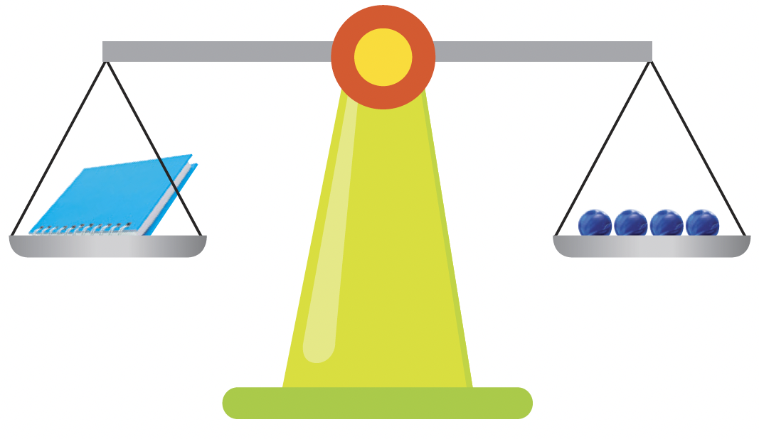
We can use different things around us to measure masses.
Each thing we use stands for 1 unit.
The notebook is as heavy as 4 marbles.
1 marble stands for 1 unit.
The mass of the notebook is about 4 units.
The notebook has
the same mass as
4 marbles.

Slide 3
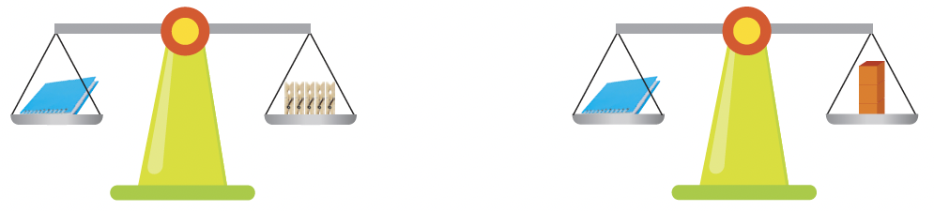
The notebook is as heavy as
5 clothes pegs.
The notebook is as heavy as
3 cubes.
1 peg stands for 1 unit.
The mass of the notebook
is about 5 units.
1 cube stands for 1 unit.
The mass of the notebook
is about 3 units.

