Slide 1
Measuring Mass in Grams

Slide 2
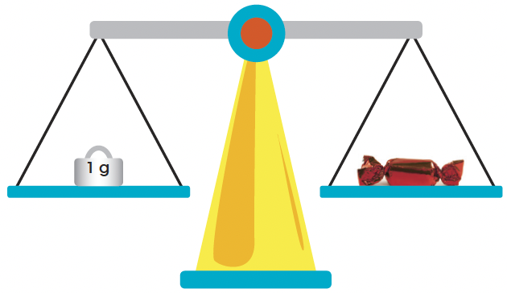
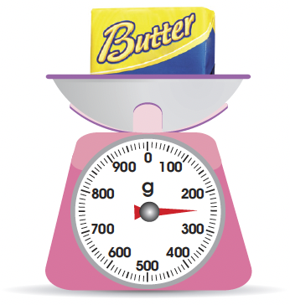
The gram is another unit of mass.
This is a 1-gram mass.
It is lighter than 1 kg.
The candy has a mass of 1 g.
The mass of the butter is 250 g.
Each small marking on the scale stands for 10 g.

