Slide 1
Measuring Mass in Kilograms

Slide 2
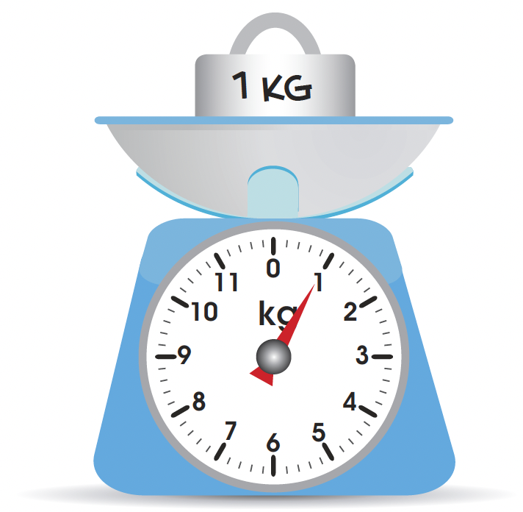
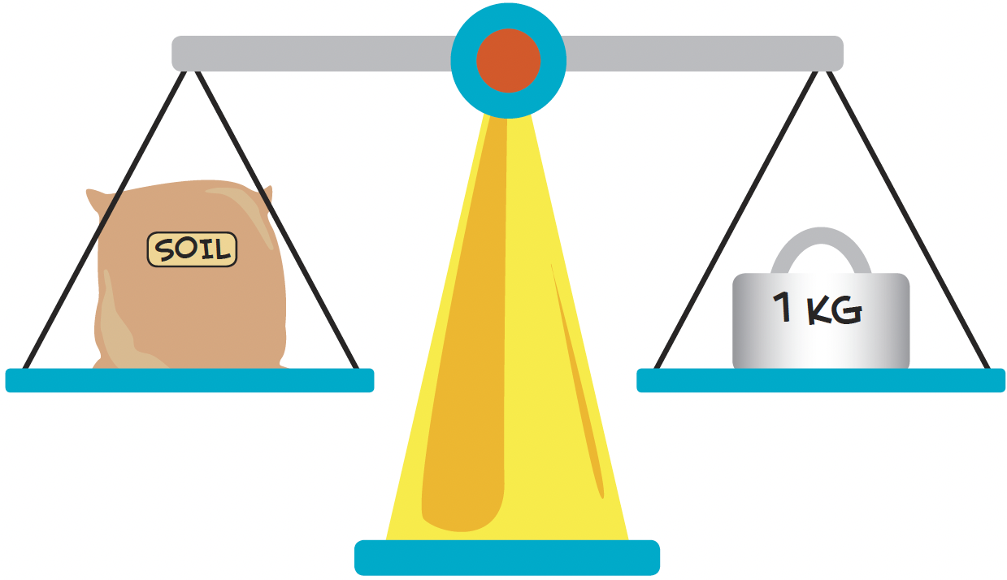
The kilogram is a unit of mass.
The kilogram is a unit of mass.
The bag of soil is as heavy as the 1-kilogram mass. The mass of the bag of soil is 1 kg.

Slide 3
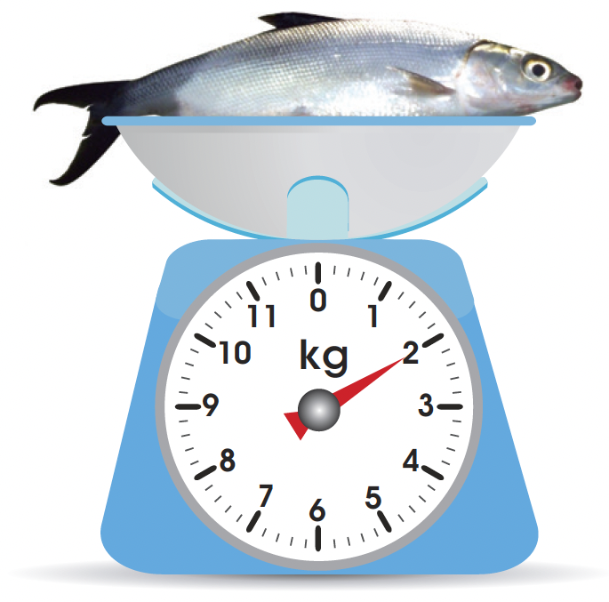
If the mass of the bag of the soil is greater than 1 kg, where will the pointer on the scale point to?
Where will the pointer on the scale point to if the mass of the bag of soil is less than 1 kg?
The mass of the bangus is 2 kg.

