Slide 1
Comparing Mass

Slide 2
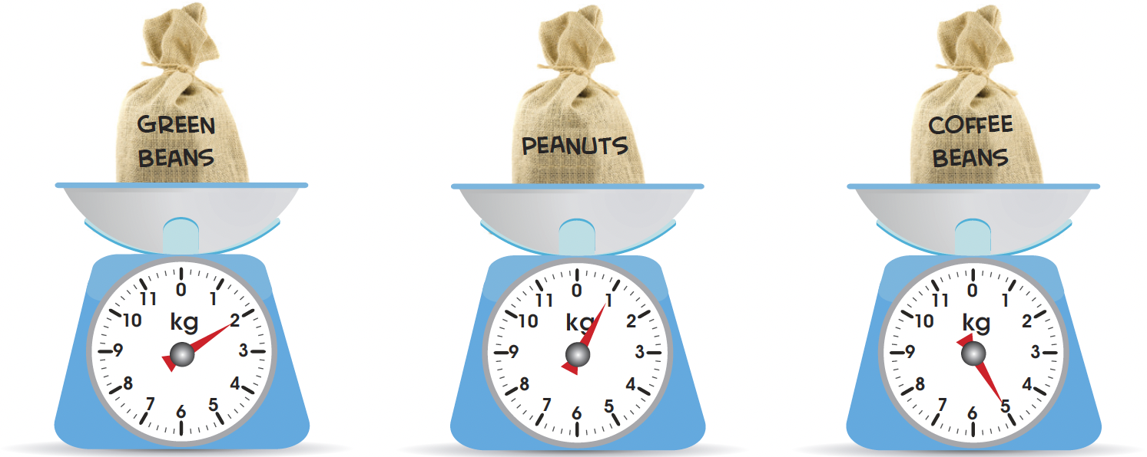
The mass of the bag of peanuts is 1 kg.
  1 kg is the same as 1000 g.
The mass of the bag of green beans is 2 kg.
The mass of the bag of coffee beans is 5 kg.

Slide 3
The bag of coffee beans is the heaviest.
The bag of peanuts is the lightest.
5 – 1 = 4
The bag of peanuts is 4 kg lighter than the bag of coffee beans.
5 – 2 = 3
The bag of coffee beans is 3 kg heavier than the bag of green beans.
Compare the mass of the 3 bags.
What is the difference
in mass?

Slide 4
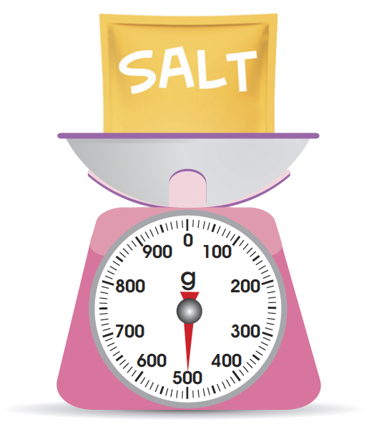
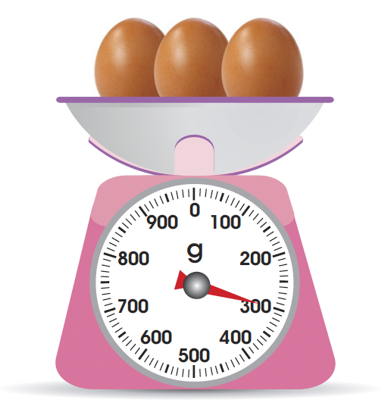
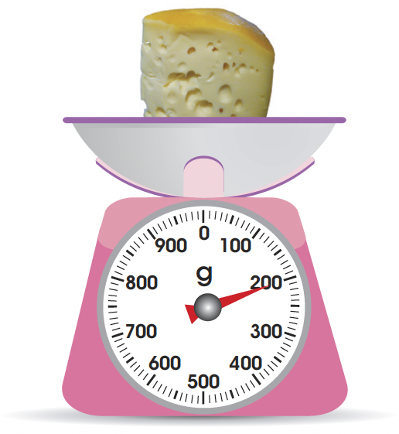
Compare the mass of the objects.
The mass of the packet of salt is 500 g.
The mass of the 3 eggs is 300 g.
The mass of the piece of cheese is 200 g.

Slide 5
The packet of salt is the heaviest.
The piece of cheese is the lightest.
The piece of cheese is lighter than the eggs.
500 – 200 = 300
The packet of salt is 300 g heavier than the piece of cheese.
300 – 200 = 100
The piece of cheese is 100 g lighter than the 3 eggs.

