Slide 1
Word Problems: Mass

Slide 2

Each person can check in a total mass of 20 kg without any extra charge when taking a plane.
  Do Kate and Carlo have to pay the extra charge when they check in their luggage?
  11 + 7 = 18
The total mass of Kate’s luggage is 18 kg.
It is less than 20 kg.
She does not have to pay the extra charge.
7 kg
11 kg

Slide 3

3 × 8 = 24
The total mass of Carlo’s luggage is 24 kg.
It is more than 20 kg.
He has to pay the extra charge.
8 kg
8 kg
8 kg

Slide 4
The mass of a box of red and blue marbles is 500 g.
  The total mass of the red marbles is 285 g.
  The total mass of the blue marbles is 200 g.
  What is the mass of the box?
  285 + 200 = 485
  The total mass of the marbles is 485 g.
  500 – 485 = 15
  The mass of the box is 15 g.

Slide 5
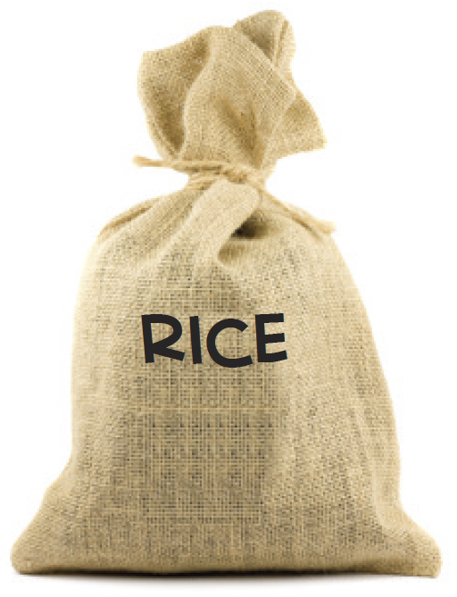
The mass of a bag of rice is 5 kg.
  Mama bought 3 such bags of rice.
  How much rice did she buy?
  5 × 3 = 15
  She bought 15 kg of rice.

Slide 6
36 kg of fruits are shared equally among 4 families.
  What is the mass of fruits that each family gets?
36 ÷ 4 = 9
Each family gets 9 kg of fruits.

