Slide 1
Understanding Capacity

Slide 2
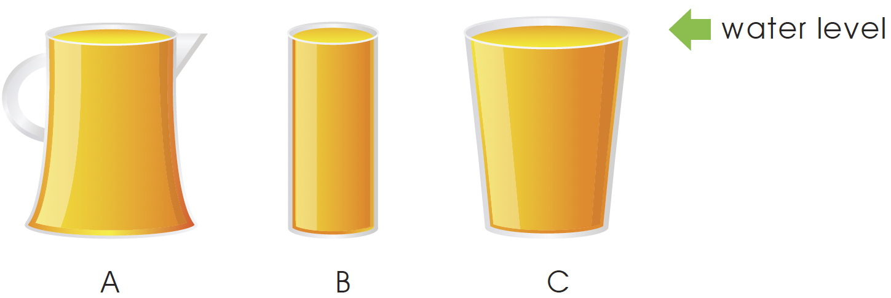
Measuring capacity
Find the capacities of containers A, B and C.
Capacity is the total amount of liquid a container can hold.
The level of colored water in each container is the same.
We pour the colored water in each container
into similar glasses to measure capacity.
But the containers are of different sizes.

Slide 3
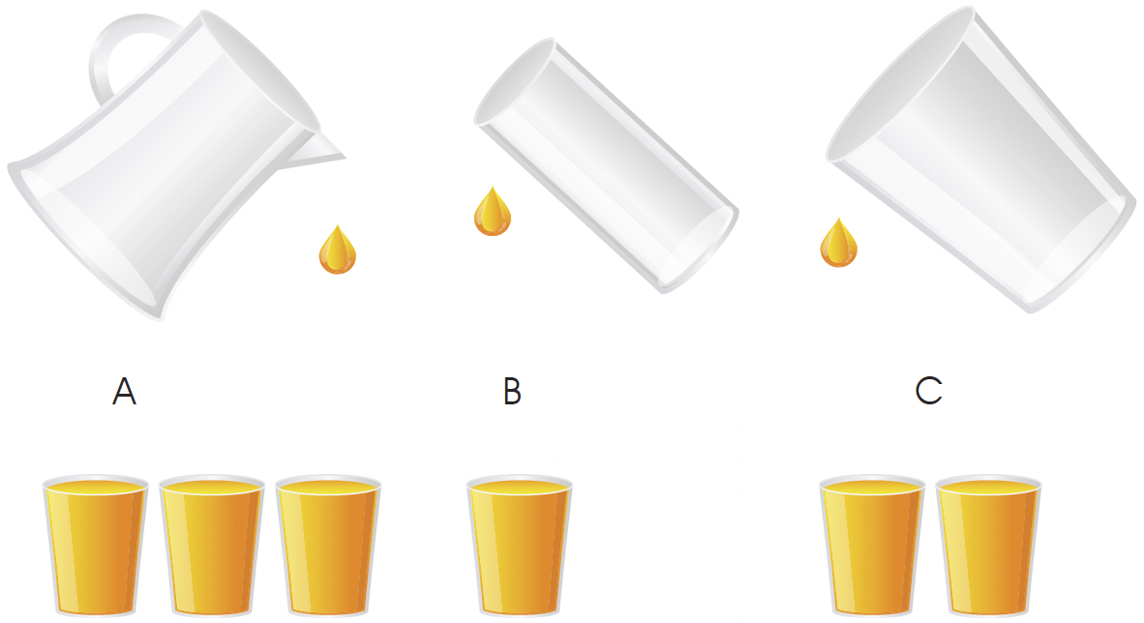
The colored water in container A can fill 3 glasses.
We say the capacity of container A is 3 glasses full.
The colored water in container B can fill 1 glass.
We say the capacity of container B is 1 glass full.
The colored water in container C can fill 2 glasses.
We say the capacity of container C is 2 glasses full.

Slide 4
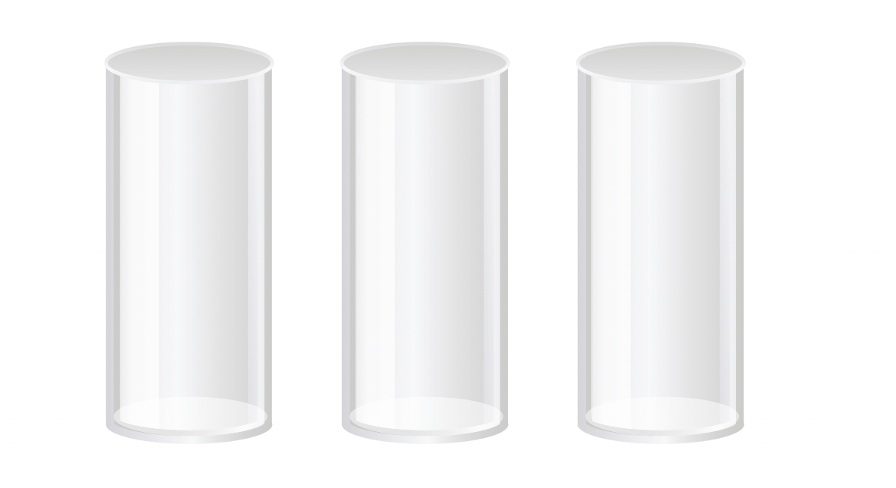
The capacities of three identical containers are the same.

Slide 5
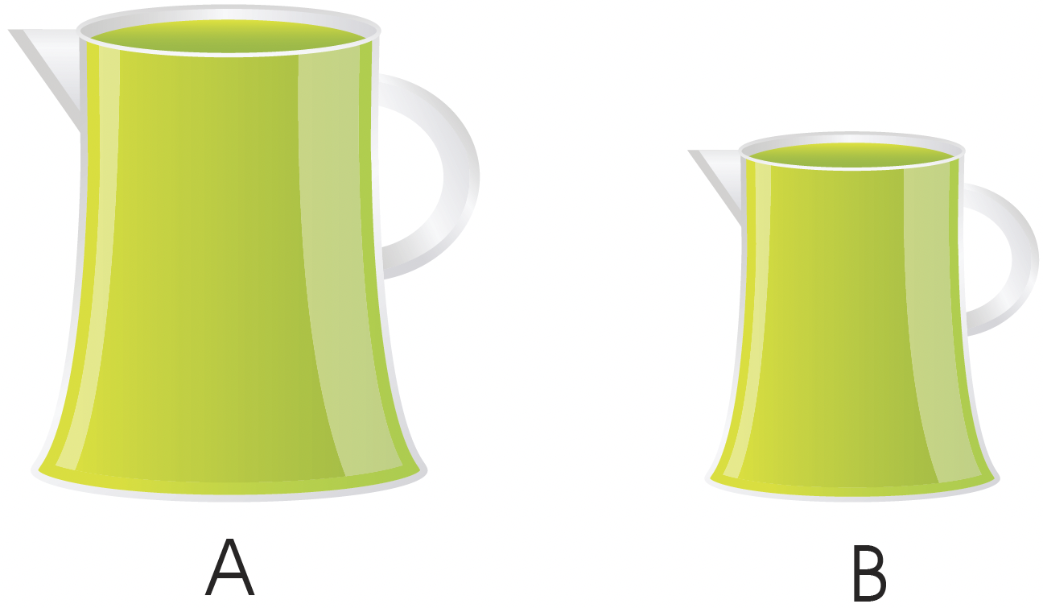
Comparing capacities
Mother fills 2 different pitchers to the brim with green apple juice.
Compare the capacities of the two pitchers.

Slide 6
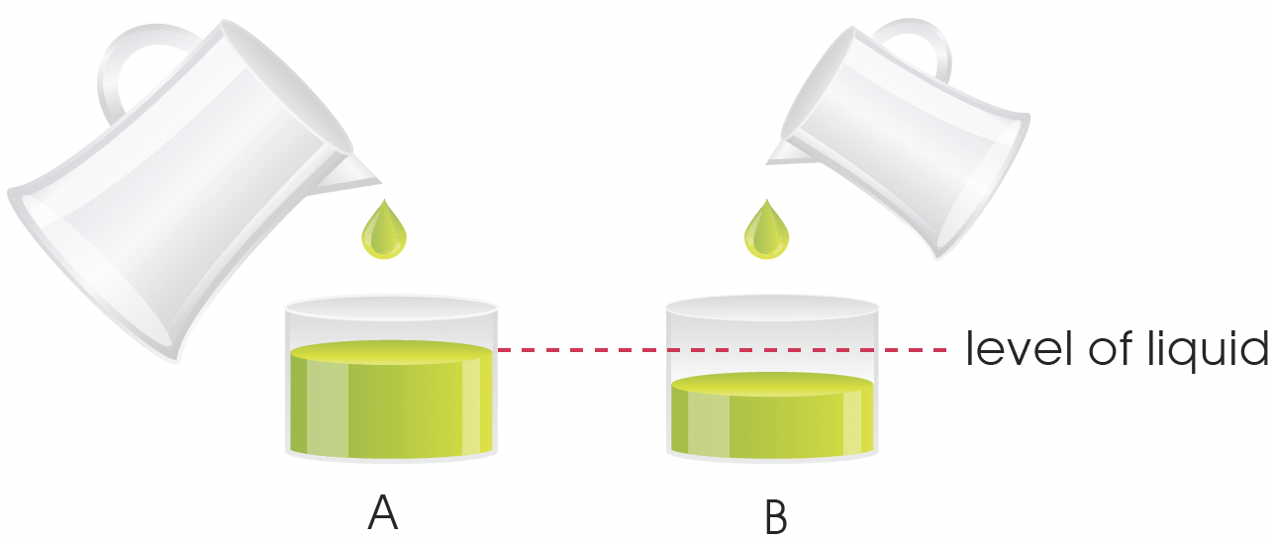
Pour the green apple juice in each pitcher into two containers of equal size, A and B.
The level of the apple juice in container A is higher than that in container B.
There is more apple juice in container A than in container B.
Pitcher A has a greater capacity than pitcher B.

Slide 7
The pictures below show the capacities of three different containers.
Packet
Jug
Pail

Slide 8
The pail has the greatest capacity.
The packet has the least capacity.
The jug holds 2 more bottles of milk than the packet.
The packet holds 4 less bottles of milk than the pail.
Arrange the containers in order, from the greatest to the least.
Pail
Jug
Packet
greatest
least

