Slide 1
Measuring Capacity

Slide 2
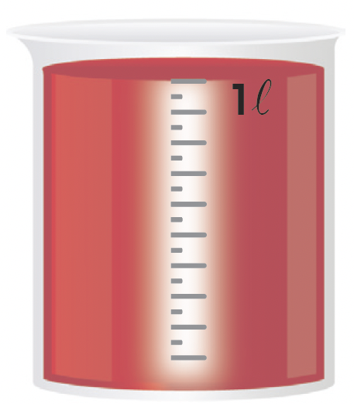
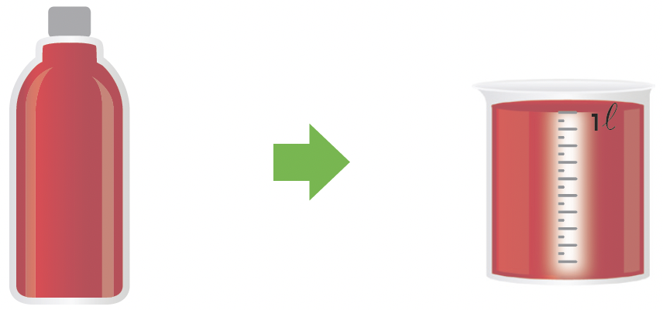
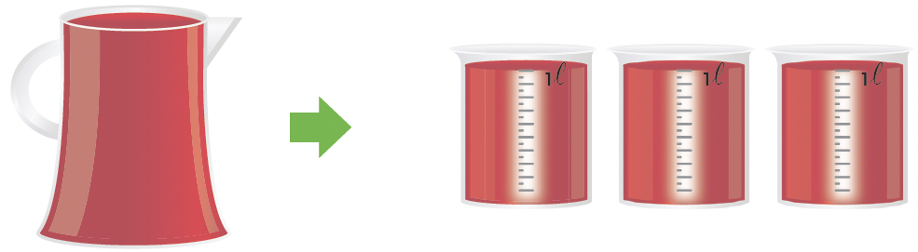
We can measure capacity in liters.
This is a 1-liter beaker.
We write liter as ℓ.
The capacity of the bottle is 1ℓ.
The capacity of the pitcher is 3ℓ.

Slide 3
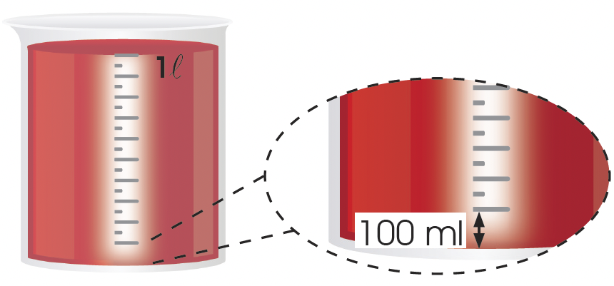
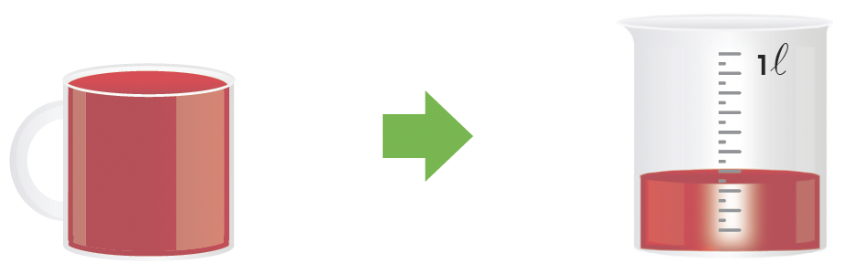
We can measure capacities in milliliters.
  Each long marking on the beaker represents 100 ml.
  We write milliliters as ml.
  The capacity of the mug is 300 ml.
10 long markings
make up 1ℓ.

