Slide 1
Word Problems: Capacity

Slide 2
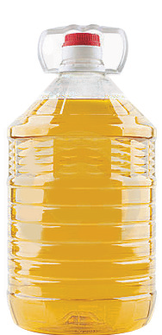
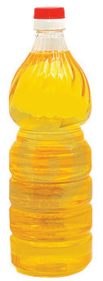
LET’S LEARN
1. Container A can hold 8 l of oil. Container B can hold 7 more liters of oil than container A.
What is the total capacity of containers A and B?
8 + 7 = 15
Container B can hold 15 l of oil.
15 + 8 = 23
The total capacity of container A and container B is 23 l.
A
B

Slide 3
LET’S LEARN
2. A small water dispenser can hold 5 l of water. A big water dispenser can hold 8 l of water. How much more water can a big water dispenser hold than a small water dispenser?
8 – 5 = 3
A big water dispenser can hold 3 more liters of water than a small water dispenser.

Slide 4
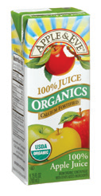
LET’S LEARN
3. Gemma buys 4 packets of apple juice. The capacity of each packet of apple juice is 1 l. What is the total capacity of the 4 packets of apple juice?
4 × 1 = 4
The total capacity of 4 packets is 4 l.
1l
1l
1l
1l

Slide 5
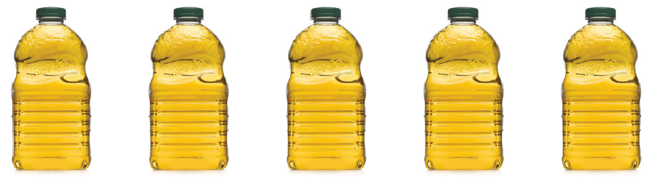
LET’S LEARN
4. Megan fills 5 similar bottles with 10 l of apple juice. What is the capacity of each bottle?
10 ÷ 5 = 2
The capacity of each bottle is 2 l.

