Slide 1
Addition

Slide 2
The Three Properties of Addition
1.
3 + 5 = 5 + 3
We can add the numbers in any order.

Slide 3
The Three Properties of Addition
2.
(3 + 2) + 4 = 3 + (2 + 4)
5 6
We can group the numbers in any way.

Slide 4

The Three Properties of Addition
3.
6 + 0 = 6
Any number added to 0 remains the same.

Slide 5
Addition without and with regrouping

Slide 6
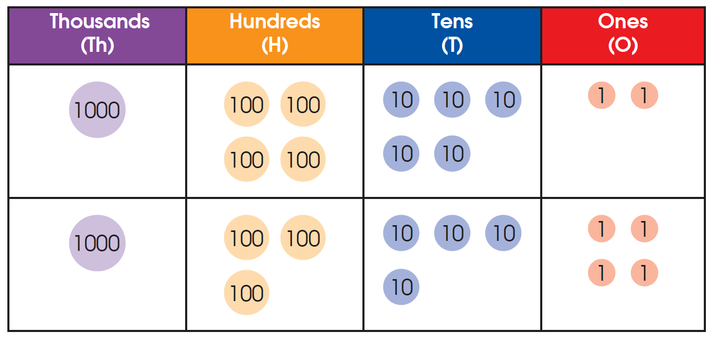
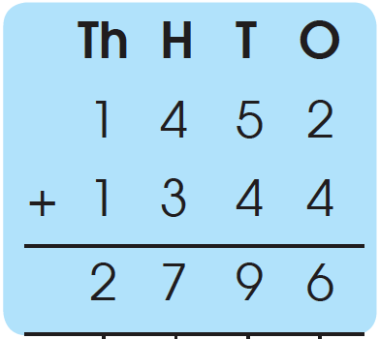
1. 1452 + 1344 = ?
Step 1 Add the ones. 2 ones + 4 ones = 6 ones
Step 2 Add the tens. 5 tens + 4 tens = 9 tens
Step 3 Add the hundreds. 4 hundreds + 3 hundreds
= 7 hundreds
Step 4 Add the thousands. 1 thousand + 1 thousand = 2 thousands
1452 + 1344 = 2796

Slide 7
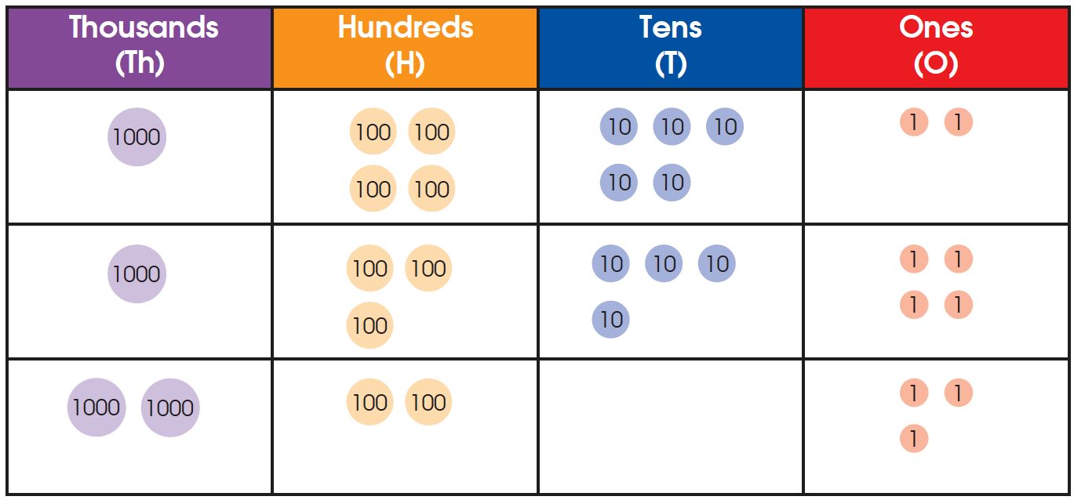
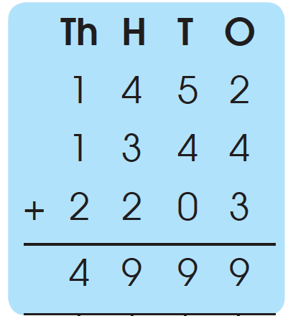
2. 1452 + 1344 + 2203 = ?
Step 1 Add the ones. 2 ones + 4 ones + 3 ones = 9 ones
Step 2 Add the tens. 5 tens + 4 tens + 0 tens = 9 tens
Step 3 Add the hundreds. 4 hundreds + 3 hundreds
+ 2 hundreds = 9 hundreds
Step 4 Add the thousands. 1 thousand + 1 thousand
+ 2 thousands = 4 thousands

Slide 8
1452 + 1344 + 2203 = 4 thousands 9 hundreds 9 tens 9 ones
= 4999
We can also add the 3 numbers using the property of addition.
1452 + 1344 + 2203 = 2796 + 2203
2796 = 4999

Slide 9
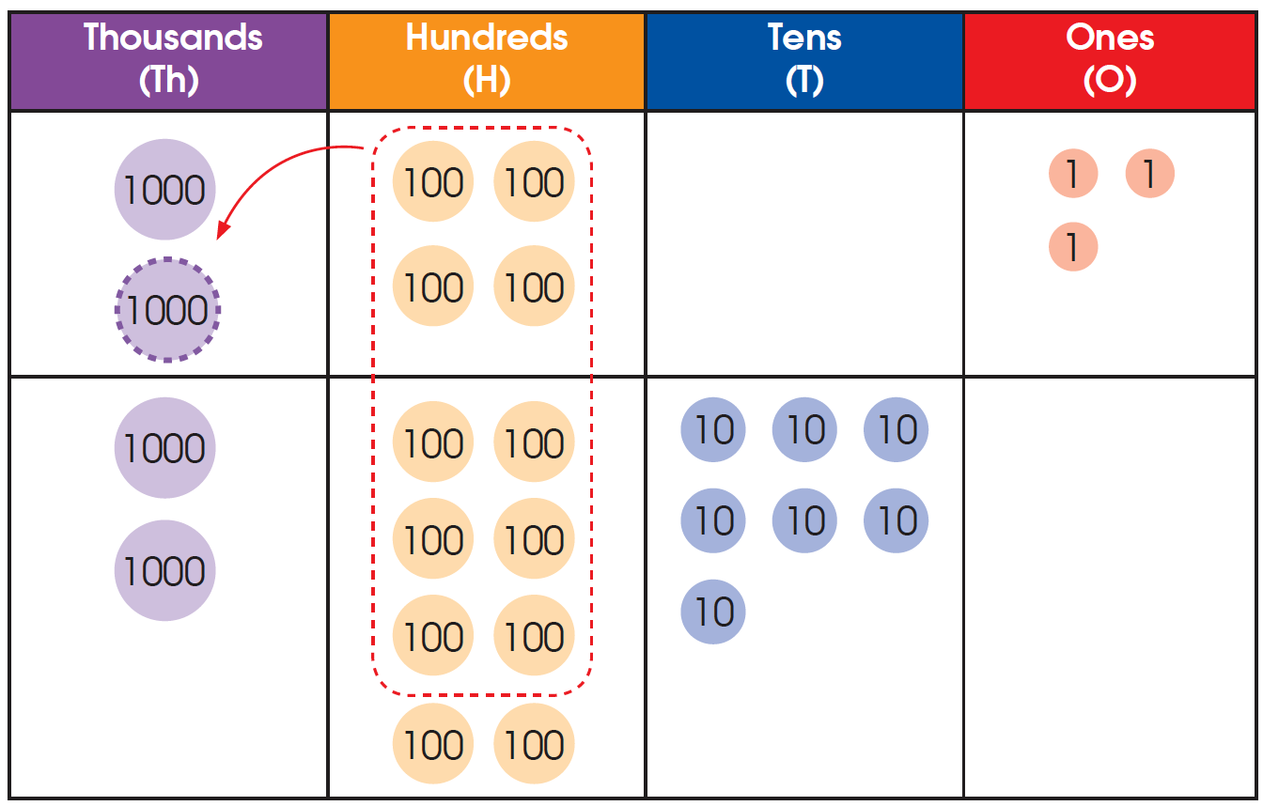
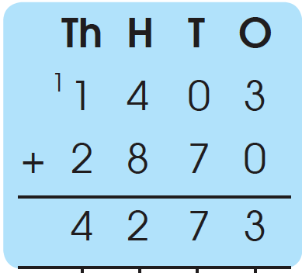
3. 1403 + 2870 + 1234 = ?
Method 1: We add 2 numbers first.
Step 1 Add the ones. 3 ones + 0 ones + 3 ones
Step 2 Add the tens. 0 tens + 7 tens = 7 tens
Step 3 Add the hundreds and regroup. 4 hundreds + 8 hundreds = 12 hundreds
= 1 thousand 2 hundreds
Step 4 Add the thousands. 1 thousand + 1 thousand
+ 2 thousands = 4 thousands

Slide 10
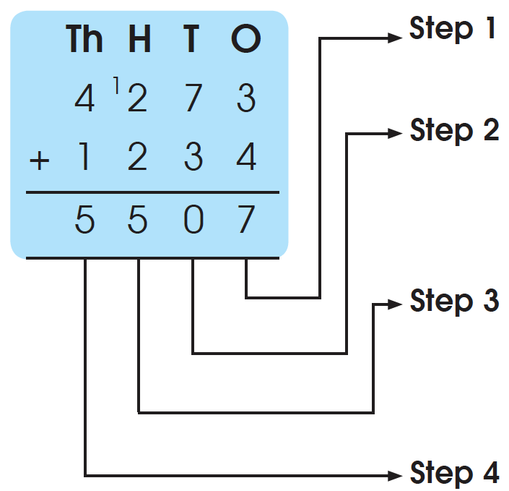
1403 + 2870 = 4 thousands 2 hundreds 7 tens 3 ones
= 4273
Next, add the remaining number to the result.
Add the ones. 3 ones + 4 ones = 7 ones
Add the tens and regroup.
7 tens + 3 tens
= 10 tens
= 1 hundred 0 tens
Add the hundreds and regroup.
2 hundreds + 2 hundreds
+ 1 hundred
= 5 hundreds
Add the thousands.
4 thousands + 1 thousand
= 5 thousands
1403 + 2870 + 1234 = 5507

Slide 11
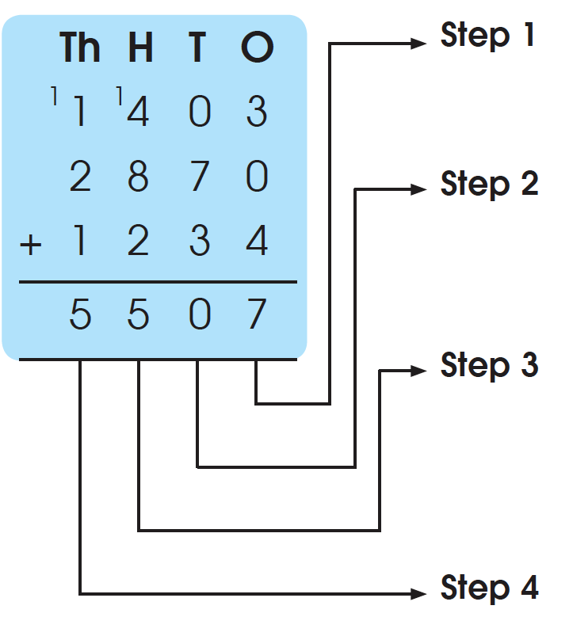
3. 1403 + 2870 + 1234 = ?
Method 2: Add the three numbers vertically.
Add the ones. 3 ones + 0 ones + 4 ones = 7 ones
Add the tens and regroup. 0 tens + 7 tens + 3 tens
= 10 tens
= 1 hundred 0 tens
Add the hundreds and regroup.
4 hundreds + 8 hundreds + 2 hundreds + 1hundred
= 15 hundreds
= 1 thousand 5 hundreds
Add the thousands. 1 thousand + 2 thousands
+ 1 thousand + 1 thousand
= 5 thousands
1403 + 2870 + 1234 = 5507

Slide 12
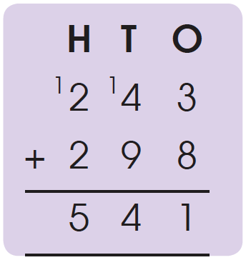
Estimation
Rounding numbers makes it easier to do calculations
1. We can estimate by rounding each number to the nearest ten before adding to check the answer.
243 ≈ 240
298 ≈ 300
243 + 298 ≈ 240 + 300
= 540
Calculate to find the sum of 243 and 298.
243 + 298 = 541
541 is close to our estimate of 540, so the
answer is reasonable.
243 + 298 = ?

Slide 13
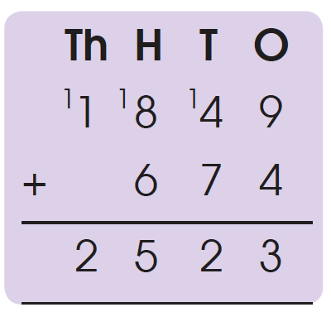
Estimation
Rounding numbers makes it easier to do calculations
2. We can also estimate by rounding each number to the nearest
hundred before adding to check the answer.
1849 ≈ 1800
674 ≈ 700
1849 + 674 ≈ 1800 + 700
= 2500
Calculate to find the sum of 1849 and 674.
1849 + 674 = 2523
2523 is close to our estimate of 2500,
so the answer is reasonable.
1849 + 674 = ?

