Slide 1
Subtraction

Slide 2
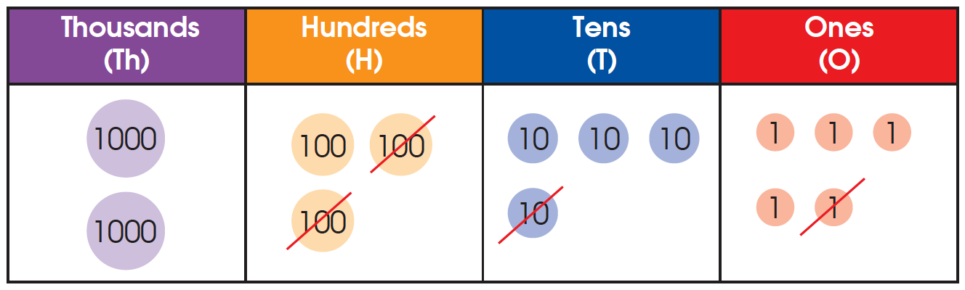
1. 2345 – 211 = ?
We subtract 211 from 2345 to get the answer. Cross out the number discs on the place-value chart to show subtraction.

Slide 3
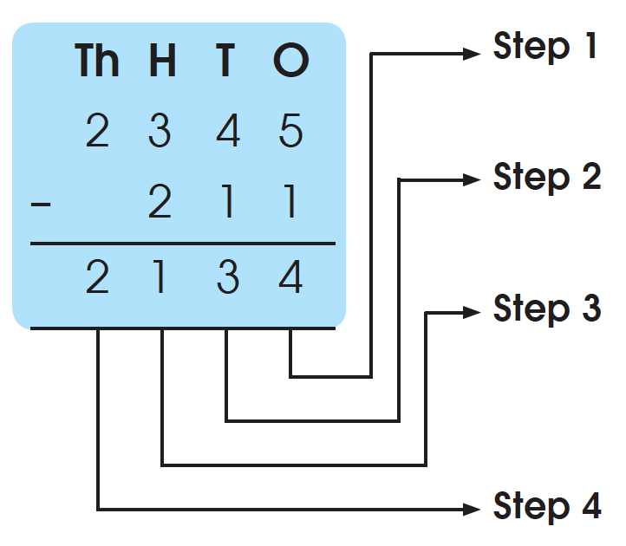
We can also subtract vertically.
Subtract the ones.
5 ones – 1 one = 4 ones
Subtract the tens.
4 tens – 1 ten = 3 tens
Subtract the hundreds
3 hundreds - 2 hundreds = 1 hundred
Subtract the thousands
2 thousands – 0 thousand = 2 thousands
2345 – 211 = 2134

Slide 4
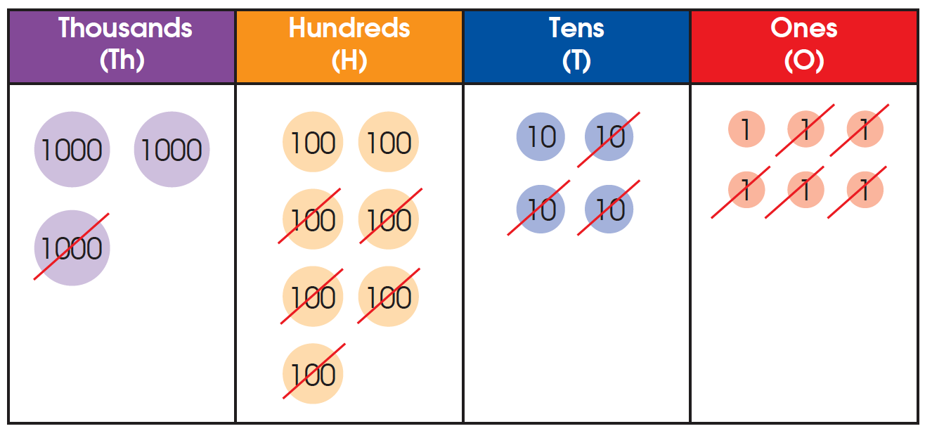
2. Subtract 1535 from 3746.

Slide 5
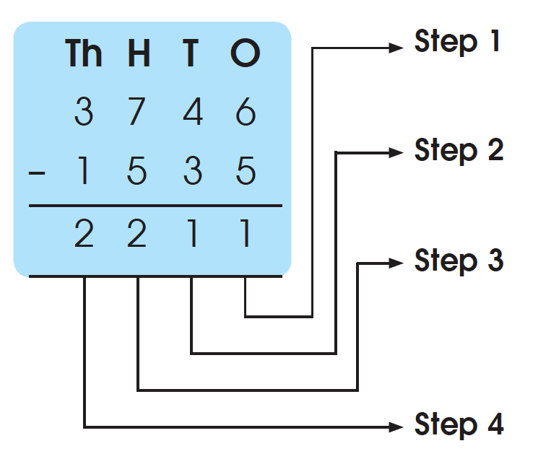
We can also subtract vertically.
Subtract the ones.
Subtract the tens.
Subtract the hundreds.
Subtract the thousands.
3746 – 1535 = 3 thousands 7 hundreds 4 tens 6 ones
– 1 thousand 5 hundreds 3 tens 5 ones
= 2 thousands 2 hundreds 1 ten 1 one
= 2211

Slide 6
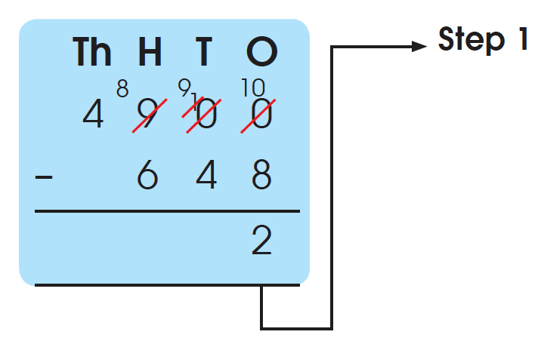
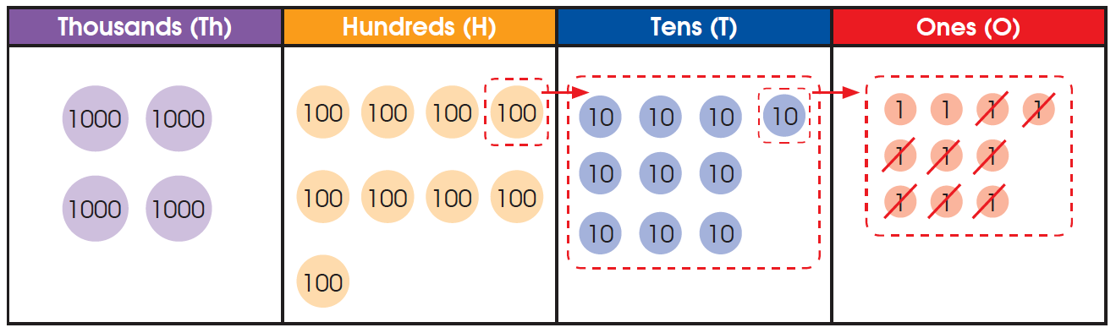
3. Subtract 648 from 4900.
Regroup 9 hundreds as 8 hundreds 9 tens 10 ones.
Step 1 Subtract the ones.
10 ones – 8 ones = 2 ones

Slide 7
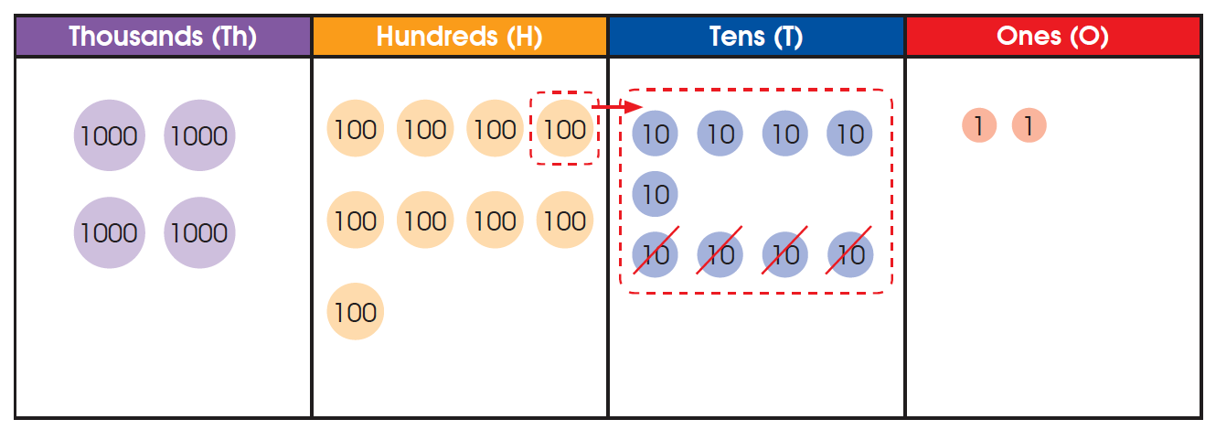
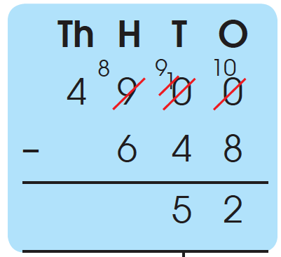
Step 2 Subtract the tens.
9 tens – 4 tens = 5 tens

Slide 8
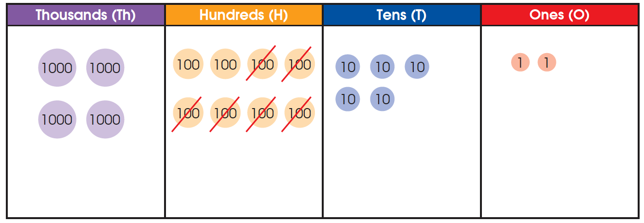
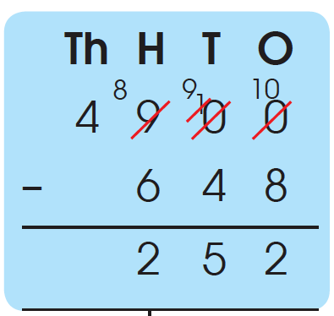
Step 3 Subtract the hundreds.
8 hundreds – 6 hundreds = 2 hundreds

Slide 9
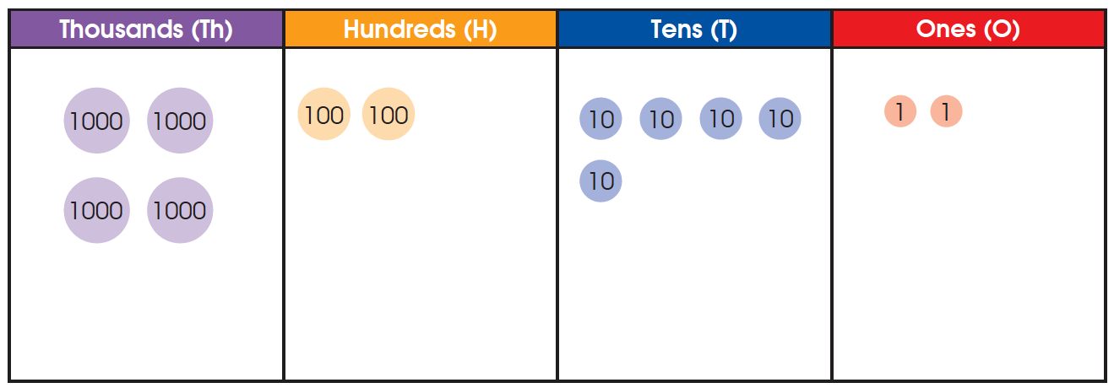
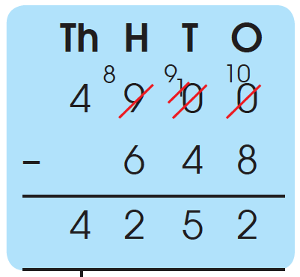
Step 4 Subtract the thousands.
4 thousands – 0 thousands = 4 thousands

Slide 10
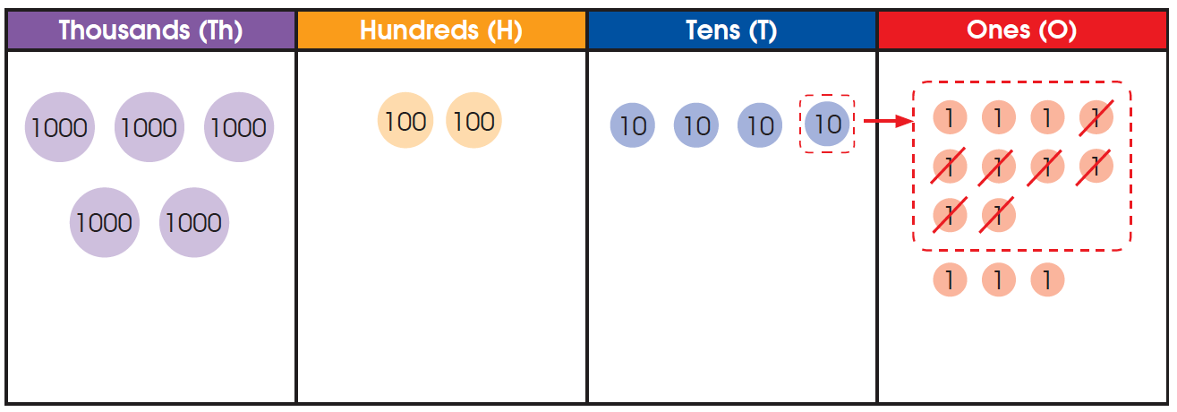
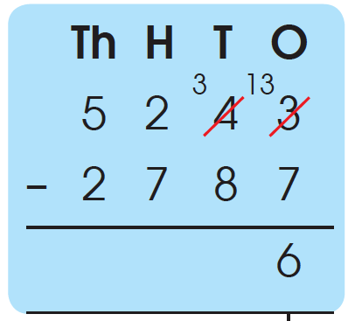
4. Subtract 2787 from 5243.
We can also subtract vertically.
Step 1 Subtract the ones.
13 ones – 7 ones = 6 ones

Slide 11
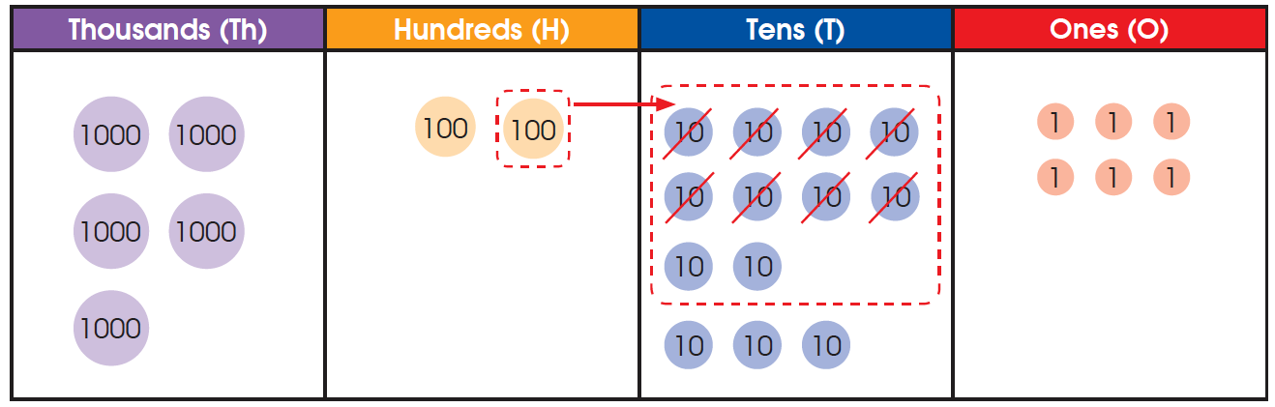
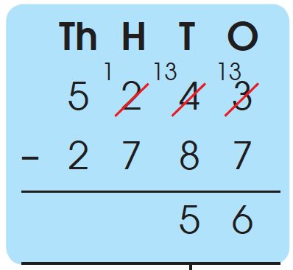
Regroup 2 hundreds as 1 hundred 10 tens.
Step 2 Subtract the tens.
13 tens – 8 tens = 5 tens

Slide 12
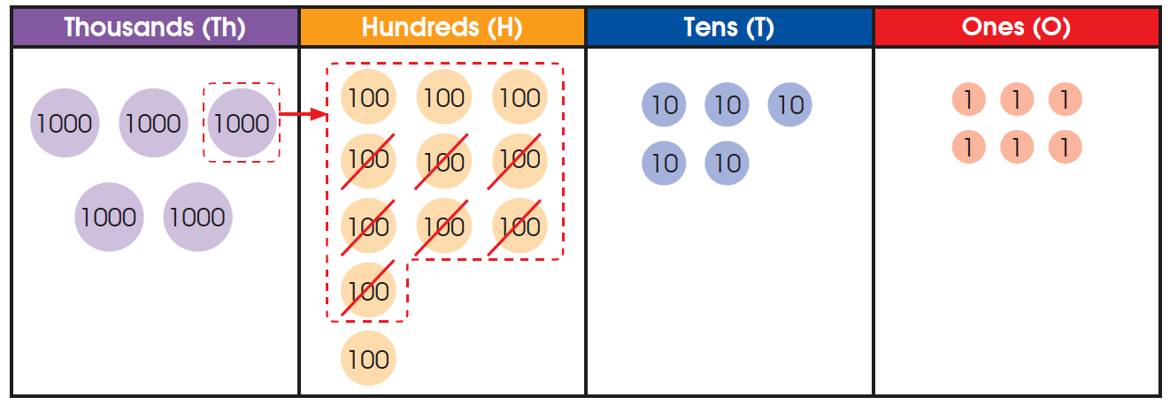
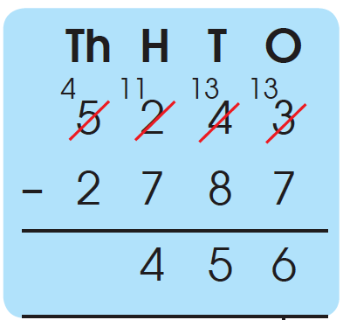
Regroup 5 thousands as 4 thousands 10 hundreds.
Step 3 Subtract the hundreds.
11 hundreds – 7 hundreds = 4 hundreds

Slide 13
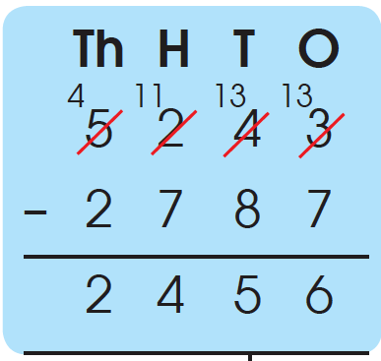
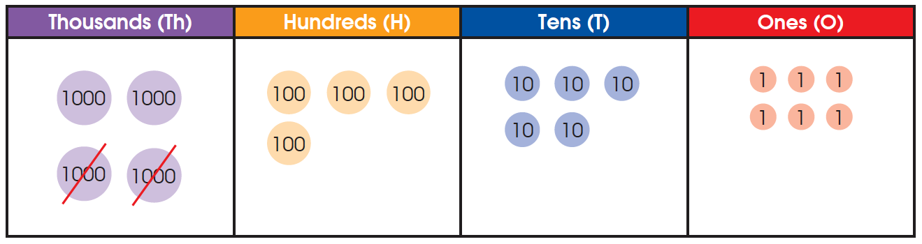
Step 4 Subtract the thousands.
4 thousands – 2 thousands = 2 thousands
5243 – 2787 = 2456

Slide 14

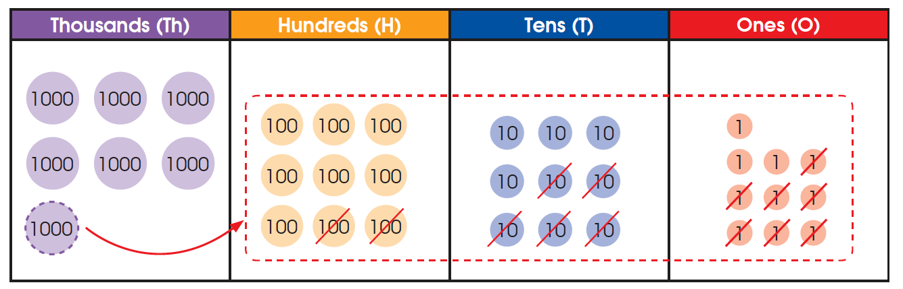
5. Find the difference between 7000 and 1257.
To find the difference, we subtract the numbers.
Regroup 7 thousands as 6 thousands 9 hundreds 9 tens 10 ones.

Slide 15
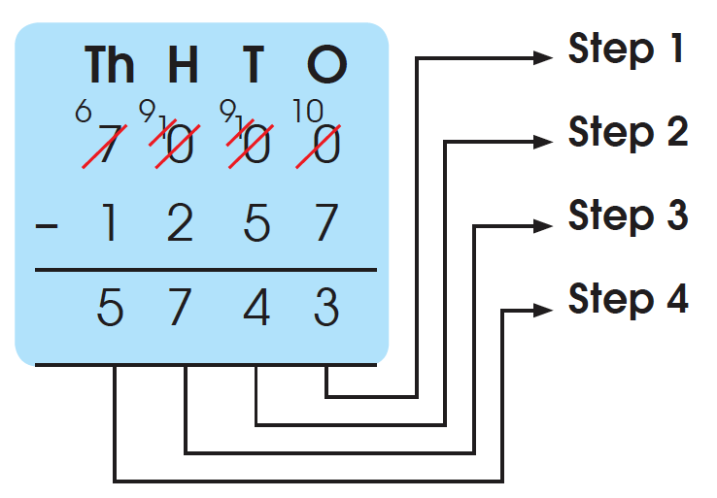
Subtract the ones.
Subtract the tens.
Subtract the hundreds.
Subtract the thousands.
7000 – 1257 = 5743

Slide 16
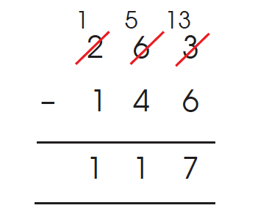
Estimation
1. We can estimate by rounding each of the numbers to the nearest ten
before subtracting to check the answer.
Find the difference between 263 and 146
263 ≈ 260
146 ≈ 150
263 – 146 ≈ 260 – 150
= 110
Calculate to find the difference.
263 – 146 = 117
117 is close to our estimate of 110, so the answer is reasonable.

Slide 17
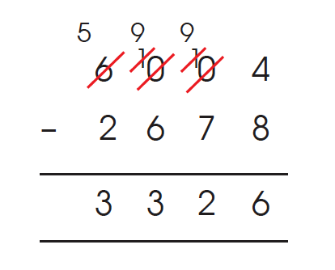
Estimation
2. We can estimate by rounding each of the numbers to the nearest
hundred before subtracting to check the answer.
Find the difference between 6004 and 2678
6004 ≈ 6000
2678 ≈ 2700
6004 – 2678 ≈ 6000 – 2700
= 3300
Calculate to find the difference.
6004 – 2678 = 3326
3326 is close to our estimate of 3300, so the answer is
reasonable.

